Slide 1
AAA, PAD and VTE Disease in Older Adults
Geriatric Cardiology Section of the
American College of Cardiology

Slide 2
Objectives
Recognize the effect of aging and its related alterations in vascular structure and function and the increased incidence, prevalence and risk of abdominal aortic aneurysm (AAA), peripheral arterial disease (PAD), and venous thromboembolism (VTE) disease in older adults
Recognize unique presentations and appraise the evidence supporting current diagnosis and management strategies for these conditions in older adults

Slide 3
Relevance
The incidence and prevalence of aortic disease, peripheral arterial disease, and venous thromboembolism rise dramatically with age, due to longer exposure to risk factors and age-associated alterations in vascular structure and function
There are no age-specific precautions or management recommendations in current guidelines as much of the evidence derive from trials that exclude adults > 80 years old; hence the importance of understanding the effect of aging in the pathophysiology of these entities, to recognize optimal management strategies

Slide 4
Case
A 79-year-old man presents after routine screening of his abdominal aortic aneurysm reporting that his aneurysm measures 5.7 cm in diameter (it was 4.3 cm 2 years prior)
PMH: coronary artery stent placed for a myocardial infarction 2 years prior, hypertension, dyslipidemia, chronic obstructive pulmonary disease, diabetes and atrial fibrillation
Exam: blood pressure is 146/72 mmHg, heart rate 65 bpm and weights 236 lbs. He has a pulsatile, nontender palpable mass in the abdomen, the rest of his exam is normal
Labs: Creatinine 2.4 mg/dl, hematocrit 35% and platelets 189,000 K/uL

Slide 5
Abdominal Aortic Aneurysm
Epidemiology:
The prevalence of Abdominal Aortic Aneurysm (AAA) increases with age:
2.1% in men >55 years old and > 8% in men > 75 years old
Cochrane ➔ 5-10% in men >65 years old
5x more in men compared to women
The risk for rupture is higher in men:
2:1 male : female (autopsy studies)
Associated mortality is 80% for older adults reaching the hospital & 50% for those undergoing emergent repair

Slide 6
Peripheral Arterial Disease in Older Adults
Presenting symptoms in older adults varies widely
Failure to thrive, weight loss from mesenteric ischemia (obstructive disease/emboli)
Acute renal failure
Strong relationship of AAA with renal vascular disease and atherosclerotic disease, including aortic disease
Atherosclerotic plaques in the abdominal aorta encroach on the renal artery origin and lead to the formation of renal artery stenosis
There is evidence of acceleration of atherosclerotic disease in the setting of increased activation of the renin-angiotensin-aldosterone system ➔ worsening renal failure

Slide 7
Abdominal Aortic Aneurysm
Screening :
Reduces mortality risk in men ages 65-83 years (Screening not advised in women)
If normal aorta size between ages 65-75 years, there is no need for additional screening
Incidentally discovered AAA < 3 cm require no further follow-up
For AAAs of 3-4 cm ➔ ultrasound imaging recommended annually

Slide 8
Abdominal Aortic Aneurysm
For AAAs of 4-5.4 cm ➔ ultrasound imaging recommended every 6 months
For AAAs ≥5.5 cm or rapid growth rate (> 0.5 cm per year) ➔ CT or MR angiography + evaluation for repair
Even for older adults that meet repair criteria, unless contraindicated, conservative therapy is not appropriate given the high mortality of aneurysm rupture in this age group

Slide 9
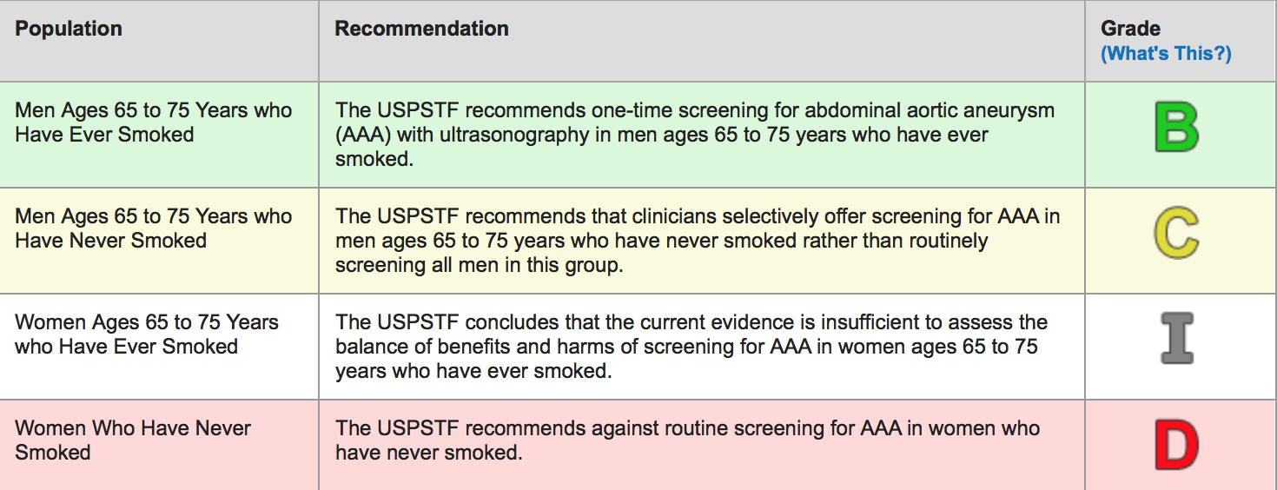
Abdominal Aortic Aneurysm Screening Guidelines
U.S. Preventive Services Task Force. June 2014

Slide 10
AAA Treatment
There is lack of outcome data on medical treatment in older adults
Patients treated medically without statins had significant increase in AAA size
Beta-blockers do not appear to have an effect in delaying increase in AAA size
Older patients with high surgical risk may undergo endovascular repair
Patients within 67-69 years of age had 2.1% and those >85 years of age had 8.5% reduced mortality compared to surgical repair
Late survival is similar with both treatment modalities (≥3 years)
Pleumeekers H, et al. Am J Epidemiol 1995;142:1291-9

Slide 11
AAA Treatment
There is ⬆ in late (up to 4 years) post-procedure reinterventions with endovascular repair
In octogenarians mortality risk for endovascular repair is ~ 3.2% compared to 9-25% for open surgical repair
The mortality risk following repair of a ruptured AAA ranges within 50-66%
Conservative approach is favored by the American Society of Anesthesia if:
There is coexisting inoperable malignancy
New York Heart Association class 3 symptoms
Forced expiratory volume 1 <35%
Creatinine >2 mg/dl
Patient and family choice

Slide 12
Case (Continued)
The patient undergoes uneventful endovascular repair with placement of endovascular stent graft and is discharged home on hospital day 3
A year later he presents with an ulcer on the lower left lateral ankle that appeared 6 weeks after injuring his leg during a fall. He tried several treatments (dressings, leg elevation, local antibiotics) without success
He has had some difficulty getting around due to hip pain but denies any exertional or rest pain in the lower extremities

Slide 13
Case (Continued)
On examination, blood pressure is 146/62 mm Hg and heart rate is 78 bpm. The ankle ulcer is approximately 4 cm x 3 cm, it has a sharp border, and the base is dry and pale with no surrounding erythema.
Pulses in the lower distal extremities are reduced bilaterally but still palpable. Ankle-brachial indexes are 1.4 and 1.42, right and left respectively

Slide 14
Peripheral Arterial Disease
Epidemiology:
The prevalence of peripheral arterial disease (PAD) increases significantly with age
14.5% in patients > 70 years old and 23.2% in those ≥ 80 years of age
A recently published large (3.6 million screened subjects) study showed:
Prevalence ⬆ from 1 in 50 in the 40- 50 year-old age group to ~ 1 in 3 in the 91- 100 year-old age group regardless of disease type/gender
Notes:
Savji N, Rockman CB, Skolnick AH, et al. Association between advanced age and vascular disease in different arterial territories: a population database of over 3.6 million subjects. J Am Coll Cardiol 2013;61:1736-43.

Slide 15
Prevalence of Vascular Disease by Age Decile
p for trend <0.0001
Savji N, et al. J Am Coll Cardiol 2013;61:1736-43

Slide 16
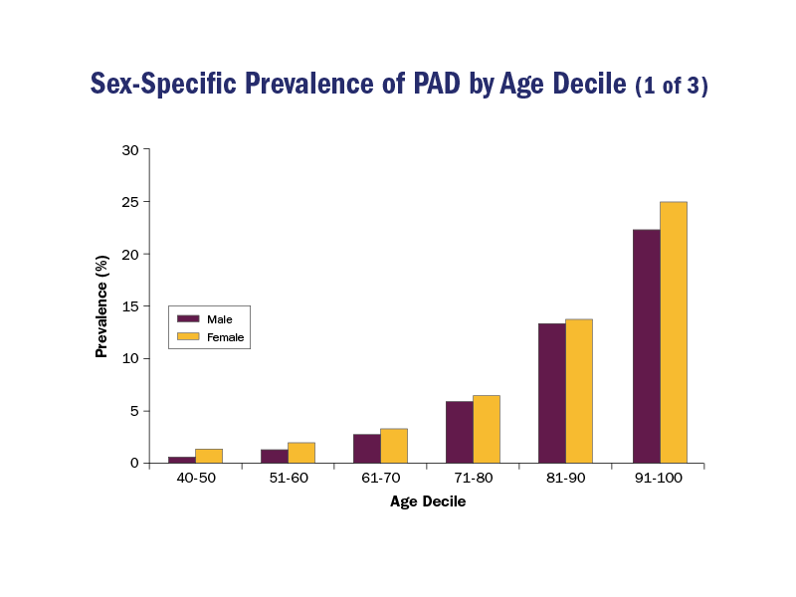
Sex-Specific Prevalence of PAD by Age Decile
p for trend <0.0001 for each comparison
Savji N, et al. J Am Coll Cardiol 2013;61:1736-43
Notes:
p for trend <0.0001 for each comparison

Slide 17
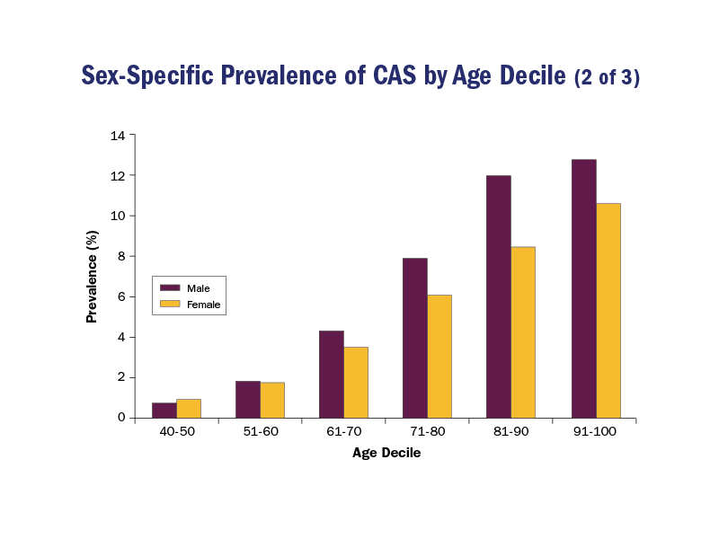
Sex-Specific Prevalence of CAS by Age Decile
p for trend <0.0001 for each comparison
Savji N, et al. J Am Coll Cardiol 2013;61:1736-43

Slide 18
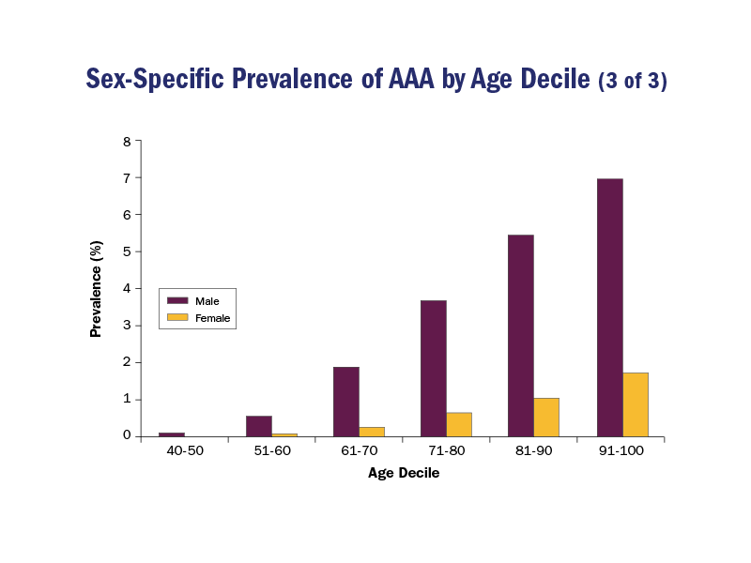
Sex-Specific Prevalence of AAA by Age Decile
p for trend <0.0001 for each comparison
Savji N, et al. J Am Coll Cardiol 2013;61:1736-43

Slide 19
PAD With Increasing Age
Rotterdam Study ➔ despite ⬆ prevalence of PAD, incidence of intermittent claudication was 1.6% of patients overall and in 2-5% in those > 80 years of age
Due to ⬆ rates of comorbidities (i.e. osteoarthritis, spinal stenosis, lung disease, and neuropathy) that limit mobility or result in pain indistinguishable from PAD
⬆ incidence of CVD in patients with PAD
10-year follow-up ➔ subjects > 65 years with PAD had 40% total mortality rate, that ⬆ to 70% if they were in high-risk categories
Use of statins, aspirin, and beta-blockers were associated with reduced 10-year mortality

Slide 20
Ankle-Brachial Index
Class I
Age >65 and/or >50 years + history of smoking or diabetes and/or leg claudication and/or nonhealing ulcers
ABI can be falsely elevated in older patients (particularly elderly diabetics) due to arterial stiffness and calcification
Toe-brachial index should ➔ diagnosis of lower extremity PAD in patients with clinically suspected PAD + nonreliable ABI test due to noncompressible vessels
Anderson JL, et al. J Am Coll Cardiol. 2013;61(14):1555-1570
Notes:
Allison MA, et al. J ACC 2008

Slide 21
Screening for PAD in Older Adults
Ankle Brachial Index | Interpretation | Value
 | Noncompressible | >1.40
 | Normal | 1.00-1.40
 | Borderline | 0.91-0.99
 | Abnormal | <0.90
Anderson JL, et al. J Am Coll Cardiol. 2013;61(14):1555-1570
Notes:
Allison MA, et al. J ACC 2008

Slide 22
Treatment of PAD in Older Adults
Management of modifiable risk factors
~ Similar to management of younger patients
Class I
Adequate BP control ➔to achieve BP goal of <140/90 mmHg or <130/80 mmHg for patients with diabetes and chronic renal disease
77.3% of adults > 70 years of age with HTN ➔ 33.3% are under treatment/controlled according to guidelines
Anderson JL, et al. J Am Coll Cardiol. 2013;61(14):1555-1570
Notes:
Allison MA, et al. J ACC 2008

Slide 23
Treatment of PAD in Older Adults
Diabetes/PAD proper foot care (use of appropriate footwear, topical moisturizing creams, podiatric care, daily foot inspection, skin cleansing, urgent evaluation of skin lesions/ulcerations)
Foot care may be challenging in older adults with cognitive, visual, orthopedic, weight or other impairments
Smoking cessation, use of behavioral counseling, pharmacotherapy or referral to smoking cessation programs
Older adults are less likely to be advised about smoking cessation therapy
12% of adults >65 years are cigarette smokers. Nicotine replacement therapy ➔ most studied but limited data about its effectiveness. There is lack of data on the safety or effectiveness of bupropion/varenicline.
Cawkwell et al. Drugs Aging. 2015
Notes:
Cawkwell et al. Drugs Aging. 2015 Jun;32(6):443-51

Slide 24
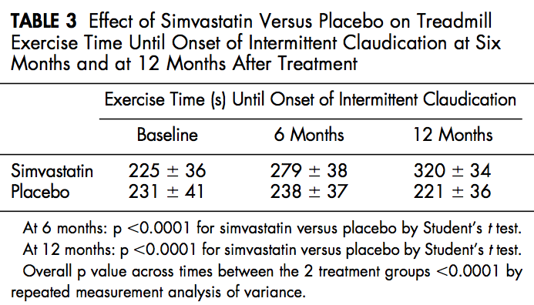
Treatment of Dyslipidemia
Patients with PAD should receive high-intensity statin therapy. Patients >75 years ➔ moderate-intensity statin
Statins have shown to increase treadmill time in older adults by 24% at 6 months and by 42% at 1 year
Aronow WS, et al. Am J Cardiol 2003;92:711-2

Slide 25
Additional Treatments for PAD
in Older Adults
Use of antiplatelet drugs
Aspirin
Use of drugs to increase walking distance
Cilostazol improves maximal walking distance including by 50% and pain-free walking distance by 67%. Results are not different for geriatric patients (age >65 years)
Cilostazol is contraindicated in heart failure and not indicated for the treatment of chronic wounds
Exercise and lower extremity PAD rehabilitation (walking to near-maximal pain for at least 6 months)
Anderson JL, et al. J Am Coll Cardiol. 2013;61(14):1555-1570
Notes:
Allison MA, et al. J ACC 2008

Slide 26
Revascularization
Endovascular therapy
Class I ➔ Balloon angioplasty +/- stenting indication for patients with lifestyle-limiting claudication unresponsive to medication and lifestyle interventions or non-healing ulcers
Risk for contrast-induced nephrotoxicity is higher for older patients, likely related to increased comorbidities
Notes:
Allison MA, et al. J ACC 2008

Slide 27
Surgical Peripheral Arterial Bypass
Class I ➔ surgical interventions indication for patients with lifestyle-limiting claudication unresponsive to medication and lifestyle interventions or non-healing ulcers
Longer operations are associated with increased risk of complications, especially in older patients
Combined procedures are not routinely recommended
Optimal evaluation to reduce the risk of perioperative cardiovascular complications and risks/benefits of open surgical repair versus endovascular stenting are key factors for older adults
Notes:
Allison MA, et al. J ACC 2008

Slide 28
Surgical Limb Amputation
Indicated only if tissue loss is beyond the point of salvage, surgery is too risky, life expectancy is very low, or functional limitations give no reason for limb salvage
Walking with prosthetic device requires significance increase in cardiac output
Older adults are less likely to adapt to limb loss/prosthetic devices
Amputation often leads to severely reduced mobility and independence resulting in increased nursing home placement and mortality
More than 50% of patients undergoing amputations for critical limb ischemia are > 80 years old
Notes:
Allison MA, et al. J ACC 2008

Slide 29
Case
82-year-old woman with a history of peptic ulcer disease and anemia is hospitalized for treatment of an acute ischemic stroke. During her hospitalization pharmacologic thromboprophylaxis was held due to concern for a possible active gastrointestinal bleed
The day of discharge she is noted to have persistent mild right lower leg edema. A Doppler ultrasound showed partially occlusive deep vein thrombus involving the right common femoral vein
She is started on treatment dose of subcutaneous enoxaparin and transfer to a rehabilitation facility

Slide 30
Venous Thromboemoblic Disease in Older Adults
Venous Thromboemoblic Disease (VTE) increases markedly with age
Age-associated alterations in thrombotic factors & laxity in large venous valves
Presence of concurrent medical illnesses
The proportion of pulmonary embolism (PE) from all VTE cases increases with age
The incidence of PE is 16% higher in men than women and 25% more in blacks than whites
The incidence of deep vein thrombosis (DVT) is indistinct across sex, racial and ethnic groups
Notes:
Silverstein MD, Heit JA, Mohr DN, Petterson TM, O'Fallon WM, Melton LJ 3rd. Trends in the incidence of deep vein thrombosis and pulmonary embolism: a 25-year population-based study. Arch Intern Med 1998;158:585-93.

Slide 31
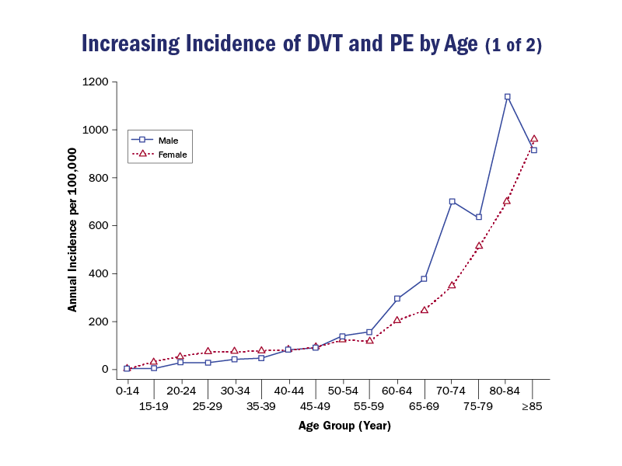
Increasing Incidence of DVT and PE by Age
Silverstein MD, et al. Arch Intern Med 1998;158:585-93
Notes:
Silverstein MD, et al. Arch Intern Med 1998;158:585-93

Slide 32
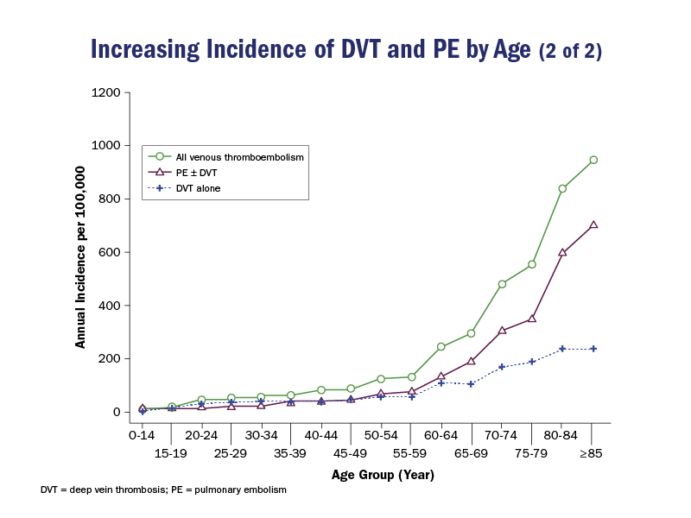
Increasing Incidence of DVT and PE by Age
Silverstein MD, et al. Arch Intern Med 1998;158:585-93
Notes:
Silverstein MD, et al. Arch Intern Med 1998;158:585-93

Slide 33
VTE in Older Adults
The diagnosis of VTE in adults > 65 years old is associated with adverse outcomes:
Patients > 70 years old often do not present with typical DVT symptoms
Older adults are more likely to have proximal lower extremity DVT without calf involvement and less likely to have isolated calf DVT
Notes:
Silverstein MD, Heit JA, Mohr DN, Petterson TM, O'Fallon WM, Melton LJ 3rd. Trends in the incidence of deep vein thrombosis and pulmonary embolism: a 25-year population-based study. Arch Intern Med 1998;158:585-93.

Slide 34
VTE Prevention in Older Adults
Older patients are more likely to receive thromboprophylaxis during hospitalizations.¹ Nevertheless, thromboprophylaxis in older adults is still suboptimal
Only 41% of patients > 70 years old receive any kind of thromboprophylaxis
Conditions that increase the risk of VTE among older adults:
Frailty, immobility, heart failure, chronic obstructive pulmonary disease, acute infection, atherosclerotic vascular disease, and minor lower extremity injury
Timmons S, et al. Age Ageing 2003;32:601-5
Notes:
1. Timmons S, et al. Age Ageing 2003;32:601-5

Slide 35
VTE Prevention in Older Adults
Older VTE patients are more likely to have had a recent hospitalization, osteoarthritis, neurologic diseases (including stroke), acute lung disease (including pneumonia), concurrent GI bleed, and acute coronary syndrome
An International prospective registry of patients >80 years old treated for VTE
Incidence of major bleeding > incidence of recurrent VTE (3.4% vs. 2.1%)
Incidence of fatal PE > incidence of fatal bleeding (3.7% vs. 0.8%)
Favoring anticoagulation while individualizing care with special attention to those at risk for bleeding

Slide 36
Case (Continued)
After 2 months of anticoagulation with warfarin, she is taken to the hospital after an episode of syncope at home.
On arrival she is alert but confused. Oxygen saturation is 93% on 100% non-rebreather, heart rate is 112 bpm, blood pressure is 98/62 mmHg, and respiratory rate is 28. The jugular venous pressure is 10 cm. There are bibasilar crackles. Heart rhythm is irregular. There is no peripheral edema. On neurologic examination there is only mild residual right upper extremity weakness from her recent stroke
ECG: atrial fibrillation with RVH

Slide 37
Case (Continued)
Labs: Estimated glomerular filtration rate was 85, brain natriuretic peptide was elevated at 210 ng/L, troponin I at 1.04 mg/dL. International normalized ratio (INR) was 1.5, hemoglobin was 9 g/dL
Chest CT: large pulmonary emboli with filling defects involving both main pulmonary arteries with right ventricular enlargement. There are also multiple small masses seen in the mediastinum.
Transthoracic echocardiogram: moderately enlarged and hypokinetic right ventricle with evidence of strain
Continuous unfractionated heparin infusion and through work up for malignancy are started.
What is the next step in management?

Slide 38
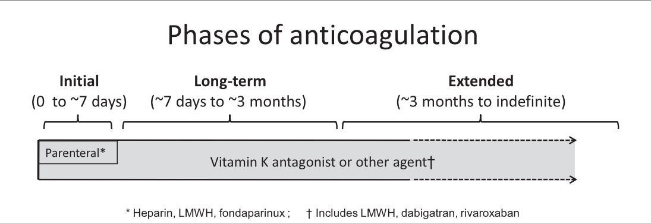
Management of Pulmonary Embolism in the Older Adult
Older patients may present with atypical symptoms: cough and syncope or acute exacerbations/slow treatment response of other comorbidities (COPD/HF)
Kearon C, et al. CHEST 2012; 141(2)(Suppl):e419S–e494S
Notes:
Kearon C, et al. CHEST 2012; 141(2)(Suppl):e419S–e494S

Slide 39
Management of Pulmonary Embolism in the Older Adult
Similar to younger patients ➔ careful consideration of bleeding risks and duration of anticoagulation
Dalteparin ⬇ rate of recurrent VTE without increasing risk of bleeding in patients with cancer
Low-molecular weight heparins are more efficacious in counteracting malignancy-related tissue-factor–initiated pathways of coagulation
Fondaparinux ➔ useful in patients that cannot take warfarin, allergic to heparin or fail warfarin therapy
Fondaparinux ➔ equivalent efficacy and safety in treating PE + convenient, once-daily dosing, but has no antidote

Slide 40
Consensus Guidelines for Optimal Duration of Anticoagulation
Key changes in the 10th ACCP VTE guidelines edition include:
Non-vitamin K antagonist oral anticoagulants (NOACs) are suggested over warfarin for initial and long-term treatment of VTE in patients without cancer
Routine use of compression stockings to prevent post-thrombotic syndrome in patients with an acute DVT (Class III)

Slide 41
Management of Pulmonary Embolism in the Older Adult
PE + hypotension + low bleeding risk ➔ thrombolytic therapy (TLT) (Class II C)
Most of the evidence comes from trials excluding patients > 80 years old
Administering fibrinolytic therapy to patients with malignancy requires great caution: presence of metastatic brain lesions is an absolute contraindication
Significant extracranial tumor burden also poses risk of hemorrhage into tumor

Slide 42
Management of Hemodynamically Unstable PE
PE + hypotension + contraindication to TLT or Failed TLT or Shock likely to cause death | Catheter-assisted thrombectomy (Class II C)
PE + hypotension + contraindication to TLT or Failed TLT or catheter-assisted Thrombectomy Shock likely to cause death | Surgical embolectomy (Class II C)
Kearon C, et al. CHEST 2012; 141(2)(Suppl):e419S–e494S

Slide 43
Management of PE in the Older Adult
PE + contraindication for anticoagulation ➔ IVC Filter (Class I B)
PE + cancer ➔LMWH over VKA therapy (Class II B)
Palliative Care evaluation ➔ patients may benefit from a focus on optimizing comfort and respecting goals of care during acute illness occurring on the background of other concomitant comorbidities
There are no age-specific precautions in the 2012 ACCP VTE Guidelines ➔ calculated creatinine clearance, existing HTN, and other risk factors for bleeding must be considered

Slide 44
Case (Continued)
INR ➔ Noted to be Subtherapeutic
Underlying hypercoagulable state, ⬆ suspicion for active malignancy, in addition to probable decreased mobility, low-molecular weight heparin would be also an appropriate choice for indefinite anticoagulation in the setting of an active malignancy
Tenuous hemodynamic status and evidence of right heart strain ➔ systemic fibrinolysis or catheter-based embolectomy would be a reasonable choice
Palliative care consultation

Slide 45
Key Points
Screening for AAA should be considered in males ages 65-75 who have smoked, or those with a family history of AAA, multiple cardiovascular risk factors, or known coronary artery disease or peripheral vascular disease
Peripheral arterial disease (PAD) is present in ≥30% of older adults and is often asymptomatic or accompanied by atypical symptoms
Comprehensive risk factor modification is important as PAD is associated with higher cardiovascular disease mortality in older adults

Slide 46
Key Points
Risk of venous thrombosis is approximately 1% per year in the very old (10-fold higher incidence than in younger persons), predominantly in the setting of immobility. Aggressive prophylaxis and early mobilization are important for older adults in the hospital setting
Acute pulmonary embolism presents more often as syncope and carries a higher in-hospital mortality (10-30%) in older adults than in younger adults

