Slide 1
Acute Coronary Syndromes in Older Adults Geriatric Cardiology Section of the American College of Cardiology

Slide 2
Objectives
Recognize atypical presentation of myocardial infarction in older adults.
Discuss evidence for safe and effective therapies for older adults with acute coronary syndrome (ACS).
Assess health outcomes among older adults with ACS after accounting for comorbidities and risk.
Appreciate the role of discharge planning in optimizing medication safety and return to independent functioning.

Slide 3
Key Points
More than 1/3 of myocardial infarctions occur in patients ages ≥75 years
More than 10% of myocardial infarctions occur in patients ages ≥85 years
Elderly are often excluded or under-represented in clinical trials

Slide 4
Elderly Enrolled in Randomized Trials vs. US MI Population

Slide 5
Key Point
Older adults appear to gain greater absolute benefits with an early invasive strategy compared with younger adults because of their higher risk for adverse outcomes with conservative management

Slide 6
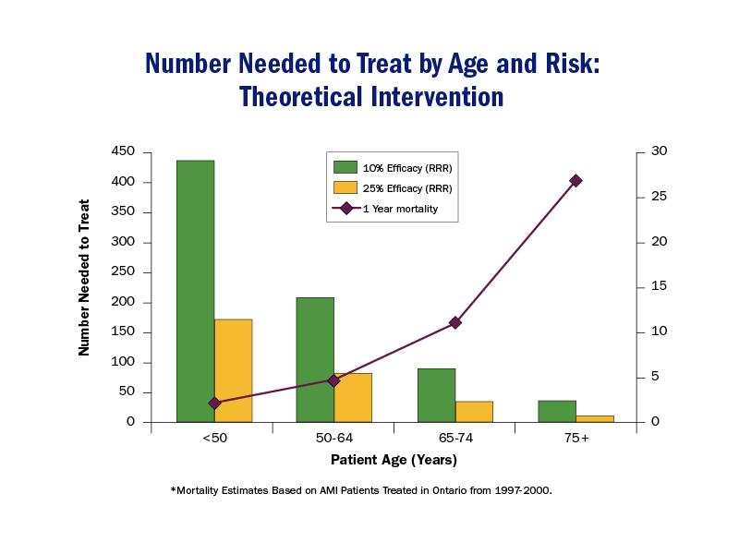
Number Needed to Treat by Age and Risk: Theoretical Intervention

Slide 7
Key Point
Older adults are at higher risk for adverse outcomes including:
mortality,
bleeding,
heart failure, and
mechanical complications of infarction than younger adults.

Slide 8
In-Hospital Outcomes by Age from the GRACE Registry

Slide 9
Key Points
Older adults with acute myocardial ischemia may present with symptoms other than chest discomfort (e.g., shortness of breath, nausea, and/or syncope) and signs of ischemia can be more difficult to discern
Their presentation may be confounded by coexisting disease states, altered physiology, frailty, and disability

Slide 10
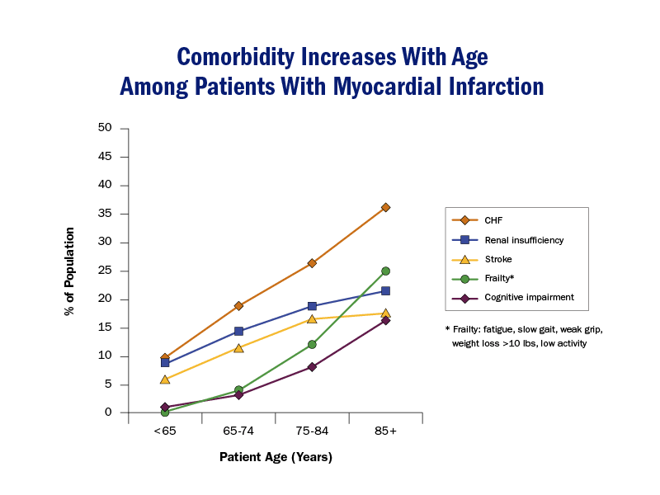
Comorbidities Among Aging MI Patients

Slide 11
Older Adults with MI – More Likely yo Present with Heart Failure
In the ischemic cascade, increased left ventricular end-diastolic pressure occurs early and elevates intracardiac pressures already high from diastolic dysfunction.
Atrial fibrillation occurs more commonly with advanced age due to the fibrotic changes within the sinus node, pulmonary veins, and atrial tissue, thereby shortening diastolic filling time and contributing to heart failure.
The age-related increase in arterial stiffness, demonstrated by increased pulse pressure, further increases the load on the left ventricle, increasing the risk of heart failure in the setting of myocardial damage.

Slide 12
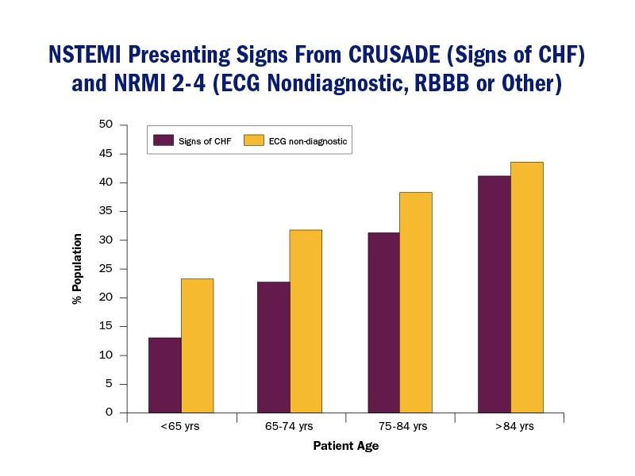
NSTEMI Presenting Signs from CRUSADE

Slide 13
Atypical Myocardial Infarction in Older Adults
Among patients with atypical presentations, nearly one half (43%) are at least 75 years of age.
Older adults’ presentation may be confounded by coexisting disease states and altered physiology, leading to atypical cardiac presentations.
Atypical cardiac presentations have been associated with a substantially increased risk of adverse outcomes including: cardiac arrest, shock, heart failure, bleeding, arrhythmias, and extended length of stay.

Slide 14
Atypical Myocardial Infarction in Older Adults
Comorbid illnesses appear to be one of the main reasons for these worse outcomes
Yet, age-related changes in other organ systems such as the kidneys and lungs, more severe coronary artery disease, higher prevalence of prior MI, less aggressive treatment, and frailty also contribute
Age-related declines in cardiovascular reserve, related to the age-related decline in beta-adrenergic responsiveness, limit the ability of older patients to maintain cardiac performance in response to acute stress (such as an acute MI)
Hence, observed increased propensity for heart failure, shock, death

Slide 15
Age-Related Change | Clinical Alteration | Clinical Impact in NSTE-ACS
↑Central arterial stiffness | ↑SBP/↓DBP; ↑LVH; ↓diastolic function; ↓coronary perfusion pressure; ↓ischemia/infarct threshold for tachycardia/hypertension with and without coronary obstructive disease; ↑PA pressure | ↑Risk end-organ damage (cerebrovascular accident, AKI); ↑BP lability; ↑reinfarction/ischemia; orthostatic hypotension; ↑HF; ↑pulmonary edema
LV diastolic function | ↑LA size; ↓early passive LV filling; ↑late LV filling and ↑LV EDP; ↑PA pressure | ↑Risk AF; (↑pulmonary edema/↓CO), ↑DOE; ↑pulmonary edema with ↑HR/↑BP
↓Response to beta-adrenergic stimulation | ↓HR/↓inotropic responsiveness to stress; resting systolic LV function unchanged with age | Hypotension, HF, ↓HR response
Conduction system changes | ↓Sinus node cells; ↓AV conduction; ↑LBBB; and ↑RBBB | Difficult to interpret electrocardiographic MI/ischemia; ↑heart block; SSS; ↑SVT, ↑sensitivity to conduction system drugs
J Am Coll Cardiol. 2014;64(24):e139-e228. doi:10.1016/j.jacc.2014.09.017

Slide 16
More Age-Related Changes | Clinical Alteration | Clinical Impact in NSTE-ACS
↓Volume regulating hormones | ↓Na, K, and water regulation—BP lability | Altered electrolytes, ↑sensitivity to fluid therapy/diuretics
Renal changes | ↓GFR (0.8 mL/min/y), ↓Na/K clearance, normal serum creatinine despite moderate to severe CKD, altered drug clearance; ↓urine concentrating ability | CrCl or eGFR must be calculated for drug dosing, ↑sensitivity to contrast nephropathy, ↑risk AKI
Fat-muscle redistribution | ↑Third spacing of fluid, may alter drug storage; ↓Vo2max | May alter fluid/drug dosing, decreased CO; DOE; early fatigability
↓Baroreceptor sensitivity | ↑BP lability | Orthostatic hypotension, fall risk
Clotting factor/platelet function/hemostasis | ↑Bleeding and clotting risk, ↑sensitivity to anticoagulants/antithrombins | ↑Risk cerebrovascular accident/reinfarction/recurrent ischemia, bleeding, thrombosis, PE, DVT; may alter drug dosing/sensitivity;↑stent thrombosis
J Am Coll Cardiol. 2014;64(24):e139-e228. doi:10.1016/j.jacc.2014.09.017

Slide 17
Frailty, NSTEMI, & Mortality

Slide 18
2014 AHA/ACC Guideline Recommendations for NSTE-ACS in Older Patients | COR | LOE
Treat older patients (≥75 y of age) with GDMT, early invasive strategy, and revascularization as appropriate | I | A
Individualize pharmacotherapy in older patients, with dose adjusted by weight and/or CrCl to reduce adverse events caused by age-related changes in pharmacokinetics/dynamics, volume of distribution, comorbidity, drug interactions, and increased drug sensitivity | I | A
Undertake patient-centered management for older patients, considering patient preferences/goals, comorbidities, functional and cognitive status, and life expectancy | I | B
Bivalirudin rather than GP IIb/IIIa inhibitor plus UFH is reasonable for older patients (≥75 y of age), given similar efficacy but less bleeding risk | IIa | B
It is reasonable to choose CABG over PCI in older patients, particularly those with DM or multivessel disease, because of the potential for improved survival and reduced CVD events | IIa | B
J Am Coll Cardiol. 2014;64(24):e139-e228. doi:10.1016/j.jacc.2014.09.017

Slide 19
Percutaneous Coronary Intervention in Older Adults
Benefits & risks of catheterization need to be explained in easily understood terms
Early invasive approach shown to be beneficial in troponin + patients ages ≥75 years in the TACTICS-TIMI 18 trial
Bleeding risks heightened in older adults (especially women); thus, carefully consider anticoagulation with intervention
After Eighty study showed invasive strategy was superior to conservative one in reduction of composite events (MI, need for urgent revascularization, stroke & death) in patients aged 80+ years with NSTEMI/unstable angina
Efficacy of invasive strategy diluted with increasing age
Two strategies did not differ in terms of bleeding complications

Slide 20
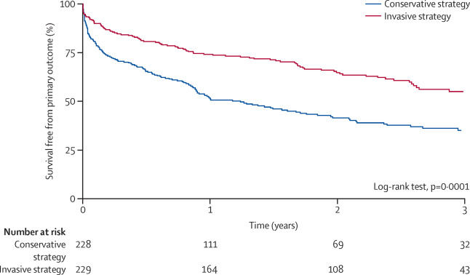
Invasive versus conservative strategy in patients aged 80 years or older with non-ST-elevation myocardial infarction or unstable angina pectoris (After Eighty study): an open-label randomised controlled trial
Kaplan-Meier curves of survival free from composite outcome. The primary outcome was a composite of myocardial infarction, need for urgent revascularisation, stroke, and death.
Tegn et.al, Volume 387, Issue 10023, 2016, 1057–1065
http://dx.doi.org/10.1016/S0140-6736(15)01166-6

Slide 21
Antithrombotic Dose Excess by Age from CRUSADE

Slide 22
Number of ACS Therapies Provided and In-Hospital Bleeding from CRUSADE

Slide 24
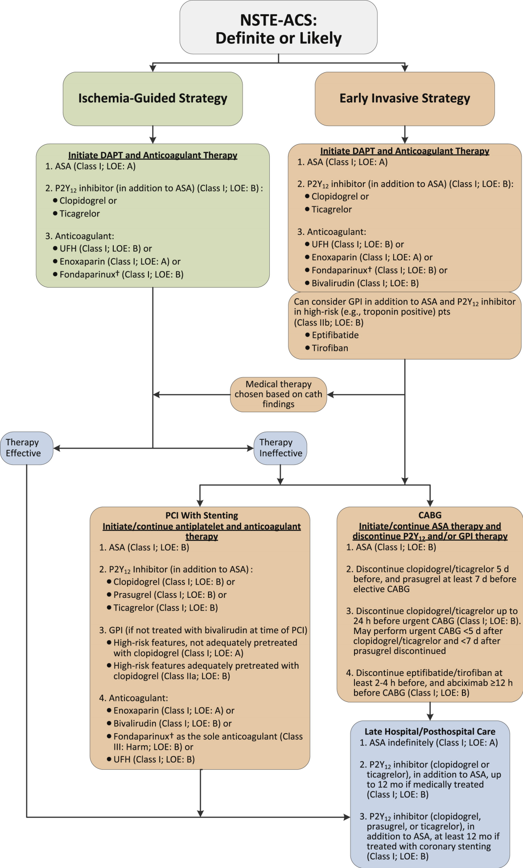
From: 2014 AHA/ACC Guideline for the Management of Patients With Non–ST-Elevation Acute Coronary Syndromes: A Report of the American College of Cardiology/American Heart Association Task Force on Practice Guidelines
J Am Coll Cardiol. 2014;64(24):e139-e228. doi:10.1016/j.jacc.2014.09.017
J Am Coll Cardiol. 2014;64(24):e139-e228. doi:10.1016/j.jacc.2014.09.017

Slide 25
Medical Therapy for NSTE-ACS in Older Adults
Current guidelines recommend aspirin, statin, beta-blockers & P2Y12 inhibitors for all acute MI patients—including older patients
Angiotensin-converting enzyme inhibitors/angiotensin-receptor blockers & P2Y12 inhibitors should be administered to most high-risk MI patients
Individualize pharmacotherapy in older patients, with dose adjusted by weight and/or CrCl to reduce adverse events caused by age-related changes in pharmacokinetics/dynamics, volume of distribution, comorbidity, drug interactions, and increased drug sensitivity (Class 1A)

Slide 26
Approach to Caring for Older Adult with NSTE-ACS
Undertake patient-centered management for older patients, considering patient preferences/goals, comorbidities, functional and cognitive status, and life expectancy (Class 1B)

Slide 27
Post-MI Discharge Planning in Older Adults
Diminished functional capacity, health literacy, uncertainty regarding diagnoses, poor communication between patient and provider, and absence of appropriate follow-up are factors associated with increased risk for adverse outcomes.
Transitions of care are particularly important in enabling independent functioning and medication safety after discharge.

Slide 28
Key Points: NSTE-ACS in Older Adults
Older adults with acute myocardial ischemia may present with symptoms other than chest discomfort and signs of ischemia can be more difficult to discern.
Their presentation may be confounded by coexisting disease states, altered physiology, frailty, and disability.
Older adults appear to gain greater absolute benefits with an early invasive strategy compared with younger adults because of their higher risk for adverse outcomes with conservative management.
Bleeding increases as a function of age and comorbid conditions common in older adults; it must be considered in light of the benefit of anticoagulant therapy and catheter interventions in each patient.

Slide 29
Key Points: STEMI in Older Adults
Reperfusion therapy for STEMI is widely available, providing clear mortality benefit compared with no reperfusion until at least 80 years of age.
While selection of reperfusion is based on multiple factors (e.g., availability of the reperfusion strategy, time from onset of symptoms, risks, and benefits), primary PCI is generally favored.

Slide 30
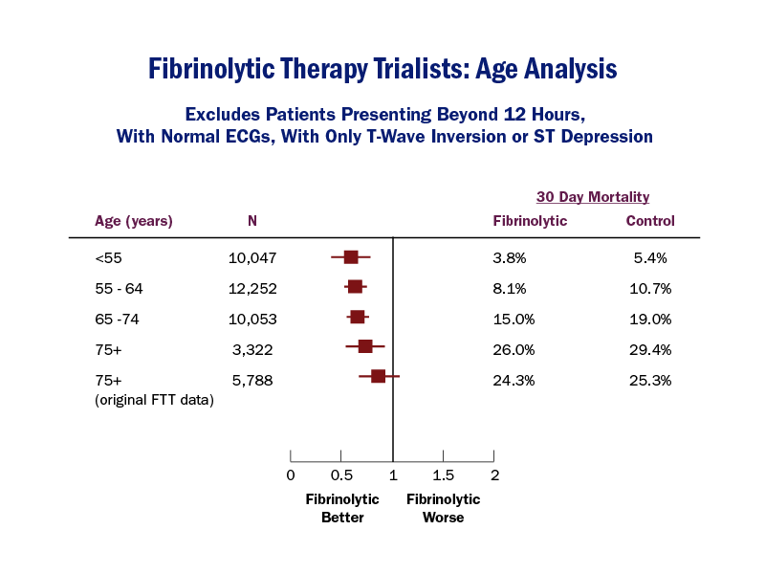
Fibrinolytic Therapy Trialists: Age Analysis

Slide 31
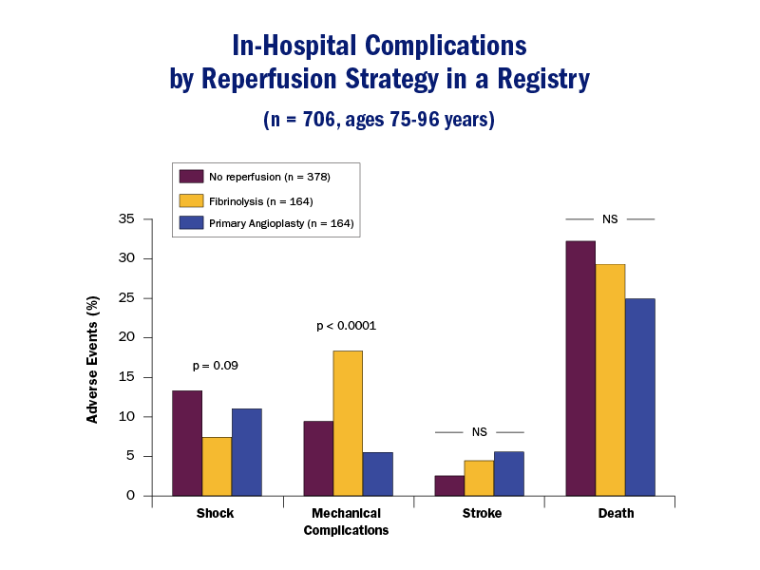
In-Hospital Complications by Reperfusion Strategy in Registry

Slide 32
⁎
Contraindications and Cautions for Fibrinolytic
Therapy in STEMI
Absolute contraindications
• Any prior ICH
• Known structural cerebral vascular lesion (e.g., arteriovenous malformation)
• Known malignant intracranial neoplasm (primary or metastatic)
• Ischemic stroke within 3 mo
• EXCEPT acute ischemic stroke within 4.5 h
• Suspected aortic dissection
• Active bleeding or bleeding diathesis (excluding menses)
• Significant closed-head or facial trauma within 3 mo
• Intracranial or intraspinal surgery within 2 mo
• Severe uncontrolled hypertension (unresponsive to emergency therapy)
• For streptokinase, prior treatment within the previous 6 mo
J Am Coll Cardiol. 2013;61(4):e78-e140. doi:10.1016/j.jacc.2012.11.019

Slide 33
Contraindications and Cautions for Fibrinolytic Therapy in STEMI
Relative contraindications
• History of chronic, severe, poorly controlled hypertension
• Significant hypertension on presentation (SBP >180 mm Hg or DBP >110 mm Hg)
• History of prior ischemic stroke >3 mo
• Dementia
• Known intracranial pathology not covered in absolute contraindications
• Traumatic or prolonged (>10 min) CPR
• Major surgery (<3 wk)

