Slide 1
Care of Older Adults with Cardiovascular Disease
Geriatric Cardiology Section of the
American College of Cardiology

Slide 2
Learning Objectives
Recognize the added complexity of addressing cardiovascular issues in the older adult geriatric population, in regards to:
Multi-morbidity
Frailty
Sensory function limitations
Cognitive limitations
Provide some tools to better assess older adults

Slide 3
How we care for older adults with cardiovascular diseases has to be different
Despite the fact that cardiovascular diseases continue to be the leading cause of morbidity and mortality in seniors, therapeutic efforts are often confounded by conditions that dominate their overall sense of health and well-being
Many older adults are burdened by sensory and/or cognitive limitations.
Extra effort to convey information in a manner that is accessible to each patient is important.
Age-related changes may impact efficacy or complexity of standard therapies.
In addition, goals of care (eg. independence, function, quality of life) usually differ significantly from their younger counterparts.

Slide 4
Case
An 89-year-old man who lives in an assisted-living facility, with a history of heart failure with preserved ejection fraction (HFpEF) was admitted for an acute decompensation, in association with a community-acquired pneumonia. He has a past medical history of type 2 diabetes, hypertension, chronic anemia, and Stage 4 renal insufficiency. He improved with diuretics and antibiotics, and after 3 days, he was discharged.
Which of the following conditions puts him at higher risk for re-admission?
Inadequate choice of antibiotics
Multiple comorbidities
Coming from an assisted living facility
Short hospital stay

Slide 5
Multi-morbid Disease
Multi-morbidity is present in over 70% of adults 75 or older.
In patients with heart failure, over 50% have 5 or more co-existing chronic conditions.
Non-CVD multi-morbid diseases can exacerbate CVD pathophysiology
Polypharmacy typically follows multi-morbidity and makes management of CVD inherently more complex.

Slide 6
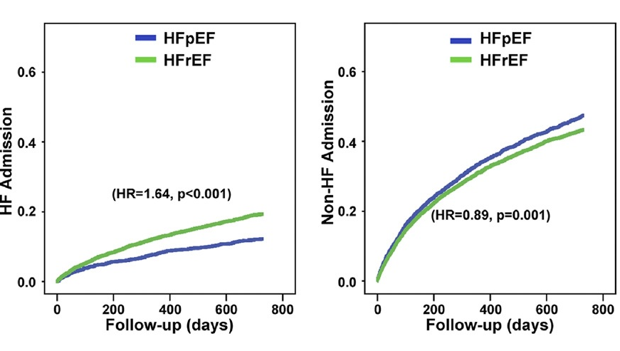
Multi-morbid Disease, Heart Failure & Re-admissions
The impact of multimorbidity is particularly evident in patients with heart failure.
There is a higher noncardiac comorbidity burden associated with higher non-HF hospitalizations in patients with HFpEF compared with those with HFrEF.
However, individually, most comorbidities have similar impacts on mortality in both groups.
Notes:
The impact of multimorbidity is particularly evident in patients with heart failure. There is a higher noncardiac comorbidity burden associated with higher non-HF hospitalizations in patients with HFpEF compared with those with HFrEF. However, individually, most comorbidities have similar impacts on mortality
in both groups.

Slide 7
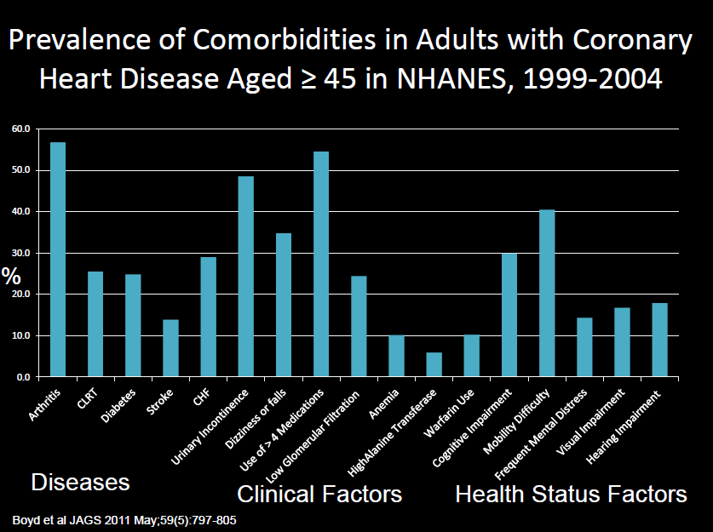
Prevalence of Comorbidities in Adults with Coronary Heart Disease
There has been a dramatic increase in the number and complexities of multi-morbid conditions in patients with coronary artery disease over the last decade.
Patients with six or more chronic conditions spend over 3 times more healthcare resources compared to average Medicare costs.

Slide 8
Geriatric Syndromes
Term used to refer to clinical conditions germane to older adults, which share underlying causative factors and involve multiple organ systems.
Unlike traditional medical syndromes, they cannot be explained by a single metabolic, pathophysiologic or genetic pathway
Commonly encountered Geriatric syndromes in patients with cardiovascular diseases include multi-morbidity, delirium, frailty, cognitive impairment, falls and impaired mobility, depression, incontinence and functional decline

Slide 9
Case
An 86-year-old man with a history of Parkinson’s disease underwent a transcatheter aortic valve replacement; after his surgical procedure, he was sent to the recovery unit. The nurse informs the cardiology fellow that the patient appears confused, intermittently agitated, pulling IV’s and attempting to leave the unit. She requests some lorazepam.
Which of the following is NOT a risk factor for delirium?
Cognitive impairment
Pain
Gender
Age
Urinary retention

Slide 10
Delirium
Affects over 2 million hospitalized patients per year; 25 to 60% of hospitalized older adults may experience this syndrome
Likely underestimated, as classic “agitation” is seen in less than 40% of cases
The key hallmark that distinguishes this syndrome from dementia is the acute onset and fluctuating course; other cardinal features include altered sleep/wake cycle, inattention and disorganized thinking
It is independently associated with increased readmission, morbidity and mortality risk at 1 year
Confusion Assessment Method is a validated screening tool.

Slide 11
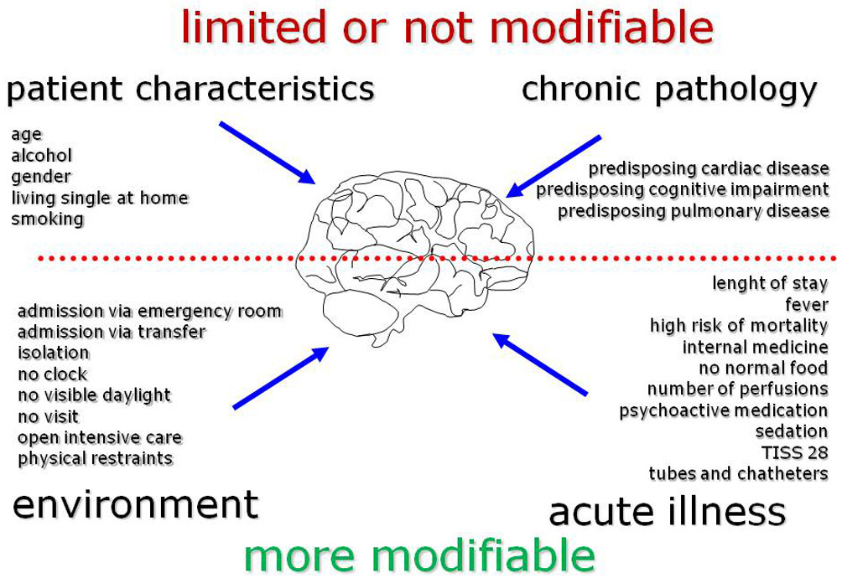
Risk Factors for Delirium
Assessment of delirium potential includes an evaluation of individual risk factors, such as:
cognitive and sensory impairment, polypharmacy, functional decline and previous episodes of delirium;
precipitating factors during an acute illness, such as hypoxia, electrolyte imbalances, dehydration, malnutrition, medication interactions and side effects;
finally, environmental factors such as noise, sleep disruption, catheters and IV’s, inability to follow day-light cycle.
Implementing a multimodal intervention can prevent its onset and significantly improve outcomes.

Slide 12
Case
An 85-year-old woman with past medical history of essential hypertension, coronary artery disease (CAD), osteoarthritis, and heart failure with preserved ejection fraction, has been brought by her daughter to establish cardiovascular care in your office. She lives alone, but her ability to care for herself has become a concerning issue. She has more trouble “getting words out”.. She forgets or confuses names of neighbors.
Which of the following is NOT consistent with mild cognitive impairment?
Advancing age
Inability to care of self
Forgetting names
Word finding difficulties

Slide 13
Dementia
Affects 13% of community dwelling in adults over 65 years old, 40% by age 80.
Advanced heart failure and over 65, estimates range from 30-60%.
Likely underestimates due to reduced recognition of the disease.
Cognitive impairment is over 5 times more common in patients classified as frail.
Hypertension and frailty may be synergistic and risk factors for development of mild cognitive impairment.
Periodic screening is necessary to accurately establish future risk and determine benefits of simplification of treatment strategies.

Slide 14
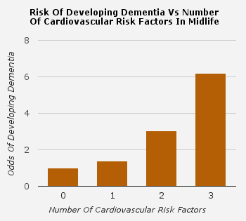
Risk of Developing Dementia vs. Number of CV Risk Factors in Midlife
There appears to be a very close relationship between CVD risk factors and overall risk of dementia.
Obesity at midlife is associated with an increased risk of dementia later in life.
Furthermore, clustering of vascular risk factors increases the risk in an additive manner.

Slide 15
Sensory Impairments
>40% of adults age 65 and older have hearing difficulties, most often presbycusis (age-related hearing loss)
>13% of adults age 65 and older have significant visual impairment.
Sensory impairments increase the risk of delirium, inadequate health literacy and misdiagnosis of depression and dementia.
Ensuring patients have hearing aids and eyeglasses is key to their ability to participate in their own CV care.

Slide 16
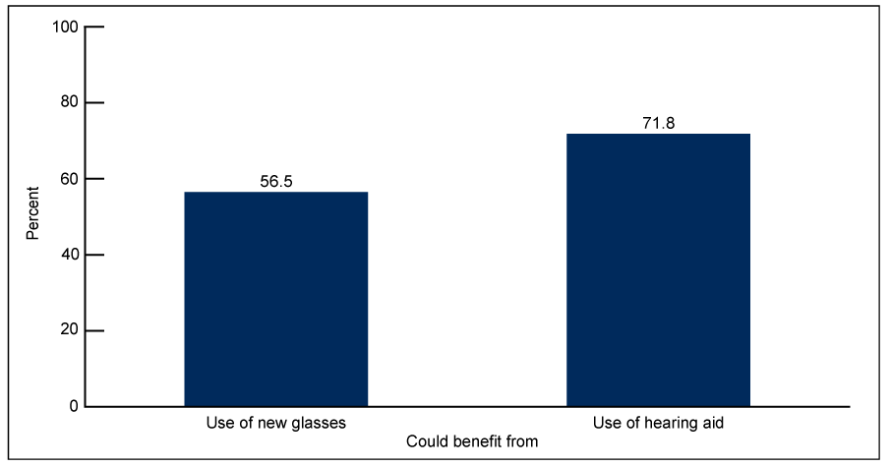
Underuse of Sensory Aids in Older Adults
Despite the detrimental consequences of sensory impairment, particularly when affecting multiple domains, sensory aids remain underused in the US: almost 6 out of every 10
Americans would benefit from new glasses, and 7 out of 10 adults over the age of 70 could benefit from a hearing aid.

Slide 17
Falls
Recurrent falls are one of the most frequent triggers for admission to long-term care facilities
Older adults with CVD are at significantly increased risk of falls via multiple mechanisms: impaired baroreflexes, orthostatic hypotension, arrhythmias and aortic stenosis
Adverse consequences of recurrent falls include: soft tissue injuries, head trauma and fractures, particularly hip; furthermore, falls lead to reduced activity and social isolation (“fear of falling”)
The goal is to address and treat reversible causes early but most falls are multi-factorial.

Slide 18
Jensen J, Lundin-Olsson L, Nyberg L, et al. Fall and injury prevention in older people living in residential care facilities. A cluster randomized trial. Ann Intern Med 2002; 136: 733–741.
Can falls be prevented?
Falls can be prevented over time, even in structured long-term environments; since these tend to be multifactorial, a considerable effort has to be made to determine the predominant driving factors for each patient; an interdisciplinary, multifaceted prevention and intervention approach yields the best results.

Slide 19
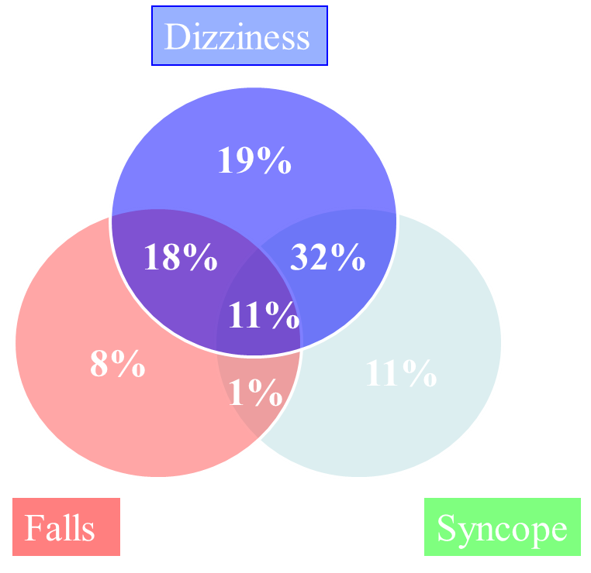
McIntosh S, Da Costa D, Kenny RA. Outcome of an integrated approach to the investigation of dizziness, falls and syncope in elderly patients referred to a 'syncope' clinic. Age Ageing 1993; 22(1):53-8.
Overlap of Dizziness, Syncope & Falls
In the elderly, syncope and unexplained falls may be indistinguishable on clinical grounds, particularly in cases of retrograde amnesia; more than 10% of the falls in this group can be caused by syncope.
Thus, an unexplained fall in an elder with retrograde amnesia should be evaluated as a potential syncope until proven otherwise.

Slide 20
Frailty
What is frailty?
A syndrome of biological decline across multiple organ systems
Leads to loss of reserve in response to stressors
Frailty is associated with poor tolerance of CVD and CVD therapies
Frailty itself is an independent adverse predictor for CVD: coronary artery disease, heart failure and cardiovascular mortality
No gold standard for assessment but there are tools that can be used
Grip Strength
Gait speed of more than 6 seconds to walk 5 meters

Slide 21
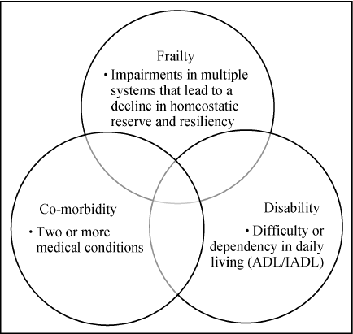
Afilalo et al. Identification of vulnerable elderly before cardiac surgery: a comparison of different survey scales. J Am Coll Cardiol 2011; 57: E1395
Frailty, Multi-morbidity and Disability
Frailty, disability and multimorbidity are different concepts as explained throughout this presentation, but there can be significant overlap among them in a given individual.
Although the clinical course may vary, it is not uncommon for multi-morbidity to lead to the development of frailty, with subsequent disability.

Slide 22
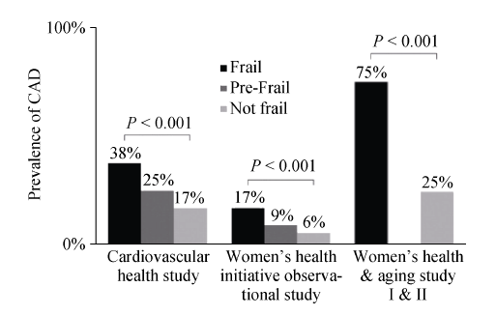
Afilalo J et al. Role of frailty in patients with cardiovascular disease. Am J Cardiol 2009; 103: 1616-1621
Frailty and Cardiovascular Disease
Notes:
Multiple large studies have documented a robust association between frailty, and even pre-frailty and cardiovascular disease. Cardiovascular disease and frailty share many commonalities, suggesting common biologic pathways such as chronic inflammation; there appears to be a reciprocal loop, as they seem to facilitate each other.

Slide 23
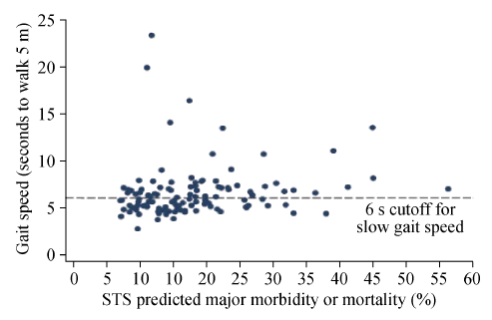
Afilalo et al. Gait speed as an incremental predictor of morbidity and mortality in elderly patients undergoing cardiac surgery. J Am Coll Cardiol 2010; 56: 1668-1676
Gait Speed vs. STS Score, Cardiac Surgery
Notes:
Gait speed, one of the key physical methods to assess frailty, has been shown in several studies to be an accurate predictor of adverse outcomes in patients undergoing cardiovascular surgery, but it is less used in clinical practice in comparison to other risk scores such as the STS; as the graphic displays, there is no significant correlation between the risk predicted by slow gait speed and the one estimated by the STS for a given patient.

Slide 24
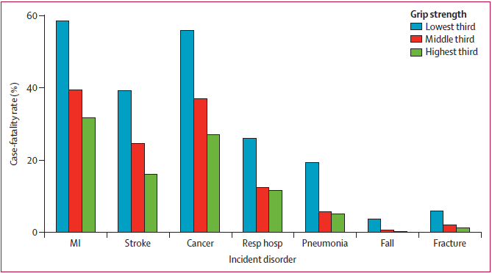
Leong DP et al. Prognostic value of grip strength: findings from the Prospective Urban Rural Epidemiology (PURE) Study. Lancet 2015; 386: 266-273
Prognostic Value of Grip Strength
Notes:
Grip strength, another one of the simple, sensitive tools to assess physical performance in frailty, is inversely associated with incident cardiovascular disease, but also with all-cause, cardiovascular and non-cardiovascular mortality in a consistent way.

Slide 25
Polypharmacy
Broadly defined as an increase in the number of medications (traditionally >5 meds), or the use of more medications than are medically necessary
Extremely common in older adults in ambulatory and inpatient settings, ranging from 36 to 67% in average
Associated with multiple negative health consequences in the elderly: adverse drug events, interactions, functional impairment, cognitive impairment, falls and urinary incontinence
The best interventions for polypharmacy involve an inter-professional approach that usually includes a Clinical PharmD
Notes:
Appetite Questions:
How is your appetite?
Have you lost weight or are your clothes big on you?
Trouble with taste of food, chewing or swallowing?
Trend weight across visits.
Falls
Have you fallen in the last year?
How often do you fall?
Did you suffer any injuries?
Where did you fall?
Do you get dizzy when you stand up?
Are you afraid of falling?
Incontinence
Do you lose urine involuntarily/accidentally?
Do you lose urine when you cough, laugh, or sneeze?
Do you often have wetting accidents?
Do you get up at night to urinate?
Memory
Have you noticed a change in memory or found it difficult to complete tasks you usually do?
Are you or a family member concerned about your memory?
Mood
Do you feel depressed?
Have you lost interest in things that used to interest you?
Pain
Are you having any pain
Intensity, location, onset, duration, radiation, quality, and associated symptoms.
Sleep
Do you have difficulty falling asleep?
Do you have any difficulty staying asleep?
Are you excessively sleepy during the day?

Slide 26
More Medications, Worse Reported QOL
CDC/NCHS, Figure 22 from National Health Examination and Nutrition Survey 2013.
Notes:
The misconception of more is better in terms of medication and overall health is emphasized by this graphic from the NHANES 2013, which supports that polypharmacy increases as a function of age, but those taking more medications have a worse self-reported quality of life.

Slide 27
Disability in Older Adults
Routine screening for ADLs/IADLs provides an opportunity to anticipate and take steps to modify advancing disability and frailty.
Disability and physical, cognitive and sensory limitations are NOT an inevitable consequence of aging
20% of older adults in the US have an identified chronic disability
Roughly 8% of older adults in the US have severe cognitive impairment

Slide 28
Screening for Disabilities
Activities of Daily Living | Independent Activities of Daily Living
Bathing Grooming Transferring Toileting Eating Dressing | Handling finances Shopping Preparing food Answering the telephone Transport

Slide 29
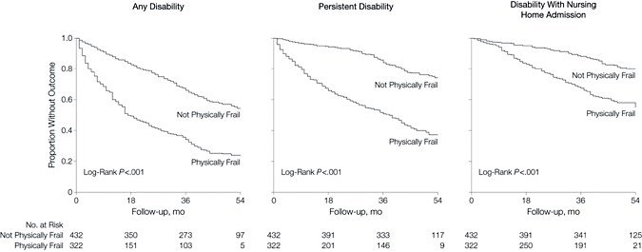
Gill et al. Hospitalization, Restricted Activity, and the Development of Disability Among Older Persons. JAMA. 2004;292(17):2115-2124. doi:10.1001/jama.292.17.2115
Impact of Hospitalization on Disability
Notes:
Hospitalizations pose an enormous risk for the development or worsening of disabilities in the elderly; it has been noted that more than one third of older adults who are hospitalized develop some disability, which may become persistent; the risk is even higher in frail older patients

Slide 30
Advanced Care Planning & Goals of Care
Advance care planning: dynamic process in which patients, their families, and their healthcare providers reflect on the patient’s goals, values, and beliefs, and use this information to accurately document the patients’ current and future health care choices.
Clinicians are responsible of informing patients about their prognosis, treatment options, and helping formulate a risk/benefit analysis.
Advance directives: documents a person completes while still in possession of decisional capacity to ensure their values are reflected when considering how treatment decisions should be made, in case capacity is lost. The primary instruments that serve as AD documents are the Durable Power of Attorney for Health Care (DPAHC or Health Care Proxy) and the Living Will (LW).
Code status is NOT a synonym, but part of an advanced directive.

Slide 31
Underuse of Advanced Directives in Older Adults
CDC, National Nursing Home Survey 2004, National Home and Hospice Care Survey 2007
Notes:
Advance directives are only used by a small percentage of all patients. Only between 18% and 30% of Americans have completed an advance directive. Additionally, only 1 in 3 chronically ill patients have a documented advance directive. 1 out of every 3 nursing home residents do not have an advance directive. Even among patients admitted to Medical ICUs, only a minority has advance care planning documented prior to admission.

Slide 32
Goals of Care in Older Adults
Typically NOT longevity
Preservation of independence
Quality of life
Avoiding falls
Relieving fatigue
Reducing hospitalization
Reducing pain
Moderating costs

Slide 33
Transitional Care of Older Adults
“Moving patients from one care setting to another”
Transitional care encompasses a broad range of services and environments designed to promote the safe and timely relocation of patients between levels of health care and across care settings.
High-quality transitional care is especially important for older adults with multiple chronic conditions and polypharmacy
Poor “handoff” of this high risk population has been linked to adverse outcomes
Notes:
Examples of specialized services to promote safer, higher quality transitions for the elderly include initiatives such as hospital at home, day hospitals, Acute Care for the Elderly (ACE) Units, inter-professional partnerships (PT, OT, SW, Home health agencies) and specific programs such as Care Transitions, Re-engineering Discharges (RED), The Bridge Model, Better Outcomes for Older Adults with Transitions (BOOST) among others.

Slide 34
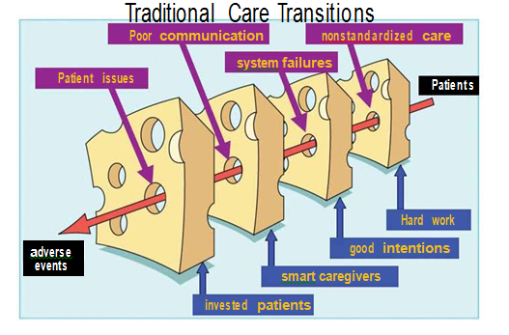
http://www.hospitalmedicine.org/Web/Quality_Innovation; adapted from Reason J. Human error: models and management. BMJ. 2000;320:768-770.
Notes:
The ultimate consequence of errors during transitions of care of older adults are adverse events; the key elements of the different transitional models are to standardize patient care, improve and foster communication, and generate multiple layers of “cross-checking” of simplified information.

Slide 35
Key Points
Care of older adults should contemplate not only longevity, but improved function, independence, and quality of life.
Optimal care of older adults’ CVD requires consideration of pertinent non-CVD aspects of care that impact CVD progression and management, including multi-morbidity, frailty and disability.
ADLs and IADLs are important for independent functioning. A change in function warrants further investigation
Falls in the elderly population can mean major mortality and functional decline. Addressing treatable/reversible causes of the falls should be undertaken as soon as the incident has occurred.
Vulnerable elders and their caregivers may benefit from referral to a geriatrician and/or an interdisciplinary geriatric team in the inpatient and outpatient settings.

Slide 36
Additional Reading Materials
Bell SP et al. Care of older adults. J Geriatr Cardiol 2016; 13: 1-7. doi:10.11909/j.issn.1671-5411.2016.01.019.
Ather S et al. Impact of Noncardiac Comorbidities on Morbidity and Mortality in a Predominantly Male Population With Heart Failure and Preserved Versus Reduced Ejection Fraction. J Am Coll ardiol 2012; 59 (11): 998-1005
Boyd et al. Clinical Practice Guidelines and Quality of Care for Older Patients With Multiple Comorbid Diseases. JAMA 2005; 294 (6): 716-724
Van Rompaey B et al. Risk factors for delirium in intensive care patients: a prospective cohort study. Critic Care 2009; 13: R77
Jansen S et al. The Association of Cardiovascular Disorders and Falls: A Systematic Review. JAMDA 2016; (17): 193-199
Chen M. Frailty and cardiovascular disease: potential role of gait speed in surgical risk stratification in older adults. J Geriatr Cardiol 2015; 12: 44-56
Mahrer R et al. Clinical Consequences of Polypharmacy in Elderly. Expert Opin Drug Saf 2014; 13 (1): 1-11

