Slide 1

Decision Making in Older Adults
Geriatric Cardiology Section of the
American College of Cardiology

Slide 2
Objectives
List the elements of informed consent and assessment for decision-making capacity
Identify types of advance directives and explain the role of patients’ wishes, preferences, and goals in decision making
Describe effective strategies for difficult discussions with older patients and their families (e.g., benefits and risks of treatments, bad news, prognosis, and do not resuscitate (DNR) orders)
Discuss issues regarding the DNR orders in different care settings (in-hospital, out-of-hospital, and prior to procedures)

Slide 3
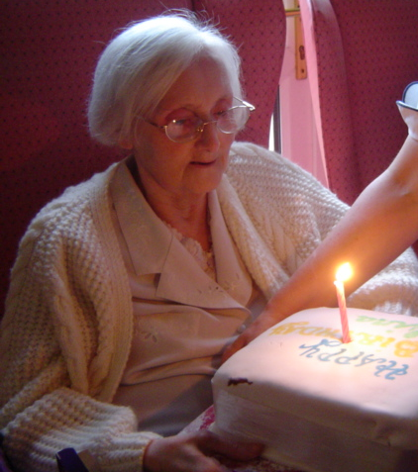
Case
Mrs. Peters is a 78-year-old woman with a history of hypertension, diabetes mellitus, coronary artery disease, coronary artery bypass graft surgery, chronic kidney disease, treated breast cancer, and urinary incontinence.
She recently had her first hospitalization for acute decompensated heart failure that responded nicely to diuresis. Her echocardiogram after diuresis reveals an ejection fraction (EF) of 30% with moderate mitral regurgitation and mildly reduced right ventricular (RV) function. Last year, her EF was 45% with normal RV function.
She has been on optimal medical therapy and has no new ischemic disease amenable to revascularization. She is functionally independent and enjoys spending time in her garden or with her grandchildren. She is also the primary caregiver for her husband, who has moderate Alzheimer’s dementia and lives at home.
Photo by Eggybird is licensed under CC BY 2.0

Slide 4
Case
Her physician recommends that Mrs. Peters have an implantable cardioverter-defibrillator (ICD) placed for primary prevention of sudden cardiac death.
She is reluctant to have any procedure. She says, “When my time comes, that’s it.”
Her physician believes she has a good quality of life and that she should accept the opportunity to prevent premature sudden cardiac death.
Photo by Eggybird is licensed under CC BY 2.0

Slide 5
Case
What underlies Mrs. Peters decision?
What are her values and preferences?
What is her understanding of her disease and prognosis?
Does she have decision-making capacity to provide informed refusal?
Photo by Eggybird is licensed under CC BY 2.0
Notes:
That Mrs. Peters’ decision is contrary to her physician’s recommendation is not, in and of itself, evidence that she lacks decision-making capacity.

Slide 6
Shared Decision Making
Process for clinicians and patients to share information with each other and work toward high-quality decisions
Patient share goals, values, preferences for health care
Clinician help narrow diagnostic and treatment options to those medically reasonable
Patient decision aids can help this process
Goal is a decision chosen among medically reasonable options that align with an informed patient’s needs
An important component for “patient-centered care”
Notes:
Shared decision making moves beyond informed consent
Shared decision making is most easily applied to decisions in which both clinicians and patients agree that equipoise exists, and decision support helps patients think through, forecast, and deliberate their options

Slide 7
Assessing Capacity
Autonomy supports the right of patients with decision-making capacity to refuse treatment
Medical information must be presented using language the patient understands, avoiding medical jargon
Specific to the decision at hand and not a global judgment about the patient’s general abilities
May “wax and wane” with delirium, acute disease, or by time of day
Any clinician can determine decision-making capacity
Notes:
The patient’s understanding of the medical information should be evaluated. Asking patients to express the key issues in their own words is helpful. A patient’s ability to communicate should be maximized. Ensure that patients are wearing their glasses or using their hearing aids during the conversation
Capacity not ruled out by presence of any specific diagnosis such as dementia or schizophrenia
Patients who lack decision-making abilities due to acute illness or delirium may regain capacity with appropriate medical and/or psychiatric treatment.
Psychiatric evaluation may not be necessary- check with institutional policy

Slide 8
Assessing Capacity
A patient with decision-making capacity:
Understands relevant information about the diagnosis, treatment options, risks, and benefits of each option and alternatives
Appreciates the consequences of the choice
Reasons about the options in the context of personal values
Makes and communicates a choice
Notes:
. Refusal of recommended treatment does not in and of itself imply that the patient lacks decision-making capacity. Clinicians should explore reasons for refusal and understand the patient’s values to carefully assess the patient’s capacity to provide informed refusal.

Slide 9
Case
Her physician has a discussion with Mrs. Peters and determines that she has capacity to decide about ICD implantation.
Her main concerns are to avoid pain and suffering at the end of her life.
She asks her physician, “Once it’s in, is it in forever, or can you take it out?”
Photo by Eggybird is licensed under CC BY 2.0

Slide 10
Advance Care Planning
Iterative dialogue between patients and health care providers in order to:
Engage patient in discussion around values and goals
Help patients understand disease trajectory and prognosis
Clarify wishes for medical care in the event the patient loses decision-making capacity
Ensure the patient’s preferences are honored if the patient loses decision-making capacity
Difficult discussions now will simply difficult decisions in the future

Slide 11
Advance Directives
Legal Components
Living Will: delineates specific medical interventions/treatments the patient would or would not want in particular circumstances (usually life-threatening, terminal or severely debilitating illness) Five Wishes MOLST/POLST (Medical/Physician Orders for Life-Sustaining Treatment) | Health Care Proxy: designates a specific surrogate decision maker to speak on behalf of the patient in the event of loss of decision-making capacity Laws vary by state.
Notes:
-Unfortunately most living will only specify no prolonged vegetative state and may not specify what to do in more nuanced scenarios in the hospital.
-Five Wishes is a type of document completed by patients and family that may provide more detailed guidance
-POLST/MOLST require physician input and distinguishes between life sustaining therapies of temporary versus indefinite durations
-Assignment of health care proxy may be prudent act for all adults, not just at end of life, as it recognizes that we are all at risk for unexpected events that render us unable to make health care decisions for ourselves. However, the documentation only serves to identify a person to be making decisions, and provides no information about how that may align with the patient’s own wishes.
- Don’t let focus on legal designations detract from vital aspects of conversation between patient, clinician, and family

Slide 12
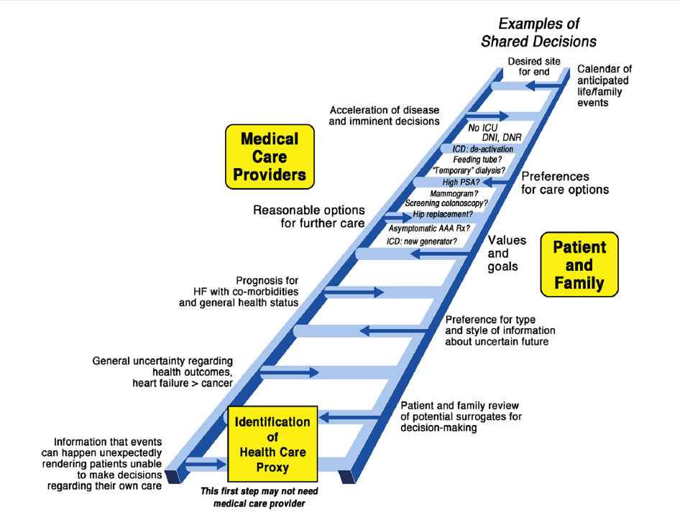
Ladder of Shared Decision Making
Stevenson and O’Donnell, JACC HF, 2015 3:122-125
Notes:
Use the basic legal documents as a first step in an iterative process to launch shared decision making based on the goals of the values of the patient and family. Individualize the process with the progress of the patient and family up the ladder of shared decisions. This way, will respond to previous information and can add new information at each level.

Slide 13
Annual Heart Failure Review
Concept analogous to annual wellness visit of primary care
Opportunity for broad dialogue:
Patient summarize symptom burden and quality of life
Goals for coming year
Preferences for survival including survival, functional capacity, quality of life
Estimation of prognosis (consider objective modeling data, but with broad uncertainty)
Review of appropriate current and potential future therapies
Plan for future events (resuscitation preferences, desire for advanced therapies, major surgery, hospice)
CMS will now reimburse physicians for discussing advance care planning with patients
Notes:
In heart failure, a recent consensus document has proposed a routine annual review for patients with advanced disease
Provides “anticipatory guidance:” when triggered by a schedule anniversary in the same way as a well baby visit or annual immunization, automatic review can relieve fear and anxiety of an event expected to be stressful or unvoiced concern that it signifies bad news

Slide 14
Case
Mrs. Peters, what are your biggest fears and worries about the future of your health?
Have you discussed your end of life wishes with your family?
Are there things that are important to you that you would like your family or medical team to know?
Photo by Eggybird is licensed under CC BY 2.0
Notes:
Conversation guide

Slide 15
Case
After discussing the purpose of the ICD and exploring her preference that the ICD be deactivated in the event of serious life-threatening illness, Mrs. Peters agrees to implantation of a defibrillator and “signs consent.”
Photo by Eggybird is licensed under CC BY 2.0

Slide 16
Informed Consent
Legal doctrine that ensures the patient controls what happens to his or her body by requiring specific authorization
Necessary but not sufficient component of shared decision making process
Patient and surrogate decision makers are given adequate information to make health care choices
Disclosure, decision-making capacity, and voluntariness are essential components of informed consent

Slide 17
Elements of Informed Consent
Diagnosis
Prognosis
Nature and purpose of treatment or procedure
Risks and benefits of the procedure, including common complications and rare, but serious, complications
Alternatives to the procedure
Consequences of not doing the procedure
Notes:
The main purpose of the consent process is to promote shared decision making, not to provide legal protection for clinicians.

Slide 18
Case
Three years later…
Mrs. Peters is admitted again for her 3rd episode of decompensated heart failure in 6 months.
On admission to the cardiac care unit (CCU), she is confused, dyspneic, hypotensive, hyponatremic, and in renal failure.
Her daughter asks when listening to morning rounds, “Is she going to die?”
Photo by Eggybird is licensed under CC BY 2.0

Slide 19
Delivering Bad News
Goodlin SJ. Palliative care in congestive heart failure. J Am Coll Cardiol 2009; 54(5): 386-96.
Notes:
Good communication skills are especially important when caring for older adults facing serious, life-threatening illness. These difficult conversations serve as a useful paradigm to illustrate components for successful communication with patients and families. The following steps for effective communication illustrate principles that are widely applicable, with modification, to many situations.
1. Choose the right setting:
have accurate and up to date facts
Find a private, quiet setting with room to sit
Plan who will participate (which family and which care team members) and plan agenda for what will be discussed
2. Ask-Tell-Ask
- ask what the patient and/or family know or understand. This can identify misunderstanding, observe important family dynamics or conflict
- elicit questions
3. Obtain invitation to share information
- ask how much information participants want to know, if other would want to be here or if anyone does not want to participate
4. Share knowledge and information. Use simple, honest language
-Avoid medical jargon. Pause frequently to allow time for information processing and questions.
5. Respond to emotions and empathy
- observe, identify and acknowledge emotions.
6. Summarize and plan next steps
- Document, summarize the content of the conversation and the plan

Slide 20
Case
During the family meeting with Sandra, her physician learns that Mrs. Peters has no health care proxy or living will.
She has become confused recently, but consistently complains that her increasing symptoms, physical limitations, and frequent hospitalizations are unbearable.
“My mother would not want resuscitation attempted.”
Photo by Eggybird is licensed under CC BY 2.0

Slide 21
Surrogate Decision Making
Surrogate Decision Maker:
Represents patient who lacks decision-making capacity
Consult state laws regarding hierarchy of decision makers
Should base decisions on:
Patient’s preferences, evidenced by prior oral or written statements, if known
Substituted judgment (what the surrogate judges the patient would decide), based on patient’s values, if known
Best interests, if patient’s values are unknown
Notes:
In situations where there is no specifically designated health care agent, an informal surrogate decision maker makes decisions, usually a close relative.
State laws vary regarding the rights and responsibilities of surrogates as well as the hierarchy of decision makers (i.e., spouse, adult child, parent, etc.) when there is no officially designated health care agent.
Even when there is a health care proxy, depending on the specific family dynamics, it is important to communicate with key family members and build consensus, if possible, about important decisions.

Slide 22
Communicating With Surrogate Decision Makers
Designate a skilled communicator from the medical team and establish relationships before difficult topics arise
Ask about the patient and his/her values to help guide medical recommendations
Counsel surrogates that their role is to decide based on what the patient would choose, considering the patient’s preferences, goals, and values
Ask about surrogate’s experience with medical decision making
Do not overburden decision makers with a laundry list of decisions; make specific recommendations
Notes:
Being a surrogate decision maker is difficult. Factors contributing to surrogate stress include grief over the loved one’s condition, unfamiliarity with the health care provider or medical situation, and uncertainty about the role of a surrogate.
Health team characteristics that positively impact the experience for surrogates include:

Slide 23
DNR Orders
A DNR order only governs care in the event of cardiac or respiratory arrest. DNR does not equal “do not treat.”
Should be addressed at care transitions
State laws regarding DNR decision making vary
In order to make a fully informed decision about DNR, decision makers need to know the expected outcome of an attempt at resuscitation, given the patient’s prognosis
Language is important; consider “do not attempt resuscitation” to convey probability of success and prognosis if patient survives

Slide 24
Case
Mrs. Peters’ husband died last year.
She has two living adult children, Sandra and Andrew.
You call her son Andrew.
He disagrees with his sister, and demands that his mother receive all available treatments to save her life.
Photo by Eggybird is licensed under CC BY 2.0

Slide 25
Case
When she learns this, Sandra breaks down into tears.
She admits to a distant relationship with her brother, whom she has not seen since the death of their father over a year ago.
How will you resolve this complex situation?
What do we know about Mrs. Peters prior wishes despite her lack of a living will?
Photo by Eggybird is licensed under CC BY 2.0
Notes:
-When there is disagreement among surrogate decision makers, careful communication focused on the patient and her values, and conveying frank information compassionately, ideally brings about consensus.
-Although she did not execute a living will, her conversation with her physician 3 years ago gives the team and family information about her wishes applicable to the current situation.
-Ethics or palliative care consultation is helpful to mediate conflict, and try to reach consensus among team and family members.

Slide 26
Futility
Physiologic futility: implies the treatment is ineffective at achieving a desired physiologic effect
Goal-defined futility: treatment is ineffective at achieving patient’s goals (e.g., restore previous level of function, survive to hospital discharge, live independently)
Futility cases are usually about conflict regarding goals of treatment. Consider common reasons for conflict:
Miscommunication/misunderstanding
Disagreement among surrogate decision makers
Emotional factors
Breakdown in trust between the patient/family and care team
Differences in values
Notes:
-The concept of futility is often invoked in response to requests for treatment the medical team believes would not be beneficial to the patient.
-Usually, these situations are about conflict, communication, and/or differences in values or goals.
-Cases truly about futility are rare.
-It is, however, important to know the definitions and learn how to best approach a case that seems to be about futility.
-The concept of futility is defined in two ways in the health care context.
-A process aimed at conflict resolution is the best first approach in ‘futility’ situations. Ethics consultation may be helpful. States vary regarding the legal process for resolving such conflicts.

Slide 27
Case Resolution
Andrew promptly visited his mother in the hospital and agreed to meet with her physician and his sister.
After seeing his mother and understanding better her current medical condition, he agreed that a DNR order was appropriate for her.
Mrs. Peters’ family decided to continue intravenous inotropes and oral medications, but that the burden of more invasive treatments, such as ventilator support and dialysis, would outweigh benefits.
Photo by Eggybird is licensed under CC BY 2.0

Slide 28
Case Resolution
Mrs. Peters continued to improve, was weaned off inotropes, and was discharged home after 2 weeks in the hospital.
As these important discussions will provide the foundation for her care during the hospitalizations to come, they should be clearly documented in the chart.
Mrs. Peters should be encouraged to appoint a health care agent and continue conversations with her family about her preferences, goals, and values.
Photo by Eggybird is licensed under CC BY 2.0

Slide 29
Key Points
Every patient should be given the opportunity to discuss treatment preferences and advance directives
Shared decision making: both clinicians and patients must weigh benefits and burdens of proposed treatments in the context of the individual preferences and goals
Effective communication strategies between clinicians and patients include: avoid medical jargon, assess understanding, elicit preferences and goals, build relationships, designate a skilled communicator, and provide support
Conflict among patients, families, and clinicians—often regarding requests for inappropriate treatment—may be resolved by a process of good communication and mediation
Surrogate decision makers should base their decisions on the patient’s preferences and values, if known, or the patient’s best interests

Slide 30
Select References
Allen LA, Stevenson LW, Grady KL, et al. Decision making in advanced heart failure: a scientific statement from the American Heart Association. Circulation 2012; 125(15): 1928-52.
Gillick MR. Advance care planning. N Engl J Med 2004;350:7-8.
Heart Failure Society of America. Advance Care Planning in Heart Failure: Module 9. 2006. Available at:http://www.hfsa.org/pdf/module9.pdf. Accessed 05/16/2014.
Goldstein NE, Mehta D, Teitelbaum E, Bradley EH, Morrison RS. “It’s like crossing a bridge” complexities preventing physicians from discussing deactivation of implantable defibrillators at the end of life. J Gen Intern Med 2008; (23 Suppl 1): 2-6.
Goodlin SJ. Palliative care in congestive heart failure. J Am Coll Cardiol 2009; 54(5): 386-96.
Meisel A, Kuczewski M. Legal and ethical myths about informed consent. Arch Intern Med 1996;156:2521-6.
Ambuel B, Weissman DE. Moderating an end-of-life family conference, 2nd Edition. Fast Facts and Concepts. August 2005; 16. Available at: http://www.eperc.mcw.edu/EPERC/FastFactsIndex/ff_016.htm. Accessed 05/16/14.
Goodlin SJ, Quill TE, Arnold RM. Communication and decision-making about prognosis in heart failure care. J Card Fail 2008;14:106-13.
FVon Gunten CF, Weissman DE. Discussing DNR Orders – Part 1, 2nd Edition. Fast Facts and Concepts. July 2005; 23. Available at: http://www.eperc.mcw.edu/EPERC/FastFactsIndex/ff_023.htm. Accessed 05/16/14.
Von Gunten CF, Weissman DE. Discussing DNR Orders – Part 2, 2nd Edition. Fast Facts and Concepts. July 2005; 24. Available at: http://www.eperc.mcw.edu/EPERC/FastFactsIndex/ff_024.htm. Accessed 05/16/14.
Vig EK, Starks H, Taylor JS, Hopley EK, Fryer-Edwards K. Surviving surrogate decision-making: what helps and hampers the experience of making medical decisions for others. J Gen Intern Med 2007;22:1274-9.
Schneiderman LJ, Jecker NS, Jonsen AR. Medical futility: its meaning and ethical implications. Ann Intern Med 1990;112:949-54.

