Slide 1
Essentials of Cardiovascular Care for Older Adults (ECCOA) Curriculum:
Geriatric Cardiology Member Section of
American College of Cardiology
“Education is the best provision for the journey to old age.” - Aristotle

Slide 2
Why Geriatric Cardiology†
Average age of CVD patients increasing.
Aging predisposes to CVD.
Multiple chronic conditions the norm
68% have >2 chronic conditions*
Patient-centered care required to embrace complexity.
Melding of primary cardiovascular and geriatrics skills
*JACC . 2014;64(17):1851-6, †JACC. 2015;66(11):1286-99.

Slide 3
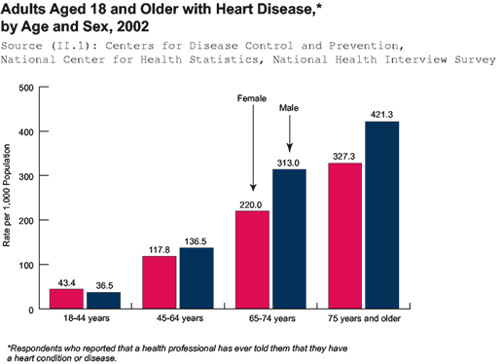
Age is Major Determinant of Disease & Outcomes
60% of all deaths attributable
to CVD occur in the 6%
of the population ≥ 75 years of age

Slide 4
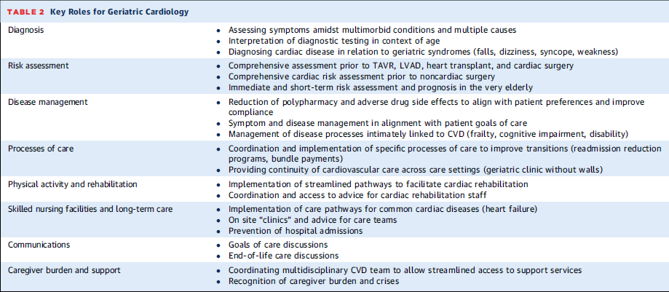
JACC. 2015;66(11):1286-99

Slide 5
Geriatric Factors that Affect Routine Cardiovascular Care
Multimorbidity
Frailty
Polypharmacy
Cognitive Impairment
Functional Status/Disability
Advanced and Current Care Planning
Transitional Care

Slide 6
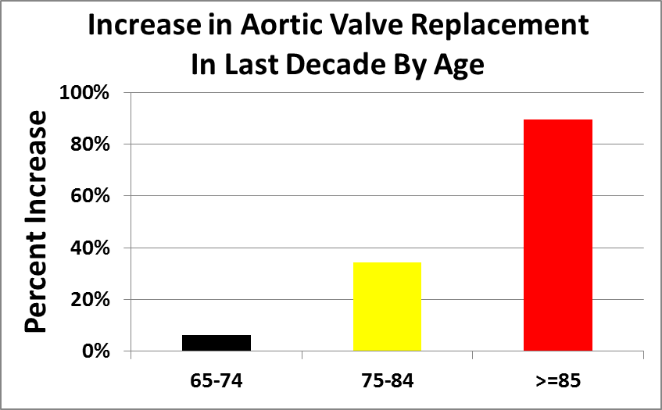
Changing Nature of Cardiac Interventions Increasing Need and Greater Success
JAMA. 2013;310(19):2078-2085

Slide 8
Unique Aspects of Cardiovascular Care for Older Adults
Traditional Cardiology | Geriatric Cardiology
Treatment focused on the heart | Treatment considers the host
Few comorbidities | Multiple comorbidities
Treatment yields expected outcomes | Treatment may result in complex effects
Large simple trials apply | Large simple trials have limited generalizability
Evidence-based medicine | Patient-centered evidence-based medicine
Cardiovascular reserve usually preserved | Cardiovascular reserve usually compromised
Outcomes: death, MI, revascularization | Outcomes: morbidity, function, independence, cognition
J Am Coll Cardiol. 2011;57(18):1801-10.

Slide 9
Geriatric Cardiology: A delicate balance
Commission
Omission
Notes:
Cardiovascular clinicians often embrace novel therapies (Acts of Commission) without clear evidence for benefit to older adults.
Geriatricians may not employ effective therapies (Acts of Omission) because of concerns about efficacy in older adults.

Slide 10
Essentials of Cardiac Care for Older Adults (ECCOA)
Modules
Online curriculum
www.acc.org/ECCOA
Available to all practitioners.
Each module takes ~30 minutes to complete
15 modules in total
Provides 17 CME/CNE (Nursing)/CPE (Pharmacists) credits & MOC credits!
Curriculum is FREE to all providers!
Cardiovascular Physiology in the Older Adult
Pharmacology for Older Adults
Care of Older Adults
Decision Making for Older Adults
Heart Failure in Older Adults
Chronic Coronary Disease in Older Adults
Acute Coronary Syndromes in Older Adults
Electrophysiology and Heart Rhythm Disorders in Older Adults
Syncope in Older Adults
Perioperative Care in Older Adults
Palliative Care in Older Adults
Prevention in Older Adults
Vascular Disease in Older Adults
Valvular Disease in Older Adults

Slide 11
ECCOA Learning Objectives
Describe the physiologic changes that accompany aging and how they impact the presentation and management of cardiovascular disease (CVD) in older adults.
Explain how age-associated changes in pharmacodynamics and pharmacokinetics often impact the dosing of cardiovascular drugs, and learn strategies to reduce adverse drug event and polypharmacy in seniors.
Recognize important geriatric syndromes and challenges commonly seen in cardiovascular patients, including atrial fibrillation, heart failure with normal systolic function, isolated systolic hypertension, falls, incontinence, polypharmacy, multimorbidity, delirium and dementia, and learn multidisciplinary management strategies.

Slide 12
ECCOA Learning Objectives
Analyze evidence-based care specific for older patients with the following cardiovascular problems: acute coronary syndromes, chronic coronary disease, hypertension, peripheral vascular disease, heart failure, syncope and arrhythmias and valvular disease.
Discuss the elements and appropriateness of patient-centered care, complicated decision making, palliative care and end-of-life care related to older patients.
Examine appropriate prevention strategies and how the role of exercise, diet and cardiac rehabilitation differ in older patients compared to younger patients.

Slide 13
ECCOA Curriculum
Designed for cardiovascular specialists and other clinicians who care for older patients with cardiovascular disease.
Teaches practitioners key features of aging that directly impact CVD to improve care and quality of life in this rapidly growing segment of the cardiovascular patient population.

