Slide 1

Heart Failure in the Older Adult
Geriatric Cardiology Section of the
American College of Cardiology

Slide 2
Learning Objectives
To describe the epidemiology of heart failure in the elderly
To describe how age-related changes in cardiovascular physiology predispose older adults to develop HF
To review the etiologies and pathophysiology of heart failure with reduced and preserved ejection fraction and the differences in their clinical presentation
To explain how co-morbid conditions complicate diagnosis and increase overall mortality and morbidity
To delineate current treatment strategies and their application to an elderly population
To utilize a multidisciplinary approach to reduce hospital admissions and improve quality of life
To apply a highly individualized approach when considering device and other advanced therapies
To discuss the role of end of life planning in management of the elderly patient with HF

Slide 3
Scope of the Problem
Heart failure (HF) is a major public health issue
Currently affects over 5.8 million people in the US
Lifetime risk of developing HF is one in five
Five-year mortality of patients with HF is similar to that of many cancers
Accounts for more than $39 billion in annual healthcare expenditures reflecting high rates of hospitalization, readmission, and outpatient visits

Slide 4
Burden of HF in the Elderly
Heart failure (HF), especially with preserved ejection fraction (HFpEF), disproportionately affects older individuals
Compared to younger counterparts, elderly HF patients are more likely to have multiple comorbid conditions, complicating both diagnosis and management
Older patients with HFpEF have similar, if not worse, outcomes such as recurrent hospitalization and mortality as those with HFrEF
However, unlike for those with systolic dysfunction, we do not have multiple treatment options with proven benefit for our patients with HFpEF

Slide 5
Epidemiology
Evidence from national databases and community-based cohorts, such as that based in Framingham County, indicates that incidence of HF may be stabilizing
However, prevalence increases sharply as population ages
Elderly are more likely to present with HFpEF and more than 50% of patients with HF now have diastolic rather than systolic dysfunction

Slide 6
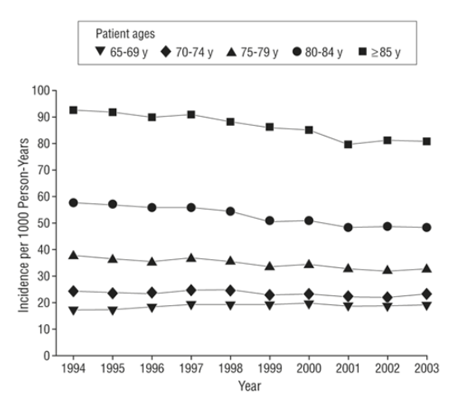
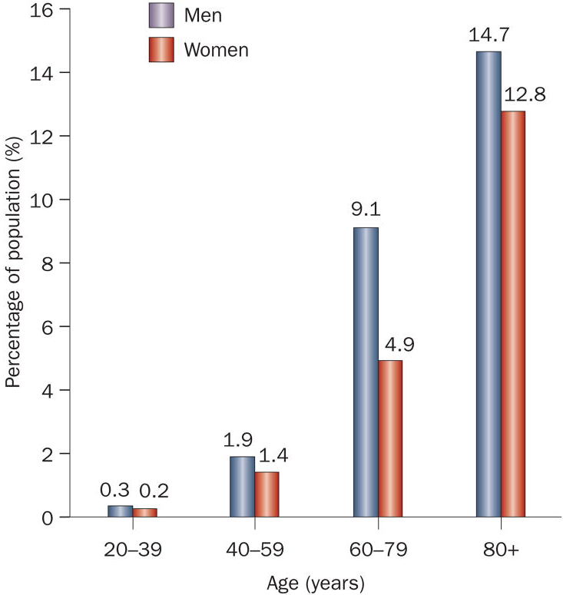
Epidemiology of HF in the Elderly
Incidence
Prevalence
Curtis LH, Whellan DJ, Hammill BG, et al. Incidence and prevalence of heart failure in elderly persons, 1994-2003. Arch Intern Med. 2008;168(4):418-24.
Bui AL, Horwich TB, Fonarow GC. Epidemiology and risk profile of heart failure. Nat Rev Cardiol. 2011;8(1):30-41.

Slide 7
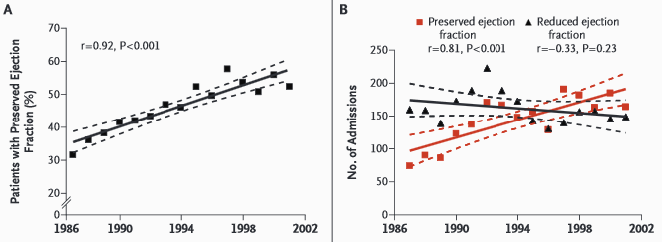
Increasing Prevalence of HFpEF
Admissions for HFpEF increased during the study period, whereas admissions for HFrEF did not change
Owan TE, Hodge DO, Herges RM, Jacobsen SJ, Roger VL, Redfield MM. Trends in prevalence and outcome of heart failure with preserved ejection fraction. N Engl J Med. 2006;355(3):251-9.

Slide 8
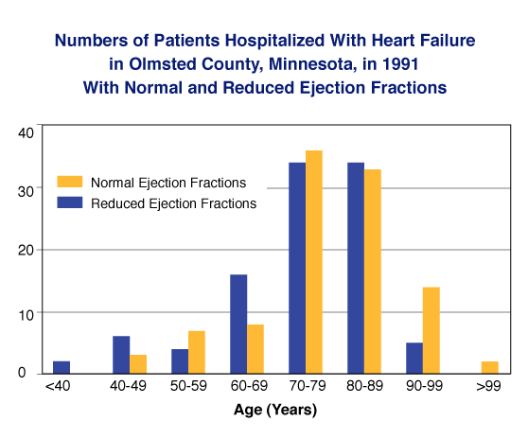
Hospitalization of Patients with HF

Slide 9
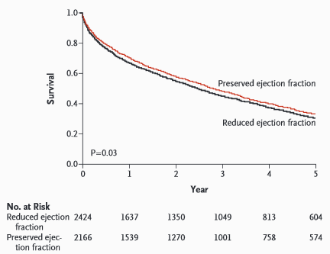
Survival of Patients with HF
Owan TE, Hodge DO, Herges RM, Jacobsen SJ, Roger VL, Redfield MM. Trends in prevalence and outcome of heart failure with preserved ejection fraction. N Engl J Med. 2006;355(3):251-9.

Slide 10
Changes in Cardiovascular Physiology with Age
Thickening of arterial walls and increased vascular stiffness → Widened pulse pressure
Endothelial dysfunction → vasoconstriction
Elevated systolic pressure → left ventricular hypertrophy
Reduced maximal heart rate → decreased cardiac reserve → lower aerobic exercise capacity
Prolonged cardiac action potential → impaired myocardial relaxation → reduced rate of early diastolic filling

Slide 11
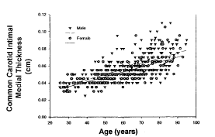
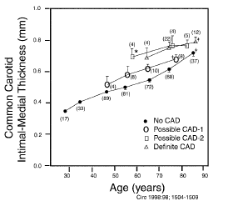
Arterial Stiffness
Circulation. 2003;107:139-146.

Slide 12
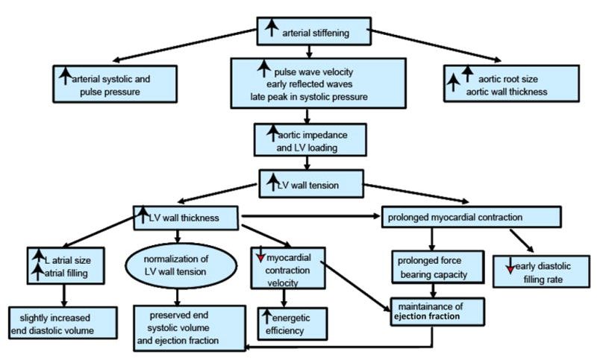
Age-related Changes in Vascular and Myocardial Physiology
Strait JB, Lakatta EG. Aging-associated cardiovascular changes and their relationship to heart failure. Heart Fail Clin. 2012;8(1):143-64.

Slide 13
Etiologies of HF: Particularly Relevant to Older Adults
Hypertension
Coronary artery disease
Myocardial infarction (MI)
Valvular disease
Toxins
Chemotherapy agents
Infiltrative diseases with cardiac involvement
TTR Amyloidosis

Slide 14
Diagnostic Challenges
Elderly are more likely to have co-morbid conditions that can mimic or mask signs and symptoms of HF
Higher prevalence of HFpEF, requiring thorough echocardiographic evaluation focus on diastolic function.
Decreased specificity of natriuretic peptides, whose levels increase with age, in women, and in those with renal dysfunction.

Slide 15
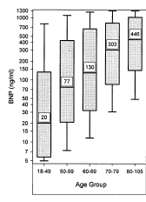
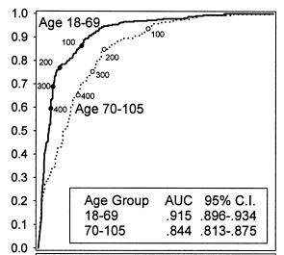
Decreased Specificity of BNP in the Older Adult with HF

Slide 16
Differential Diagnosis of Common HF Symptoms

Slide 17
Common Non-cardiac Chronic Disease Conditions in Elderly HF Patients
Hypertension (55%)
Diabetes mellitus (31%)
Chronic obstructive pulmonary disease (26%)
Ocular disorders i.e. glaucoma, macular degeneration (24%)
Osteoarthritis (16%)
Thyroid disorders (14%)
Alzheimer’s disease (9%)
Depression (8%)
Chronic renal failure (7%)
Notes:
Numbers in parentheses represent prevalence in 122,630 patients aged ≥65 Years with CHF (Curtis LH, Whellan DJ, Hammill BG, et al. Incidence and prevalence of heart failure in elderly persons, 1994-2003. Arch Intern Med. 2008;168(4):418-24.)

Slide 18
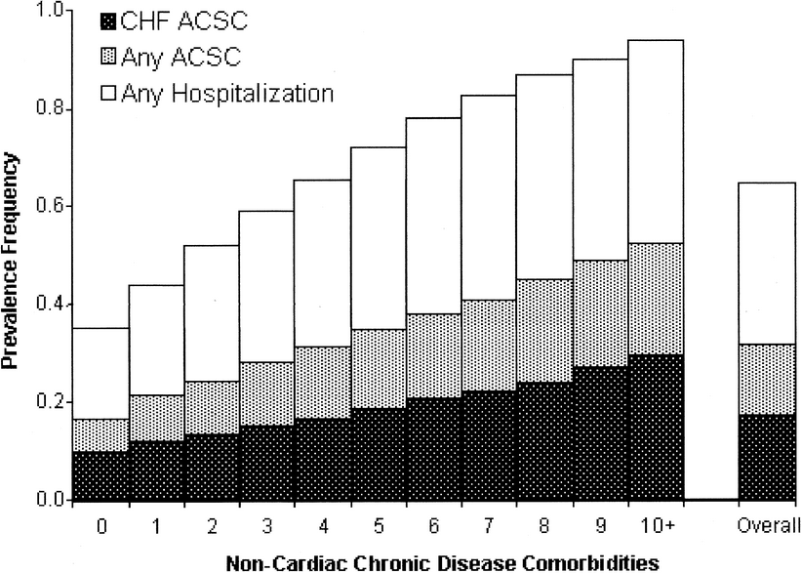
Impact of Non-cardiac Co-morbidities in Elderly HF Patients on Hospitalization Rates
Potentially preventable CHF hospitalization
Any potentially preventable hospitalization
Any hospitalization
Braunstein JB, Anderson GF, Gerstenblith G, et al. Noncardiac comorbidity increases preventable hospitalizations and mortality among Medicare beneficiaries with chronic heart failure. J Am Coll Cardiol. 2003;42(7):1226-33.

Slide 19
Comorbidites Confer Risk of Adverse Outcomes Independent of Age
Of 122,630 Medicare beneficiaries age ≥65 years with HF, nearly 40% had ≥5 non-cardiac co-morbidities
These patients accounted for 81% of total inpatient hospital days of all HF patients in this sample
Relative to overall Medicare population, those with HF had significantly higher risk of hospitalization
Braunstein JB, Anderson GF, Gerstenblith G, et al. Noncardiac comorbidity increases preventable hospitalizations and mortality among Medicare beneficiaries with chronic heart failure. J Am Coll Cardiol. 2003;42(7):1226-33.

Slide 20
Profile of Older Adult with HF
 | Older Adult | Middle-Aged Adult
Prevalence | 10-20% | <1%
Sex | Predominantly female | Predominantly male
Etiology | Hypertension | Coronary artery disease
Systolic function | Preserved (normal) | Reduced
Co-morbid conditions | Multiple | Few

Slide 21
HF as Syndrome Rather than Disease
 | Disease | Syndrome
Prevalence | Variable | High
Organ-focused | Often | Rarely
Mechanism(s) | Single | Multiple
Heterogeneity | No | Yes
Chief complaint | Represents specific pathologic condition | Disconnect between chief complaint and underlying pathology

Slide 22
Management of HFrEF in the Elderly
Do general treatment strategies of blocking adrenergic activity and the renin-angiotensin-aldosterone-system have a similarly favorable benefit to risk ratio for the elderly?
For the most part, YES and potentially greater benefit given higher absolute risk in older adults.
But, data largely derived from meta-analysis of subgroups.

Slide 23
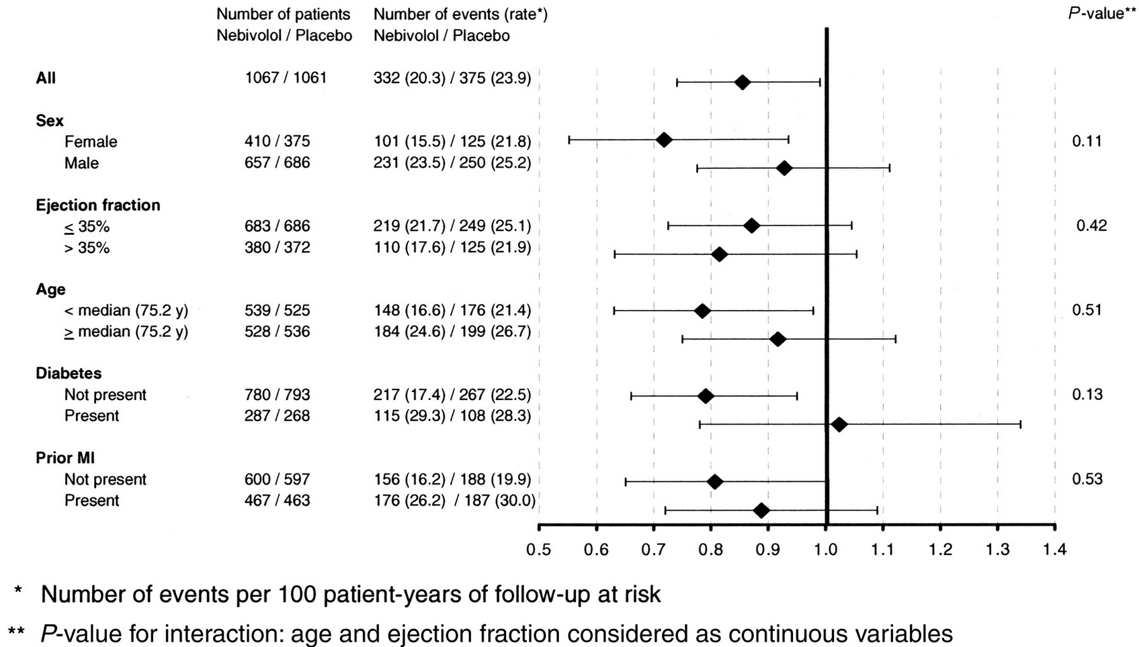
Management of HF with Reduced Ejection Fraction (HFrEF) – Beta Blockers
Nebivolol
Placebo
Flather MD, Shibata MC, Coats AJ, et al. Randomized trial to determine the effect of nebivolol on mortality and cardiovascular hospital admission in elderly patients with heart failure (SENIORS). Eur Heart J. 2005;26(3):215-25.
Notes:
The SENIORS study was performed to assess effects of the beta-blocker, nebivolol, in patients >/=70 years, regardless of ejection fraction. 2128 patients aged >/=70 years with a history of heart failure were randomized to nebivolol (titrated from 1.25 mg once daily to 10 mg once daily) and to placebo. The primary outcome was a composite of all cause mortality or cardiovascular hospital admission (time to first event). Mean age was 76 years (SD 4.7), 37% were female, mean ejection fraction was 36% (with 35% having ejection fraction >35%), and 68% had a prior history of coronary heart disease. The mean maintenance dose of nebivolol was 7.7 mg. The primary outcome occurred in 332 patients (31.1%) on nebivolol compared with 375 (35.3%) on placebo [hazard ratio (HR) 0.86, 95% CI 0.74-0.99; P=0.039]. There was no significant influence of age, gender, or ejection fraction on the effect of nebivolol on the primary outcome. Death (all causes) occurred in 169 (15.8%) on nebivolol and 192 (18.1%) on placebo (HR 0.88, 95% CI 0.71-1.08; P=0.21).

Slide 24
Mortality Benefit of Beta Blockers for Patients with HFrEF Stratified by Age
Trial | Beta Blocker | Total | # of Elderly Subjects | Definition of Elderly | RR Overall (95% CI) | RR for Elderly (95% CI)
BEST | Bucindolol | 2708 | 1095 | > 65 years | 0.91 (0.78-1.07) | 0.91 (0.78-1.05)
US Carvedilol | Carvedilol | 1094 | 554 | > 59 years | 0.45 (0.24-0.86) | 0.35 (0.14-0.88)
CIBIS-II | Bisoprolol | 2647 | 539 | > 71 years | 0.70 (0.49-0.99) | 0.66 (0.53-0.82)
COPERNICUS | Carvedilol | 2289 | 1102 | > 65 years | 0.75 (0.58-0.98) | 0.57 (0.41-0.80)
MERIT-HF | Metoprolol | 3991 | 1330 | Upper tertile vs. others | 0.70 (0.52-0.95) | 0.61 (0.47-0.80)
SENIORS | Nebivolol | 2128 | 1064 | > 75 years | 0.92 (0.75-1.12) | 0.79 (0.63-0.98)
*Hazard ratio composite of all cause mortality or cardiovascular hospital admission

Slide 25
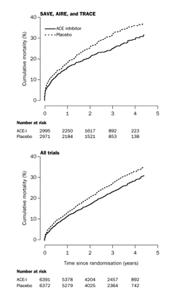
Management of HFrEF – Angiotensin-Converting Enzyme Inhibitors
Meta-analysis of 5 large randomized trials of ACE inhibitors show lower rates of mortality, myocardial infarction, and hospital admission for HFrEF
Mean age of enrolled patients was 61 years
Flather MD, Yusuf S, Køber L, et al. Long-term ACE-inhibitor therapy in patients with heart failure or left-ventricular dysfunction: a systematic overview of data from individual patients. ACE-Inhibitor Myocardial Infarction Collaborative Group. Lancet. 2000;355(9215):1575-81.

Slide 26
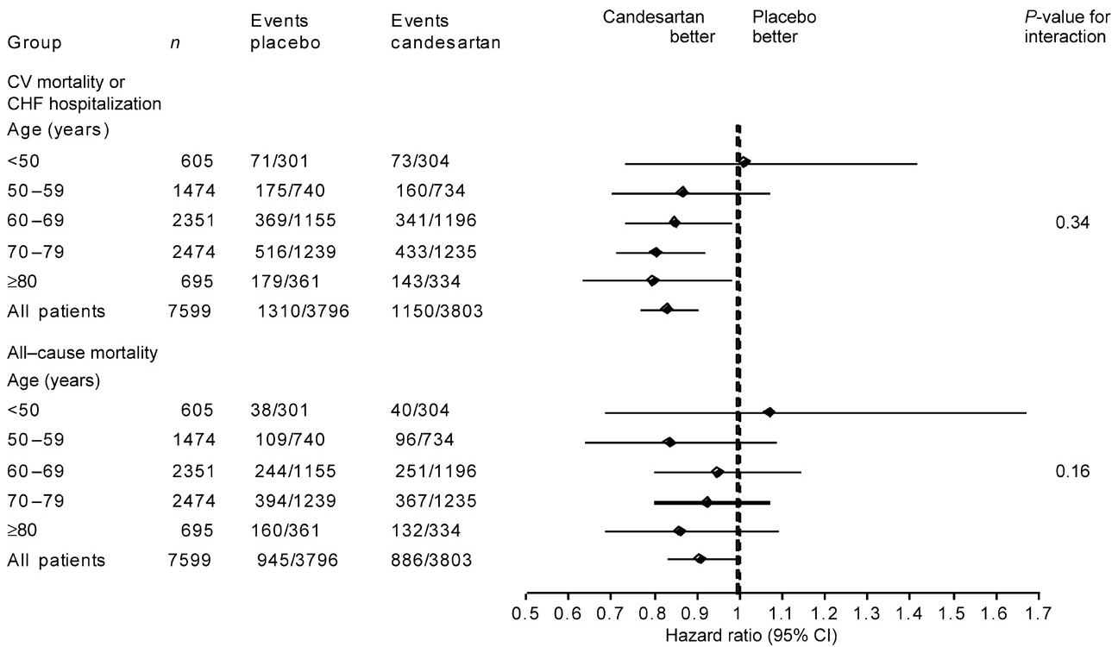
Management of HFrEF – Angiotensin Receptor Blockers
Cohen-solal A, Mcmurray JJ, Swedberg K, et al. Benefits and safety of candesartan treatment in heart failure are independent of age: insights from the Candesartan in Heart failure--Assessment of Reduction in Mortality and morbidity programme. Eur Heart J. 2008;29(24):3022-8.
Notes:
Older patients were at a greater absolute risk of adverse CV mortality and morbidity outcomes but derived a similar relative risk reduction and, therefore, a greater absolute benefit from treatment with candesartan, despite receiving a somewhat lower mean daily dose of candesartan. Adverse effects were more common with candesartan than with placebo, although the relative risk of adverse effects was similar across age groups. The benefit to risk ratio for candesartan was thus favourable across all age groups.

Slide 27
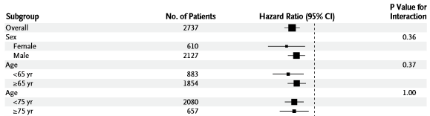
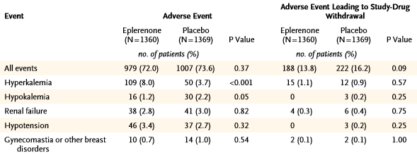
Management of HFrEF – Aldosterone Antagonists
Zannad F, Mcmurray JJ, Krum H, et al. Eplerenone in patients with systolic heart failure and mild symptoms. N Engl J Med. 2011;364(1):11-21.
Notes:
In the EMPHASIS-HF trial, the use of eplerenone reduced the risk of death from a cardiovascular cause or hospitalization for heart failure and these results were not statistically different between the subgroups of patients of older age (24% of the population studied) or less than 75 years. However, in older patients, higher prevalence of renal insufficiency increases the risk of hyperkalemia, as well as of worsening of renal function when spironolactone and eplerenone are administered. As a consequence, serum creatinine and potassium levels should be even more closely monitored in older patients. Finally, gynecomastia is more common in these patients due to concomitant age-related decline in testosterone levels.

Slide 28
Management of HFrEF – Digoxin
Elderly are less responsive to the therapeutic effects of digoxin and experience higher toxic effects due to lower muscle mass
Daily dose in the elderly should not exceed 0.125 mg and the plasma concentration should not exceed 1 ng/mL

Slide 29
Recent Advances in Medical Management of HFrEF – Neprilysin inhibitor
Enalapril
(n=4212)
1117
32
914
Kaplan-Meier Estimate of
Cumulative Rates (%)
24
LCZ696
(n=4187)
16
HR = 0.80 (0.73-0.87)
P = 0.0000002
Number needed to treat = 21
8
0
0
180
360
540
720
900
1080
1260
Patients at Risk
Days After Randomization
LCZ696
Enalapril
4187
4212
3922
3883
3663
3579
3018
2922
2257
2123
1544
1488
896
853
249
236
Mcmurray JJ, Packer M, Desai AS, et al. Angiotensin-neprilysin inhibition versus enalapril in heart failure. N Engl J Med. 2014;371(11):993-1004.

Slide 30
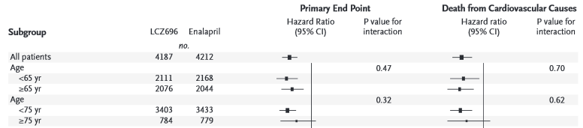
Recent Advances in Medical Management of HFrEF – Neprilysin inhibitor
LCZ696 – sacubitril (neprilysin inhibitor increases levels of endogenous vasoactive peptides e.g., natriureptic peptides) + valsartan
When compared to enalapril, LCZ696 led to superior reductions in mortality and hospitalizations for HF
Benefit may be attenuated for those 75 years of age or older
Mcmurray JJ, Packer M, Desai AS, et al. Angiotensin-neprilysin inhibition versus enalapril in heart failure. N Engl J Med. 2014;371(11):993-1004.

Slide 31
Guidelines for Pharmacologic Management of Older Patients with HFrEF
Determine and address underlying etiology and contributing risk factors
Introduce medications at low doses, titrate slowly and monitor frequently for adverse effects
Blockade of adrenergic and RAAS system generally confer similar improvements of morbidity and mortality on older patients compared to younger counterparts

Slide 32
Defining HFpEF
Clinical signs and/or symptoms of HF
Normal or mild reduction of systolic function with LVEF >50% and normal size of LV (LV end-diastolic volume index <97 mL/m²)
Presence of LV diastolic dysfunction, demonstrated by Doppler echocardiography, cardiac catheterization, or blood natriuretic peptide measurements

Slide 33
Controversial Role of Diastolic Dysfunction
Ongoing controversy regarding pathophysiologic role of abnormal diastolic function in clinical syndrome of HFpEF
Many elderly patients with longstanding hypertension may have reduced LV diastolic function without clinical HF
Furthermore, some echocardiographic markers of diastolic dysfunction are not universally present in patients with hemodynamically-proven HFpEF

Slide 34
Pathophysiology of HFpEF
Age-related physiologic changes with concomitant hypertension, diabetes and coronary artery disease result in concentric hypertrophy, decreased left ventricular chamber size, decreased diastolic compliance and impaired active relaxation
Filling of the LV to a normal or less than normal end diastolic volume occurs only at increased filling pressures
Hallmark manifestation is dyspnea on exertion or decreased exercise tolerance due to stress-induced increases in already elevated LV end diastolic pressure

Slide 35
Contributors to Clinical HFpEF Syndrome
Hypertension
Atrial Fibrillation
Arterial
Stiffening
Salt
Sensitivity
Sarcopenia
HFpEF
Chronotropic
Incompetence
Endothelial Dysfunction
Volume Overload
Diastolic Dysfunction
Anemia

Slide 36
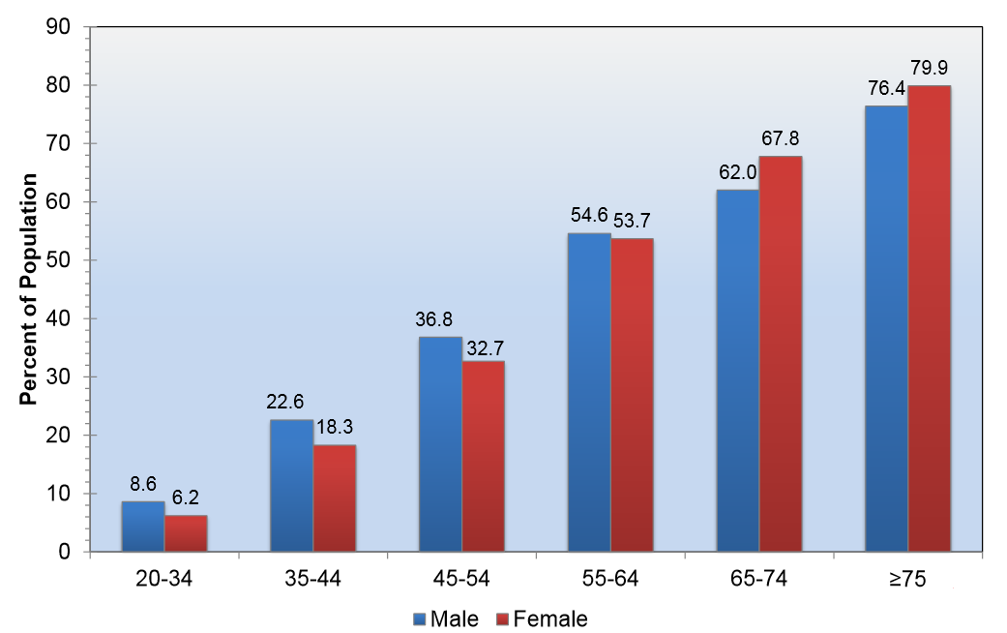
Increasing Prevalence of Hypertension with Age
Mozaffarian D et al. Published online in Circulation Dec. 16, 2015

Slide 37
Hypertension is Key Risk Factor for HFpEF
Due to extremely high prevalence in older adults, hypertension (HTN) contributes more to the population burden of HF than MI
75% of patients who developed HF in Framingham cohort had antecedent HTN
Men with HTN had twofold increase in risk
Women with HTN had threefold increase in risk
Other cohort studies have shown that HTN confers higher risk of HF on women than on men
More severe elevations in blood pressure → greater risk of developing HF

Slide 38
Blood Pressure Control is Key!
Effect of Anti-hypertensive Therapy on Incident Heart Failure
Trial | N | Years | Relative Risk Reduction (%)
European Working Party | 840 | >60 | 22%
Coope and Warrender | 884 | 60-79 | 32%
Swedish Trial | 1627 | 70-84 | 51%
SHEP | 4736 | >60 | 55%
Syst-Eur | 4695 | >60 | 36%
STONE | 1632 | 60-79 | 68%
HYVET | 3845 | >80 | 64%
SPRINT | 9361 | >50 | 62%

Slide 39


Treatment of HTN Reduces HF Incidence
Meta-analysis of 613,815 participants of large studies of effects of lowering blood pressure
For every 10 mm Hg reduction in systolic blood pressure, there was significant reduction in risk of heart failure (relative risk 0.72, 95% confidence interval 0.67–0.78)
13% reduction in all-cause mortality (0.87, 0.84–0.91)
Ettehad D, Emdin CA, Kiran A, et al. Blood pressure lowering for prevention of cardiovascular disease and death: a systematic review and meta-analysis. Lancet. 2015.

Slide 40
Management of HFpEF
Over the last two decades, despite significant reduction in death from HFrEF due to advances in pharmacotherapy, mortality rate for patients with HFpEF has remained unchanged
No large randomized controlled trials of pharmacotherapy for HFpEF have demonstrated survival benefit

Slide 41
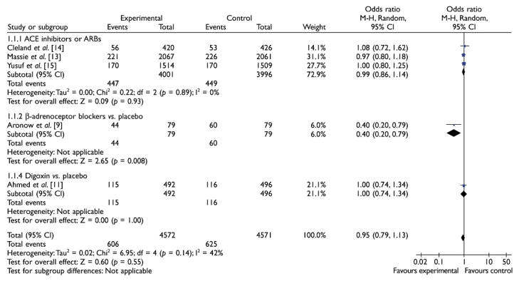
Effects of Pharmacotherapy for HFpEF on Mortality
Rajagopalan S, Arora A, Shafiq N, et al. Pharmacotherapy of heart failure with normal ejection fraction (HFNEF)--a systematic review. Br J Clin Pharmacol. 2011;72(3):369-80.

Slide 42
Management of HFpEF – Diuretics
ALLHAT sub-study of patients treated with chlorthalidone
Decreased hospitalization rates compared to those treated with amlodipine or doxazosin
Decreased incidence of new HFpEF compared to those treated with lisinopril
Hong Kong Diastolic Heart Failure Study evaluated effect of diuretics (furosemide or thiazide) alone or in combination with ramipril or irbesartan in 150 patients with LVEF > 45%
Diuretic use alone associated with improvement of symptoms and quality of life
No survival benefit or reduction in HF hospitalization
Given lack of mortality benefit, diuretics should only be used for relief of symptoms due to sodium and water retention

Slide 43
Management of HFpEF – Nitrates
Since HTN (increased afterload) so detrimental, it was long thought that vasodilators improved diastolic filling and exercise capacity in patients with HFpEF
Recent multicenter, double-blind, crossover study of 110 HFpEF patients assigned to isosorbide mononitrate or placebo
Novel study design as primary end point was daily activity level as quantified by patient-worn accelerometers
Highlights shifting focus in HFpEF to targeting functional capacity and quality of life rather than survival
Treatment group was less active and did not have better quality of life

Slide 44
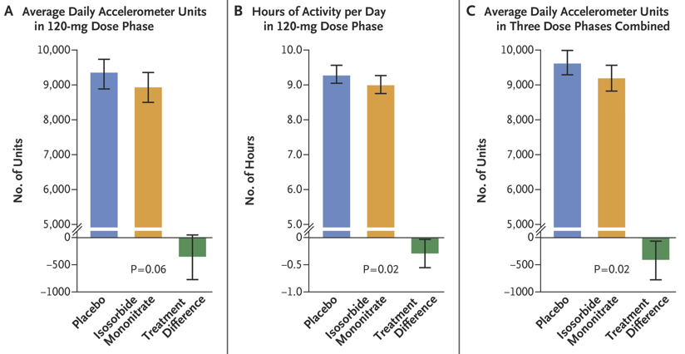
Activity Levels in Patients with HFpEF Receiving Nitrates
Redfield MM, Anstrom KJ, Levine JA, et al. Isosorbide Mononitrate in Heart Failure with Preserved Ejection Fraction. N Engl J Med. 2015;373(24):2314-2324

Slide 45
Management of HFpEF – Beta Blockers
Large meta-analysis of 12 clinical studies (2 randomized controlled trials and 10 observational studies) involving 21,206 HFpEF patients
Beta blockers associated with 9% reduction in relative risk for all-cause mortality (95% CI: 0.87 – 0.95; P < 0.001)
Mortality benefit will remain uncertain until there is a randomized controlled trial of beta blockers vs placebo in HFpEF patients

Slide 46
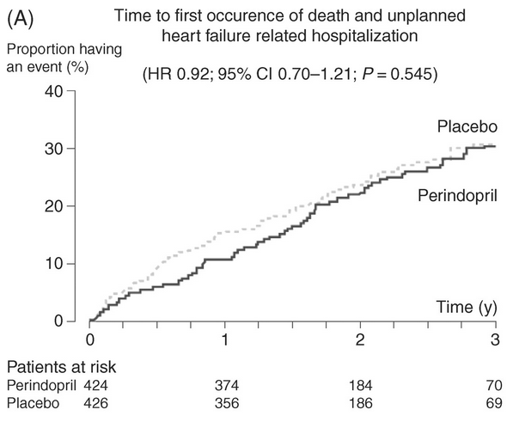
Management of HFpEF – Angiotensin-converting Enzyme Inhibitors
Perindopril for Elderly People With Chronic Heart Failure (PEP-CHF) trial compared the effects of perindopril with placebo in a group of HFPEF patients aged > 70 years
No reduction in mortality
Decreased heart failure hospitalizations
Cleland JG, Tendera M, Adamus J, et al. The perindopril in elderly people with chronic heart failure (PEP-CHF) study. Eur Heart J. 2006;27(19):2338-45.

Slide 47
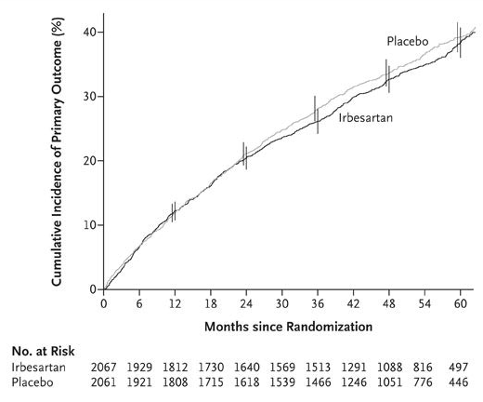
Management of HFpEF – Angiotensin Receptor Blockers
Irbesartan therapy in HF patients with LVEF >45% did not reduce mortality or cardiovascular hospitalizations
Study population representative of many HFpEF patients
Predominantly elderly females
History of hypertension
Low prevalence of prior myocardial infarction and eccentric LV remodeling
Lam CS, Carson PE, Anand IS, et al. Sex differences in clinical characteristics and outcomes in elderly patients with heart failure and preserved ejection fraction: the Irbesartan in Heart Failure with Preserved Ejection Fraction (I-PRESERVE) trial. Circ Heart Fail. 2012;5(5):571-8.

Slide 48
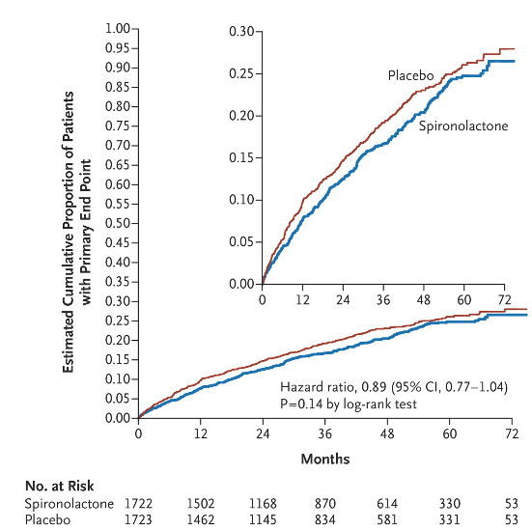
Management of HFpEF – Aldosterone Antagonists
Treatment of Preserved Cardiac Function Heart Failure with an Aldosterone Antagonist (TOPCAT) trial randomized 3445 patients with symptomatic HF with LVEF ≥45% to either spironolactone (15 to 45 mg daily) or placebo
27.5% of patients were age ≥75
Significantly lower rate of HF hospitalization with spironolactone (206 patients [12.0%] vs. 245 patients [14.2%]; hazard ratio, 0.83; 95% CI, 0.69 to 0.99, P=0.04)
No difference in mortality
Pitt B, Pfeffer MA, Assmann SF, et al. Spironolactone for heart failure with preserved ejection fraction. N Engl J Med. 2014;370(15):1383-92.

Slide 49
Management of HFpEF – Digoxin
Only recommended for control of ventricular rate in HFpEF patients with rapid atrial fibrillation

Slide 50
Guidelines for Pharmacologic Management of Patients with HFpEF
RCTs have not shown any treatment to have clear mortality benefit
Pharmacotherapy should be aimed at alleviating symptoms
Diagnose and address co-morbidities
Improvements of functional capacity and quality of life may be more important than impact on mortality as these patients tend to be older and frail

Slide 51
Exercise Training
Clear benefit for patients with HFrEF
Many, albeit small, studies demonstrate benefit in HFpEF
Exercise training in Diastolic Heart Failure (Ex-DHF) study showed improved exercise capacity and quality of life in patients with mild HFpEF randomized to supervised endurance/resistance training in addition to usual care
Associated with atrial reverse remodeling and improved left ventricular diastolic function
Kitzman et al randomized HFpEF patients with mean age 70 to 16 weeks of endurance training
Improved peak Vo2

Slide 52
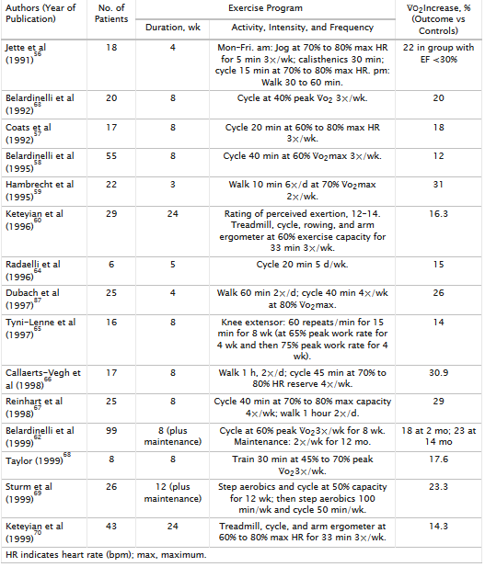
Controlled Trials of Exercise Training Demonstrating Improved Peak V̇o₂ in HF
Piña IL, Apstein CS, Balady GJ, et al. Exercise and heart failure: A statement from the American Heart Association Committee on exercise, rehabilitation, and prevention. Circulation. 2003;107(8):1210-25.

Slide 53
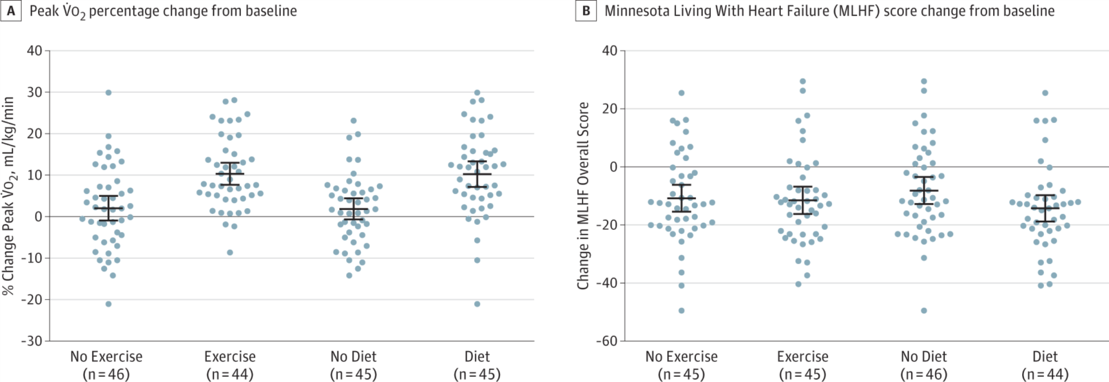
Impact of Exercise Training and Decreased Caloric Intake on Exercise Capacity
Among obese older patients with HFpEF, both caloric restriction and aerobic exercise training increased peak V̇o₂
Effects may be additive
Kitzman DW, Brubaker P, Morgan T, et al. Effect of Caloric Restriction or Aerobic Exercise Training on Peak Oxygen Consumption and Quality of Life in Obese Older Patients With Heart Failure With Preserved Ejection Fraction: A Randomized Clinical Trial. JAMA. 2016;315(1):36-46.

Slide 54
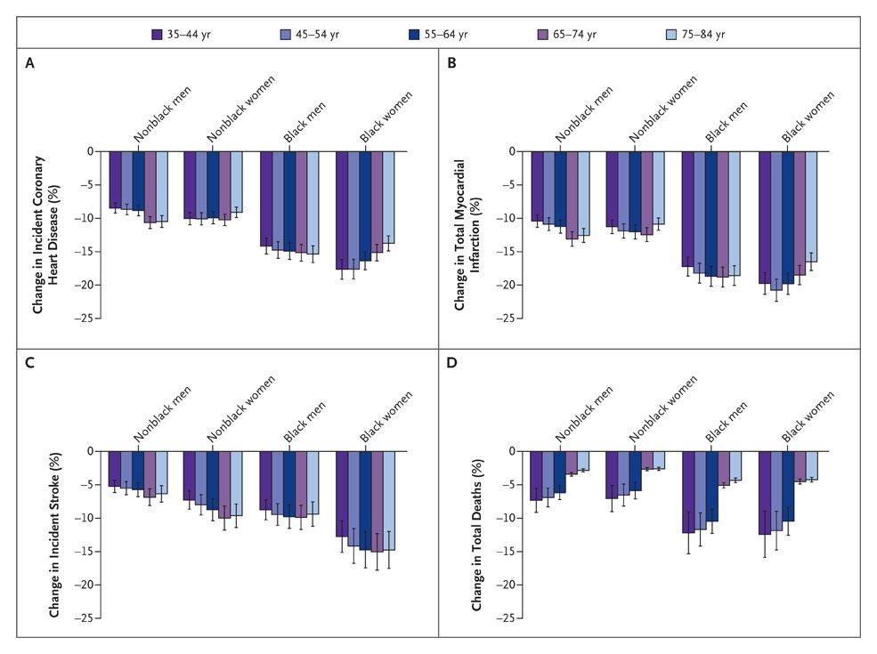
Projected Outcomes of Modest Dietary Sodium Restriction
Bibbins-domingo K, Chertow GM, Coxson PG, et al. Projected effect of dietary salt reductions on future cardiovascular disease. N Engl J Med. 2010;362(7):590-9.

Slide 55
Heart Failure Patient Education and Training in Self-Efficacy
Patients with HF and their family members and caregivers require individualized education and counseling that emphasizes self care
Utilize a multidisciplinary, team-based approach
Teaching should emphasize target behaviors (i.e., recording daily weights, notifying providers at onset of change in symptoms)
Consider referring high-risk patients to a chronic disease management program
High risk patients include those with persistent NYHA class III or IV symptoms, history of recurrent hospitalizations, multiple comorbidities including diabetes and COPD, cognitive impairment, or persistent non-adherence to therapeutic regimens

Slide 56
Device Therapy
Implantable cardiac defibrillators (ICDs) and cardiac resynchronization therapy (CRT) have been shown in randomized controlled trials to improve symptoms and prolong life
However, few trials included older adults >75 years of age
ICDs are not indicated in patients with class I or IV HF, or in patients with life expectancy <12 months

Slide 57
Device Therapy – ICD
HF patients ≥75 years have been under-represented or excluded in ICD intervention trials
Subgroup analyses have demonstrated similar benefit for elderly and younger patients using age cut-offs of 60, 65, or 70 years
Decisions must be individualized
Consider life expectancy (should be at least 1 year) and impact of shocks (appropriate and inappropriate) on quality of life and patient preferences through a process of shared decision making

Slide 58
Device Therapy - CRT
Indicated for those with symptomatic HFrEF despite optimal medical therapy with a prolonged QRS duration due to a left bundle branch block
Subgroup analysis of the MAD-IT study found that CRT-D significantly reduced the composite endpoint of death or HF in participants aged 75 years and older
Study of 65 patients with advanced HF undergoing CRT implantation showed similar results in LVEF improvement, quality of life and NYHA symptoms in those >75 years of age

Slide 59
Role of Left Ventricular Assist Devices (LVADs) in Management of Elderly HF Patients
Implantation of LVADs as destination therapy in patients with end-stage HF studied in Randomized Evaluation of Mechanical Assistance in the Treatment of Congestive Heart Failure (REMATCH) trial
At one year, patients supported with LVADs had significantly improved survival compared to those receiving maximal medical therapy alone (25% vs 52%)
Included very few patients older than 75
Second-generation continuous flow LVADs (Heartmate II) demonstrated significant improvement in survival at 2 years, free from disabling stroke and reoperation for device repair or replacement compared to older, pulsatile devices
Food and Drug Administration approved continuous-flow LVADs in 2010 for destination therapy
Optimal patient selection for LVAD therapy remains an active area of investigation
According to 2013 ACC/AHA guidelines, indications for referral include patients with LVEF <25% and NYHA class III-IV functional status despite maximal medical therapy and either high predicted 1- to 2-year mortality or dependence on continuous parenteral inotropic support

Slide 60
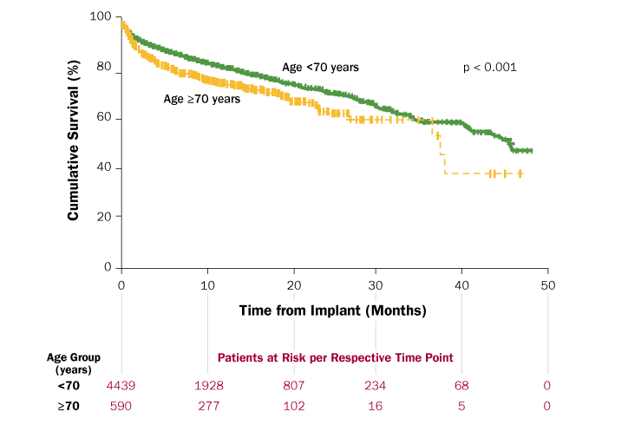
Survival of Elderly Patients Less than or Greater than 70 Years of Age with LVADs
Atluri P, Goldstone AB, Kobrin DM, Cohen JE, MacArthur JW, Howard JL, et al. Ventricular Assist Device Implant in the Elderly Is Associated With Increased, but Respectable Risk: A Multi-Institutional Study. Ann Thorac Surg. 2013;96(1):141-7.

Slide 61
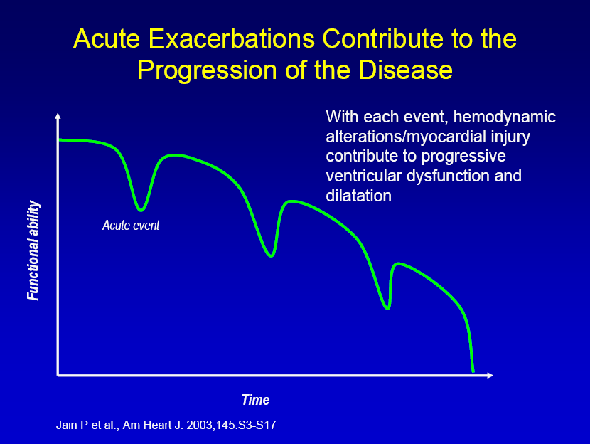
Palliative Care
End of life planning is often inadequately addressed
Pain, dyspnea, and anxiety often untreated
Patients should be encouraged to develop an advanced care directive and assign a healthcare proxy
Preferences for care at the end of life should be discussed periodically and whenever there has been a significant change in clinical status
Deactivation of an ICD
Code status

Slide 62
Summary
HF is predominantly a disorder affecting the elderly
Elderly HF patients are more likely to be women, have antecedent hypertension, lower burden of coronary disease, and multiple co-morbid conditions
Age-related changes in cardiovascular physiology, coupled with changes in other organ systems, predispose older patients to development of HF and increase symptom severity, worsen prognosis, and complicate management
Treatment of hypertension reduces incidence of HF by about 50% in older adults and is therefore a highly effective strategy for prevention of heart failure in this population
More than 50% of older adults with HF have a normal ejection fraction and when compared to patients with HFrEF, they experience similarly high mortality and rates of recurrent hospitalization

Slide 63
Summary
While management of HFrEF is generally similar in older patients compared to their younger counterparts, there are limited data regarding the most challenging subsets of patients, such as those aged >80 years, those with multiple co-morbidities, and residents of long-term care facilities
There have been few trials of pharmacotherapy for HFpEF, and none have shown reductions in mortality
Dietary indiscretion, especially excess sodium and fluid intake, is a major preventable cause of heart failure exacerbations and can be targeted through multidisciplinary management and training in self-care
There is limited data regarding benefit of ICDs and biventricular pacemakers in very elderly HF patients older than 80 years, and the decision-making process regarding device therapy requires attention to psychosocial and ethical issues
Preferences for care at the end of life should be routinely discussed

Slide 64
Key References
Iacoviello M, Antoncecchi V. Heart failure in elderly: progress in clinical evaluation and therapeutic approach. J Geriatr Cardiol. 2013;10(2):165-77.
Strait JB, Lakatta EG. Aging-associated cardiovascular changes and their relationship to heart failure. Heart Fail Clin. 2012;8(1):143-64.
Udelson JE. Heart failure with preserved ejection fraction. Circulation. 2011;124(21):e540-3.
Rajagopalan S, Arora A, Shafiq N, et al. Pharmacotherapy of heart failure with normal ejection fraction (HFNEF)--a systematic review. Br J Clin Pharmacol. 2011;72(3):369-80.
Mcmurray JJ. Clinical practice. Systolic heart failure. N Engl J Med. 2010;362(3):228-38.
Braunstein JB, Anderson GF, Gerstenblith G, et al. Noncardiac comorbidity increases preventable hospitalizations and mortality among Medicare beneficiaries with chronic heart failure. J Am Coll Cardiol. 2003;42(7):1226-33.

Slide 65
References – Major Recent Clinical Trials
Redfield MM, Anstrom KJ, Levine JA, et al. Isosorbide Mononitrate in Heart Failure with Preserved Ejection Fraction. N Engl J Med. 2015;373(24):2314-2324.
Mcmurray JJ, Packer M, Desai AS, et al. Angiotensin-neprilysin inhibition versus enalapril in heart failure. N Engl J Med. 2014;371(11):993-1004.
Pitt B, Pfeffer MA, Assmann SF, et al. Spironolactone for heart failure with preserved ejection fraction. N Engl J Med. 2014;370(15):1383-92.

Slide 66


