Slide 1
Hypertension & Stroke in Older Adults
Geriatric Cardiology Section of the
American College of Cardiology

Slide 2
Learning Objectives
To recognize the increased incidence, prevalence and risk of hypertension and cerebrovascular disease in older adults
To identify the relationship between age-related alterations in structure and function of the vascular system and hypertension and cerebrovascular disease.
To critically appraise the evidence that governs diagnosis and management of hypertension and cerebrovascular disease in older adults

Slide 3
Relevance
The incidence and prevalence of hypertension (HTN) and cerebrovascular disease (CVD) increase sharply with advancing age
A combination of longer exposure to cardiovascular risk factors, as well as age-specific alterations in vascular structure and function contributes to the development and progression of hypertension and stroke in this population

Slide 4
Case
A healthy, asymptomatic 84-year-old woman presents for evaluation of her blood pressure (BP).
At a community health fair, a BP reading of 178/68 mm Hg was recorded. At home, using an automatic cuff, her systolic values range from 132 to 145 mm Hg.
Medications: multivitamin, calcium and
Exam: Supine systolic BP of 178 mm Hg. The manual supine BP result is 176/64 mm Hg; there is an auscultatory gap between approximately 160 and 140 mm Hg. Her manual upright BP after two minutes of standing is 168/60 mm Hg with a heart rate of 80 bpm. Laterally displaced point of maximal impulse and an apical S4, with symmetric +1 pitting edema to her mid shins.
ECG: NSR with LVH.
Laboratory values show normal CBC, electrolytes and thyroid function, with a creatinine of 1.2, with a calculated clearance of 43 ml/min.

Slide 5
Epidemiology of Hypertension (HTN) in Older Adults
The development of HTN, particularly isolated systolic HTN, appears as a consequence of age-associated changes in vascular structure and function (increased arterioventricular stiffness, attenuated autonomic reflexes and impairment of adequate salt and volume regulation)
Incidence and prevalence of HTN increase parallel to age; the prevalence of HTN in octogenarians is around 80%
The lifetime risk of a 55-year old male to develop hypertension exceeds 90%
Cardiovascular events, particularly stroke, increase as a function of elevations in systolic blood pressure and pulse pressure

Slide 6
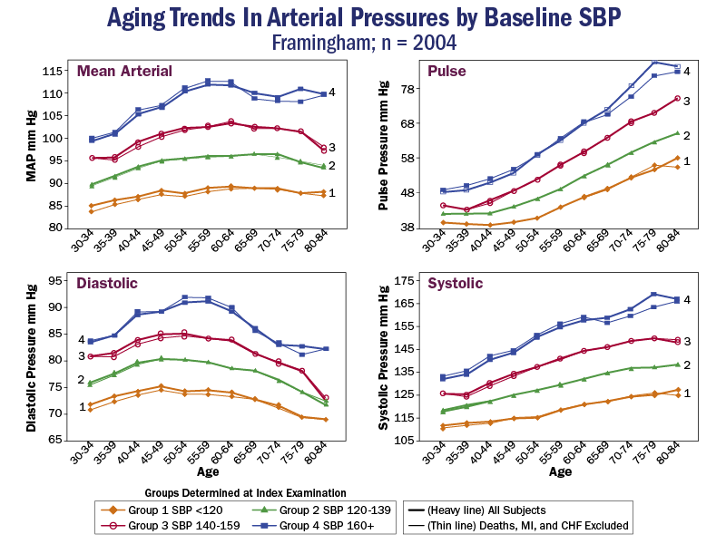
The Framingham Heart Study. Circulation 1997;96:308-15.
CHF = congestive heart failure; MI = myocardial infarction; SBP = systolic blood pressure.
Reproduced with permission from Franklin SS, Gustin W 4th, Wong ND, et al. Hemodynamic patterns of age-related changes in blood pressure.
Notes:
From this large epidemiologic study, we can conclude that in older adults, systolic blood pressure and pulse pressure increase with advancing age; importantly, diastolic blood pressure decreases with increasing age, mostly as a consequence of decreased central arterial compliance.

Slide 7
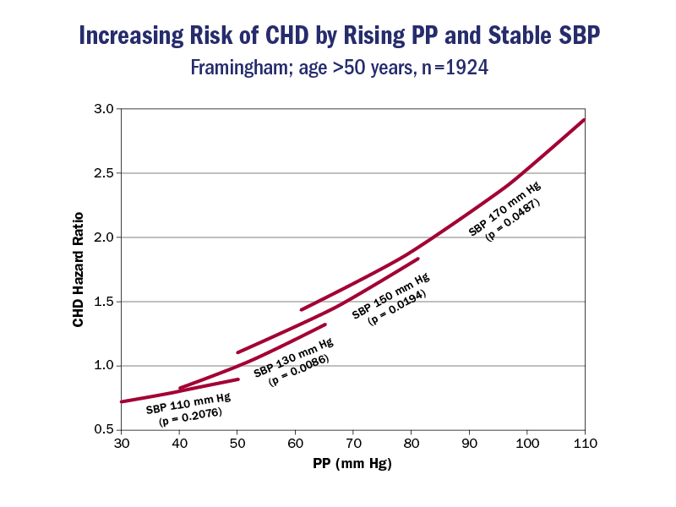
Reproduced with permission from Franklin SS, Khan SA, Wong ND, et al. Is pulse pressure useful in predicting risk for coronary heart disease? The Framingham heart study. Circulation 1999;100:354-60.
Notes:
Epidemiological studies support that in older adults, SBP and PP carry a greater risk than DBP for coronary artery disease (CAD), AF, CHF, kidney disease, dementia and total mortality, likely owing to the damaging nature of the increased pulsatility of the wavefronts; for every 10 mm Hg rise in PP, risk of a coronary heart disease (CHD) event rises by 27% and stroke by 32%.

Slide 8
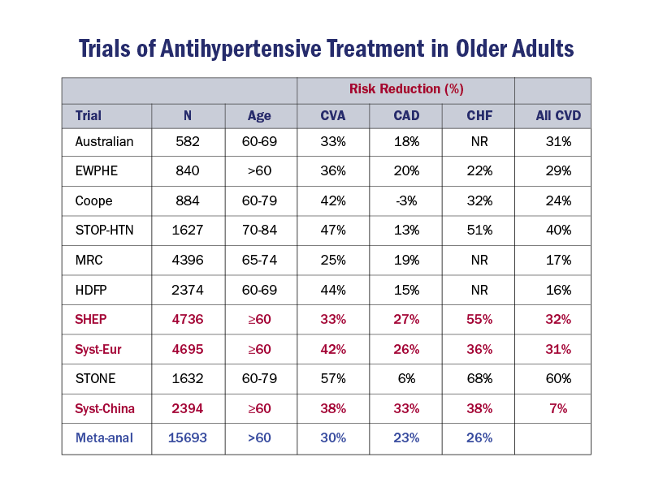
Staessen J, Gasowski J, Wang J, et al. Risks of untreated and treated isolated systolic hypertension in the elderly: meta-analysis of outcome trials. Lancet 2000;355:865-72.
Notes:
Multiple, randomized clinical trials have demonstrated a reduction in cardiovascular events, including coronary artery disease, stroke and heart failure by lowering blood pressure.

Slide 9
Diagnosis of HTN in Older Adults
The diagnosis of hypertension should not be made based on an isolated reading.
Due to attenuated baroreflexes and increased arterial stiffness, blood pressure variability is more common in older adults
Ambulatory blood pressure monitoring can be helpful to achieve a diagnosis, particularly in patients with conflicting ambulatory readings.
End-organ alterations should be sought on physical examination and workup: hypertensive retinopathy, left ventricular hypertrophy, and hypertensive nephropathy.

Slide 10
Blood pressure (BP) measuring tips in Older Adults
Repeat measurements several times and on several occasions while palpating the pulse.
Perform manual BP measurements, inflating cuff >200 mm Hg and listening for an auscultatory gap; automated cuffs may not inflate to a pressure high enough to detect the true systolic value; after an auscultatory gap, the machine may incorrectly interpret the next wave as the systolic pressure
Measure orthostatic BP; orthostatic hypotension is more common in the elderly
Validate and calibrate home machines.

Slide 11
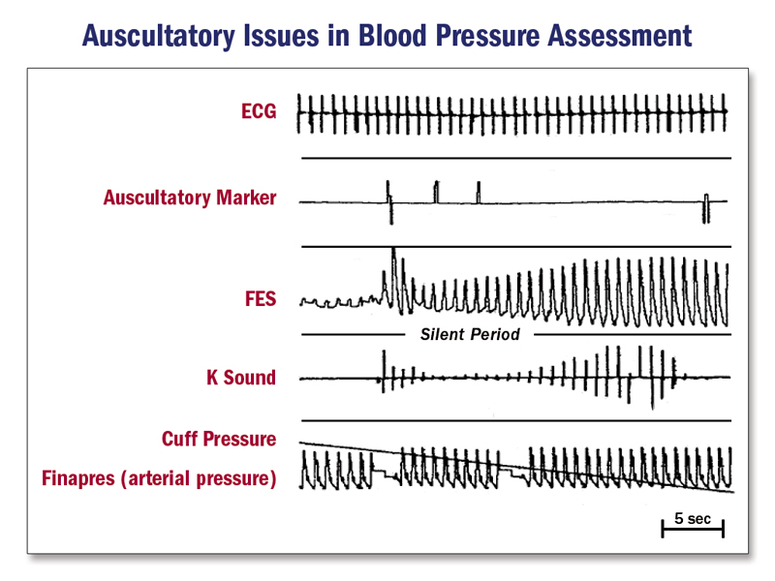
Reproduced with permission from Cavallini MC, Roman MJ, Blank SG, et al. Association of the auscultatory gap with vascular disease in hypertensive patients. Ann Intern Med 1996;124:877-83.
Notes:
During the silent gap the pulse wave is palpable but K sounds are not audible most likely due to vascular stiffness. Failure to determine palpatory pressure could lead to failure to recognize 5% of patients with hypertension. The gap is recognized only when the point of obliteration of the pulse is determined by palpation prior to deflation of the armcuff.
ECG = electrocardiogram; FES = foil electret sensor; K sound = Kortkoff sounds.

Slide 12
Secondary Hypertension in Older Adults
Uncommon; more than 90% of older adults suffer from essential (primary) hypertension
Atherosclerotic renovascular disease is a relatively common secondary cause, seen in patients with established cardiovascular disease in whom blood pressure is difficult to control
Several medications and over the counter supplements can increase blood pressure; non-steroidal antiinflammatories (NSAIDS), including COX-2 inibitors deserve special attention, given their ability to decrease renal prostaglandin production and glomerular filtration rates

Slide 13
Notes:
It is worth mentioning that more than 70% of older adults take at least one supplement, herbal medicine or over-the-counter drug on a regular basis; these have to be considered in every clinical encounter, as many can directly impact blood pressure management. For instance, St John’s Wort and Gingko biloba can modify the absorption of calcium channel blockers

Slide 14
Treatment Considerations of Hypertension in Older Adults
There continues to be great controversy regarding the specific blood pressure targets in older adults
The most recent JNC 8 report, based on available evidence at the time of publication, determined that the hypertension threshold in healthy individuals over the age of 60 should be 150/90 mmHg; this is similar to the threshold used in the HYVET trial, less than 150/80 in individuals over 80 years old
In the presence of chronic kidney disease and/or diabetes, JNC 8 recommends a goal of less than 140/90 as ideal
However, recent data from the SPRINT trial conflicts with these recommendations, as a more stringent systolic blood pressure goal of less than 120 mmHg was associated with a significant reduction in mortality and cardiovascular events

Slide 15
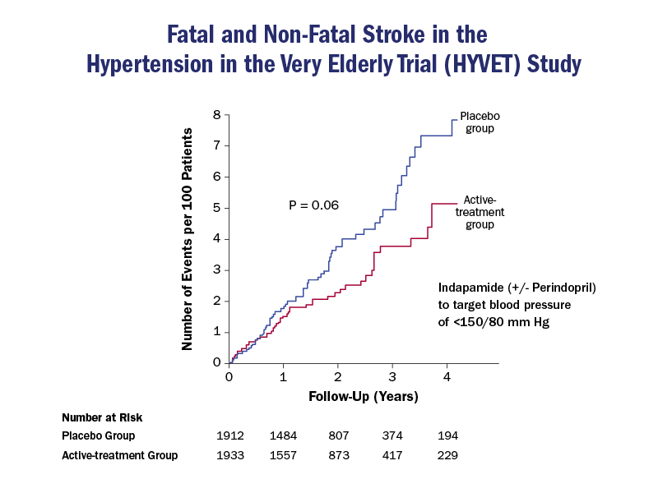
MODIFIED FROM Beckett NS, Peters R, Fletcher AE, et al. Treatment of hypertension in patients 80 years of age or older. N Engl J Med 2008;358:1887-98 (comment p. 1958).
Notes:
The landmark study HYVET (Hypertension in the Very Elderly Trial), an international, multisite, randomized controlled trial of HTN among 3,845 patients >80 years old with systolic HTN addressed this question. Subjects were randomized to Indapamide SR 1.5 mg or placebo, with a target goal of SBP <150 mm Hg and DBP <80 mm Hg. Perindopril (2 or 4 mg) was added if needed to achieve this target. The primary outcomes were fatal and nonfatal stroke. The trial was stopped prematurely by its Data Safety Monitoring Board due to an unexpected significant 28% decrease in mortality in the treated group (P = 0.02). The results demonstrated significant reductions in stroke, mortality, and heart failure.

Slide 16
Modified from James PA, Oparil S, Carter BL, et al. 2014 evidence-based guideline for the management of high blood pressure in adults: report from the panel members appointed to the Eighth Joint National Committee (JNC 8). JAMA 2014;311(5);50
ACEI = angiotensin-converting enzyme inhibitor; ARB = angiotensin-receptor blocker; CCB = calcium channel blocker; DBP = diastolic blood pressure;
SBP = systolic blood pressure.
Notes:
Notice that regardless of the need for pharmacologic treatment, lifestyle interventions should be established as a priority, and maintained as patients are prescribed antihypertensive agents. Notice than when compared to previous JNC 7 recommendations, which specifically recommended the use of thiazide-like diuretics as first line agents, physicians are now encouraged to choose between ACEI, ARBS, CCB or thiazide-type diuretic for initiation of therapy.

Slide 17
Lifestyle Interventions in Hypertension
Several trials support the benefit of lifestyle interventions in older adults
The TONE study (Trial Of Non-pharmacologic interventions in the Elderly) showed that modest sodium restrictions and weight loss lower blood pressure to the same degree as a single antihypertensive agent
The DASH study (Dietary Approaches to Stop Hypertension) confirmed the significant benefits of sodium, alcohol, saturated fat and carbohydrate restriction, paired with consumption of fruits, vegetables, nuts and dairy products
Regular physical activity lowers blood pressure, and is particularly useful in older adults with metabolic syndrome

Slide 18
Medication Management for Hypertension in Older Adults
The aphorism “start low and go slow” is important in older adults, recognizing that in most individuals combination therapy will be needed, particularly those who exceed blood pressure goals by more than 20/10 mmHg
JNC-8 indicates that 4 classes can be considered as first line agents: thiazide-like diuretics, calcium channel blockers, ACE inhibitors and ARBs.
Beta-blockers are currently not considered first line agents in older adults, except if there is another compelling indication (eg. recent myocardial infarction)

Slide 19
Medication Adherence in Older Adults
Antihypertensive prescription in older adults should take into consideration potential drug-drug and drug-disease interactions, as well as age-related physiologic changes
As medication lists get longer, so does the risk of interactions, side effects and non-adherence
Long acting and once-daily formulations should be preferred to improve adherence
Cost should be an important consideration, as many older adults live on a fixed, limited income

Slide 20
MODIFIED FROM Harvey RA, et al. Lipincott Pharmacology 5th ed. 2011.
Alpha Blockers, Clonidine and Short-acting nifedipine are on the Beers List of Medications to Avoid in Older Adults
ACE-I = angiotensin-converting enzyme inhibitor; ARB = antiotensin-receptor blocker; BPH = benign prostatic hyperplasia; CCB = calcium channel blocker; COPD = chronic obstructive pulmonary disease.

Slide 21
Key Points Hypertension
The prevalence of isolated systolic HTN and widened PP increases with age and poses more risk than diastolic HTN for coronary events, stroke, AF, heart failure, kidney disease, dementia and total mortality in older adults.
The assessment of HTN in older adults requires attention to appropriate BP measurement, multiple readings, and monitoring for postural hypotension and secondary causes.
Pharmacologic management of HTN in older adults requires a “start low, titrate slowly” approach and treatment should include lifestyle modifications.

Slide 22
Additional Reading: Hypertension
Franklin SS, Gustin W 4th, Wong ND, et al. Hemodynamic patterns of age-related changes in blood pressure. The Framingham Heart Study. Circulation 1997;96:308-15.
Whelton PK, Appel LJ, Espeland MA, et al. Sodium reduction and weight loss in the treatment of hypertension in older persons: a randomized controlled trial of nonpharmacologic interventions in the elderly (TONE). TONE Collaborative Research Group. JAMA 1998;279:839-46; 279:1954.
Moore TJ, Vollmer WM, Appel LJ, et al. Effect of dietary patterns on ambulatory blood pressure: results from the Dietary Approaches to Stop Hypertension (DASH) Trial. DASH Collaborative Research Group. Hypertension 1999;34:472-7.
ALLHAT Officers and Coordinators for the ALLHAT Collaborative Research Group. Major outcomes in high-risk hypertensive patients randomized to angiotensin-converting enzyme inhibitor or calcium channel blocker vs diuretic: The Antihypertensive and Lipid-Lowering Treatment to Prevent Heart Attack Trial (ALLHAT). JAMA 2002;288:2981-97.
Beckett NS, Peters R, Fletcher AE, et al. Treatment of hypertension in patients 80 years of age or older. N Engl J Med 2008;358:1887-98.

Slide 23
Case
79-year-old man noticed a sudden onset of left arm weakness when driving. His wife brought him to the ER.
PMH: HTN x 25 years, Hyperlipidemia
He has never smoked.
Medications: Amlodipine 5 mg daily (qd), HCTZ 25 mg qd, pravastatin 40 mg qd.
BP = 198/112 mm Hg, heart rate is 105 bpm, respiration rate is 20, pulse ox is 98% on room air, and he is afebrile.
Exam: soft right carotid bruit and an S4. Neurological examination reveals: left facial palsy, mild dysarthria, remarkable for 2+ strength left upper extremity), 4+ left lower extremity, 5+ right upper and lower extremity.
Labs: normal glucose, complete blood cell count, PT/aPTT, electrolytes, and renal function.
EKG: Sinus tachycardia with LVH
CT brain: no acute hemorrhage and no mass effect or edema.

Slide 24
Epidemiologic Aspects of Stroke in Older Adults
Over 80 y.o., prevalence of stroke is 12-17%
Incidence of stroke is higher in men than women at all ages, except in the “oldest old” (>85 y.o.) when this pattern is reversed
Treatment of hypertension and smoking cessation have a profound impact in risk reduction of stroke in older adults
Atrial fibrillation is a particularly important and modifiable risk factor with increasing age

Slide 25
MODIFIED FROM: Goldstein LB, Adams R, Alberts MJ, et al. Primary prevention of ischemic stroke: a guideline from the American Heart Association/American Stroke Association Stroke Council: cosponsored by the Atherosclerotic Peripheral Vascular Disease Interdisciplinary Working Group; Cardiovascular Nursing Council; Clinical Cardiology Council; Nutrition, Physical Activity, and Metabolism Council; and the Quality of Care and Outcomes Research Interdisciplinary Working Group: the American Academy of Neurology affirms the value of this guideline. Stroke 2006;37:1583-633.
Notes:
After age 55, the risk of stroke doubles for each decade of life. Treatment of hypertension in older adults can decrease the risk of stroke by 30-40%, while smoking cessation reverts the 2 to 4 times increased risk of stroke during active smoking.

Slide 26
Vascular Cognitive Impairment
Vascular Cognitive Impairment (VCI) is primarily a condition of the older adults and is caused by clinical strokes, subclinical strokes, and white matter lesions.
VCI: Second most common cause of dementia
VCI overlaps with Alzheimer’s disease in a substantial proportion of patients.

Slide 27
Epidemiology of Carotid Disease in Older Adults
In asymptomatic adults older than 65 years, the prevalence of extracranial carotid stenosis of more than 50% is 5-10%, but the prevalence of ≥80% stenosis is ≤1%.
The annual stroke risk of asymptomatic patients with ≥50% carotid stenosis is 1-4.3% but increases to 5.5% in those with at least 75% stenosis.

Slide 28
Management of Asymptomatic Carotid Disease in Older Adults
In patients with plaque identified in either carotid artery, <60% stenosis should be treated aggressively with statin medications, BP control, smoking cessation, and routine follow-up.
CEA is recommended for asymptomatic, surgically appropriate individuals with ≥60% but <100% stenosis as soon as feasible by a vascular surgeon with less than 3% morbidity/mortality rates.
Ipsilateral stroke risk, but not 5-year total mortality, is reduced by CEA.
Of note, many of the older CEA versus medical therapy trials were conducted before aggressive lipid lowering with statins

Slide 29
Carotid Artery Stenting (CAS) vs. Carotid Endarterectomy (CEA)
The current standard of care for asymptomatic patients with moderate to severe carotid stenosis is CEA
For the average surgical risk patient with asymptomatic carotid stenosis, trial data do not yet support CAS as an equal or better alternative to CEA.
In symptomatic patients (stroke or TIA within 6 months) with moderate (50-69%) to severe (70-99%) ipsilateral stenosis, CEA is recommended in surgically appropriate patients with perioperative mortality <6%
In high surgical risk symptomatic patients with >70% ipsilateral stenosis, CAS is a reasonable alternative to CEA.

Slide 30
Modified from White CJ, Beckman JA, Cambria RP, et al. Atherosclerotic Peripheral Vascular Disease Symposium II: controversies in carotid artery revascularization. Circulation 2008;118:2852-9.
Notes:
Notice that advanced age over 75 years represents a risk factor for both CEA and CAS; thus, decisions on the most appropriate modality of treatment are usually based on comorbidities and anatomical/structural features

Slide 31
Thrombolytic Therapy in Older Adults
Third International Stroke Trial (IST-3) suggested that the benefit of tPA was at least as great in patients 80 years of age or older as in younger patients

Slide 32
Patient Centered Stroke Care in Older Adults
2014 Palliative and End-of-Life Care in Stroke: A Statement for Healthcare Professionals from the AHA/ASA promotes a focus on “patient and family-centered care that optimizes quality of life by anticipating, preventing, and treating suffering” and a balanced and collaborative approach to end-of-life decision-making
For chronic post stroke pain, pharmacological treatment with amitriptyline or lamotrigine is reasonable, though in older adults, given the side effects associated with amitriptyline, nortriptyline may be a reasonable substitute (Class IIa; Level of Evidence B)
In vulnerable populations (older adults and impaired communication), there should be enhanced strategies for detection and monitoring of symptoms, including pain, “including verbal descriptor scales, caregiver report, and knowledge of pain behaviors.”

Slide 33
Key Points: Stroke
Advancing age is a powerful risk factor for stroke
Aggressive medical therapy, particularly adequate blood pressure and lifestyle modifications, specially smoking cessation, can significantly decrease the risk of stroke in older adults
Early CEA or CAS after a cerebrovascular event can significantly decrease the risk of stroke; the ideal timeframe should be within 2 weeks of the neurological event
In acute stroke, age alone is not a contraindication to thrombolytic therapy.

Slide 34
Additional Reading: Stroke
White CJ, Beckman JA, Cambria RP, et al. Atherosclerotic Peripheral Vascular Disease Symposium II: controversies in carotid artery revascularization. Circulation 2008;118:2852-9.
Chiam PT, Roubin GS, Panagopoulos G, et al. One-year clinical outcomes, midterm survival, and predictors of mortality after carotid stenting in elderly patients. Circulation 2009;119:2343-8.

