Slide 1

Palliative Care in
Older Adults
Geriatric Cardiology Member Section of the
American College of Cardiology

Slide 2
Learning Objectives
Review two case studies
Assess and manage common distressing symptoms in older cardiac patients
Recognize that palliative care and hospice benefit patients and families by addressing multiple dimensions of suffering
Identify key components of care for imminently dying patients and their families
Recognize the challenges in end-of-life care presented by new technologies
Apply guidelines for good communication with patients and families to conversations about end-of-life decision making and death notification

Slide 3

Case 1: Presentation (1 of 3)
Mr. Krause is a 93 year old man with a history of coronary artery bypass grafting (CABG) 18 years ago. He is cognitively intact, but has lived in a nursing home for 1 year because of functional debility due to intractable angina and falls. He takes an average of 6 sublingual (SL) nitroglycerin (NTG) per day (in addition to his other anti-anginal medications). Unable to walk, he spends most of his time sitting in a chair. He is able to feed and toilet himself, but now needs assistance with bathing.
His past medical history is remarkable for colon cancer (30 years ago), stage 3 chronic kidney disease, HTN, osteoarthritis, constipation, and hearing impairment. He takes 8 medications daily. A widower of 12 years, Mr. Krause relies on his nephew, who visits daily, as his primary family caregiver and durable power of attorney for healthcare (health care agent).
Photo licensed under CC0.

Slide 4
Case 1: Presentation (1 of 3)
Mr. Krause is transferred to the ED for severe chest pain and dyspnea. On arrival, he is confused, calling for his children and insisting that one of the nurses is his wife. He is combative with staff.
Vital Signs are: BP 136/68, P 108, RR 29, T 98.0, oxygen saturation 92%. His chest pain, dyspnea and confusion improve some with morphine and IV nitroglycerin. Lab studies include: troponin T 0.8 ng/mL (normal range 0-0.1 ng/mL) and serum creatinine 1.9 mg/dl.
Mr. Krause arrived with a DNR form, recently completed in the nursing home. His nephew confirmed he does not want any invasive interventions. “He knows he will die of his heart disease and just wants to be comfortable. He’s been saying ‘I’m ready to go’ a lot lately. I called 911 because of his pain. I couldn’t stand by and watch.”
Photo licensed under CC0.

Slide 5
Case 1: Presentation (1 of 3)
Mr. Krause is experiencing a pain crisis, which requires urgent physician attention with frequent re-evaluations to assess the success of pain management interventions. Adequate pain control should be established within an hour. In addition to usual treatment for NSTEMI (oxygen, nitrates, beta blockers), an opioid is appropriate to control his severe pain.
Photo licensed under CC0.

Slide 6
Case 1: Opioid Use & Dosing
“Start low and go slow”
Peak effect
  Oral, 45-60 minutes; intravenous, 15-30 minutes
Repeat dosing
  Most oral and IV opioids, 4 hours, but may be longer if reduced hepatic/renal clearance
Escalate dose depending on pain severity
  Increase dose by 25-50% for mild to moderate pain
  Increase dose by 50-100% for severe pain
Schedule long acting medication but use as needed for breakthrough pain
  ~10% of total daily opioid dose, once pain control achieved
Notes:
“Start low and go slow”
appropriate starting dose is determined by the patient’s previous exposure to opioids as well as the presence of renal or hepatic disease
low dose of intravenous morphine, like 2 mg, is reasonable
Peak effect
PRN order may be given as frequently as time to peak effect
Safe to repeat if control not achieved, and no SAE; 15-30m for IV, 1hr for oral
Repeat dosing
Dosing schedule based on 4-hour half-life in uncompromised patients

Slide 7
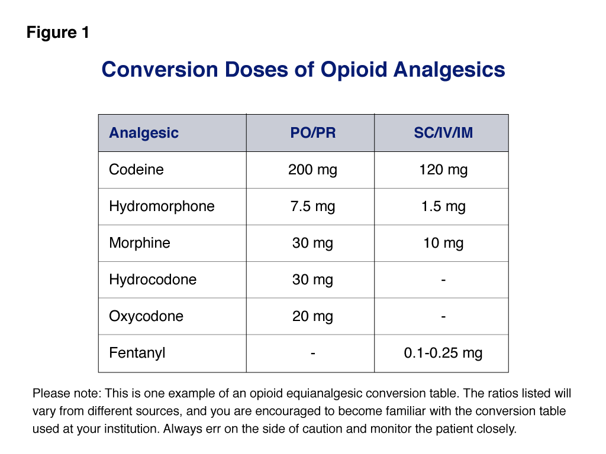
Notes:
- Morphine is generally the first line opioid unless a patient is allergic.
- Hydromorphone and fentanyl are other commonly available IV opioid medications and could be used with appropriate dosing conversions if available in a given setting
Morphine and other opioids also have metabolites that may cause toxicity with renal impairment;
however, opioid use is still reasonable with close monitoring and low starting doses.
Fentanyl is less dependent on renal clearance and would be a better choice for longer-term use.

Slide 8
Case 1: Opioids, Cont.
Symptom relief tolerance
  But don’t assume increased dose means tolerance; should evaluate for decompensation or new condition
Side effect tolerance
  Commonly less sedation, pruritus, nausea
Effective dose is for therapeutic effect
Dependence
Potential Side Effects
Sedation
Pruritus
Nausea
Constipation
Urinary retention
Respiratory depression (only at supra therapeutic doses)
Confusion
Notes:
Side effect tolerance
Common side effects: sedation, pruritus, nausea, urinary retention, respiratory depression (at supra therapeutic doses), confusion
Bowel regimen must accompany opioid administration
Effective dose is for therapeutic effect
No ceiling dose
Opioids do not cause specific visceral organ damage

Slide 9
Case 1: Presentation, Cont. (2 of 3)
Thirty minutes later, Mr. Krause says his pain is better - now moderate - but he still asks for more pain medicine.
He seems anxious and very short of breath now.
How might you re-evaluate his symptoms?
Photo licensed under CC0.

Slide 10
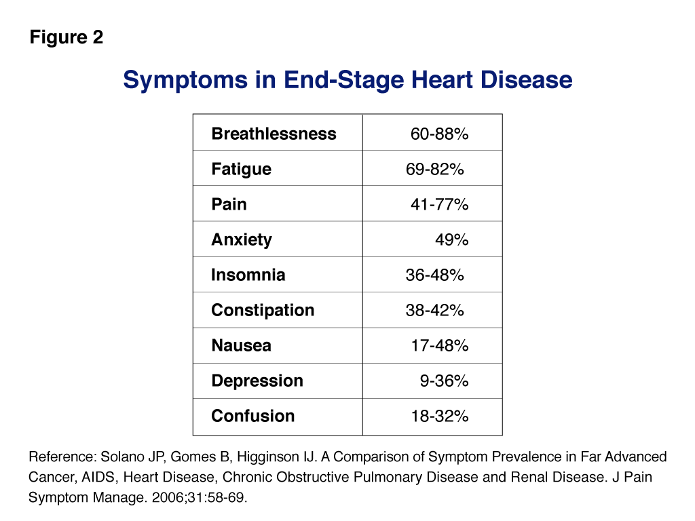

Slide 11
Case 1: Adjunctive Symptom Management
Dyspnea
  Diuretics, oxygen, short-acting benzodiazepines, fans, distraction and relaxation
Fatigue
  Optimize sleep-wake cycle
  Screen for depression and sleep disordered breathing
  Exercise may improve endurance as well as dyspnea
  Consider psycho-stimulants for potential rapid response and improvement
Anxiety
  Screen for delirium and depression
  Anxiolytic medications may be effective in a longer time frame
  But benzodiazepines in older adults may cause or worsen delirium
Notes:
In an older cardiac patient, pain may be multifactorial, from co-morbid conditions, cardiac ischemia, procedures, fluid overload, etc
Potentially life-prolonging medications may also palliate symptoms. For example, beta-blockers may relieve angina and afterload reduction and diuretics for heart failure symptoms
Notably, patient’s own goals of care may indicate that if burden of treating reversible causes is high, prefer to address symptoms instead

Slide 12
Case 1: Adjunctive Symptom Management
Constipation
  Assess daily while hospitalized
  Start a bowel regimen when initiating opioids
Depression
  Screen patients routinely, especially elderly or those with advanced disease
  In older adults with chronic kidney disease and heart failure, serum sodium should be monitored with SSRIs given the risk of hyponatremia
Delirium (hypoactive and hyperactive)
  Routinely screen with focused assessment
  May try neuroleptic but avoid benzodiazepines

Slide 13
Case 1: Presentation, Cont. (3 of 3)
Mr. Krause says he does not want to be in the hospital. His nephew asked for a clergy member to come see Mr. Krause, and now he asks you about hospice.
You consult the palliative care team to address Mr. Krause’s anxiety and dyspnea and to answer the family’s questions about hospice. They give you initial guidance for symptom management as above, and encourage you to initiate hospice referral.
What is palliative care, and how can hospice be helpful?
Photo licensed under CC0.

Slide 14
Case 1: What is Palliative Care?
Relieve suffering and improve quality of life
  Pain and non-pain symptom management
  Communication and advanced care planning
  Psychosocial support
  Caregiver concerns
Hospice: Administrative entity for terminally ill with expected survival of less than 6 months
Notes:
Palliative care team
Core team: physician, nurse and/or nurse practitioner, social worker, and chaplain
Home health aides, pharmacists, occupational and physical therapists, psychologists, dietician and volunteers may be included as well
Relieve suffering
Continues current pain and symptom management plan

Slide 15
Case 1: Support for Palliative Care
In non-small-cell lung cancer patients, early palliative care integrated into disease-modifying cancer care led to improvements in quality of life, mood, and survival
  Palliative care integrated patients survived approximately 2 months longer
  Received less aggressive end-of-life care
  Greater documentation of resuscitation preferences in medical record
Data within cardiology lacking
Palliative Care in Heart Failure (PAL-HF), randomized controlled trial recently completed
  Aims to provide empiric evidence for the potential benefits of a team-based palliative care intervention, used in conjunction with usual heart failure care, on patient-reported quality of life
Temel JS, Greer JA, Muzikansky A, et al. Early palliative care for patients with metastatic non-small-cell lung cancer. N Engl J Med 2010; 363(8): 733-42.
Notes:
Palliative care team
Core team: physician, nurse and/or nurse practitioner, social worker, and chaplain
Home health aides, pharmacists, occupational and physical therapists, psychologists, dietician and volunteers may be included as well
Relieve suffering
Continues current pain and symptom management plan

Slide 16
Case 1: End of life: Discussing Hospice
Organize the setting
Reflect and shape patient’s understanding of situation
Explore and shape patient’s expectations and anticipations
Introduce hospice as an option
Acknowledge emotions
Notes:
Create the Setting
Review necessary medical details and invite all who should be in attendance
“It would help to discuss overall goals for your care at this point.”
Define the Patient’s Understanding
Use an open-ended question
“What have the doctors told you about your condition?”
Define What the Patient Anticipates
Explore patient goals
Summarize and reflect on what has been said
“What are you expecting for your illness?...So, you’re saying that you would rather be at home and not come back to the hospital…”
Introduce Hospice as An Option
Align the patient’s goals and wishes with hospice services
Make a clear recommendation
“We’ve defined that you desire to be at home, independent, and comfortable. The best way I know to meet those needs is through hospice care. I recommend that we explore this option for you.”
Acknowledge Emotions
Even when the discussion is uneventful, emotions should be explored with an empathic statement
An adequate pause in conversation for listening is critical
“You seem very comfortable in this decision, but I imagine it is still very hard for you. *Pause* I wish things were different.”
Next Steps
Provide direction and follow-through.
“It seems that we have a plan. I will initiate a referral so we can start with some information and discuss that.”

Slide 17
Case 1: End of life: Hospice Care
Provide quality of life and comfort for patients with terminal illness, while neither hastening death nor prolonging life
Patients tend to go too late
    Eligible when terminal diagnosis with predicted survival of less than 6 months
    But disease-dependent: Cancer disease models more accurate; heart failure much less predictable
Enrollment
    Do not need DNR
    Must forgo curative treatment for the enrollment diagnosis
Notes:
Barriers to referral for end stage cardiac disease
Fluctuating course and prognostic uncertainty
Difficulty providing certain potentially palliative treatments

Slide 18
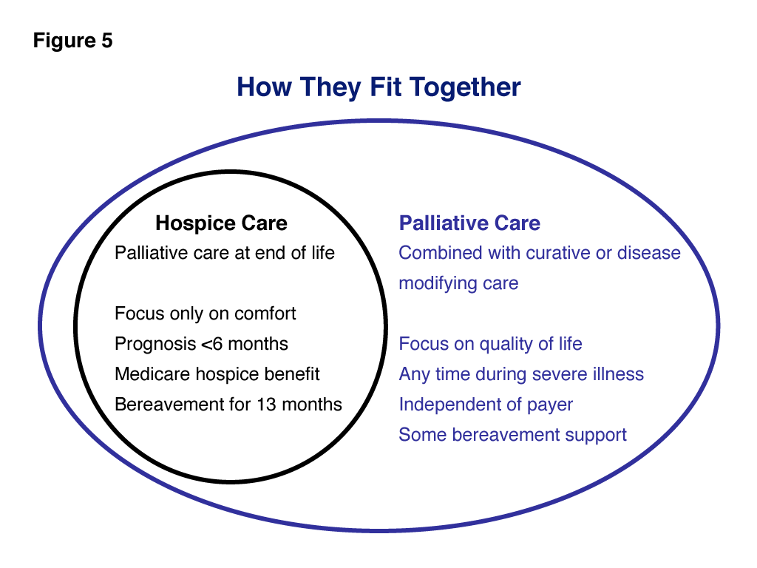

Slide 19
Case 1: Review
Visit precipitated by multifactorial symptoms
  Pain, dyspnea, fatigue and other symptoms should be routinely assessed and treated in older cardiac patients
  When used according to established principles and geriatric dosing guidelines, opioids are safe and effective for the treatment of dyspnea and pain in older cardiac patients
Palliative care discussion
  Palliative care addresses multidimensional suffering for patients and families facing a potentially life-limiting illness
  It is appropriate at any point in the illness course and may co-exist with curative or life-prolonging treatment
  Communication with patients should include discussion of prognosis as well as treatment options aimed at symptom palliation and modification of the underlying disease

Slide 20
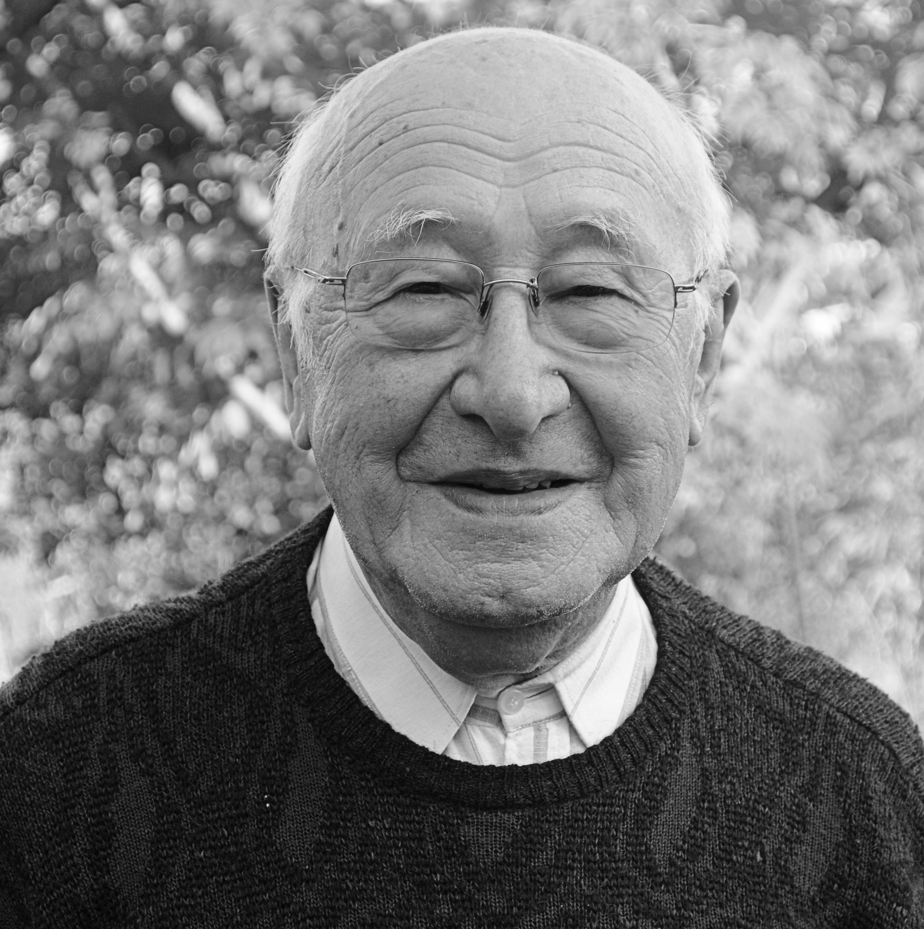
Case 2: Presentation (1 of 4)
Roberto Ramirez is a 68 year-old man with a history of coronary artery disease. He had a coronary artery bypass graft 12 years ago.
Two years ago, he presented to the emergency department with worsening heart failure and chest pain. He had sustained an NSTEMI. On coronary angiography, all of his vein grafts were found to be occluded. His LIMA remained patent. An echocardiogram at the time showed a drop in his ejection fraction to 20%, which had not recovered 60 days after his NSTEMI, prompting the insertion of an ICD.
Photo licensed under CC0.

Slide 21
Case 2: Presentation (1 of 4)
Since then, he has had one shock for ventricular tachycardia since device implantation. His current medications include aspirin, clopidogrel, metoprolol, atorvastatin, and lisinopril. He also has a history of diabetes mellitus type 2 for which he takes metformin. He has Stage 3 chronic kidney disease with a baseline creatinine of approximately 1.3mg/dl.
Mr. Ramirez worked actively as a barber, except when limited by his heart failure. He lived with his wife of 50 years, who is an active volunteer at her church.
Photo licensed under CC0.

Slide 22
Case 2: Presentation (1 of 4)
Today, he presents to the emergency department again with recurrent chest pain and dyspnea, orthopnea, and significant volume overload. Upon your evaluation of him, he states that he can no longer walk from his bed to the bathroom without stopping to catch his breath. His wife is at his bedside and appears concerned. Mr. Ramirez states that he does not want another angiogram as it ‘didn’t make any difference last time’.
What treatments would you use to immediately relieve pain and dyspnea? What would you do next?
Photo licensed under CC0.

Slide 23
Case 2: Symptom Management
Manage dyspnea
  Loop diuretics
  Supplemental oxygen
  Non-invasive positive pressure ventilation
Examine causes of decompensation
Opioids may be adjunctive
Notes:
Symptom control should be initial action
Ongoing distress can worsen dyspnea and anxiety

Slide 24
Case 2: Goals of Care & Quality of Life
Consider patient’s goals of care
  Patient rejected future angiogram/angioplasty. Is it…
    ... a momentary expression of frustration?
    … a preference against a specific treatment?
    … an overall philosophy regarding ongoing care?
  Invasive versus non-invasive management of end-stage heart failure
  How each option impacts prognosis
Perceived quality of life (QoL) for heart failure patients
  Heart failure involves mental and social aspects, as well as physical function
  Consider Kansas City Cardiomyopathy Questionnaire (KCCQ) and the Minnesota Living with Heart Failure Questionnaire
Notes:
After controlling symptoms, may consider patient’s rejection of angiplasty as an opening to discuss goals of care and quality of life

Slide 25
Case 2: Progression of Heart Failure
Objectively unpredictable
  Difficult to reliably model course of disease (unlike cancer)
  Typical course of disease is recurrent decompensation interspersed with periods of stability
May result in hesitation to communicate prognosis
  In 1997, McCarthy et al. found that only 37% of family members reported being aware of a poor prognosis, only 8% of patients and 44% of family members were told that time was short, and 36% of these patients died alone.
McCarthy M, Hall JA, Ley M. Communication and choice in dying from heart disease. J R Soc Med. 1997;90:128-131.
Notes:
After controlling symptoms, may consider patient’s rejection of angiplasty as an opening to discuss goals of care and quality of life

Slide 26
Case 2: Communication Guidelines
Assessment
Prognosis
Preparation
Preferences
Planning for eventual decline
Adler ED, Goldfinger JZ, Kalman J, et al. Palliative care in the treatment of advanced heart failure. Circulation. 2009;120:2597-2606.
Notes:
Assessment
Ask the patient what he or she understands about his or her condition.
Prognosis
Be conscious that prognostic uncertainty is no excuse for a failure to communicate about the implications of advanced heart disease.
Preparation
Prepare the patient emotionally for what to expect. Provide approximate time estimates (e.g., months or years?). Talk about some likely scenarios.
Preferences
Discuss healthcare proxy and goals if patient is permanently brain injured, including additional cardiopulmonary resuscitation, ventilators, and location of care. Discuss deactivation of ICD/cardiac resynchronization therapy/VAD, if applicable.
Planning for eventual decline
Suggest getting financial and emotional affairs in order. Help to mobilize community and family supports (e.g., palliative care, home care, hospice referrals).

Slide 27
Case 2: Presentation Cont. (2 of 4)
Mr. Ramirez returns home for 4 months following treatment. He has frequent clinic visits during that time, but then is re-admitted to the hospital. His dyspnea is relieved with diuresis, but his low blood pressure has resulted in the need to lower doses of his carvedilol and lisinopril, and he remains volume overloaded. His renal function worsens, with a creatinine rise to 1.9 mg/dl. Mr. and Mrs. Ramirez ask, “What about the Dick Cheney heart pump? Is that for me?”
How would a left ventricular assist device benefit this patient?
What about inotropic therapy?
Photo licensed under CC0.

Slide 28
Case 2: Inotropic Therapy
Improves hemodynamics, exercise tolerance, and relieves dyspnea
But, increased risk of death:
  6-month mortality frequently quoted at >50%
  Recent analysis suggests inotrope use in conjunction with modern HF therapies (ICD, CRT, aldosterone antagonists, or even ß-blockers) for palliation offered median survival of 9 months³
  Most patients successfully transition to LVAD or transplantation
Burden of continuous home IV infusion
Increasing offered by hospice agencies but expensive
  Hashim T, Sanam K, Revilla-Martinez M, et al. Circ: HF 2015;8:880-886
Notes:
Mr Ramirez has advanced end stage heart failure for which there are limited therapeutic options. Based on the REMATCH trial (Randomized Evaluation of Mechanical Assistance for the Treatment of Congestive Heart Failure), his mortality on medical treatment along could be as high as 75%.

Slide 29
Case 2: Left Ventricular Assist Device
As “destination therapy,” the LVAD improves survival, quality of life, and functional status for appropriate patients
Smaller, more durable, continuous flow LVADs offer patients 2-year survival rates of 60-70% or greater
Device related complications are common
  55% will require re-hospitalization for stroke, bleeding, infections, ongoing heart failure
Will change how patients live and die
Caregiver support will be essential
Notes:
Some complications can be seriously debilitating and negate any positive benefits gained from therapy
Patients must learn new strategies to interact with their home and external environments– including maneuvering their equipment and power supply
Caregiver support: for many, the lvad will permanently tie a caregiver or multiple caregivers to the patient
How they die: these patients expect to live the remainder of their lives dependent on support and the concept of device deactivation must be broached

Slide 30
Case 2: Presentation Cont. (2 of 4)
Mr. Ramirez undergoes a right heart catheterization which shows cardiogenic shock. Based on these findings and his symptoms, you initiate inotropic support with dobutamine while discussion proceeds about other therapeutic options.
Mr. Ramirez expresses a strong determination to live and see his grandchildren grow up. However, he has always been a self-sufficient man and would not want to be dependent on others.
You collaborate with the Palliative Care consultation team to help Mr. Ramirez and his family consider his options.
How would you help the Ramirez family prepare for destination LVAD?
Photo licensed under CC0.

Slide 31
Case 2: Role for Palliative Care in DT-LVAD
Goals of care of patients receiving DT often undefined
Many lack advanced directives
Some do not address worsening quality of life, comorbid conditions, and complications
Patients and family left with unexpected burden of care and poor quality of life: “destination nowhere”
End of life with LVAD will require device deactivation
Notes:
PATIENTS NEED HELP IN DECISION MAKING

Slide 32
Case 2: Role for Palliative Care in DT-LVAD
Swetz KM, Freeman MR, AbouEzzeddine OF, et al. Palliative medicine consultation for preparedness planning in patients receiving left ventricular assist devices as destination therapy. Mayo Clin Proc 2011; 86(6): 493-500.
Notes:
Major components of preparedness plan above. Decisions are made on the basis of a detailed discussion with patient and their loved ones regarding care preferences in the event of the development of poor quality of life, acute device failure, catastrophic complications, or a progressive comorbid condition (pulmonary disease or malignancy tumor)
Preparedness planning sets appropriate expectations

Slide 33
Case 2: Presentation Cont. (2 of 4)
After discussing with his heart failure cardiologists, meeting with the LVAD surgeon and care coordinators, and help from palliative care, Mr. Ramirez decides to undergo DT-LVAD therapy. He clearly discussed with his wife and family his wish to not continue life support measures if he would be “completely dependent on others for care.”
Mr. Ramirez undergoes destination LVAD therapy.
Photo licensed under CC0.

Slide 34
Case 2: Presentation Cont. (3 of 4)
After surgery, Mr. Ramirez’s postoperative course was complicated by bilateral pneumothoraces, limiting his ability to participate in physical therapy because of pain and dyspnea.
His symptoms are effectively managed by the palliative care team.
He is discharged to inpatient rehab and then home.
Photo licensed under CC0.

Slide 35
Case 2: Presentation Cont. (3 of 4)
Two weeks later, he is readmitted for dehydration and failure to thrive due to dizziness and persistent nausea that limited oral intake.
“Should I have ever agreed to the LVAD?”
Mrs. Ramirez also expressed being very overwhelmed with the amount of care the patient required and felt very burnt out.
Photo licensed under CC0.

Slide 36
Case 2: Presentation Cont. (3 of 4)
Mr. Ramirez’s LVAD team re-engaged the palliative care team to help Mr. and Mrs. Ramirez.
The palliative care team managed the patient’s nausea while the medical team adjusted his LVAD settings to help with dizziness.
Social work helped Mrs. Ramirez cope better.
Mr. Ramirez was able to feel better and looked forward to gaining strength at home. His quality of life continued to improve with LVAD functioning.
Photo licensed under CC0.

Slide 37
Integrated Approach to Palliative Care
Adapted from Luo N, et al. (In press, 2016)
Notes:
Many authors now call for proactive palliative care involvement in patients considering and/or later receive DT-LVAD to help with end of life preferences, facilitate advance care planning, manage symptoms, and maximize QOL
Importantly, palliative care support is iterative in nature.
Together with other members of the MCS team, the palliative care practitioners’ established relationship with the patient can facilitate renewed discussions regarding the achievable benefits versus burdens of the device.

Slide 38
Case 2: Presentation Cont. (4 of 4)
Mr. Ramirez went on to do remarkably well. He eventually learned to perform all LVAD-related care alone and even visited his barber shop from time to time.
Photo licensed under CC0.

Slide 39
Case 2: Presentation Cont. (4 of 4)
Five years later, he falls while changing a light bulb. He suffers a skull fracture with subarachnoid bleeding.
Photo licensed under CC0.

Slide 40
Case 2: Presentation Cont. (4 of 4)
He survives but neurologic and cognitive status does not improve. He can no longer walk and often becomes agitated and non-cooperative with care. His behavior worsens to where he requires midazolam to prevent harm to himself, staff, and his LVAD.
Photo licensed under CC0.

Slide 41
Case 2: Presentation Cont. (4 of 4)
After discussion of prognosis at multidisciplinary case conferences and based on the patient’s wishes in his preparedness planning, a collective decision was made by the patient’s family to withdrawal LVAD support.
Photo licensed under CC0.

Slide 42
Case 2: Presentation Cont. (4 of 4)
Mrs. Ramirez and her family express genuine gratitude and appreciation at the presence and comfort offered to them and the patient by the palliative team, particularly in empowering her to make difficult decisions on her husband’s behalf and ensuring that he was comfortable and treated with dignity in his final days.
Photo licensed under CC0.

Slide 43
Case 2: End of Life with DT-LVAD
Most patients on destination LVAD therapy will die with the device in place
A palliative care team can guide these difficult discussions regarding withdrawal
  Help patients and families clarify prior or define new goals of care
  Empower decision making that serves these goals
  Manage symptoms at end of life
Withdrawal of LVAD akin to withdrawal of other life-sustaining devices, such as endotracheal tubes
  Death that follows withdrawal occurs from underlying heart failure

Slide 44
Adapted from Luo N, et al. (In press, 2016)
Notes:
Figure: interdisciplinary checklist that outlines steps required at the time of device deactivation
The act of device deactivation may cause undue fear and distress.
Preparation, communication, and coordination are again important
Case evidence suggests unconsciousness and death ensues within twenty minutes of deactivating the pump, but some patients may survive for several days following LVAD deactivation, and this variability should be explained to families in preparation.

Slide 45
Case 2: Review
Options are limited for end-stage heart failure patients who are ineligible for transplant
Even so, patients will frequently prefer survival given the option
DT-LVAD changes the dying process
Early palliative care engagement can assist patients with goal-oriented decision making, symptom management, and end of life care with LVAD
Early preparation, awareness, and collaboration is key

Slide 46
Select References
Adler ED, Goldfinger JZ, Kalman J, et al. Palliative care in the treatment of advanced heart failure. Circulation. 2009;120:2597-2606.
Brush S, Budge D, Alharethi R, et al. End-of-life decision making and implementation in recipients of a destination left ventricular assist device. The Journal of Heart and Lung Transplantation. 2010;29:1337-1341.
Felker GM, O’Conner CM. Inotropic therapy for heart failure: an evidence-based approach. Am Heart J. 2001;142:393-401.
Forman DE, Rich MW, Alexander KP, Zieman S, Maurer MS, Naijar SS, Cleveland JC Jr, Krumholz HM, Wenger NK, Cardiac Care for Older Adults. J Am Coll Cardiol. 2011 May 3;57(18):1801-10.
Goodlin, SJ. Palliative Care in Congestive Heart Failure. J Am Coll Cardiol. 2009 July 28;54(5):386-96.
Mccarthy M, Hall JA, Ley M. Communication and choice in dying from heart disease. J R Soc Med. 1997;90:128-131.
Rose EA, Gelijns AC, Moskowitz AJ et al. Long-term use of a left ventricular assist device for end-stage heart failure. N Engl J Med. 2001;345:1435-1443.
Swetz KM, Freeman MR, AbouEzzeddine OF, et al. Palliative medicine consultation for preparedness planning in patients receiving left ventricular assist devices as destination therapy. Mayo Clin Proc 2011; 86(6): 493-500.
Tanner CE, Fromme EK, Goodlin SJ. Ethics in the Treatment of Advanced Heart Failure: Palliative Care and End-of-Life Issues. Congest Heart Fail. 2011 Sep-Oct:17(5):235-240.

Slide 47


