Slide 1
Perioperative Care in the Older Adult
Geriatric Cardiology Section of the
American College of Cardiology

Slide 2
Relevance
Over the last 20 years, the number of people 70 years of age or older requiring surgical interventions has increased substantially
Perioperative management of people over 70 years of age poses challenges not encountered in younger patients
Lack of recommendations in perioperative guidelines
Underrepresented in trials, studies
Understanding the pathophysiologic changes that occur in the older surgical patient is necessary to ensure appropriate perioperative risk assessment and medical management

Slide 3
Functional Reserve in the Older Adult
Aging is associated with reduced physiologic reserve in all organ systems increasing susceptibility to perioperative adverse events
Presence of multiple comorbid illnesses, functional limitations, cognitive impairment, & frailty increases perioperative morbidity and iatrogenic complications in the older patient
Age-related changes alter the pharmacodynamics and pharmacokinetics of drugs making older patients more sensitive to anesthetics and analgesics agents
Primary determinants of perioperative risk:
Functional status
Presence of coexisting diseases
✗ Not age alone

Slide 4
Case
A 79-year-old man presents for elective open repair of a large asymptomatic suprarenal abdominal aortic aneurysm
He has coronary artery disease with class II chronic stable angina, hypertension, hyperlipidemia, depression, and ongoing tobacco use (one pack/day for 50 years)
He lives alone and states that he is able to perform routine household chores and push-mow his lawn

Slide 5
Case
Medications include mirtazapine 7.5 mg qhs, trazodone 100 mg tid, simvastatin 40 mg qhs, hydrochlorothiazide 25 mg q am, metoprolol tartrate 100 mg bid, and sublingual nitroglycerin 0.4 mg as needed
Physical examination reveals a robust-appearing older man. The heart rate is 55 bpm, and the blood pressure is 160/90 mm Hg. He has mild expiratory wheezing but the remainder of the exam is unremarkable
Laboratory findings are normal

Slide 6
What factors should be considered in assessing this patient’s preoperative risk ?

Slide 7
Preoperative Cardiac Risk Assessment
Focuses on three elements:
Nature and urgency of the surgical procedure
Patient’s functional capacity
Individual’s cardiac risk profile
Cardiac risk associated to noncardiac surgical procedures relates to the type of surgery
The risk of perioperative cardiac adverse events increases with the urgency, extent, location, and duration of the surgery, as well as anticipated blood loss and potential fluid and electrolyte shifts during the procedure
Notes:
As surgery elicits a complex stress response involving multiple metabolic and neurohormonal pathways that result in an increase in myocardial oxygen consumption and alterations in the balance between thrombosis and fibrinolysis in favor of thrombosis, the cardiac risk associated with noncardiac surgical procedures is related to both the type of surgery and the level of stress associated with the procedure. Thus, the risk of perioperative cardiac adverse events increases with the urgency, extent, location, and duration of the procedure, as well as anticipated blood loss and potential fluid and electrolyte shifts.

Slide 8
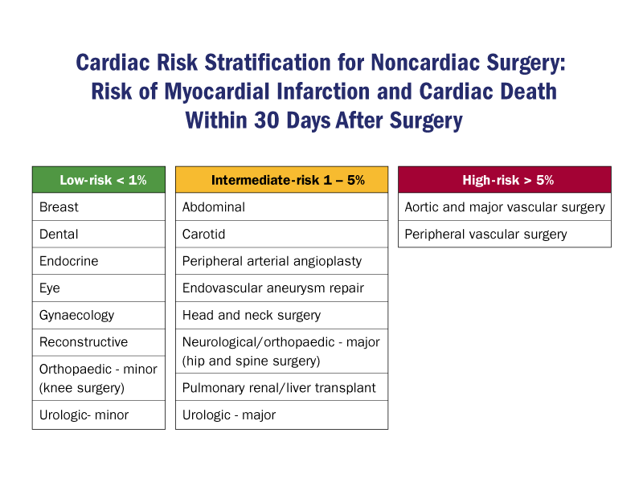
Cardiac Risk Stratification for Noncardiac Surgery: Risk of Myocardial Infarction and Cardiac Death within 30 Days after Surgery
2009 ¹
2014 ²
Low Risk
High Risk
Modified from Poldermans D, et al. Eur Heart J 2009;30:2769-812
Fleisher LA, et al. J Am Coll Cardiol. 2014 Dec 9;64(22):e77-137
Notes:
Cardiac Risk Stratification for Noncardiac Surgery: Risk of Myocardial Infarction and Cardiac Death within 30 Days after Surgery

Slide 9
Assessment of Functional Capacity
Poldermans D et al. Eur Heart J 2009;30:2769-812

Slide 10
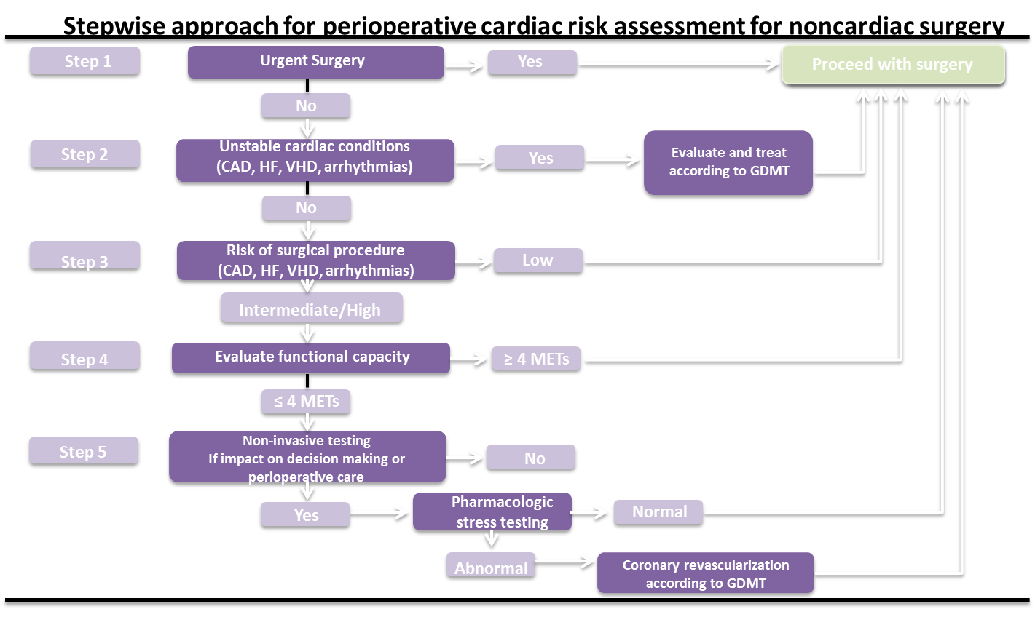
Stepwise Approach for Perioperative Cardiac Risk Assessment for Noncardiac Surgery

Slide 11
Assessment of Perioperative Cardiac Risk: Goldman Risk Index
Bettelli G et al. Minerva Anestesiol 2011;77:637-46
Notes:
Reproduced with permission from Bettelli G et al.. Preoperative evaluation in geriatric surgery: comorbidity, functional status and pharmacological history. Minerva Anestesiol 2011;77:637-46

Slide 12
Case Cont.
Surgical procedure: Vascular, classified as high-risk (estimated MACE >5%)
Functional capacity: good (MET >4)
Cardiac Risk assessment:
Extensive history of cardiac disease ➔ stable
Lack of cardiac symptoms
Hemodynamically stable with no other clinical evidence of acute decompensation
Intermediate risk for perioperative cardiac complications during a high-risk procedure
No indication for additional testing

Slide 13
What are your recommendations for perioperative management?

Slide 14
Severe hypertension (systolic BP >180 mm Hg, diastolic BP >110 mm Hg) may increase the risk for perioperative cardiovascular complications
There is little evidence of increased perioperative risk with Stage 1 hypertension (BP 140-159/90-99 mmHg)
Aggressive BP control in the perioperative period has not been shown to reduce the risk of complications and may lead to intraoperative hypotension

Slide 15
Recommendations on Beta-Blockers
ACC/AHA Guidelines for Perioperative Beta-Blockers
Fleisher LA, et al. J Am Coll Cardiol. 2014 Dec 9;64(22):e77-137
Notes:
Recommendations on Beta-Blockers
ACC/AHA Guidelines for Perioperative Beta0Blockers

Slide 16
Case Cont.
The patient’s BP is elevated, but he has no evidence of end-organ damage
Continuation of chronic beta-blocker therapy is appropriate to reduce myocardial oxygen demand by lowering heart rate and BP, reducing the risk of myocardial ischemia
Potential benefits must be weighted against the risk of hypotension, decreased cardiac output, and diminished perfusion of vital organs

Slide 17
What are the most common cardiac and noncardiac complications that occur during the perioperative period in older adults undergoing major surgery?

Slide 18
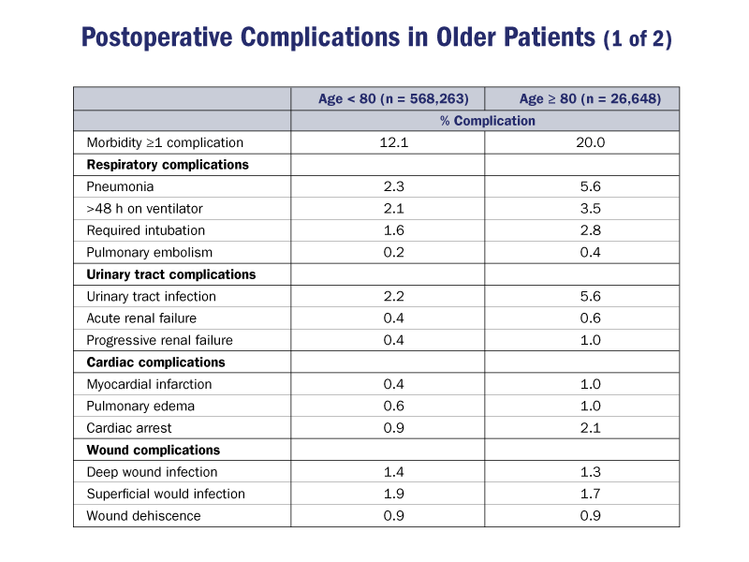
Postoperative Complications in the Older Adult
Hamel MB, et al. J Am Geriatr Soc.2005(53)424-29

Slide 19
Postoperative Complications in the Older Adult
Hamel MB, et al. J Am Geriatr Soc.2005(53)424-29

Slide 20
Cardiac Complications
Myocardial ischemia
Supraventricular arrhythmias
Ventricular arrhythmias
Heart failure due to pre-existing left ventricular systolic or diastolic dysfunction in conjunction with volume overload

Slide 21
Case Cont.
The patient undergoes uneventful surgical repair of his abdominal aneurysm under general anesthesia
During the firs24h post-surgery the patient develops an irregular heart rate at 130bpm and complaints of shortness of breath
On physical exam, the patient is alert and denies pain. Temperature is 35.2°C, heart rate is 130 bpm and irregular, BP is 145/65 mm Hg, oxygen saturation is 96% on 2 L O2 (nasal cannula). Lungs are clear

Slide 22
Case Cont.
ECG shows atrial fibrillation (AF) with a ventricular rate of 110 bpm; there are no ischemic changes
Laboratory findings include a serum sodium of 132 mEq/L, potassium of 3.2 mEq/dl, magnesium of 1.4 mg/dl, and hemoglobin of 9.6 g/dl

Slide 23
Postoperative Atrial Fibrillation
Incidence of postoperative AF in older adults:
3-5% major noncardiac surgery outside the thorax
10-15% intrathoracic procedures
30-40% cardiac procedures (i.e CABG)
Up to 50% isolated valve surgery
up to 60% combined valve surgery with CABG
Associated with increased hospital length of stay, risk for stroke, increased mortality, and higher costs

Slide 24
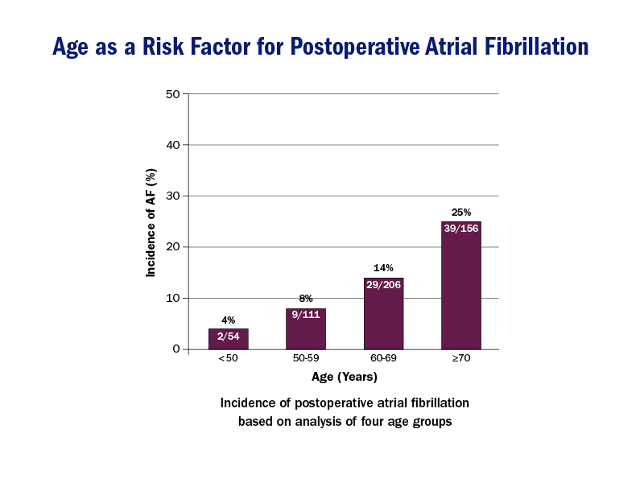
Age as a Risk Factor for Postoperative Atrial Fibrillation
Amar D, et al. Anesthesiology 2002;96:352-6

Slide 25
Reversible Causes of Perioperative Arrhythmias
Hypoxaemia
Hypercarbia
Acidosis
Hypotension
Electrolyte Imbalance
Mechanical Irritation
Pulmonary artery catheter
Chest tube
Hypothermia
Adrenergic stimulation (light anesthesia)
Proarrhythmic drugs
Micro/macro shock
Cardiac ischaemia
Reversible causes of supraventricular tachycardias and non-sustained ventricular tachycardia. Listed are some of the most common conditions in the operating room environment that predisposed patients to arrhythmias. These conditions are usually reversible, and should be treated before considering use of pharmacological antiarrhythmic therapies.

Slide 26
Management of Perioperative Atrial Fibrillation/Flutter
Direct current cardioversion is indicated in hemodynamically unstable patients with incident AF or atrial flutter
In stable patients, initial treatment includes correction of any precipitating factors, control of heart rate, and anticoagulation with unfractionated heparin or low molecular weight heparin (unless contraindicated)

Slide 27
Management of Perioperative Atrial Fibrillation/Flutter
Treatable precipitating factors include:
Hypothermia
Inadequate pain control
Electrolyte abnormalities
Ischemia
Volume overload
Pneumonia or other infectious processes
Pulmonary embolism

Slide 28
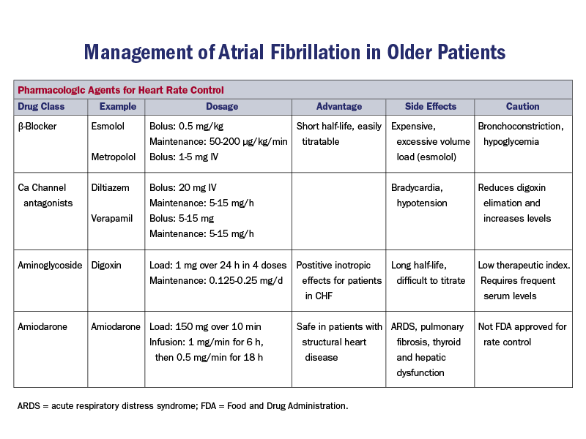
Management of Atrial Fibrillation in Older Adults
Fischer GW et al. Anesthesiol Clin 2009;27:417-27
Notes:
Fischer GW et al. Anesthesiol Clin 2009;27:417-27.

Slide 29
Hypothermia
Advanced age is associated with impaired central and peripheral thermoregulatory function
These alterations may be exacerbated by anesthetic-induced inhibition of thermoregulatory reflexes ➔ mild hypothermia (1-2°C below normal) is common in older adults following major surgery, especially those who are underweight or frail
Hypothermia may contribute to electrolyte abnormalities (hypokalemia and hypomagnesaemia), platelet dysfunction, increased risk for surgical wound infection and impaired drug metabolism

Slide 30
Case Cont.
The patient should be actively warmed to a core temperature of ≥ 36°C, and electrolyte abnormalities (hypokalemia and hypomagnesaemia) should be corrected
Heparin should be initiated and the dose of his beta-blocker should be optimized.
If the patient remains in AF for more than 24 hours and has persistent moderate or marked symptoms, pharmacological or electrical cardioversion should be considered

Slide 31
Noncardiac Complications
Delirium, cognitive impairment
Respiratory insufficiency
Hospital-acquired pneumonia
Deep venous thrombosis
Acute kidney injury
Pressure ulcers

Slide 32
Case Cont.
On postoperative day 2, the patient becomes disoriented, pulls his intravenous lines and attempts to get out of bed to urinate despite having a Foley catheter in place. He is intermittently confused, especially at night, but with intervening lucid periods
His vitals signs are normal, rhythm spontaneously converted to sinus, cardiopulmonary and neurological examinations are unremarkable
Distinguish acute delirium, reversible postoperative cognitive dysfunction (POCD), and chronic dementia in the postoperative setting

Slide 33
Delirium
Delirium is a frequent but often unrecognized post surgical complication in older adults
The incidence ranges from 4-52%
Can be higher in older adults requiring intensive care (70-87%)
Postoperative delirium in older patients is associated with persistent cognitive deficits, loss of independence, functional decline, increased hospital costs, and increased short-term and long-term mortality

Slide 34
Incidence of Postoperative Delirium
Lagoo-Deenadayalan SA, et al. Chapter 29: Common Perioperative Complications in Older Patients. Principles and Practice of Geriatric Surgery. New York: Springer; 2011

Slide 35
Delirium
Diagnosis:
Instruments such as the Confusion Assessment Method (CAM)
Delirium Subtypes:
Emergence delirium: upon awakening from general anesthesia
Postoperative delirium: ~3 days post-surgery
Variable course
Patients with delirium are at risk for developing both recurrent delirium and subsequent dementia

Slide 36
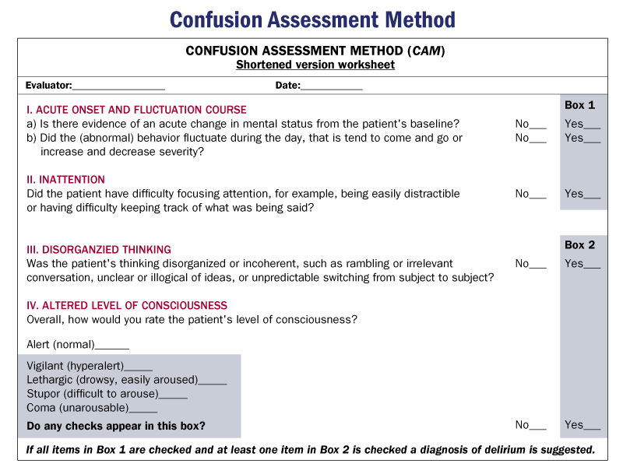
Inouye SK, et al. Ann Intern Med 1990;113:941-8

Slide 37
Risk Factors of Postoperative Delirium
Chow WB, et al.J Am Coll Surg 2012;215:453-66
Notes:
Risk Factors for Postoperative Delirium

Slide 38
Risk Factors of Postoperative Delirium
Lagoo-Deenadayalan SA, et al. Chapter 29:
Common Perioperative Complications in Older Patients.
Principles and Practice of Geriatric Surgery. New York:
Springer; 2011

Slide 39
Drugs Associated with Postoperative Delirium
Reproduced with permission from www.ebmedicine.net.

Slide 40
Prevention of postoperative Delirium
Requires identification of high-risk patients
Multi-faceted approach:
Avoid sensory deprivation
Preserve normal social interactions and diurnal variations in activities (especially the sleep/wake cycle)
Maintain physiological homeostasis
Minimize potential precipitants of delirium

Slide 41
Lagoo-Deenadayalan SA, et al. Chapter 29: Common Perioperative Complications in Older Patients. Principles and Practice of Geriatric Surgery. New York: Springer; 2011

Slide 42
Treatment of Postoperative Delirium
Identify the underlying cause(s)
Provide supportive care
Control symptoms

Slide 44
Postoperative Cognitive Dysfunction (POCD)
Deterioration in cognitive, memory and executive function that occurs following surgery
Duration: days to weeks
Patients with POCD are not confused and do not undergo rapid fluctuations in mental status
The incidence in patients older than 60 years of age undergoing major surgery ranges from 25-41%

Slide 45
POCD
Diagnosis
Neuropsychological testing before and after surgery
Family or physician impression of a decline in mental acuity
✗ Conventional screening tools for cognitive dysfunction are insensitive for detecting POCD

Slide 46
POCD
Longer hospital stay, high risk of institutionalization after discharge, and impaired quality of life
Increased morbidity and mortality
POCD at hospital discharge is associated with increased 3-month mortality
Persistent POCD at 3 months is associated with increased 1-year mortality
Return to baseline mental function in days to weeks
About 10% of patients will have persistently reduced cognition 3 months after surgery

Slide 47
POCD after Major Noncardiac Surgery
Monk TG, et al. Anesthesiology 2008;108:18-30

Slide 48
Bettelli G, et al. Minerva Anestesiol 2011;77:637-46

Slide 49
Chronic dementia
Exists before surgery
May be exacerbated by the procedure
Acute delirium
Postsurgical
Sudden onset of fluctuating changes in mental status with reduced awareness of the environment and decreased attention
POCD
Postsurgical

Slide 50
Case Cont.
The patient in the case vignette has postoperative delirium
Sudden onset; fluctuating pattern of confusion
Reduced awareness of the environment
Contributing factors: age, polypharmacy (multiple psychotropic drugs), depression
Vascular surgery is an uncommon cause of delirium
Hypoperfusion related to cross-clamping of the aorta
Atherosclerotic emboli
Choice of anesthesia does not affect the risk for delirium in older surgical patients

Slide 51
Case Cont.
Differential diagnosis:
POCD
Alcohol withdrawal: lack of hemodynamic signs of sympathetic arousal
Inadequate pain control: lack of hemodynamic signs of sympathetic arousal

Slide 52
Case Cont.
The patient does well and is discharged home. Six months later falls down a flight of stairs and sustains a complex fracture on the right femoral neck.
The patient is seen by an orthopedic surgeon, who recommends open reduction/internal fixation of the fracture within 48 hours. You are asked to see the patient for cardiology “clearance.”

Slide 53
Hip Fractures in Older Adults
Hip fracture is a highly morbid event associated with considerable disability in older adults; it confers 2.9 and 3.7-fold increases in 1-year mortality in women and men, respectively
Mortality rates range from 5-10% at 1 month and up to 30% at 1 year; 30-50% of survivors have a high degree of residual disability
Factors associated with increased perioperative mortality include older age (especially age ≥80 years), male gender, fracture location, and comorbidity burden

Slide 54
Factors Independently Associated With In-hospital Mortality In Patients With Hip Fractures
Librero J, et al. BMC Health Serv Res 2012;12:15
Notes:
Reproduced with permission from Librero J, Peiró S, Leutscher E, et al. Timing of surgery for hip fracture and in-hospital mortality: a retrospective population-based cohort study in the Spanish National Health System. BMC Health Serv Res 2012;12:15.

Slide 55
The Bone and Joint Decade Canada.
National Hip Fracture Tool Kit. June 2011
Notes:
The Bone and Joint Decade Canada. National Hip Fracture Tool Kit. June 2011.

Slide 56
Hip Fractures in Older Adults
Urgency and timing of surgery correlate with perioperative outcomes
Mortality rates following emergency operations in older patients range from 10-30% (> 3 times) than comparable elective procedures
Early surgery (< 24-48 h) has no effect on mortality in stable patients with hip fracture but its associated with less postoperative pain and shorter hospital stay
Current guidelines recommend performing surgery within 24-48 hours of admission or as soon the patient’s medical condition permits

Slide 57
Reasons for Surgical Delay in Patients Undergoing Hip Fracture Surgery
Vidán MT, Set al. Ann Intern Med 2011 Aug 16;155:226-33
Notes:
Vidán MT, Sánchez E, Gracia Y, Marañón E, Vaquero J, Serra JA. Causes and effects of surgical delay in patients with hip fracture: a cohort study. Ann Intern Med 2011 Aug 16;155:226-33.

Slide 58
General vs. Regional Anesthesia in Older Patients
Potential benefits of epidural anesthesia in the elderly
Notes:
Potential benefits of epidural anesthesia in the elderly

Slide 59
Le-Wendling L, et al. Pain Med 2012;13:948-56

Slide 60
Other Noncardiac Complications…
Postoperative deep vein thrombosis
Predisposing factors: Age > 60 years, stasis of blood, decreased flow in the iliofemoral veins & hypercoagulable state
Risk ranges between 4-8% in older patients not receiving prophylaxis. The risk doubles in high-risk settings
Preventive strategies: early ambulation, mechanical prophylactic measures (use of graded pneumatic compression boots or compression stockings), and anticoagulation

Slide 61
Decubitus Ulcers
Loss of subcutaneous tissue and ⬇ elasticity of aged skin can damage superficial tissues when skin is compressed for prolonged periods of time
Older adults at higher risk for decubitus ulcers, which often lead to secondary infections, delayed recovery, prolonged hospital stays, and discharge to a transitional care facility
Preventive measures: routine postoperative skin surveys, frequent repositioning, use of pressure redistributing support surfaces, pressure relieving overlays in the operating room, use of foam alternatives (60% ⬇ in incidence), and use of heel protectors (73% ⬇ in heel ulcers)

Slide 62
Respiratory Insufficiency
Hospital acquired pneumonia
Acute Kidney Injury
Urinary Tract Infections
Preventive measures: maintain excellent pulmonary toilet, precautions against transmission of pathogens (e.g., hand hygiene), minimize the use of nephrotoxins and ensure adequate hydration, and limit the use of urinary catheters

Slide 63
Key Points
Age-related changes diminish reserve capacity and greatly increase the risk of perioperative complications
Functional status and the presence of coexisting diseases should be the primary determinants of perioperative risk among older adults
Age per se should not be an exclusion criterion for surgery
Indications for preoperative cardiac testing are similar to younger patients; in the absence of worsening symptoms or hemodynamic instability, routine preoperative testing is not recommended

Slide 64
Key Points
Postoperative delirium is associated with increased morbidity and short-term and long-term mortality
Predisposing factors for the development of POCD include aging, previous cerebral vascular accident, metabolic problems, lower level of education, physiological perturbations, anesthesia, and hospitalization
The development of supraventricular arrhythmias, ⬆ the risk of perioperative stroke and is associated with longer hospital stays and related costs

Slide 65
Key Points
Regional anesthesia in appropriately selected older patients is associated with better peripheral vascular circulation, ⬇ blood loss, improved pain control, less ileus, deep vein thrombosis, respiratory complications, and suppression of the surgical stress response; however, it has not been shown to ⬇ mortality or risk of postoperative delirium or cognitive dysfunction
Thermoregulatory dysfunction predisposes older adults (especially those who are frail and/or underweight) to perioperative hypothermia, which increases risk for myocardial ischemia and cardiac arrhythmias

Slide 66
Key Points
In addition to the type of surgery, the presence of multiple chronic conditions, especially cancer, arthritis, and osteoporosis, is associated with increased risk for perioperative pain.
Inadequate pain control, as well as excessive use of analgesics, is associated with increased risk for perioperative complications, including reduced mobility, delayed recovery, and iatrogenic events such as respiratory depression, pneumonia, constipation, and deep vein thrombosis

