Slide 1

Pharmacology in the
Older Adult
Geriatric Cardiology Section of the
American College of Cardiology

Slide 2
Relevance of Age-related Pharmacologic Changes
Older adults represent the largest group to which cardiovascular drugs are prescribed, yet, the elderly have been underrepresented or excluded from most safety and efficacy cardiovascular trials
Key differences in anatomy, physiology, and pharmacokinetics and pharmacodynamics between older and younger or middle-aged adults
The result are additional challenges in optimizing cardiovascular medication regimens

Slide 3
Age-related Anatomic and Physiologic Changes Affect Drug Dosing
With older age, major changes in body composition include a decrease in total body water, intravascular volume, muscle mass and bone density
Smaller intravascular volume means intravascular loading doses should be smaller to achieve the same concentrations as in younger patients
Decreased muscle mass leads to decreased strength and increasing sensitivity to medications that can affect muscles (such as statins) or higher concentrations of medications that are concentrated in muscles (digoxin).
Decreased muscle mass can lead to decreased function with slower walking speed, lower hand and arm strength, difficulty in rising from a chair and can progress to the phenotype of frailty.

Slide 4
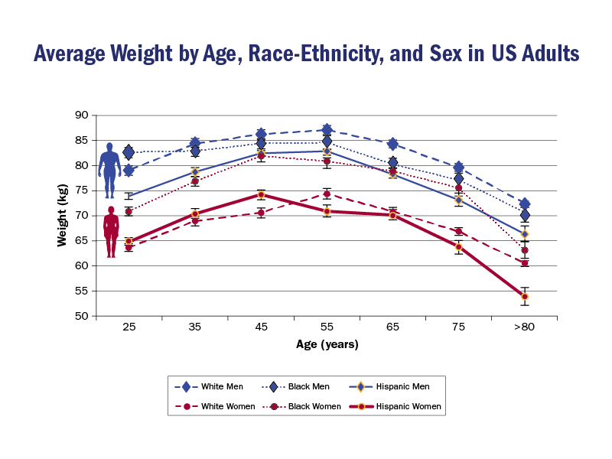
Reproduced with permission from Cardiovascular disease in the elderly. In: Bonow RO, Mann DL, Zipes DP, Libby P. Braunwald’s Heart Disease: A Textbook of Cardiovascular Medicine. 9th ed. Philadelphia: Elsevier Saunders; 2011.
Notes:
Age-related body composition changes are most prominent after age 75, with an increase in fat/muscle ratio. As we can see in the figure, gender differences can be significant, as women tend to weight less and have smaller bodies. Body composition changes vary as well according to ethnicity

Slide 5
Pharmacokinetics in Older Adults
Pharmacokinetics refer to the processing of a drug after it is administered, which includes absorption, distribution, metabolism and excretion
“What the body does to the drug”.
Age-related changes in absorption have not been shown to have significant impact on drug absorption
In contrast, significant changes in drug distribution, metabolism and excretion have been shown to be clinically important and should be considered when administering medications in older adults with cardiovascular disease

Slide 6
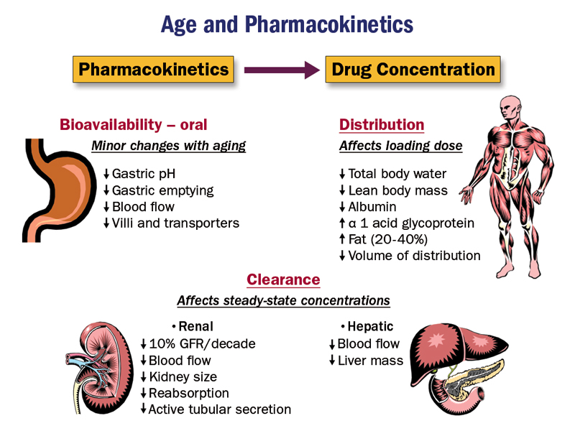
?
CYP activity

Slide 7
Pharmacodynamics in Older Adults
Pharmacodynamics
“What the drug does to the body”
Older adults can exhibit increased sensitivity to certain agents, such as antiplatelet drugs, anticoagulants, nitrates and calcium channel blockers, and those with central nervous system or anticholinergic effects
During acute coronary syndromes, loading doses for heparin and thrombolytics should be based on weight and renal function, which usually results in lower recommended doses for older adults (esp. small older white women)

Slide 8
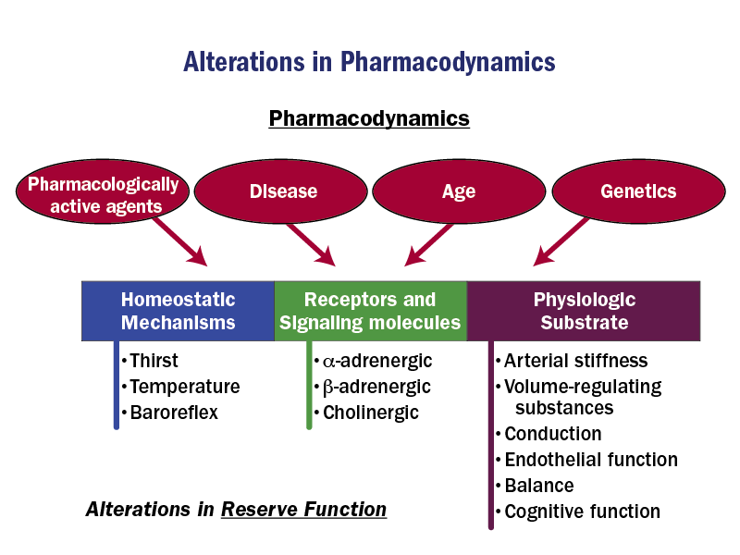
Notes:
By itself, advancing age predisposes to increased sensitivity to many commonly used cardiovascular medications; in addition, multi-morbidity and individual genetic differences alter the responses of a cardiovascular system that has a reduced residual reserve, when compared to younger adults.

Slide 9
Adverse Drug Events:
A Major Problem in Older Adults
Adverse drug events (ADEs) are the fourth leading cause of hospital admissions of older adults in the US.
One in every four admissions of elderly patients can be related to an ADE
Clinically, altered mental status is very common as part of the presentation of ADEs
A significant fraction of ADEs can be anticipated, lessened or prevented with attention and knowledge of pharmacologic changes germane to older adults

Slide 10
What are the Most Frequent Causes of Adverse Drug Events in the Elderly?
Polypharmacy - Concomitant administration of multiple pharmacologically active agents leading to unwanted interactions or increased drug concentrations or effects
  prescription drug–prescription drug, prescription drug–over-the-counter drug, prescription drug–herbal medication, and prescription drug–dietary supplement)
Failure to adjust for reduced drug clearance (esp. renal)
Enhanced drug effects coupled with reduced reflex responses and/or disease states

Slide 11
POLYPHARMACY:
Increased risk of bleeding with Rivaroxaban
Piccini, et. al. Circulation. 2016;133:352-360.

Slide 12
Renal Function in Older Adults:
More than just the Creatinine
Due to the reduced muscle mass in older people, a concomitant decrease in creatinine (byproduct of muscle mass breakdown) occurs, which can result in “normal” creatinine values despite the presence of reduced renal function.
The tool most frequently used for renal clearance-adjusted dosing is the Cockcroft-Gault equation that incorporates age, sex, and serum creatinine ; a variety of mobile apps and online calculators are available.
  While estimated glomerular filtration rate is a more accurate reflection of renal disease status it has not been used to develop renal dosing adjustments for most FDA-approved medications that are renally excreted.

Slide 13
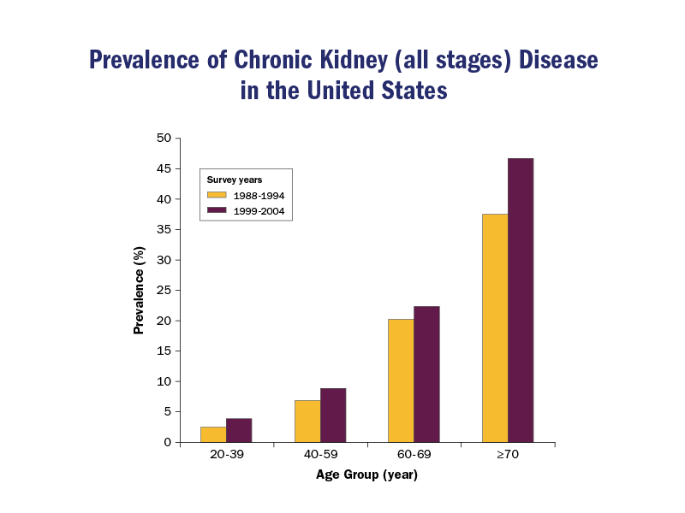
Reproduced with permission from Coresh J, Selvin E, Stevens LA, et al. Prevalence of chronic kidney disease in the United States. JAMA 2007;298:2038-47.
Notes:
Chronic kidney disease (CKD) is a growing health problem that disproportionately affects older adults; effective glomerular filtration rate (eGFR) decreases by 8 ml/min each decade after age 40; this results in the presence of CKD in more than 25% of adults over the age of 70. In many cases, this decline has practical pharmacologic implications.

Slide 14
Drug-Drug Interactions:
Unintended Consequences
Multimorbidity goes hand in hand with polypharmacy in older adults
Drug-drug interactions can be due to altered pharmacokinetics (e.g. competing for protein binding, enzymatic metabolism or renal clearance) or pharmacodynamics
The risk of adverse drug-drug interactions increases exponentially as the medication list grows in older adults

Slide 15
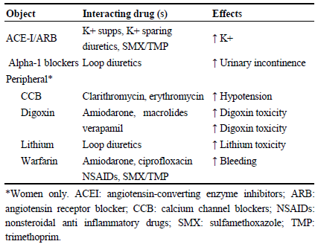
Dangerous Liaisons
Brenes-Salazar JA , Alshawabkeh L, Schamder KE et al. J Geriatr Cardiol 2015; 12: 192-195

Slide 16
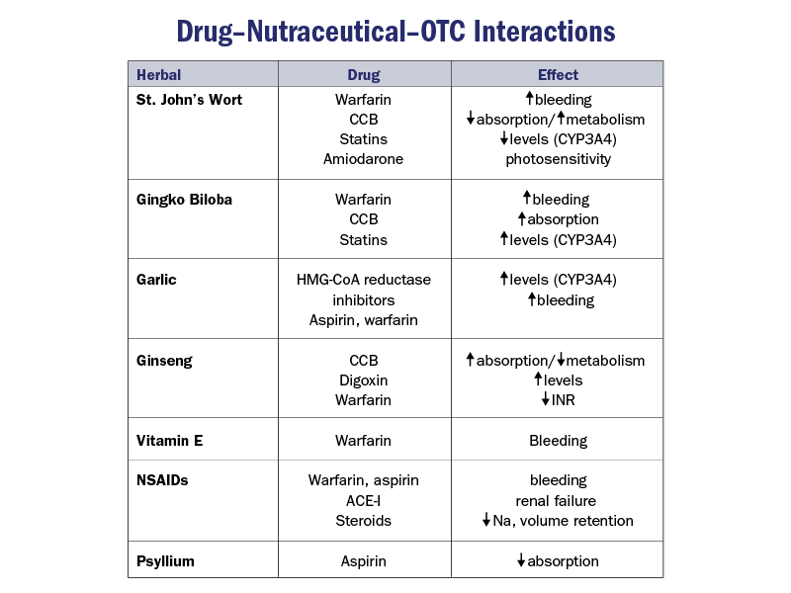
Notes:
Between 30 and 90% of older adults use at least one over-the –counter (OTC) product, and roughly 60 to 75% of them may consume a herbal, vitamin, or nutritional supplement. All of these should be assessed at the time of medication reconciliations, both in the inpatient and ambulatory setting, as many of these have significant clinical interactions with commonly prescribed cardiovascular drugs

Slide 17
Drug-physiologic Substrate Interactions
Age-related physiologic changes that impact response to cardiovascular medications (especially diuretics and vasodilators) include increased ventricular and central arterial stiffness, attenuated autonomic reflexes and volume-regulating hormones
Lightheadedness, orthostatic hypotension and syncope can occur due to these cardiovascular changes
Gastrointestinal transit in older adults can significantly decrease in the presence of bile acid sequestrants, opiates, drugs with anticholinergic effects and calcium channel blockers, leading to constipation
In addition, certain adverse drug events (ADEs) are unintended consequences of interactions between medications and additional patient’s comorbidities (examples follow)

Slide 18
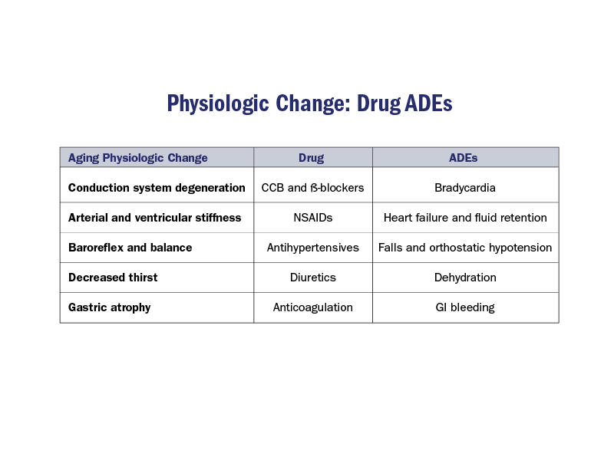
Notes:
Older adults should be educated about the cardiovascular risks of NSAIDs. A possible association with increased cardiovascular death and events has been noted for most NSAIDs; older adults are at particular risk of edema and heart failure exacerbations precipitated by these agents, as well as decrease in renal function and hyperkalemia, which may be exacerbated in the presence of certain cardiovascular drugs, such as ACE inhibitors or ARBs

Slide 19
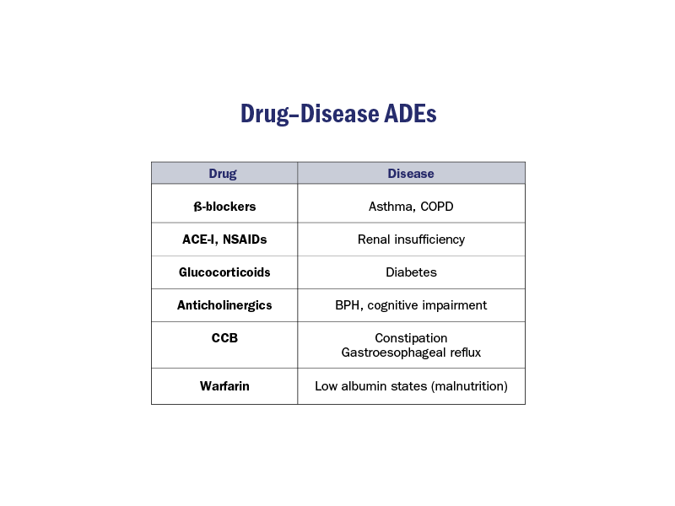

Slide 20
Epidemiology of Medication Non-Adherence in the Elderly
It is estimated that at least 50% of elderly patients are not adherent with prescribing directions with at least one of their medications
However, the same is true for their younger counterparts
Non-adherence in older adults is a complex issue, as many medical, personal, educational, socioeconomic and cultural risk factors can contribute

Slide 21
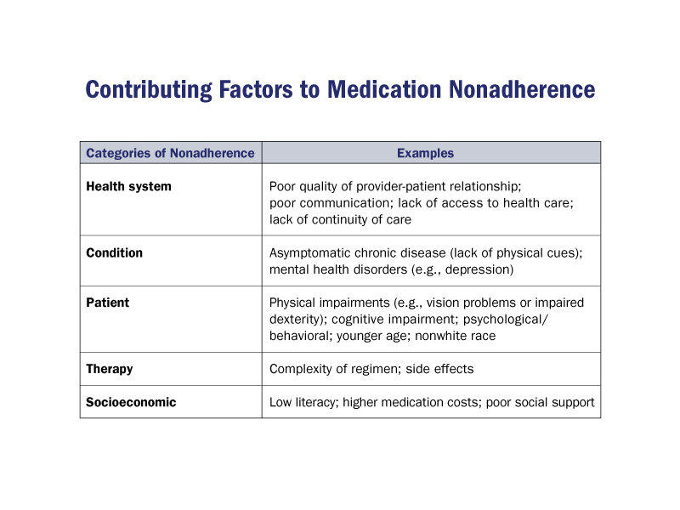
Notes:
Many risk factors for medication non-adherence disproportionately affect older adults when compared to younger, more functional patients, such as neuro-sensorial impairments, cognitive decline, and limited or fixed income. Barriers to compliance should be explored in every inpatient and ambulatory encounter.

Slide 22
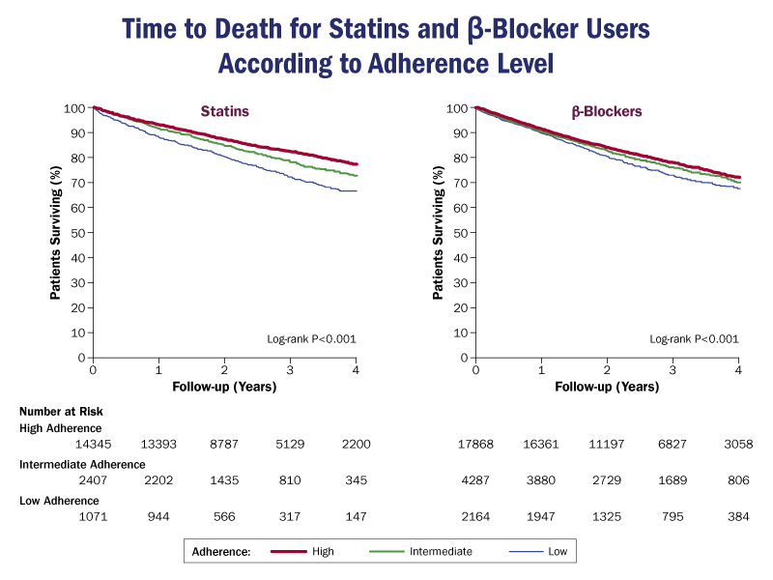
Reproduced with permission from Rasmussen JN, Chong A, Alter DA. Relationship between adherence to evidence-based pharmacotherapy and long-term mortality after acute myocardial infarction. JAMA 2007;297:177-86.
Notes:
In a study of 31,455 elderly patients with median follow-up of 2.4 years following acute MI, patients with high adherence to statins (≥80% of days covered) were observed to have an 8% absolute risk reduction in death compared to patients with low adherence (<40% of days covered). A statistically similar, but less pronounced effect was observed for beta-blockers

Slide 23
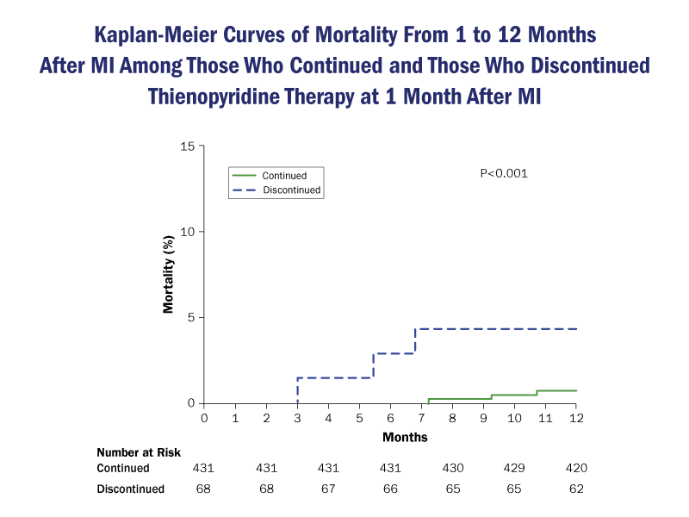
Reproduced with permission from Spertus JA, Kettelkamp R, Vance C, et al. Prevalence, predictors, and outcomes of premature discontinuation of thienopyridine therapy after drug-eluting stent placement: results from the PREMIER registry. Circulation 2006;113:2803-9.
Notes:
In a study of 500 patients who received a drug-eluting stent following acute MI, 13.6% stopped taking their prescribed thienopyridine drug within 30 days following discharge; age was a strong predictor for discontinuing the drug. Compared to adherent patients, those who discontinued thienopyridine had a 10-fold higher likelihood of death within 11 months.

Slide 24
Strategies to Improve Medication Adherence in Older Adults
Reduce cost (generics, lower co-pay)
Facilitate access (pharmacy, mail order, assistance)
Simplify the dosing regimen (once daily, convenient administration times, associate with a daily cue (e.g. meals)
Use of adherence and reminder aids, low tech or high tech --- family, pillboxes, calendars, alarms, mobile applications
Involve and educate family and caregivers!

Slide 25
Strategies to Improve Medication Adherence in Older Adults (Cont.)
Regimens that entail every other day dosing are less likely to succeed
Adjust diuretic dosage times in more active patients so that they do not interfere with activity or sleep
Patient adherence improves when matched to each individual patient’s needs and goals
Ensure that patients have an understanding of the purpose and potential benefit of each drug and address concerns regarding adverse effects and barriers to adherence.

Slide 26
Key Points
Medication dosing in older adults should contemplate age-related changes in body composition; this particularly translates in smaller weight-based loading doses
An older adult may have clinically significant renal impairment in the presence of a “normal” creatinine; estimate GFR in the elderly and adjust medication dosage accordingly
Some adverse drug events in older adults can be anticipated, prevented or lessened with careful review of patient-specific dosing, drug-drug, and drug-disease interactions
Medication non-adherence in older adults with cardiovascular disease is a complex issue, but simple patient-centered strategies can be used to minimize its adverse impact

Slide 27
Additional Readings
Cusack BJ. Pharmacokinetics in older persons. Am J Geriatr Pharmacother 2004;2:274-302.
Bowie MW, Slattum PW. Pharmacodynamics in older adults: a review. Am J Geriatr Pharmacother 2007;5:263-303
Schwartz JB and D Zipes. In: Mann DL, Zipes DP. Libby P, Bonow RO. Braunwald's Heart Disease: A Textbook of Cardiovascular Medicine. 10th ed. Philadelphia: Saunders Elsevier; 2014: Geriatric Cardiology: Chapter 76.
Zhan C, Correa-de-Araujo R, Bierman AS, et al. Suboptimal prescribing in elderly outpatients: potentially harmful drug-drug and drug-disease combinations. J Am Geriatr Soc 2005;53:262-7.
Gurwitz JH, Field TS, Harrold LR, et al. Incidence and preventability of adverse drug events among older persons in the ambulatory setting. JAMA 2003;289:1107-16.

Slide 28


