Slide 1
Syncope in the Older Adult
Geriatric Cardiology Section of the
American College of Cardiology

Slide 2
Objectives
Discuss the impact of age on the incidence and prevalence of syncope, as well as on the morbidity and mortality associated with this condition
Recognize how the etiology of syncope changes with advancing age
Explain the appropriate use and diagnostic yield of tests and procedures in the evaluation of syncope in older adults
Recognize that comorbid conditions and medications impact the diagnosis and management of syncope in older adults
Notes:
The objectives of this talk are as follows:
To discuss the impact of age on the incidence and prevalence of syncope, as well as on the morbidity and mortality associated with this condition.
To recognize how the etiology of syncope changes with advancing age.
To explain the appropriate use and diagnostic yield of tests and procedures in the evaluation of syncope in older adults.
And to recognize that comorbid conditions and medications impact the diagnosis and management of syncope in older adults.

Slide 3
Relevance
Syncope is associated with significant morbidity and mortality in older adults
>10% of falls in the elderly may be caused by syncope
Up to 35% of syncopal episodes result in injury
2-year mortality rate of older patients with syncope ~30%
Understanding the unique aspects related to syncope diagnosis and management in older adults may limit these adverse outcomes
Notes:
Why is this relevant?
Syncope is associated with significant morbidity and mortality in older adults, with more than 10% of falls in the elderly caused by syncope.
Syncope results in injury in up to 35% of cases, and carries a 2-year mortality rate of ~30% in older adults.
Understanding the unique aspects related to syncope diagnosis and management in older adults can hopefully limit these adverse outcomes.

Slide 4
Case
An 85-year-old woman with a history of hypertension, hyperlipidemia, and cerebrovascular accident 10 years ago is brought to the emergency department after “passing out” at the dinner table after eating a large bowl of pasta. She denies any prodromal symptoms. She quickly regained consciousness <1 minute afterwards without confusion or other neurologic complaints. This is her second episode in 6 months.
Notes:
I’d like to start with a case—
An 85-year-old woman with a history of hypertension, hyperlipidemia, and cerebrovascular accident 10 years ago is brought to the emergency department after “passing out” at the dinner table after eating a large bowl of pasta. She denies any prodromal symptoms. She quickly regained consciousness <1 minute afterwards without confusion or other neurologic complaints. This is her second episode in the past 6 months.

Slide 5
Syncope
Defined as a self-limited transient loss of consciousness and postural tone due to global cerebral hypoperfusion
Syncope and unexplained falls may be indistinguishable on clinical grounds, as there is frequently an element of retrograde amnesia
Unexplained falls in the elderly should be managed as potential syncope, especially when recurrent
Older adults with syncope have ~3.5 chronic medical illnesses and are taking 3x as many medications as the general population; these factors contribute to the complexity of assessing and managing syncope in older patients
Notes:
Syncope is defined as a self-limited transient loss of consciousness and postural tone due to global cerebral hypoperfusion.
Syncope and unexplained falls may be indistinguishable on clinical grounds, as there is frequently an element of retrograde amnesia
Unless proven otherwise, unexplained falls in the elderly, especially when recurrent, should be managed as potential syncope.
Older adults with syncope have ~3.5 chronic medical illnesses and are taking 3x as many medications as the general population, contributing to the complexity of assessing and managing syncope in older patients

Slide 6
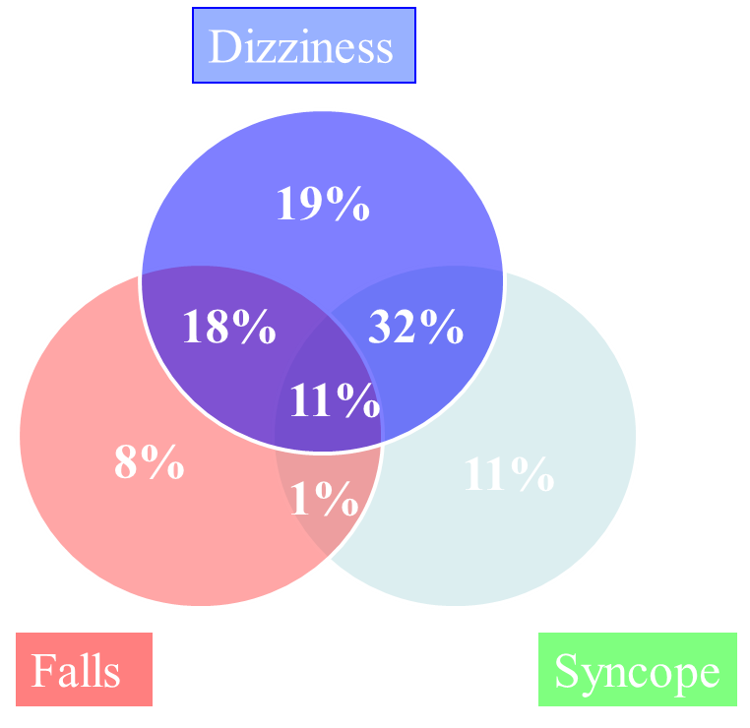
Overlapping Entities
McIntosh S, et al. Age Ageing, 1993
Notes:
There is a great deal of overlap between common symptoms of dizziness, falls, and syncope among the elderly.
In a study of 65 consecutive elderly patients (mean age of 78), over half had overlap of at least 2 out of the 3 symptoms; and 11% had all 3

Slide 7
Prevalence by Age
Rate per 1000 person-years
Syncope becomes increasingly common among the aged, with an overall prevalence of >20% in age>75, and an annual incidence approaching 2% in those aged >80 years.
Soteriades ES, et al. NEJM 2002
Notes:
Syncope becomes increasingly common among the aged, with an overall prevalence of >20% in age>75, and an annual incidence approaching 2% in those aged >80 years.

Slide 8
Contributors in the Elderly
Baroreflex impairment
Side effects of vasodilators
Increased ventricular/vascular coupling
Syncope in the Elderly
Impaired adrenergic response
Decreased salt/water handling
Decreased renin-aldosterone levels
Forman DE, et al. Cardiol Clin 1997
Notes:
There are numerous age-related changes in cardiovascular structure and function that contribute to the incidence and prevalence of syncope in the elderly.
These include: Impaired baroreceptor function, polypharmacy including side effects of vasodilators, increased ventricular/vascular coupling and diastolic dysfunction, impaired adrenergic response, decreased salt and water handling and relative reduction of intravascular volume, and decreased renin-aldosterone levels

Slide 9
What is the differential diagnosis?
Notes:
So what is on differential for older adults with syncope?

Slide 10
Etiologies
Types of syncope differ across age, largely due to the prevalence of age-related cardiovascular changes and polypharmacy in older adults
Compared to younger patients, syncope in the elderly tends to be multifactorial
Etiologies of syncope can be grouped according to underlying pathophysiology
Arrhythmic
Neurally mediated
Orthostatic and dysautonomic
Structural cardiovascular
It is important to distinguish the above from mimickers of syncope, such as seizures and stroke
Notes:
Types of syncope differ across age, largely due to the prevalence of age-related cardiovascular changes and polypharmacy in older adults.
Compared to younger patients, syncope in the elderly tends to be multifactorial.
Etiologies of syncope can be grouped according to underlying pathophysiology: Arrhythmic, Neurally mediated, Orthostatic and dysautonomic, and Structural cardiovascular
It is also important to distinguish the above from mimickers of syncope, such as seizures and stroke

Slide 11
Etiologies Based on Pathophysiology
Arrhythmic | Neurally mediated | Dysautonomic/ orthostatic | Cardiovascular structural | Mimics of syncope
Ventricular tachycardia | Vasovagal | Hypovolemia | Aortic stenosis | Stroke/TIA
Torsades de pointes | Vasodepressor | Medications | Aortic dissection | Seizures
Supraventricular tachycardia | Carotid sinus hypersensitivity | Post-prandial | Hypertrophic cardiomyopathy | Migraine
A-fib/flutter | Post-micturition/ defecation | Parkinson’s | Pulmonary hypertension | Narcolepsy
Sick sinus syndrome | Post-cough | Diabetic/other neuropathies | Atrial myxoma | Panic attacks
AV block | Post-laugh | Amyloid | Pulmonary embolism | Conversion disorder
Pacemaker syndrome | Post-exercise | Spinal Cord Disease | Subclavian steal | Concussion
Notes:
Here is a table demonstrating a breakdown of the etiologies according to underlying pathophysiology.
Arrhythmia includes both ventricular and supraventricular arrhythmias, as well as conduction disturbances
Neurally-mediated causes include vasovagal/vasodepressor syncope, carotid sinus hypersensitivity, and can occur following specific activities like micturation or bowel movements, or even following a cough, laughing, or exercise
Dysautonomic/orthostatic causes include syncope related to hypovolemia or medications, or can occur following a meal or as a result of systemic disease
And cardiovascular structural causes results from intrinsic diseases of the heart, lungs, or vasculature
Mimickers of syncope largely include neurologic and psychiatric syndromes.

Slide 12
What are the most likely causes in older adults?
Notes:
So what is the most likely cause among older adults?

Slide 13
Incidence of Etiologies
In a study performed in 2006, the majority of syncope (2/3 in fact) was caused by a neurally-mediated process.
Brignole M, et al. Eur Heart J 2006
Notes:
In a study performed in 2006, the majority of syncope (2/3 in fact) was caused by a neurally-mediated process.

Slide 14
Neurally Mediated: Vasovagal
Described as reflex-mediated syncope due to sudden transient autonomic failure to maintain vascular tone (typically from sudden withdrawal of sympathetic system)
May be preceded by prodrome (less likely in older adults)
Two mechanistic subtypes represent ends of spectrum
Vasodepressor (primarily driven by vasodilation)
Cardio-inhibitory (primarily driven by bradycardia)
May occur during micturation or bowel movements via sympathetic withdrawal
Preventative measures include increased fluid intake, compression stockings, and counter-pressure maneuvers
Notes:
Vasovagal syncope is a neurally-mediated cause of syncope.
It is classically described as reflex-mediated syncope resulting from a sudden transient autonomic failure to maintain vascular tone.
This is typically due to the sudden withdrawal of the sympathetic system.
In brief, prolonged orthostatic stress results in an increased amount of peripheral venous pooling to a point great enough that the venous return to the heart falls so precipitously that a significant increase in ventricular inotropy occurs. This hypercontractile state is believed to activate mechanoreceptors that would normally fire only during stretch. The sudden increase in neural traffic to the medulla is thought to mimic the conditions seen in hypertension, thus causing an apparent “paradoxic” decline in sympathetic activity that results in hypotension, bradycardia, and ultimately syncope
Vasovagal syncope may be preceded by prodrome, though this is less likely to be the case in older adults.
Two mechanistic subtypes represent ends of the spectrum—Vasodepressor syncope is primarily driven by vasodilation; whereas cardio-inhibitory syncope is primarily driven by bradycardia.
Given the role of sympathetic withdrawal in the mechanism of vasovagal syncope, it is not surprising that vasovagal syncope can occur during micturation or bowel movements as well.
Preventative measures include increased fluid intake, compression stockings, and counter-pressure maneuvers such isometric arm contraction, leg crossing, or muscle tensing

Slide 15
Neurally Mediated: CSH
Syncope precipitated by factors that exert pressure in the neck may be suggestive of carotid sinus hypersensitivity (CSH), an underappreciated cause of syncope in the elderly
CSH and carotid sinus syndrome (i.e., symptomatic CSH) become increasingly common at an older age, with >30% of unexplained falls and syncope representing CSH among older patients
It is diagnosed by carotid sinus massage, where it causes an asystolic period of ≥3 seconds and/or a fall in systolic blood pressure of ≥50 mm Hg or to less than 80mmHg
Notes:
Cartoid sinus hypersensitivity is an underappreciated cause of neurally mediated syncope in the elderly
Syncope precipitated by factors that exert pressure in the neck may be suggestive of carotid sinus hypersensitivity (CSH).
CSH and carotid sinus syndrome (which essentially is symptomatic CSH) become increasingly common at an older age, with >30% of unexplained falls and syncope among older adults representing CSH.
Diagnosis is typically made by performing a carotid sinus massage. An asystolic period of ≥3 seconds and/or a fall in systolic blood pressure of ≥50 mm Hg or to less than 80mmHg are diagnostic of CSH.

Slide 16
Orthostatic Hypotension
A very common cause of syncope in the elderly, which underscores the importance of obtaining postural vital signs
Usually occurs due to volume contraction, medications, or autonomic dysfunction
An additional diagnostic challenge in the elderly is the fact that asymptomatic reductions in blood pressure when assuming the upright position is occasionally documented, and may erroneously be attributed as the cause of syncope
Preventative measures may include avoidance of certain medications, maintenance of euvolemia, and compression stockings
Notes:
Orthostatic hypotension is another very common cause of syncope in the elderly, underscoring the importance of obtaining postural vital signs
This usually occurs due to volume contraction, medications, or autonomic dysfunction.
It is important to recognize that asymptomatic reductions in blood pressure when assuming the upright position is occasionally documented, and may erroneously be attributed as the cause of syncope.
Preventative measures may include avoidance of certain medications (for example, alpha blockers and vasodilators), maintenance of euvolemia, and compression stockings

Slide 17
Postprandial Syncope
Defined as syncope that occurs following a meal, due to splanchnic blood pooling
More often associated with warm foods and carbohydrates; typically occurs 30-90minutes after meal
May be prevented by drinking cold water (transiently increases blood pressure), and caffeine (also increases blood pressure)
Notes:
Postprandial syncope is defined as syncope that occurs following a meal, and occurs due to splanchnic blood pooling which results from redirecting blood to the gut for digestion. It is more often associated with warm foods and carbohydrates, typically occurring about 30-90minutes after a meal.
Preventative measures include drinking cold water and caffeine both of which transiently increase blood pressure

Slide 18
Primary Autonomic Failure
An important cause of recurrent syncope in older patients
May be idiopathic or due to diabetes, amyloidosis, chronic recumbency (i.e., being bed-ridden), or various neurological disorders including multiple system atrophy, Bradbuy-Eggleston syndrome, or Parkinsonism (Shy-Drager)
Unfortunately, treatment is challenging and often unsuccessful
New FDA-approved agent, Droxidopa (Northera) acts as an oral prodrug for norepinephrine, and may improve symptoms
Notes:
Primary autonomic failure is an important cause of recurrent syncope in older patients
This may be idiopathic or due to diabetes, amyloidosis, chronic recumbency (i.e., being bed-ridden), or various neurological disorders including multiple system atrophy, Bradbuy-Eggleston syndrome, or Parkinsonism (aka, Shy-Drager)
While treatment is challenging and often unsuccessful, a new FDA-approved agent, Droxidopa (Northera), offers some promise. This novel agent acts as an oral prodrug for norepinephrine, and may improve symptoms.

Slide 19
Arrhythmic
Prevalence increases with age
Bradycardia secondary to medications, or sick sinus syndrome from degenerative changes in the sinus node can cause syncope
Ventricular tachycardia is particularly relevant in the setting of coronary artery disease (CAD) or LV dysfunction
Atrial fibrillation can cause syncope due to sinus pauses with delayed sinus node recovery (more common), or due to slow ventricular rates with intermittent atrioventricular (AV) block
Acute coronary syndromes presenting with syncope are relatively rare
Notes:
There’s also arrhythmic causes of syncope, which are generally less common but increase in prevalence with age.
Bradycardia secondary to medications, or sick sinus syndrome from degenerative changes in the sinus node can cause syncope
Ventricular tachycardia is particularly relevant in the setting of coronary artery disease (CAD) or LV dysfunction
And atrial fibrillation can cause syncope due to sinus pauses with delayed sinus node recovery (more common), or due to slow ventricular rates with intermittent atrioventricular (AV) block. While acute coronary syndromes can present with syncope, it is relatively rare

Slide 20
What is the work-up for syncope in older adults?
Notes:
So what should be done as part of the work-up for syncope in older adults?

Slide 21
Initial Workup
Should include:
A thorough history
Physical examination
12-lead ECG
A specific diagnosis can be achieved in at least 50% of cases with this initial information
Structural heart disease is rare in the absence of a suggestive initial evaluation
Provocative tests such as postural vital signs (ironically obtained in ~38%) are more likely to yield a definitive diagnosis than structural imaging modalities. They also represent the most cost-effective test.
Notes:
An initial workup should include the basics—a thorough history, the physical examination, and a 12-lead ECG
A specific diagnosis can be achieved in at least 50% of cases with this initial information
Structural heart disease is an important cause of syncope, but is rare in the absence of a suggestive initial evaluation
It is important to note that provocative tests such as postural vital signs (ironically obtained in less than half of cases; ~38%) are more likely to yield a definitive diagnosis than structural imaging modalities; and also represent the most cost-effective test.

Slide 22
Costs of Diagnostic Tests
(Among 2106 admissions in 1920 patients)
Mendu ML, et al. Arch Internal Med, 2009
Notes:
Here is a table looking at the costs of diagnostic studies for syncope, as well as the cost per test affecting diagnosis and management.
As you can see, provocative tests like postural blood pressure, which can simply be performed at the bedside even by a medical student, represent the most cost-effective test.

Slide 23
Case, Cont.
An 85-year-old female with HTN, HL, CVA presenting with 2nd episode of “passing out,” this time at the dinner table
She takes lisinopril 20mg daily, atorvastatin 20mg daily, and aspirin 81mg daily
Vital signs, including orthostatic maneuvers, are within normal limits. Physical examination reveals a discrete grade 2/6 mid-peaking systolic ejection murmur at the left second intercostal space with no radiation and an intact second heart sound, but is otherwise unremarkable, including a nonfocal neurologic exam. Basic labwork including CBC and BMP are also within normal limits.
Notes:
Our patient takes lisinopril 20mg daily, atorvastatin 20mg daily, and aspirin 81mg daily
Vital signs, including orthostatic maneuvers, are within normal limits.
Physical examination reveals a discrete grade 2/6 mid-peaking systolic ejection murmur at the left second intercostal space with no radiation with an intact second heart sound. The remainder of the exam is normal, including a nonfocal neurologic exam.
Basic labwork including a CBC and BMP are also within normal limits.

Slide 24
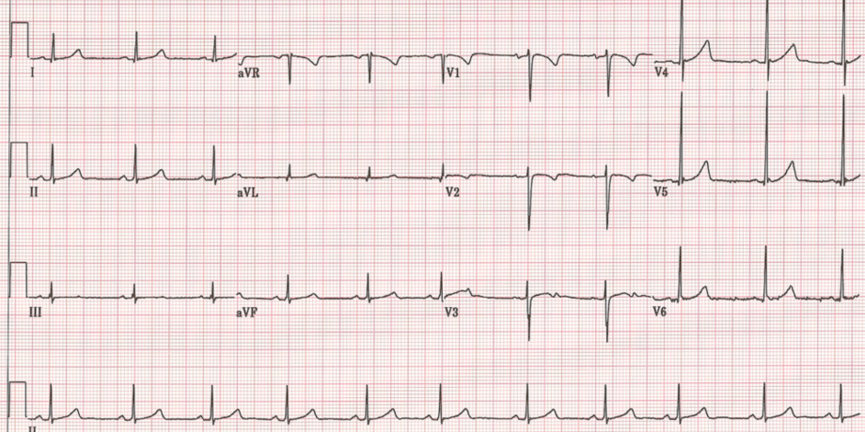
ECG
Notes:
Here is her EKG, which is normal sinus rhythm, and without any abnormality

Slide 25
Historical Clues for Diagnosis
Historical Clue | Possible Diagnosis
Nausea, diaphoresis, long prodrome, no CV disease, syncope of more than 4 years | Neurally-mediated syncope
During/after unpleasant stimulus, defecation, micturition, laughter, swallowing, coughing | Neurally-mediated syncope
During/after a meal | Post-prandial hypotension
With neck pressure | Carotid sinus hypersensitivity
After assuming upright posture | Orthostatic hypotension
During exertion | Aortic stenosis, HCM, myocardial ischemia
With arm exercise | Subclavian steal
While supine/History of CHF or MI | Arrhythmic
Confusion, tongue biting, head turning | Seizure
Notes:
The history can really inform the etiology of syncope.
Some important historical clues are shown here.

Slide 26
Is hospitalization necessary?
Notes:
Is hospitalization necessary? Well the short answer is: not always.

Slide 27
Risk Stratification
It is critical to risk-stratify patients with syncope according to the probability of life-threatening events in the short-term
Risk stratification can identify patients who will benefit from hospitalization and expedited evaluation
Elderly patients can be stratified into low and high risk of death based on the presence of pre-existing heart disease
Notes:
It is important to risk-stratify patients with syncope according to the probability of life-threatening events in the short-term
Risk stratification can identify patients who will benefit from hospitalization and expedited evaluation
Elderly patients can be stratified into low and high risk of death based on the presence of pre-existing heart disease

Slide 28
Low Risk vs. High Risk
Low Risk (rarely requires inpatient evaluation):
Presence of normal LV systolic function, lack of wall-motion abnormalities or clinical history of myocardial infarction, and no evidence of conduction disease on ECG make a cardiac etiology less likely
High Risk (warrants inpatient care):
Individuals with evidence of significant cardiovascular disease, abnormal vital signs (mainly hypotension, tachycardia, and hypoxemia), and key abnormal laboratory values (anemia, elevated troponins, elevated BNP)
Notes:
Low Risk syncope includes:
The presence of normal LV systolic function, lack of wall-motion abnormalities or clinical history of myocardial infarction, and no evidence of conduction disease on ECG. In these cases, a cardiac etiology is less likely, and inpatient evaluation is rarely necessary
High risk syncope includes:
Individuals with evidence of significant cardiovascular disease, abnormal vital signs (such as hypotension, tachycardia, and/or hypoxemia), and key abnormal laboratory values (anemia, elevated troponins, and/or elevated BNP). Its really these people that have worse short term outcomes, and therefore warrant inpatient care.

Slide 29
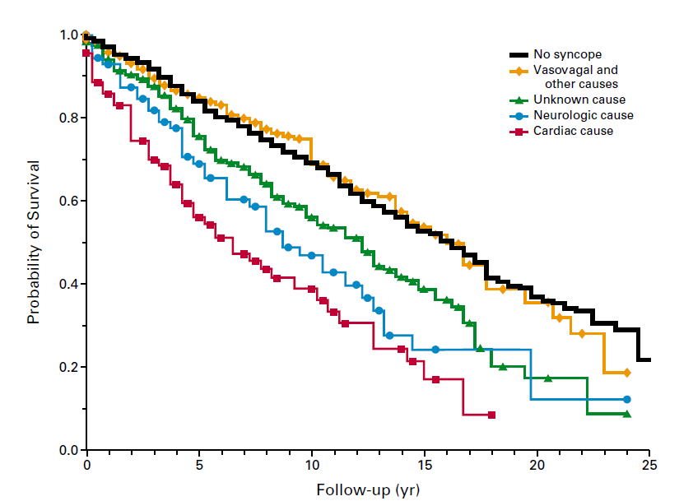
Syncope Stratified by Risk of Death
Soteriades ES, et al. NEJM 2002
Notes:
Here’s a study from 2002 evaluating the prognosis of syncope among participants in the Framingham Heart Study from 1971 to 1998. You’ll note that among the 822 individuals who reported syncope, those with a cardiac cause had the worst survival at each time point of the study.
This highlights the importance of identifying those who are at risk for cardiac causes.

Slide 30
Available Risk Scores
Boston Syncope Criteria (sensitivity 97%, spec. 62%) | Risk Stratification of Syncope in ER – ROSE (sensitivity 87%, spec. 65%) | San Francisco Syncope Rule (sensitivity 96%, spec. 62%)
Suspected ACS | BNP >300 pg/ml | History of CHF
Conduction disease | Positive guaiac | Hematocrit <30%
Worrisome cardiac history | Hemoglobin <9 g/dl | Shortness of breath
Valvular disease | Oxygen saturation <94% | Systolic BP <90 mm Hg
Family history of SCD | Q-wave on ECG | Abnormalities on ECG or cardiac monitor
Persistently abnormal vitals
Volume depletion
CNS event
Notes:
Accordingly, several risk stratifications tools have been developed with a particular focus on cardiac risk factors.
High-risk features, from the Boston Syncope criteria include: 1) signs/symptoms of ACS, 2) evidence of conduction disease, 3) concerning cardiac history, 4) valvular heart disease, 5) family history of sudden cardiac death, 6) persistently abnormal vital signs in the ED, 7) volume depletion, and 8) primary central nervous system event.
High risk parameters of the ROSE criteria (Risk Stratification of Syncope in the Emergency Room) include: 1) a BNP >300 pg/ml, 2) positive guaiac, 3) hemoglobin <9 g/dl, 4) oxygen saturation <94%, and 5) Q waves on ECG.
And high risk makers of the The San Francisco Syncope Rule includes: 1) a history of congestive heart failure, 2) hematocrit <30%, 3) shortness of breath, 4) systolic blood pressure <90 mm Hg, and 5) abnormal findings on ECG or cardiac monitoring.

Slide 31
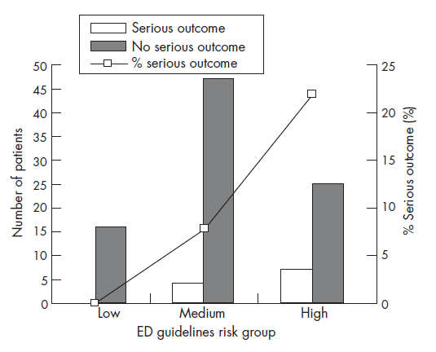
Risk Stratification
Reed MJ, et al. Emerg Med J 2007
Notes:
As seen here, higher risk (this study actually looked at BNP as a risk marker) was indeed associated with a higher % of serious outcomes

Slide 32
Syncope Units
Syncope units have been proposed in an effort to:
Standardize the evaluation and management of syncope providing an individualized and effective assessment
Increase diagnostic yield
Improve clinical outcomes
Such units are usually multidisciplinary in nature, involving ED staff, cardiologists, and physicians with expertise in syncope
Notes:
The insurgence of syncope observational units have occurred in order to: 1.) Standardize the evaluation and management of syncope providing an individualized and effective assessment, 2.) Increase diagnostic yield, 3.) and Improve clinical outcomes
Such units are usually multidisciplinary in nature, involving ED staff, cardiologists, and physicians with expertise in syncope

Slide 33
Benefits of Syncope Units
Facilitate an efficient and cost-effective assessment on an individualized basis designed to maximize diagnostic yield while minimizing the use of unnecessary expensive tests
Increase the proportion of syncope cases for which a definitive diagnosis is established
Decrease hospital admissions; lower the cost of care
Have not been shown to reduce mortality or the frequency of recurrent syncopal events, and have not yet been implemented on a large-scale basis
Notes:
The theoretical benefits of syncope units are that they:
1.) Facilitate an efficient and cost-effective assessment on an individualized basis designed to maximize diagnostic yield while minimizing the use of unnecessary expensive tests
2.) Increase the proportion of syncope cases for which a definitive diagnosis is established
3.) And decrease hospital admissions, reducing overall cost of care
With that said, to date they have not yet been shown to reduce mortality or the frequency of recurrent syncopal events, and have not yet been implemented on a large-scale basis

Slide 34
Case, Cont.
An 85-year-old female with HTN, HL, CVA presenting with 2nd episode of “passing out,” this time at the dinner table.
She takes lisinopril, atorvastatin, and aspirin.
Vitals signs including orthostatic maneuvers WNL; Physical exam with 2/6 mid-peaking SEM and intact S2. Neurologically intact. Normal CBC and BMP. Normal ECG
She is transferred to a syncope unit for further evaluation.
Notes:
Given that she appears low risk, she is transferred to a syncope unit for further evaluation.

Slide 35
Does she need an echocardiogram?
Notes:
Does she need an echo?

Slide 36
Utility of Echocardiography
Diagnostic yield is related to the probability of finding significant structural heart disease as suspected by careful initial history, physical examination, and ECG
Echocardiography is most useful to assess:
Severity of underlying cardiac disease
Confirm and classify suspected aortic stenosis
Risk stratification
It may be reasonable to defer echo in the early phase of workup if there are no suggestive cardiovascular findings
Notes:
The diagnostic yield of an echo is related to the probability of finding significant structural heart disease, which can reliably be based upon a careful initial history, physical examination, and ECG.
Echocardiography is really most useful to assess: Severity of underlying cardiac disease, to confirm and classify suspected aortic stenosis, and therefore for risk stratification
Even among older adults, it may be reasonable to defer an echo in the early phase of workup if there are no suggestive cardiovascular findings

Slide 37
Aortic Stenosis
Calcific degenerative AS is the most common valvular lesion in the elderly, with prevalence ~6% by age 86 years
It is associated with effort syncope, from inadequate increase in cardiac output commensurate with increased demands
Susceptibility to dehydration and use of vasodilators in the elderly may predispose to syncope if severe/critical AS is present
Notes:
As mentioned, echo is particularly helpful if you suspect aortic stenosis.
Calcific degenerative AS is the most common valvular lesion in the elderly, with a prevalence ~6% by age 86 years
It is associated with effort syncope, from inadequate increase in cardiac output commensurate with increased demands
The susceptibility to dehydration and use of vasodilators in the elderly may predispose to syncope if severe/critical AS is present

Slide 38
Classification of Aortic Stenosis Severity by Echo
Aortic stenosis severity may be classified by a variety of hemodynamic parameters, including jet velocity, mean gradient, valve area and valve area index as shown here.
 | Mild | Moderate | Severe
Jet velocity (m/sec) | <3.0 | 3.0-4.0 | >4.0
Mean gradient (mm Hg) | <25 | 25-40 | >40
Valve area (cm²) | >1.5 | 1.0-1.5 | <1.0
Valve area index (cm² per m²) |  |  | <0.6
Nishimura, et al. JACC, 2008
Notes:
Aortic stenosis severity may be classified by a variety of hemodynamic parameters, including jet velocity, mean gradient, valve area and valve area index as shown here.

Slide 39
Prognosis and Treatment of Aortic Stenosis
Prognosis
Presence of syncope or angina is associated with a median survival of 2-3 years
Symptoms of heart failure have a median survival of <2 years
Syncope, angina, and heart failure require prompt intervention to reduce the risk of progressive functional decline and the potential for sudden cardiac death
Aortic valve replacement is the only effective therapy
Can be performed with low perioperative mortality and excellent long-term results in older patients, including octogenarians
Percutaneous aortic valve replacement (TAVR) has emerged as an option for high-risk (and possibly intermediate-risk) surgical candidates
Notes:
The presence of syncope or angina is associated with a median survival of 2-3 years, and the presence of CHF symptoms have a median survival of <2 years.
Thus, syncope, angina, and heart failure require prompt intervention to reduce the risk of progressive functional decline and the potential for sudden cardiac death.
Aortic valve replacement is the definitive therapy for aortic stenosis.
It can generally be performed with low perioperative mortality and excellent long-term results in older patients, including octogenarians
For high risk candidates, percutaneous aortic valve replacement (TAVR) has emerged as an option, and will likely become an alternative to surgery for intermediate risk patients in the near future.

Slide 40
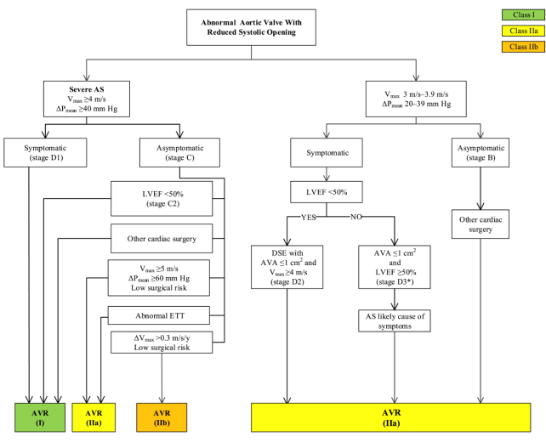
Treatment Algorithm
Here is the treatment algorithm from the recent 2014 AHA/ACC Guideline for the Management of Patients With Valvular Heart Disease
In brief, AVR is a class I indication for severe AS when symptomatic, when EF<50, or when undergoing other cardiac surgery.
It may also be reasonable to perform an AVR in the setting of very severe AS with low surgical risk, an abnormal exercise tolerance test, or quickly accelerating disease with low surgical risk.
Nishimura, et al. JACC, 2014
Notes:
Here is the treatment algorithm from the recent 2014 AHA/ACC Guideline for the Management of Patients With Valvular Heart Disease
In brief, AVR is a class I indication for severe AS when symptomatic, when EF<50, or when undergoing other cardiac surgery
It may also be reasonable to perform an AVR in the setting of very severe AS with low surgical risk, an abnormal exercise tolerance test, or quickly accelerating disease with low surgical risk

Slide 41
Case, Cont.
An 85-year-old female with HTN, HL, CVA presenting with 2nd episode of “passing out,” this time at the dinner table.
She takes lisinopril, atorvastatin, and aspirin.
Vitals signs including orthostatic maneuvers WNL; Physical exam with 2/6 mid-peaking SEM and intact S2. Neurologically intact. Normal ECG.
She is transferred to a syncope unit for further evaluation.
A transthoracic echo is performed due to murmur on physical exam, demonstrating a normal EF and mild aortic stenosis.
Notes:
A transthoracic echo is performed on our patient due to a murmur on physical exam, revealing a normal EF and mild aortic stenosis.

Slide 42
What other diagnostic studies are indicated?
Notes:
Are there other diagnostic studies that are indicated in the workup of syncope in older adults?

Slide 43
Additional Cardiovascular Studies
Carotid sinus massage can diagnose carotid sinus hypersensitivity. The risk of neurologic complications when performing massage is very low in the absence of audible carotid bruits, and a history of stroke/transient ischemic attack.
Tilt-table testing is able to identify a proportion of elderly patients who have either neurally mediated syncope or dysautonomia (e.g. orthostatic hypotension)
Notes:
Additional diagnostic cardiovascular studies may include carotid sinus massage which can diagnose carotid sinus hypersensitivity.
The risk of neurologic complications when performing massage is very low in the absence of audible carotid bruits, and a history of stroke/transient ischemic attack.
Tilt-table testing is also potentially helpful, as it can identify a proportion of elderly patients who have either neurally-mediated syncope or dysautonomia (e.g. orthostatic hypotension)

Slide 44
Indications for Tilt Table Testing
Class I
A single unexplained episode of syncope in a high-risk setting (e.g., occurrence of or potential for physical injury, or with occupational implications), or recurrent episodes in the absence of organic heart disease, or in the presence of organic heart disease after cardiac causes have been excluded
When it will be of clinical value to the patient to demonstrate susceptibility to neurally-mediated syncope
Class II
For assessing recurrent pre-syncope or dizziness
When an understanding of the hemodynamic pattern in syncope may alter therapy
Guidelines on Management (Diagnosis and Treatment) of Syncope – Update 2009
Executive Summary. The Task Force on Syncope, European Society of Cardiology.
Notes:
The indications for Tilt Table Testing are as follows:
It is a class I indication for a single unexplained episode of syncope in a high-risk setting (potential for physical injury, or with occupational implications like for a bus-driver), or recurrent episodes in the absence of organic heart disease, or in the presence of organic heart disease after cardiac causes have been excluded. More broadly, it is indicated when there is value in demonstrating susceptibility to neurally-mediated syncope
It is a class II indication for assessing recurrent pre-syncope or dizziness, specifically when an understanding of the hemodynamic pattern in syncope may alter therapy

Slide 45
Indications for Tilt Table Testing
Class III
Assessment of treatment
Single episode of syncope without injury and not in a high-risk setting
Clear-cut clinical vasovagal features leading to a diagnosis when demonstration of a neurally-mediated susceptibility would not alter treatment
Guidelines on Management (Diagnosis and Treatment) of Syncope – Update 2009
Executive Summary. The Task Force on Syncope, European Society of Cardiology.
Notes:
On the other hand, tilt table testing should not be used for the assessment of treatment, a single episode of syncope without injury and not in a high-risk setting, or for clear-cut vasovagal syncope where demonstration of a neurally-mediated susceptibility would not alter treatment

Slide 46
Additional Studies for Arrhythmia
Diagnostic yield of short-term ECG monitoring is low compared to long-term ECG monitoring
Beyond 24-hour Holter monitors, there are 2-week event monitors that may be helpful in detecting less frequent but clinically relevant arrhythmias. Wireless event monitors like the Zio patch (single ECG sensor) offer accuracy with additional convenience
Implantable loop recorders (ILR) have the highest diagnostic rates in patients with unexplained syncope, where bradycardia is more commonly identified than tachyarrhythmias
Invasive electrophysiologic testing (IEP) is rarely indicated; most older adults have bradyarrhythmias, for which IEP is unhelpful
Notes:
There are several useful studies when arrythmia is suspected—
In general, the diagnostic yield of short-term ECG monitoring is low compared to long-term ECG monitoring.
Beyond 24-hour Holter monitors, there are 2-week event monitors that may be helpful in detecting less frequent but clinically relevant arrhythmias. Wireless event monitors like the Zio patch (single ECG sensor) offer accuracy without the hassle of wearing multiple leads and wires.
Implantable loop recorders (ILR) have the highest diagnostic rates in patients with unexplained syncope, and typically reveals bradycardia more often then tachyarrhythmias.
Invasive electrophysiologic testing (IEP) is typically more useful for tachyarrhythmias, and is therefore rarely indicated for syncope in older adults, among whom the arrhythmic etiology is most commonly bradyarrhythmias

Slide 47
Indications for Electrophysiologic Testing
Class I: An arrhythmic cause of syncope is suspected based on symptoms, presence of severe structural heart disease, and/or ECG abnormalities
Class II
Patients with high-risk occupations in whom an arrhythmic cause of syncope needs to be excluded
To further characterize an arrhythmia that has already been identified as the cause of syncope
Class III: Patients without evidence for structural heart disease and normal ECGs
Guidelines on Management (Diagnosis and Treatment) of Syncope – Update 2009
Executive Summary. The Task Force on Syncope, European Society of Cardiology.
Notes:
Indications for an invasive electrophysiology study are as follows:
It is a Class I indication when an arrhythmic cause of syncope is suspected based on symptoms, presence of severe structural heart disease, and/or ECG abnormalities
It is a Class II indication for patients with high-risk occupations in whom an arrhythmic cause of syncope needs to be excluded (again, a bus-driver for example), and/or to further characterize an arrhythmia that has already been identified as the cause of syncope
Invasive electrophysiology testing is NOT indicated for patients without evidence for structural heart disease and normal ECGs

Slide 48
Other Diagnostic Studies
Utility for establishing the etiology of syncope in older adults is limited for the following tests due to low sensitivity and specificity:
Head computed tomography (CT) scanning
Carotid Doppler imaging
Electroencephalography
Notes:
In general, neurological testing such as head CT, carotid doppler imaging, and EEG are not particularly useful due to its low sensitivity and specificity

Slide 49
Utility of Neurology Consult
Although frequently requested, neurology consultation is unnecessary in most patients with true syncope, especially when the history and physical examination strongly suggest a cardiac etiology
Primary neurological events typically produce focal findings and are rarely the cause of true syncope which, by definition, is associated with transient loss of consciousness caused by global cerebral hypoperfusion without residual neurological deficits
Post-ictal state and/or tongue-biting are suggestive of seizures, warranting a formal neurological evaluation
Notes:
Although frequently requested, neurology consultation is also usually not necessary in most patients with true syncope, especially when the history and physical examination strongly suggest a cardiac etiology
Primary neurological events typically produce focal findings and are rarely the cause of true syncope which, by definition, is associated with transient loss of consciousness caused by global cerebral hypoperfusion without residual neurological deficits.
A formal neurological evaluation would be warranted in the presence of a post-ictal state and/or tongue-biting, as these are suggestive of a primary neurological event such as seizure

Slide 50
Diagnostic Yield of Testing
(n = 649; mean age 68)
Diagnostic yield, %
Less than 1%
Pires LA, et al. Arch Intern Med 2001
Notes:
In a study of 649 patients with a mean age of 68, you can see the diagnostic yield of several different studies in the setting of syncope, clearly demonstrating the utility of postural vital signs and tilt-table testing, and the dysutility of imaging

Slide 51
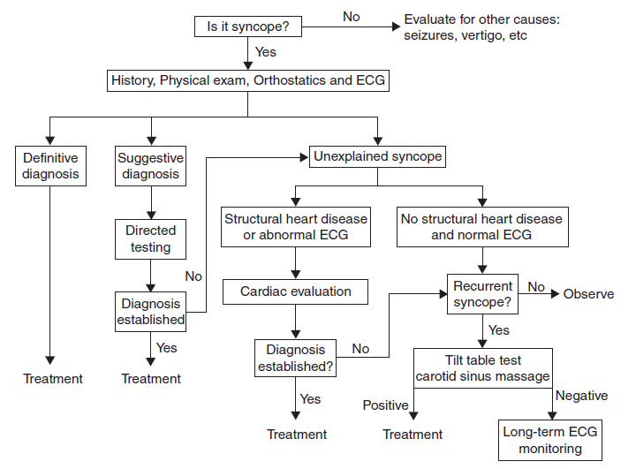
A Diagnostic Approach to Syncope
Notes:
Here’s an algorithm that delineates a potential approach to syncope, starting off with a history, physical exam, orthostatic or postural vital signs, and an ECG
If a diagnosis cannot be made based on just that information, additional testing can be pursued.
For those with suggestive cardiac features, a full cardiac evaluation is warranted
For those without suggestive cardiac features and with recurrent syncope, tilt table, carotid sinus massage, and/or long-term ECG monitoring are reasonable.

Slide 52
Case, Cont.
An 85-year-old female with HTN, HL, CVA presenting with 2nd episode of “passing out,” this time at the dinner table.
She takes lisinopril, atorvastatin, and aspirin.
Vitals signs including orthostatic maneuvers WNL; Physical exam with 2/6 mid-peaking SEM and intact S2. Neurologically intact. Normal ECG.
She is transferred to a syncope unit for further evaluation; Echo notable for a normal EF and mild aortic stenosis.
Postprandial syncope is diagnosed. She is counseled to drink cold water during meals, and subsequently discharged without an inpatient admission.
Notes:
For our patient, postprandial syncope is diagnosed.
She is therefore counseled to drink cold water during meals, and subsequently discharged without an inpatient admission.

Slide 53
Should she refrain from driving?
Notes:
A common question that arises among older adults with syncope is whether or not they can continue driving

Slide 54
Driving Considerations
Decisions on driving restrictions in elderly patients with syncope must be made on an individualized basis
Complete restrictions are intuitive in cases of severe untreated arrhythmias and severe untreated neurally mediated syncope; providing recommendations for other types of syncope can be challenging
According to retrospective data, identified risk factors for occurrence of syncope while driving include:
Male gender
Age >65 years
Presence of prodromal symptoms
History of cardiovascular disease or stroke
Prior episodes of syncope while driving
Notes:
Decisions on driving restrictions in elderly patients with syncope must be made on an individualized basis
Complete restrictions are probably intuitive in cases of severe untreated arrhythmias and severe untreated neurally-mediated syncope.
Providing recommendations for other types of syncope is a bit more challenging.
According to retrospective data, identified risk factors for occurrence of syncope while driving include: Male gender, Age >65 years, Presence of prodromal symptoms, History of cardiovascular disease or stroke, and Prior episodes of syncope while driving
Again, decisions must be individualized based on the suspected cause of syncope and these risk factors

Slide 55
Case, Cont.
An 85-year-old female with HTN, HL, CVA presenting with 2nd episode of “passing out,” this time at the dinner table.
She takes lisinopril, atorvastatin, and aspirin.
Vitals signs including orthostatic maneuvers WNL; Physical exam with 2/6 mid-peaking SEM and intact S2. Neurologically intact. Normal ECG.
She is admitted to a syncope unit for further evaluation; Echo notable for a normal EF and mild aortic stenosis.
Postprandial syncope is diagnosed, and she is discharged.
Her syncope does not necessarily preclude her from driving.
Notes:
In this case of post-prandial syncope, it is not necessary to restrict her from driving.

Slide 56
Key Points I
Syncope is an important cause of morbidity and mortality in older adults
Numerous age-related changes in cardiovascular structure and function, multimorbidity, and polypharmacy contribute to incidence/prevalence of syncope in elderly
The most common etiology in older adults is neurally mediated causes, such as vasovagal syncope
Other important considerations include orthostasis, dysautonomia, arrhythmia, and cardiac structural disease
Notes:
Syncope is an important cause of morbidity and mortality in older adults.
Numerous age-related changes in cardiovascular structure and function, multimorbidity, and polypharmacy contribute to the incidence and prevalence of syncope in older adults.
The most common etiology in older adults is neurally-mediated causes, which includes vasovagal syncope.
Other important considerations include orthostasis, dysautonomia, arrhythmia, and cardiac structural disease.

Slide 57
Key Points II
Older adults can be risk-stratified based on presence of high-risk features including cardiac disease; higher risk patients warrant inpatient evaluation, whereas lower risk patients may not
History and physical, ECG, and postural vitals signs are important for evaluation, and may be sufficient to make a diagnosis
The diagnostic yield of postural vital signs is high; whereas that of brain imaging, EEG, carotid dopplers, and stress tests are low
Echocardiography may be helpful for those with underlying or suspected cardiac disease
Notes:
Older adults can be risk-stratified based on the presence of high-risk features including cardiac disease
Higher risk patients warrant inpatient evaluation, whereas lower risk patients may not
History and physical, ECG, and postural vitals signs are important for evaluation, and may be sufficient to make a diagnosis.
Accordingly, the diagnostic yield of postural vital signs is high, while the yield of brain imaging, EEG, carotid dopplers, and stress tests are low.
Echocardiography may be helpful for those with underlying or suspected cardiac disease.

Slide 58
For Additional Reading:
Cohen R and Maurer MS. Evaluation and Management of Syncope in Older Adults. In Tresch and Aronow's Cardiovascular Disease in the Elderly, Fifth Edition edited by Wilbert S. Aronow, Jerome L. Fleg, Michael W. Rich
Kenny RA, Bhangu J, King-Kallimanis BL. Epidemiology of syncope/collapse in younger and older Western patient populations. Prog Cardiovasc Dis. 2013 Jan-Feb;55(4):357-63.
Jansen RW, Lipsitz LA. Postprandial hypotension: epidemiology, pathophysiology, and clinical management. Ann Intern Med. 1995 Feb 15;122(4):286-95.
Lipsitz LA. Syncope in the elderly. Ann Intern Med. 1983 Jul;99(1):92-105.
Notes:
For those who are interested, here is a list of references for additional reading.
Thank you.

