Slide 1
Valvular Disease in Older Adults
Geriatric Cardiology Section of the
American College of Cardiology

Slide 2
Objectives
Review the epidemiology, pathophysiology, physical examination, management of patients with valvular heart disease specifically elderly patients.
Consider the optimal modalities for imaging of valvular heart diseases in older adults.
Review the current available evidence on TAVR, as a treatment modality for patients with inoperable severe aortic stenosis as well as patients at high risk-for TAVR.
Review the data on use of TAVR in elderly patients, especially with regards to frailty score.
Review the updated ACC/AHA guidelines for management of valvular heart diseases and apply them to the elderly population.

Slide 3
Aortic Stenosis (AS) in Older Adults
Etiology: Mostly due to stiffening, scarring and calcification of the aortic valve leaflets.
Calcific deposits in the aortic cusps are seen in 36% of males and 40% of women by the age of 80.
Independent clinical factors associated with degenerative aortic valve disease in the Cardiovascular Health Study in the elderly include age, male gender, smoking, history of hypertension, height, and high lipoprotein (a) and LDL cholesterol levels.
Independent predictors of progression of AS in the elderly include male gender, cigarette smoking, hypertension, diabetes mellitus

Slide 4
Physical Exam Findings in AS
Young Adults | Older Adults
Harsh, ejection systolic crescendo-decrescendo murmur | Often soft, ejection systolic crescendo-decrescendo murmur
Prominent carotid pulsus “parvus et tardus” | Absent carotid pulsus “parvus et tardus”
Soft A2 | Absent A2
Left ventricular heave and S4 gallop | S4 gallop is often secondary to hypertension and is therefore not specific for aortic stenosis
Systolic blood pressure in severe aortic stenosis <200 mmHg | Systolic blood pressure in severe aortic stenosis <200 mmHg

Slide 5
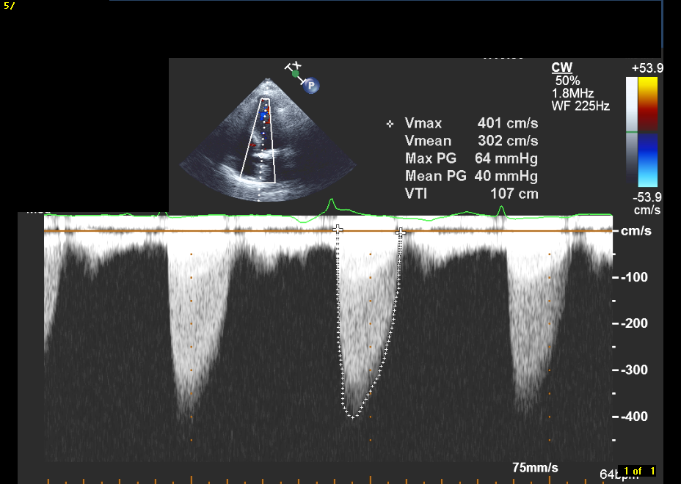
Figure 1. Doppler Interrogation of the aortic valve shows a maximum velocity of 4 m/s, a mean gradient of 40mmHg and a calculated aortic valve area (continuity equation) of 0.85 cm2.

Slide 6
Figure 2. Risk factors for calcific aortic stenosis
Clinical | Biochemical
Age | Hyperlipidemia (LDL and Lp (a))
Male sex | Hypercalcemia
Smoking | Elevated serum creatinine
Hypertension
Diabetes mellitus
Coronary artery disease
Chronic renal failure
Paget’s disease
Hyperparathroidism
LDL = low density lipoprotein, Lp(a) = lipoprotein a
Cowell SJ, Newby DE, Boon NA, Elder AT. Calcific aortic stenosis: same old story?
Age Ageing 2004;33:538-44.

Slide 7
Figure 3. Independent predictors of progression of AS
Male gender
Cigarette smoking
Hypertension
Diabetes Mellitus
LDL ≥ 125 mg/dl and
HDL ≤ 35 mg/dl
Use of statins (inverse association).
Aronow WS et al. Association of coronary risk factors and use of statins with progression of
mild subvalvular aortic stenosis in older persons. Am J cardiol 2001;88:693-695

Slide 8
Figure 4. The prevalence of physical signs of aortic stenosis in elderly patients
Physical Sign | Mild (%) | Moderate (%) | Severe (%)
ASEM | 95 | 100 | 100
Prolonged duration ASEM | 3 | 63 | 84
Late-peaking ASES | 3 | 63 | 84
Prolonged carotid upstroke time | 3 | 33 | 53
A2 absent | 0 | 10 | 16
A2 decreased or absent | 5 | 49 | 74
ASEM = aortic systolic ejection murmur, A2 = aortic component of the second heart sound
Modified from Aronow WS. Valvular aortic stenosis in the elderly. Cardiol Rev 2007;15:217-25.

Slide 9
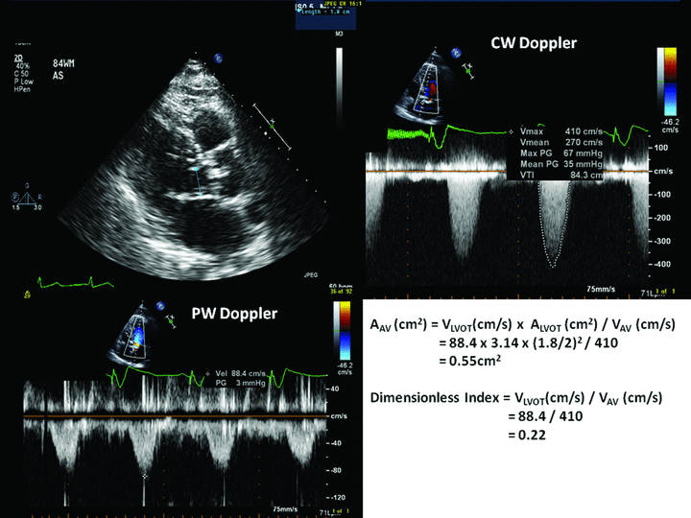
Figure 5. Echocardiographic Evaluation of Calcific Aortic Stenosis in the Older Adult
2DTTE of a 79-year-old man with exertional angina and syncope. On the parasternal long-axis view (upper left) a calcified aortic valve with restricted opening is shown at the arrow. The maximal velocity across the valve on CW Doppler is 4.1 m/sec (upper right) with a VTI of 84 cm which correspond to a peak gradient of 67 mmHg and mean gradient of 35 mmHg.
The PW across the LVOT measured a velocity of 88.4 cm/sec across the LVOT (lower left). In the lower right, the aortic valve area and the dimensionless index are calculated, both corresponding to severe aortic stenosis. Notice that small errors in the measurement of the LVOT diameter will result in large errors in the calculated aortic valve area while the dimensionless index is unaffected by this measurement.
Echocardiography Volume 28, Issue 1, pages 117-129
Notes:
2DTTE of a 79‐year‐old man with exertional angina and syncope. On the parasternal long‐axis view (upper left) a calcified aortic valve with restricted opening is shown at the arrow. The maximal velocity across the valve on CW Doppler is 4.1 m/sec (upper right) with a VTI of 84 cm which correspond to a peak gradient of 67 mmHg and mean gradient of 35 mmHg. The PW across the LVOT measured a velocity of 88.4 cm/sec across the LVOT (lower left). In the lower right, the aortic valve area and the dimensionless index are calculated, both corresponding to severe aortic stenosis. Notice that small errors in the measurement of the LVOT diameter will result in large errors in the calculated aortic valve area while the dimensionless index is unaffected by this measurement.
© This slide is made available for non-commercial use only. Please note that permission may be required for re-use of images in which the copyright is owned by a third party.

Slide 10
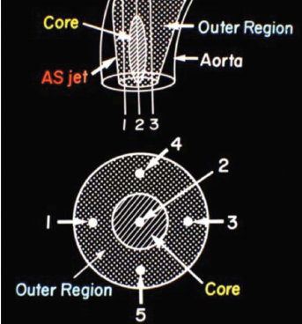
Figure 6. Proper Measurement of Aortic Stenosis Severity by Doppler Ultrasound.
(Rephrase the figure legend in brief and delete)
The aortic stenosis jet consists of a central core with high velocity (2) surrounded by a outer region of lower velocities (1, 3, 4, & 5). For accurate assessment of aortic stenosis severity, the continuous-wave Doppler cursor must be position in the jet core and aligned parallel to the jet direction.
Nanda NC. Textbook of Color Doppler Echocardiography.
Philadelphia, PA: Lea and Febiger, Inc; 1989:178–190.

Slide 11
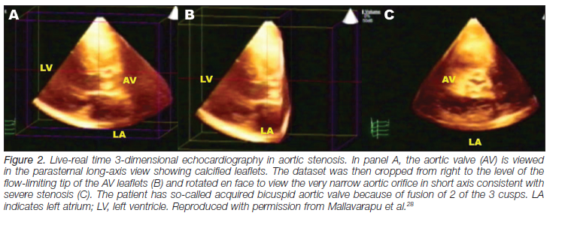
Figure 7. Three-dimensional transthoracic echocardiographic assessment of aortic stenosis and regurgitation
Mallavarapu RK, Nanda NC. In: Gill EA, Nanda NC, Lang RM, eds.
Cardiology Clinics on 3D Echocardiography. Philadelphia, PA:
2007;25:327–334.

Slide 12
Figure 8. The incidence of new coronary events in older adults with aortic stenosis
 | No AS | Mild AS | Moderate AS | Severe AS
N | 1496 | 165 | 96 | 40
Follow-up (months) | 49 | 52 | 32 | 20
Age | 81 | 84 | 85 | 85
New coronary events | 41% | 62% | 80% | 93%
AS = aortic stenosis
Modified from Aronow WS. Valvular aortic stenosis in the elderly. Cardiol Rev 2007;15:217-25.

Slide 13
Medications Which May Delay Progression of Aortic Stenosis
Statins (Positive observational studies but no effect in randomized trials : SEAS, SALTIRE and ASTRONOMER.)
ACE inhibitors (Conflicting observational studies: RCT’s awaited)
Bisphosphonates
ApoA-I mimetic peptide infusions (Reversed AS in mice. Human studies awaited)

Slide 14
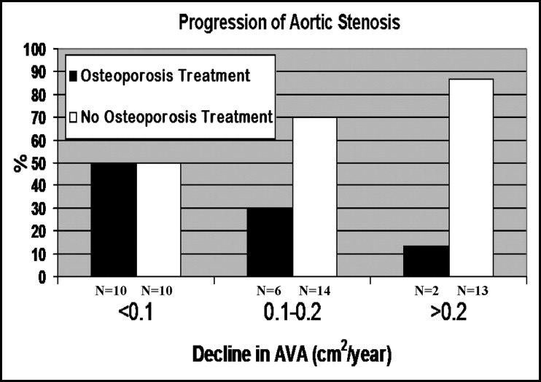
Bisphosphonates and Aortic Stenosis
Skolnick AH et al. Osteoporsis treatment and progression of aortic stenosis. Am J cardiology. 2009 Jul 1;104(1):122-4

Slide 15
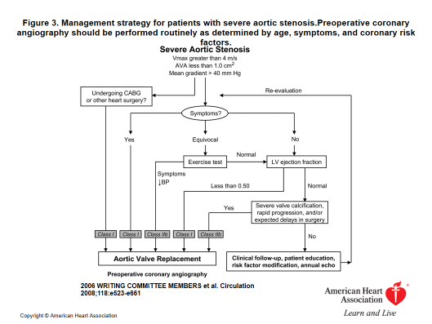
Figure 9. Management strategy for patients with severe aortic stenosis. Preoperative coronary angiography should be performed routinely as determined by age, symptoms, and coronary risk factors.

Slide 16
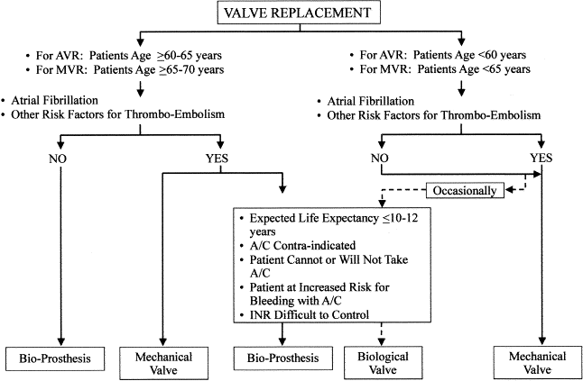
Figure 10. Recommendations for selecting Bioprosthetic versus Mechanical Valves
A/C = anticoagulation; AVR = aortic valve replacement; INR = international normalized ratio; MVR = mitral valve replacement.
Rahimtoola SH. J Am Coll Cardiol 2003;41:893-904.

Slide 17
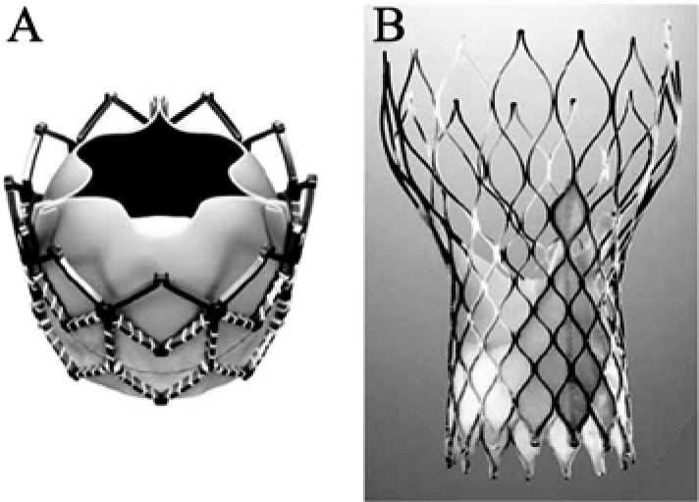
Figure 11. Transcatheter Aortic Valve Replacement (TAVR)
Edward Sapiens TAVR
Medtronic Corevalve System

Slide 18
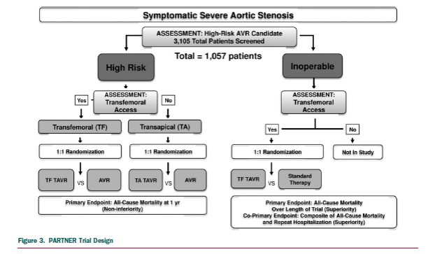
Figure 12. PARTNER Trial Design

Slide 19
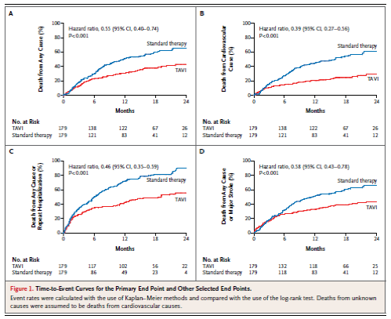
Figure 13. TAVR vs Standard Medical Therapy in patients with inoperable severe aortic stenosis

Slide 20
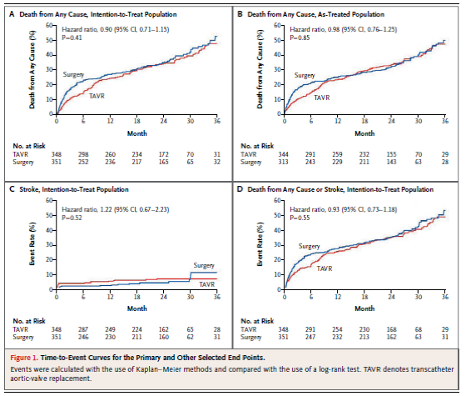
Figure 14. Two year results of TAVR vs. SAVR in patients considered high-risk for SAVR

Slide 21
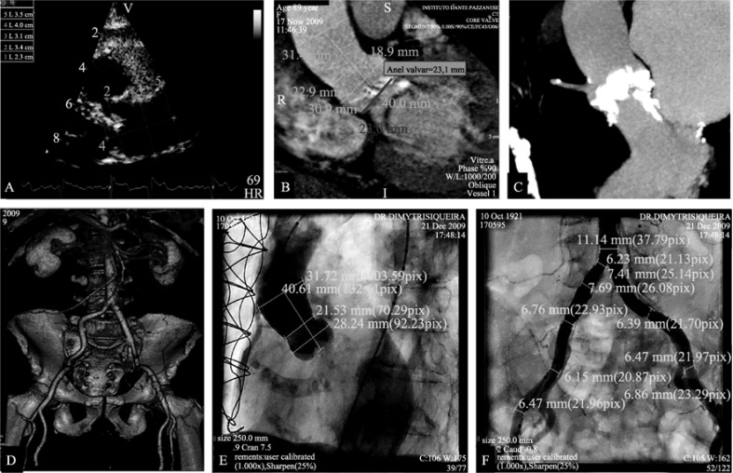
Figure 15. Multimodality Imaging of Transcatheter Aortic Valve Replacement

Slide 22
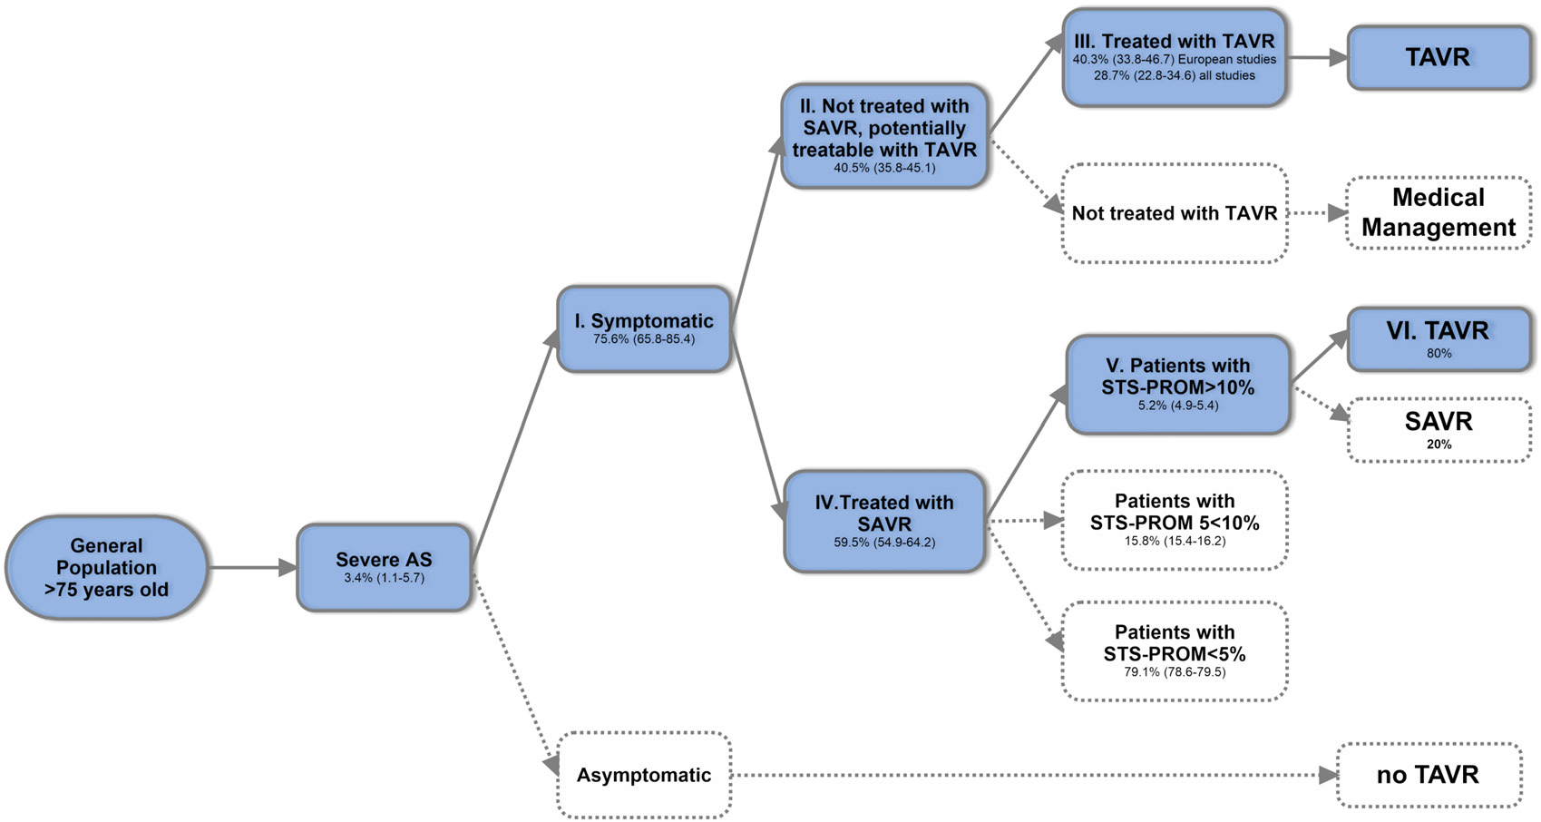
Figure 16. Model for Estimation of TAVR candidates in the Elderly
Osnabrukke RLJ. In Press. JACC. Aortic Stenosis in the Elderly: Disease Prevalence and Number of
Candidates for Transcatheter Aortic Valve Replacement: A meta-analysis and modelling study

Slide 23
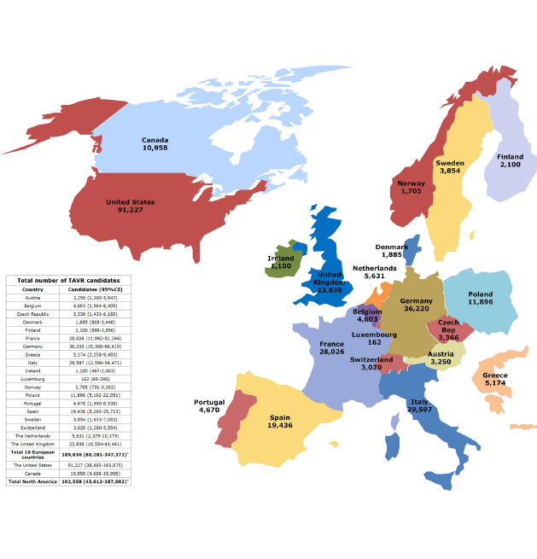
Figure 17. Estimated total number of elderly TAVR Candidates

Slide 24
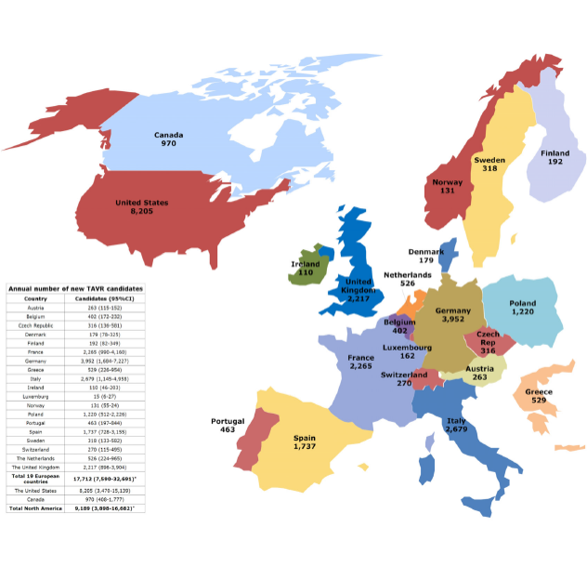
Figure 18. Estimated annual number of elderly potential TAVR Candidates

Slide 25
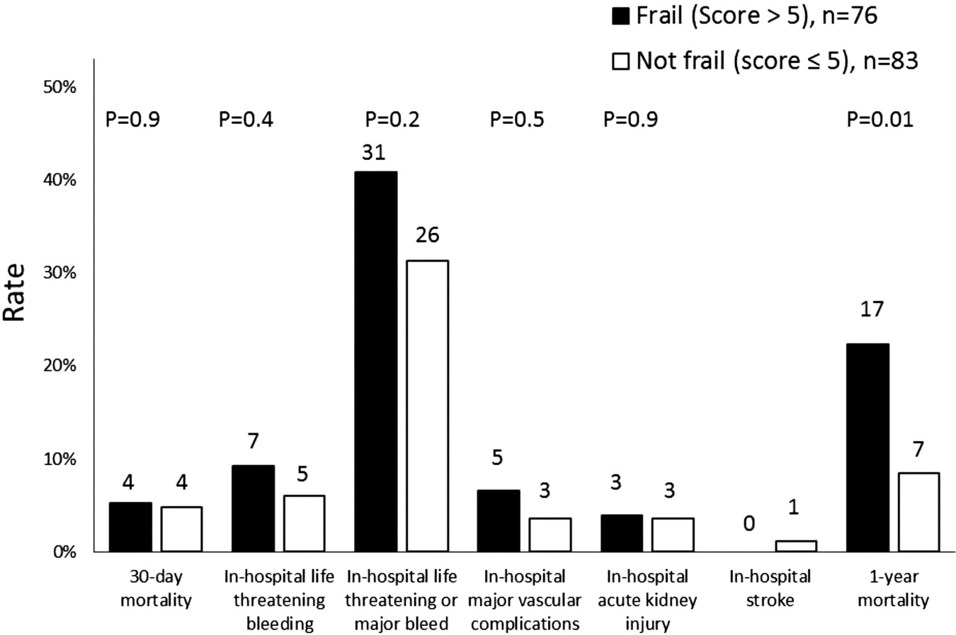
Figure 19. Clinical outcomes after TAVR stratified by frailty scores
Green et al. (J Am Coll Cardiol Intv 2012;5:974–81.

Slide 26
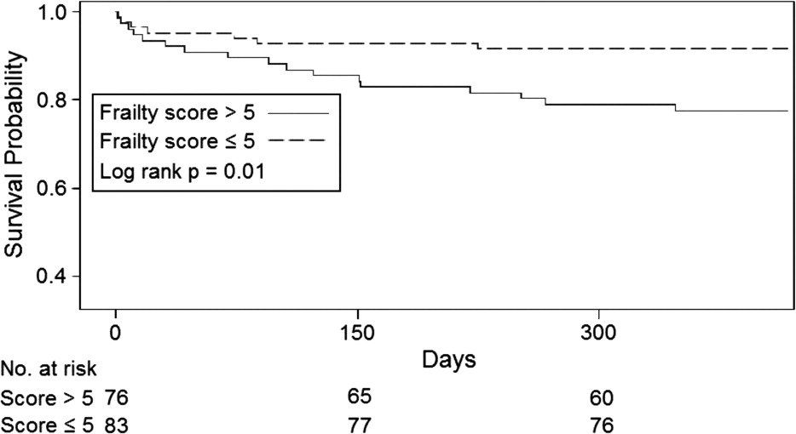
Figure 20. Kaplan Meier Survival estimates stratified by frailty scores.

Slide 27
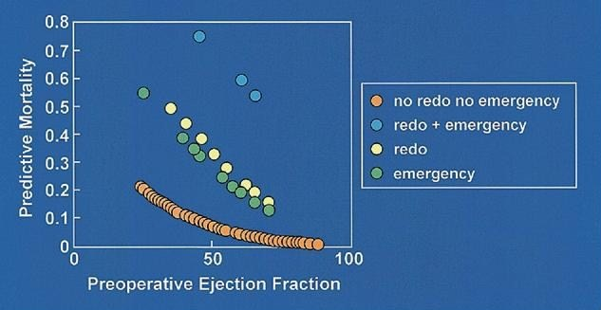
Figure 21. Predicted mortality after AVR in octogenarians in relation to preoperative left ventricular function
Langanay T et al. J Heart Valve Dis 2006;15:630–7

Slide 28
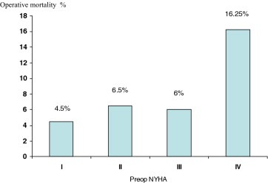
Figure 22. Operative risk for AVR in elderly according to the preoperative
NYHA functional class
Langanay T, Fletcher E, Fouquet O et al. Aortic valve replacement in the elderly: the real life. Ann Thoracic Surg. 2012; 93:70-7.

Slide 29
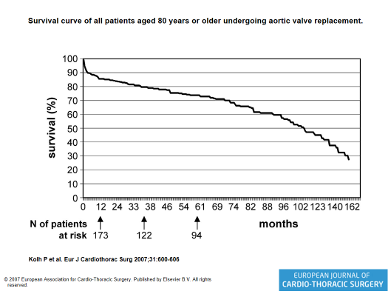
Figure 23. Survival Curve of all Patients Aged 80 Years or Older Undergoing Aortic Valve Replacement

Slide 30
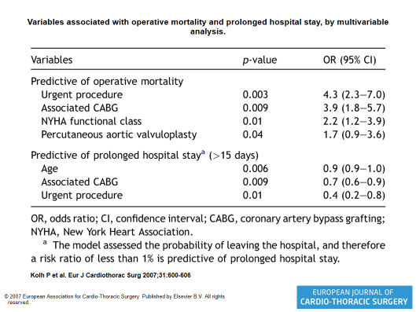
Figure 24. Variables associated with operative mortality and prolonged hospital
stay by multivariable analysis

Slide 31
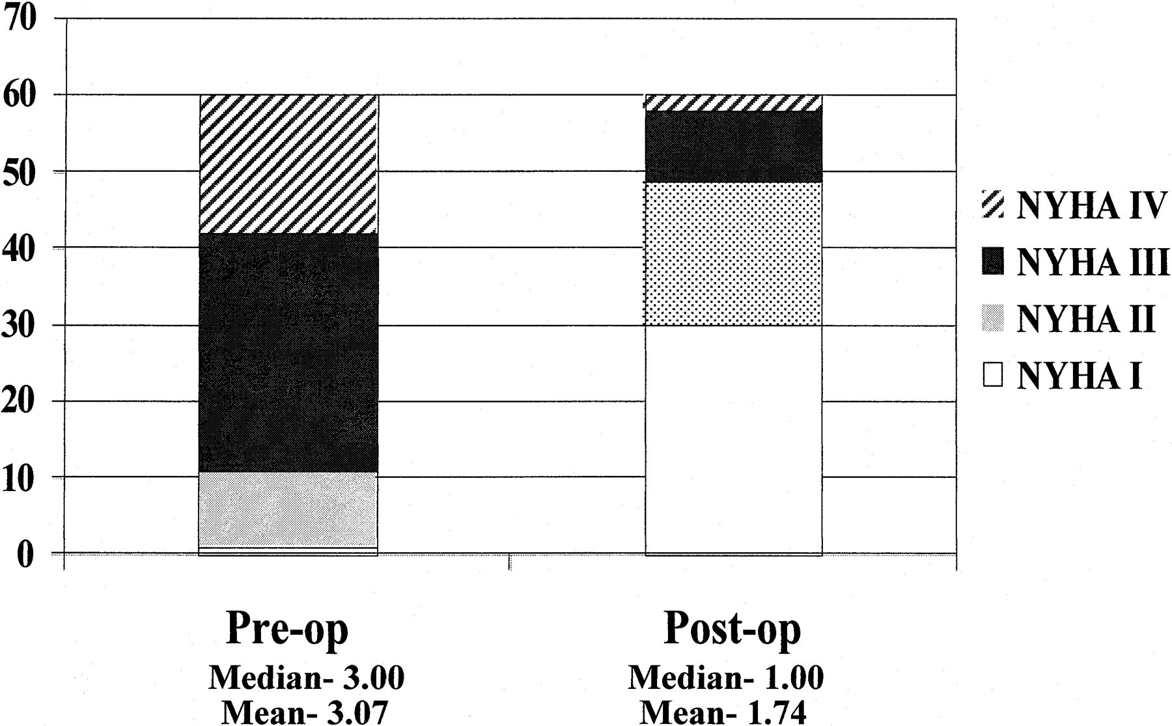
Figure 24. Improvement in NYHA class in octogenarian survivors after aortic
valve replacement
Sundt, T. M. et al. Circulation 2000;102:III-70-III-74

