Slide 1
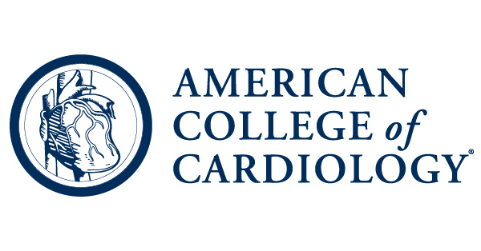
Stepping Into the Ring with Step 1
Tony Maltagliati, MS
American College of Cardiology Medical Student Leadership Group
MD Candidate // Class of 2021
University of Arizona College of Medicine - Tucson
Notes:
Hello, thank you for the opportunity, it’s an honor to present this work to you all! Our group investigated *TITLE*

Slide 2

Disclosures & Funding
I am currently a fourth-year medical student and have no conflicts of interest, financial or otherwise.
The advice in this presentation is a combination of many resources and insights. This worked for me, but adjustments may be needed to fit your Step 1 goals and learning style, and there are certainly other strategies that may work as well or even better for you!
In February 2020, the National Board of Medical Examiners announced the USMLE Step 1 exam would transition to a pass/fail scoring format rather than the three-digit score, with this change occurring no earlier than January 2022. Details including changes to the minimum passing score or specific implementation, particularly given the impact of the COVID-19 crisis on the timeline, were not available as of July 2020.

Slide 3
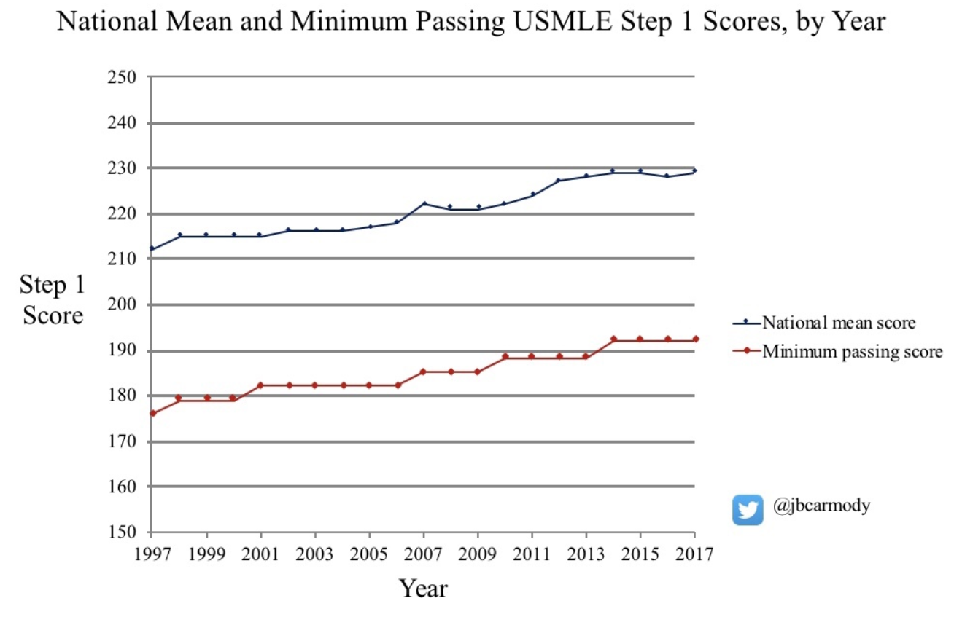
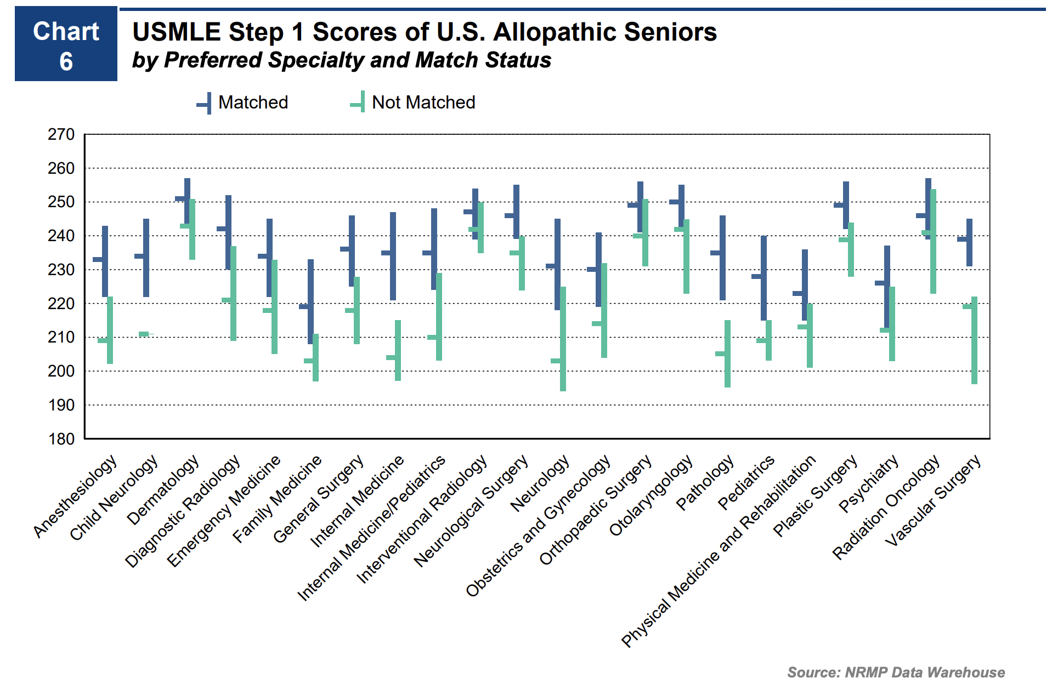
USMLE Step 1
”Measure understanding of important basic science concepts and ability to apply it to medicine”
2018 NRMP Data¹
Minimum passing score: 194
Average score to match: 233 (SD 17.5)
Notes:
Step 1 minimum passing score and national mean score have steadily increased, not because people are smarter now than they were 20 years ago, but because Step 1 is a key factor in matching to residency. There is a conserved trend across all specialties showing overall correlation of step 1 score with matching.

Slide 4
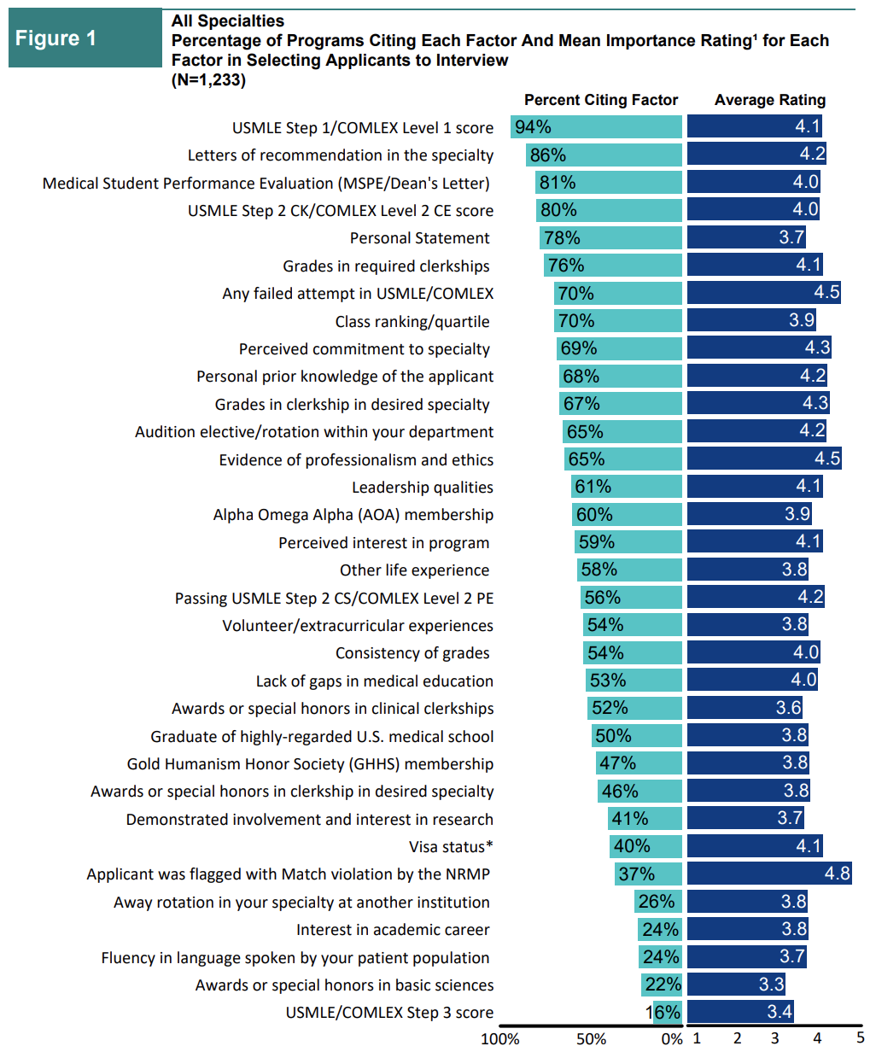
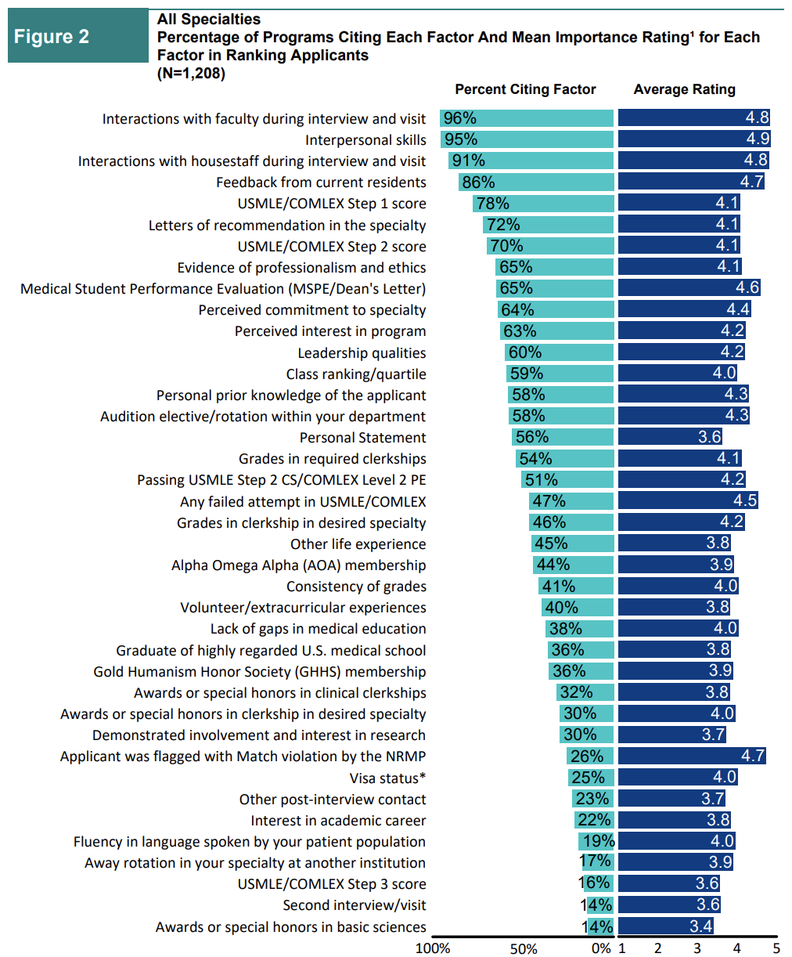
USMLE Step 1
2018 NRMP Program Director Survey² Response Rate 29.3%
Notes:
Step 1 is the single most important factor for determining whether an applicant receives an interview, and remained in the top 5 match criteria. In both instances, it was weighed deemed more important than Step 2, which is a "measure of an applicant's ability to apply the medical knowledge, skills, and understanding of clinical science essential for providing patient care"

Slide 5
Critical Components of Match
Summary from University of Michigan Website³
Class A Criteria: Step 1, Step 2, clerkship grades
Step 1 Passing-215: Low
215-230: OK to good
230-245: Good
245-255: Very good
250+: Excellent
Class B Criteria: Interview
Class C Criteria: Research, extracurriculars, leadership, personal statement, LORs, MSPE

Slide 6
Resources
Core resources: “UFAP” Uworld, First Aid, Pathoma
Additional dedicated study period resources: Dr. Goljan audio lectures
Optional longitudinal resources/Q banks: Anki, Kaplan, Amboss, Firecracker, Boards and Beyond […] Sketchy, Picmonic, Osmosis. Do NOT try to use all of these! Less is more. Which you choose, if any, is dependent on whether your school provides any of these and your learning style.

Slide 7
Study Guide
UWorld Q Bank c. 2018 Systems | # of Q's (with all subject boxes checked)
Allergy & Immunology | 39
Biostatistics and Epidemiology | 58
Cardiovascular | 314
Dermatology | 66
ENT | 15
Endocrine, Diabetes & Metabolism | 187
Female Reproductive System & Breast | 65
Gastrointestinal & Nutrition | 228
General Principles | 75
Hematology & Oncology | 224
Infectious Diseases | 173
Male Reproductive System | 24
Miscellanoues (Multisystem) | 31
Nervous System | 299
Ophthalmology | 12
Poisoning & Environmental Exposure | 7
Pregnancy, Childbirth & Puerperium | 28
Psychiatric/Behavioral & Substance Abuse | 132
Pulmonary & Critical Care | 189
Renal, Urinary Systems & Electrolytes | 148
Rheumatology/Orthopedics & Sports | 126
Social Sciences (Ethics/Legal/Professional) | 45
Total | 2485
Amalgam from: ”DermGuy” youtube videos (no longer posted), Reddit, advisors, peers.
Think of this as a job with 8-10 hours of pure work most days.
Study by organ system, with day 1 being reading through First Aid chapter, distilling your own “master notes” into a notebook, and listening to relevant Goljan lectures. Days 2 and 3 are going through Uworld on that topic. I preferred doing sets of 40 questions, untimed, on tutor mode.
Pros: focus learning and mastering one system at a time, periodically revisit your “master notes” and never look at First Aid again*.
Cons: this is dedicated study, so any way you slice it if you’re doing it right, it is going to be tiring.
Reddit Search: “Step 1 Score Calculator” & “Step 1 Score Correlation”

Slide 8
Study Guide
Every day: eat nutritious food, sleep well, take breaks,
stay connected with friends/family, exercise and go outside.
Day | Subject
1 | Cardio Day 1
2 | Cardio Day 2
3 | Cardio Day 3
4 | Pulm Day 1
5 | Pulm Day 2
6 | Pulm Day 3
7 | 1/2 Day off, 1/2 day GI Day 1
8 | GI Day 2
9 | GI Day 3
10 | Renal Day 1
11 | Renal Day 2
12 | Renal Day 3
13 | Stats, Public Health, Psychiatry Day 1
14 | Stats, Public Health, Psychiatry Day 2
15 | Stats, Public Health, Psychiatry Day 3
16 | Biochem Day 1
17 | Biochem Day 2
18 | Catch up on everything - free time if you're caught up
19 | NBME Form 15 and review answers
20 | Micro/Immun, Day 1
21 | Micro/Immun, Day 2
22 | Micro/Immun, Day 3
23 | MSK & Derm Day 1
24 | MSK & Derm Day 2
25 | MSK half day off
26 | Catch up (Derm, MSK, Micro notes, misc) - free time if you're caught up
27 | Catch up (Derm, MSK, Micro notes, misc) - free time if you're caught up
28 | Hem/Onc Day 1
29 | Hem/Omc Day 2
30 | Hem/OncDay 3
31 | Read master notes. NBME Form 18.
32 | Review NBME Form 18 answers -> short day
33 | NS Day 1
34 | NS Day 2
35 | NS Day 3
36 | Endo/Repro Day 1
37 | Endo/Repro Day 2
38 | Endo/Repro Day 3
39 | UWorld 2 & Review answers
40 | Finish master notes…this is a free day if you stay on top of everything
41 | NBME 120 & review it
42 | NBME 16 & Review
43 | Pharm chapter -> master notes
44 | UWSA #1 & review it
45 | Review old NBMEs (Forms 19 & 15) *our school made us take these earlier in our curriculum*
46 | Can do NBME 17, I planned to but felt I was running out of steam so took the day off
47 | Read through 1/2 of master notes, take your time to digest it. Mine was ~90 notebook pages.
48 | Finish reading through master notes & go through First Aid’s “Rapid Review” section. This should make you feel very confident, as it is the core information tested on Step 1 and from my experience ~85% of the questions on my test was this content. Pack your snacks and drinks, have omega 3s with dinner, try to get good sleep.
49 | Step 1 Exam!!! Wake @ 5:30, have coffee and re-read First Aid’s “Rapid Review” section

Slide 9
Study Guide for DO Students
Zach Manna of ACC Med Student Leadership Group did a 100 day study plan for dual-prep for Step 1 and COMLEX Level 1 beginning January 2nd incorporating Uworld, annotating in First Aid & Pathoma (not ”master notes”), Boards & Beyond, Sketchy micro & path videos, Goljan audio. Given taking COMLEX Level 1 shortly after USMLE Step 1, he added 35 Combank questions (untimed, tutor mode, covering any previous topics up to that point) per day at the ~1/3rd point of this study period. Zach took Step 1 two days before COMLEX Level 1, but said that it seems typical to take Level 1 anywhere between two and seven days after.
Zach’s Days per block (14 break days were scattered in this period, with 3 of the break days just before Step 1): GI (11), Immuno/Path/Pharm (7), Heme-Onc (12), MSK/Derm (7), Endo (7), Repro (10), Psych (6), Pulm (6), Neuro (10), Renal (7), Cardio (9), Anatomy+Embryology (5), Biochem (8).
I know this is not an exhaustive description of Zach’s study guide and will defer to him and/or other DO members to share more details on their experience in dual preparing for USMLE Step 1 & COMLEX Level 1!

Slide 10
Test Day
If you see a Q with a huge stem, quickly look at the last line for their question and glance at the choices to give you context. Otherwise you may have to re-read the whole question.
Highlight salient parts of the questions as you go. Questions can become a blur, so highlighting can help you focus, identify key features, and save time when reviewing marked questions.
Mark questions as needed and try to finish each block with ~5 minutes to revisit
Take 5-10 minute breaks between each block
Do not dwell on questions you’re unsure about or on questions that bother you after a block is over, just continue and do your best. Focus on how much you DO know, which will be a ton!

Slide 11
Final Thoughts
Everyone is different, so don’t force yourself to do this plan exactly.
Anki is a love/hate thing and a lot of extra work. Had I done it, maybe I could have scored 5-10 points higher on Step 1 but would have felt overworked and unhappy. I personally would choose to use energy on Q banks than on flashcards since they are more reflective of the test.
If you do Kaplan x1, Uworld x2, NBME practice tests, the free 120, and the questions in your curriculum, you will have done ~10,000 questions. The test is 280 questions.
Step 1 is 2.8% of all the questions you have already done. Let that sink in.
You are ready and you will do great!
There is more to your pre-clerkship medical school experience than Step 1, so explore what interests you and get involved in research, leadership, activities & community outreach. A stellar Step 1 score with no personalization or interesting experiences is not holistically impressive, so set realistic goals and have fun discovering your path!
Feel free to email me with questions or comments: AJM@email.arizona.edu

Slide 12

References
1) National Resident Matching Program. “Charting Outcomes in the Match: U.S. Allopathic Seniors 2nd edition”. 2018.
2) National Resident Matching Program. “Results of the 2018 NRMP Program Director Survey” 2018.
3) Critical Components in the Match. University of Michigan.
https://medstudents.medicine.umich.edu/student-support/match/critical-components-match

