Slide 1
Ambulatory Specialty Model (ASM) For Heart Failure

Slide 2
ASM For Heart Failure: What is it?
Medicare’s Innovation Center (CMMI) established this mandatory 5-year demonstration project in select geographic areas comparing individual cardiologists on their HF care across 5 quality measures and a cost measure designed with two-sided risk arrangement – subject to financial gains and losses.

Slide 3
ASM For Heart Failure: Objectives
Broader strategy to expand specialty participation in value-based care
Tests whether episode-based accountability for chronic conditions like HF can improve outcomes and reduce total cost of care
Builds on prior specialty-focused efforts: TEAM, BPCI-Advanced models, aligns with MIPS Value Pathways
Parallel project for Low Back Pain

Slide 4
ASM For Heart Failure: Time Period and Implementation Schedule
Five-year mandatory model in selected geographic areas scheduled for Jan. 1, 2027, through Dec. 31, 2031, with payment period 2029-2033.
November 2025
ASM Changes/Finalization
Early 2026
Preliminary List of Participants
Selected Geographic Areas
ACC Outreach Begins
July 2026
Final Rule Release
Finalized Participants List
January 2027
ASM Performance Period Begins
January 2029
Payment Adjustment Begins

Slide 5

ASM For Heart Failure: Mandatory Geographic Areas
In January 2026, 235 core-based statistical areas (CBSAs) or metropolitan divisions covering 47 states were selected for mandatory participation
Access the list of selected geographic areas
Participants List (Coming Soon)
Preliminary – Early 2026
Final – July 2026

Slide 6

ASM For Heart Failure: Participant Criteria
PECOS-enrolled physicians with cardiology specialty located in a selected mandatory geographic areas.
Clinicians meeting the following eligibility criteria would be required to participate in ASM:
A clinician who bills claims under the Medicare PFS
Identified by TIN/NPI as a selected specialty type- Cardiovascular Disease/Cardiology
Meets the EBCM episode volume threshold of ≥20 Medicare HF patients applicable to an ASM targeted chronic condition
Located in one of the selected mandatory geographic areas
Physicians with other specialties including interventional cardiology, cardiac electrophysiology, advanced heart failure & transplant cardiology, and adult congenital heart disease as well as APPs are excluded from ASM.
Specialty type is determined by PECOS enrollment and the plurality of Medicare Part B claims
Participation and reporting is at the individual level, NOT the practice/hospital/health system level
ASM Eligibility will be assessed annually based on the previous year’s criteria

Slide 7

ASM For Heart Failure: Performance Assessment
Like MIPS Value Pathways, four ASM performance categories will be utilized for data collection, comparison and evaluation:
Quality (50%)
Cost (50%)
Improvement Activities (–20 points max)
Promoting Interoperability Conditions (–10 points max)

Slide 8
ASM for Heart Failure: Quality Measures
ASM Participants are required to collect and submit data on the following measures.
MIPS #492: Risk-Standardized Acute Unplanned CV-Related Admission Rates For Patients With HF (Claims data)
MIPS #008: HF: Beta-Blocker Therapy For Left Ventricular Systolic Dysfunction (LVSD)
MIPS #005: HF: ACE Inhibitor or ARB or ARNI Therapy For LVSD
MIPS #236: Controlling High Blood Pressure
MIPS #377: Functional Status Assessments For HF
Minnesota Living with HF Questionnaire
Kansas City Cardiomyopathy Questionnaire
ASM exempts participants from MIPS and MVP reporting
Data collection begins on Jan. 1, 2027

Slide 9
Current MIPS Participation* Top 10 Reported Measures (CV Specialties) in 2023
Most cardiologists are scored on non-CV measures, showing a gap between MIPS and specialty care.
Measures #236 and #492 are used in the ASM for HF.
Quality Measure ID | Measure Name
484 | Clinician and Clinician Group Risk-standardized Hospital Admission Rates for Patients with Multiple Chronic Conditions
479 | Hospital-Wide, 30-Day, All-Cause Unplanned Readmission (HWR) Rate for the MIPS Groups
236 | Controlling High Blood Pressure
1 | Diabetes: Glycemic Status Assessment Greater Than 9%
492 | Risk-Standardized Acute Cardiovascular-Related Hospital Admission Rates for Patients with Heart Failure within the Merit-based Incentive Payment System (MIPS)
112 | Breast Cancer Screening
226 | Preventive Care and Screening: Tobacco Use: Screening and Cessation Intervention,
134 | Preventive Care and Screening: Screening for Depression and Follow-Up Plan
318 | Falls: Screening for Future Fall Risk
113 | Colorectal Cancer Screening
*From the 2025 QPP Experience Report Utilizing 2023 Performance Year Data

Slide 10
Current Quality Measure Participation*
Measure ID | Measure Name | Count (Out of ~15K CV Specialists) | Average Score
5 | Heart Failure (HF): Angiotensin-Converting Enzyme (ACE) Inhibitor or Angiotensin Receptor Blocker (ARB) or Angiotensin Receptor-Neprilysin Inhibitor (ARNI) Therapy for Left Ventricular Systolic Dysfunction (LVSD) | 1,197 | 8.27
8 | Heart Failure (HF): Beta-Blocker Therapy for Left Ventricular Systolic Dysfunction (LVSD) | 1,008 | 8.2
236 | Controlling High Blood Pressure | 10,831 | 8.14
377 | Functional Status Assessments for Heart Failure | 8 | 3
492 | Risk-Standardized Acute Cardiovascular-Related Hospital Admission Rates for Patients with Heart Failure under the Merit-based Incentive Payment System | 7,817 | 5.34
*From the 2025 QPP Experience Report Utilizing 2023 Performance Year Data
ASM HF Quality Measures have low reporting and submission rates. Participants must work with their practice staff as early as possible to assess the capabilities to collect and submit these measures.

Slide 11
ASM For Heart Failure: Quality Measures Considerations
Quality Measures Submission
Work with your practice’s QPP/MIPS administrator
Assess ability to collect and submit required QMs through EMR
Test reporting capabilities prior to 2027 performance year
License Needed for Function Status Assessment Measure
Minnesota Living with HF Questionnaire
Kansas City Cardiomyopathy Questionnaire
Notes:
Consider practice-wide participation in MVP for Advancing Care for Heart Disease

Slide 12




ASM For Heart Failure: HF Episode Cost Measure – Medicare-Covered Services
ASM Participants will be evaluated on the cost of care for their assigned HF patients. CMS will calculate the costs through Medicare claims data for the included services and procedures
Acute Care Settings
Emergency Department
Inpatient – Medical
Inpatient – Surgical
Post-Acute Care
Inpatient Rehabilitation Facility
Long-Term Care Hospital
Skilled Nursing Facility (30-day window)
Home Health
Ambulatory & Outpatient Care
Outpatient facility services
Clinician services (physician and practitioner services)
Other Medicare-Covered Services
Durable Medical Equipment, Prosthetics, Orthotics, Supplies
Medicare Part D drugs

Slide 13
ASM For Heart Failure: Patient Attribution to Individual Clinician
TIN-NPI Level Attribution: An episode is attributed to any clinician that billed at least 30% of the trigger or confirming codes on Part B physician claim lines during the episode. The measure’s attribution methodology also imposes additional checks to ensure that TIN-NPIs are appropriately attributed.
Billed at least one trigger or confirming code within one year prior to or on the episode start date
Prescribed at least two condition-related prescriptions on different days to two different patients during the measurement period plus a one-year lookback period
Based on the HF Episode Cost Measure

Slide 14
HF Episode Cost Measure: Considerations
Limited performance and data sharing (MIPS data likely available mid to late 2026)
Your ACO is supplied “shadow bundle data” with cost measure; Ask to see this data and comparisons
Cost data will be compared across all model participants

Slide 15
ASM For Heart Failure: Improvement Activities
Each ASM participant must attest to completing both activities to avoid score reduction.
(IA-1): Connecting to Primary Care and Ensuring Completion of Health-Related Social Needs Screening and Improvement Activity
(IA-2): Establishing Communication and Collaboration Expectations with Primary Care Using Collaborative Care Arrangements

Slide 16
ASM For Heart Failure: Promoting Interoperability Conditions
Mirroring the category from MIPS, Promoting Interoperability can be collected and reported as previous MIPS submissions.
e-Prescribing
Health Information Exchange
Provider-to-Patient Exchange
Public Health and Clinical Data Exchange

Slide 17

ASM for Heart Failure: Final Score Methodology
Final Score Methodology
Quality and cost account for 50% each
Improvement activities (–20 pts max)
Promoting interoperability performance (–10 pts max)
Payment Approach
Based on performance scoring, participants will be assigned a payment adjustment factor from –9% to +9%
Portion of the Medicare Part B payments paid to ASM participants for covered professional services during an ASM performance year – would result in net positive, neutral or negative payment adjustments during an ASM payment year
Risk levels increase in performance year 3-5 by 1% per year

Slide 18
ASM For Heart Failure: How the ASM Incentive Pool is Created
CMS Creates Two Incentive Pools (HF & LBP) - CMS sets aside a portion of Part B spending
CMS Funds Pool: Uses Small
Reductions in Part B Payments
Formula: Risk level * redistribution % * sum of participant Medicare part B payments
Estimated Part B Payment Reductions: - PY 1–2: ~1.35% - PY 3–5: ~1.5–1.8%
Payment Adjustment:
Adjustment applied two calendar years after the performance year.
Example: 9% * 85% * $1 Billion = $76.5 Million
Notes:
ASM is different than the budget neutral payment adjustments in MIPS

Slide 19


ASM For Heart Failure: Eligible Waivers
All ASM participants waived from MIPS participation for any ASM performance year
The ASM also waives the geographic site requirements that limit telehealth payment to services furnished within specific types of geographic areas

Slide 20
ASM For Heart Failure: Readiness Checklist
Assemble an ASM implementation team with physicians, quality administrators and staff
Identify all participating cardiologists and develop a practice-level plan
Evaluate and test your ability to collect and submit Quality Measures via EMRs
Explore opportunities to review your ACO’s shadow bundles cost data for HF care
Develop action plan for implementing the following:
Function Status Assessment tool
Minnesota Living with HF Questionnaire
Kansas City Cardiomyopathy Questionnaire
Improvement Activities
(IA-1): Connecting to Primary Care and Ensuring Completion of Health-Related Social Needs Screening and Improvement Activity
(IA-2): Establishing Communication and Collaboration Expectations with Primary Care Using Collaborative Care Arrangements

Slide 21
ASM For Heart Failure: Model and Policy Improvements
The ACC remains committed to supporting members through this transition to value-based models and initiatives. During the CMS rulemaking process for the ASM for HF, the College presented numerous concerns and opportunities. The College will continue to provide feedback to CMS.
The individual-level focus and lack of team-based care principles
Issues with real-time patient attribution information
Several operational and design flaws that could limit effectiveness
License required use of proprietary functional assessment tools
Immediate downside risk and lack of transition period
Timeliness of data

Slide 22
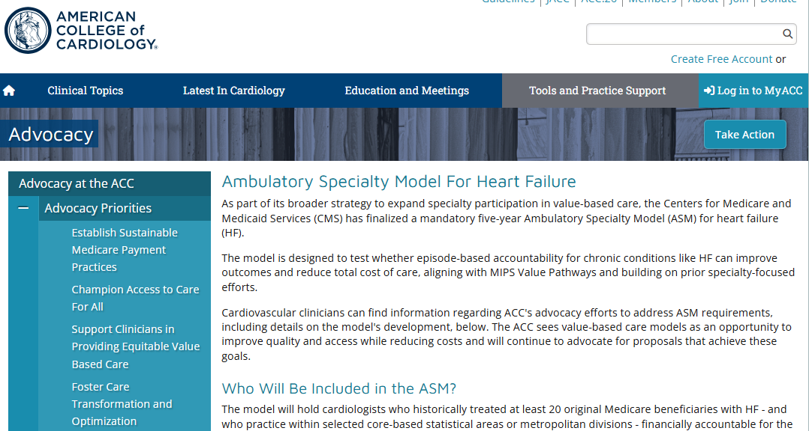
ASM For Heart Failure: Visit ACC.org For More Information
Latest developments and educational tools on ASM for HF
Mandatory Geographic Areas
Submit your ASM questions and feedback to ACC staff
Notes:
Ambulatory Specialty Model For Heart Failure - American College of Cardiology

