Slide 1
2018 CV Training Program Directors Omnibus Research July 2018

Slide 2
Methodology
This research was designed to develop a general understanding from CV Training Program Directors of the following:
Profiles of their CV training programs overall
Profiles of the CV training program director respondents
Perceptions of CV training with a focus on understanding the sentiment regarding COCATS 4
An email invitation and four reminders were sent to 229 US-based CV training program directors.
The survey fielded from April 6 – May 12, 2018.
A total of 130 CV training program directors completed the survey for an overall response rate of 57%. The following is a breakout of programs by US four-point geographic regions:
Total | Northeast | Midwest | South | West
n=130 | n=43 | n=32 | n=40 | n=15
100% | 33% | 25% | 31% | 12%

Slide 3
Cardiovascular Training Program Profile

Slide 4
General Cardiovascular Program Profile
 | Total Number of Fellows | Total Number of Female Fellows | Total Number of Underrepresented Minority Fellows | Total Number of International Medical Graduate Fellows | Total Number of Fellows Graduating General CV Disease Fellowship (2017-2018)
Mean Number of Fellows | 14.28 | 3.37 | 1.87 | 4.10 | 4.49
Median Number of Fellows | 13.50 | 3.00 | 1.00 | 4.00 | 4.00
Std. Deviation | 7.49 | 2.62 | 2.17 | 3.67 | 3.14
Number of Programs (N-Size) | 130 | 130 | 130 | 130 | 130
Number of Fellows in Advanced Fellowships
 | Interventional Cardiology | Electrophysiology (EP) | Heart Failure (HF) | ACHD | Imaging
Mean Number of Fellows | 1.80 | 1.49 | 0.63 | 0.18 | 0.59
Median Number of Fellows | 2.00 | 1.00 | 0.00 | 0.00 | 0.00
Std. Deviation | 1.80 | 1.91 | 0.98 | 0.56 | 1.35
Number of Programs (N-Size) | 130 | 130 | 130 | 130 | 130
Q: Thinking about the Fellows in your general cardiovascular program, please provide a count of the following: (n=130)
Q: How many fellows does your institution have in each of the following advanced fellowships? (n=130)

Slide 5
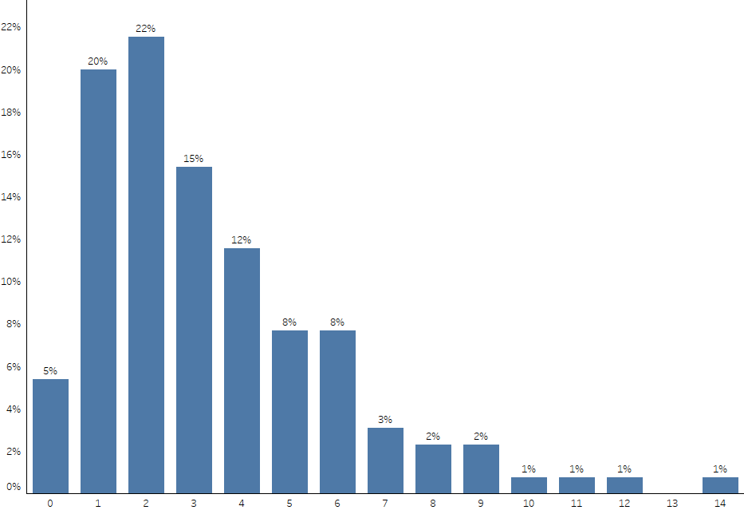
Total Number of Female Fellows Per Cardiovascular Program
(n=130)
Q: Thinking about the Fellows in your general cardiovascular program, please provide a count of the following: Total Number of female Fellows (n=130)

Slide 6
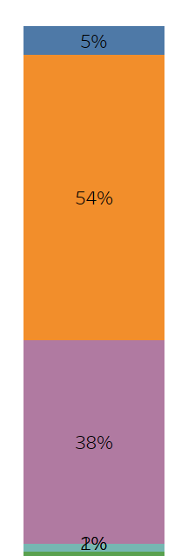
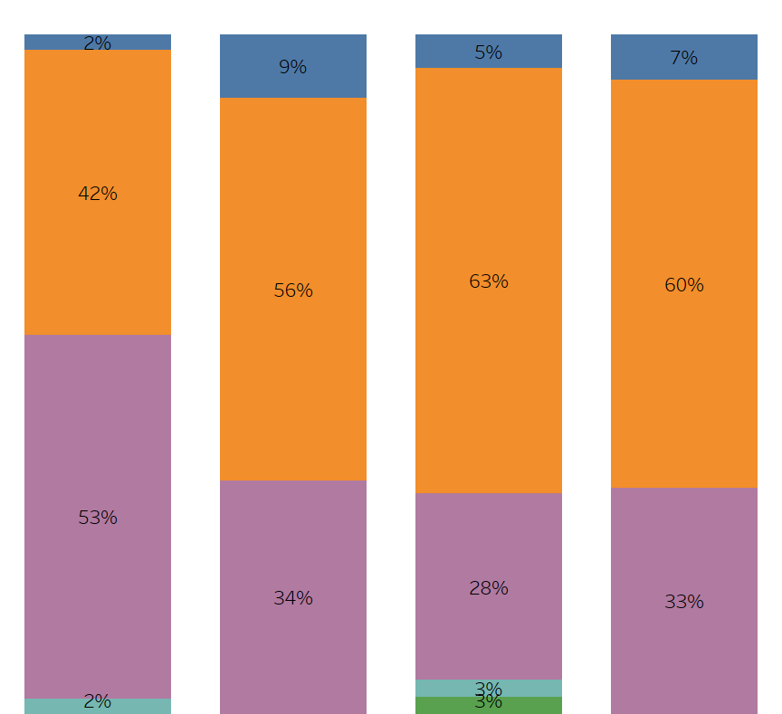
Percentage of Female Fellows Per Cardiovascular Program by Region
Total
Northeast
Midwest
South
West
0%
1% - 25%
26% - 50%
51% - 75%
> 75%
(n=130)
(n=43)
(n=32)
(n=40)
(n=15)
Q: Thinking about the Fellows in your general cardiovascular program, please provide a count of the following: Total Number of female Fellows (n=130)

Slide 7
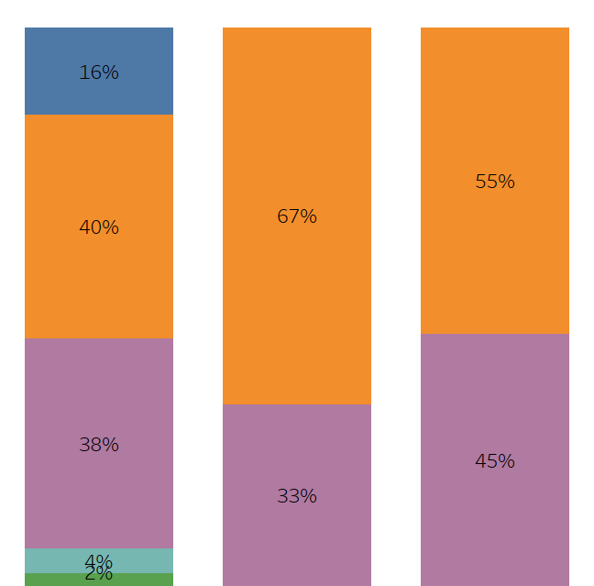
Percentage of Female Fellows Per Cardiovascular Program by Program Size
Program Size*
Total
Small
Medium
Large
0%
1% - 25%
26% - 50%
* - Program Size is defined as follows:
- small = 1-10 fellows
- medium=11-17
- large=18 or more
51% - 75%
> 75%
(n=130)
(n=45)
(n=43)
(n=42)
Q: Thinking about the Fellows in your general cardiovascular program, please provide a count of the following: Total Number of female Fellows (n=130)

Slide 8
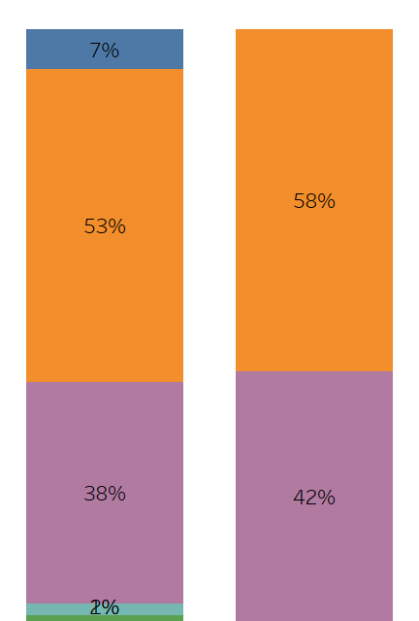
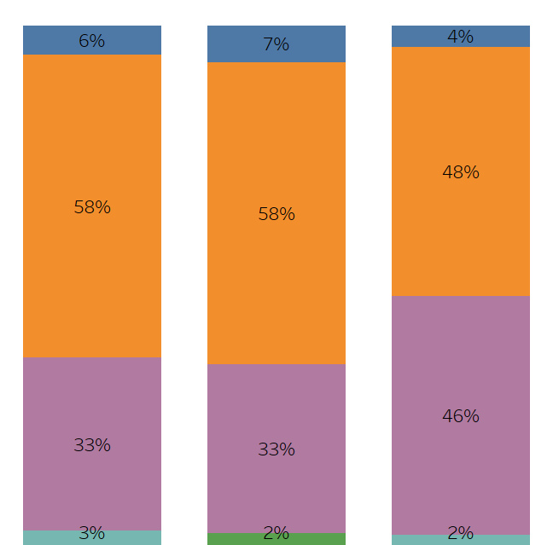
Percentage of Female Fellows Per Cardiovascular Program by PD Gender /Age
Program Director - Gender
Program Director - Age
Total
Male
Female
Early Career
(36 – 45 years)
Mid Career
(46 – 55 years)
Late Career
(> 55 years)
0%
1% - 25%
26% - 50%
51% - 75%
> 75%
(n=130)
(n=104)
(n=26)
(n=36)
(n=43)
(n=50)
Q: Thinking about the Fellows in your general cardiovascular program, please provide a count of the following: Total Number of female Fellows (n=130)

Slide 9
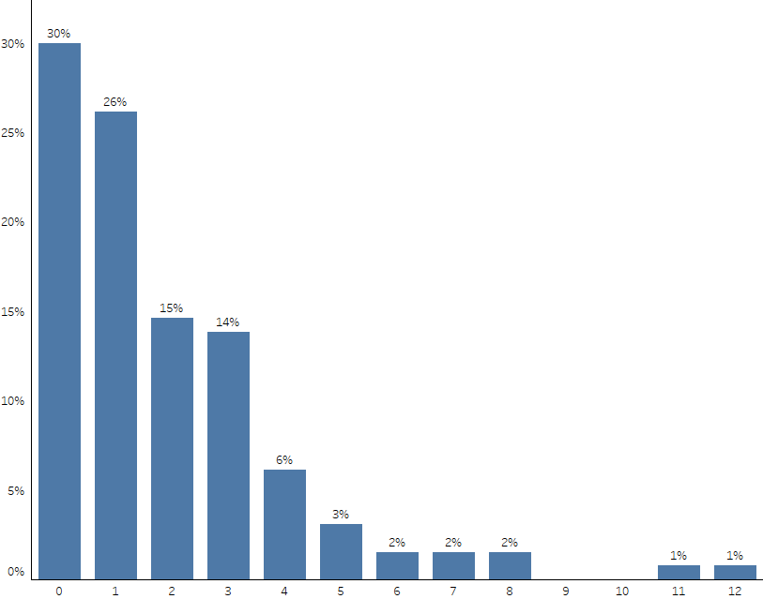
Total Number of Underrepresented Minority Fellows Per Cardiovascular Program
(n=130)
Q: Thinking about the Fellows in your general cardiovascular program, please provide a count of the following: Total Number of underrepresented minority Fellows
(n=130)

Slide 10
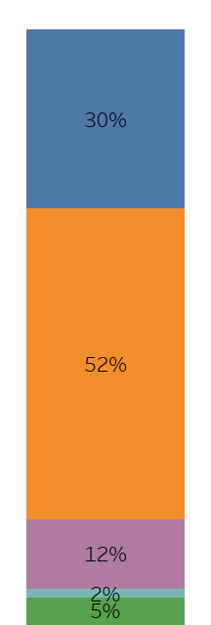
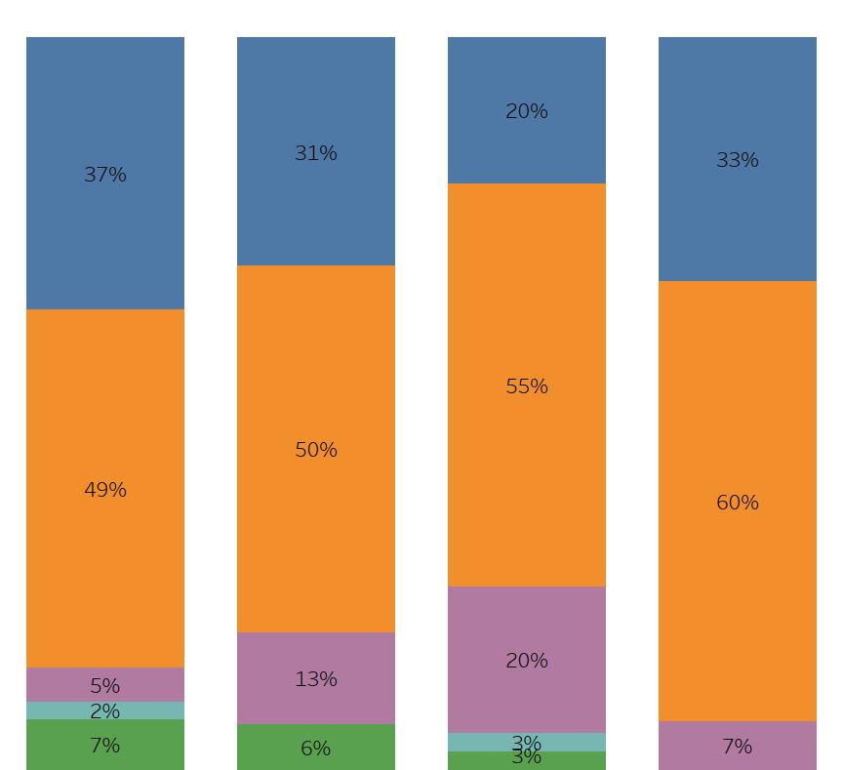
Percentage of Underrepresented Minority Fellows Per Cardiovascular Program by Region
Total
Northeast
Midwest
South
West
0%
1% - 25%
26% - 50%
51% - 75%
> 75%
(n=130)
(n=43)
(n=32)
(n=40)
(n=15)
Q: Thinking about the Fellows in your general cardiovascular program, please provide a count of the following: Total Number of underrepresented minority Fellows
(n=130)

Slide 11
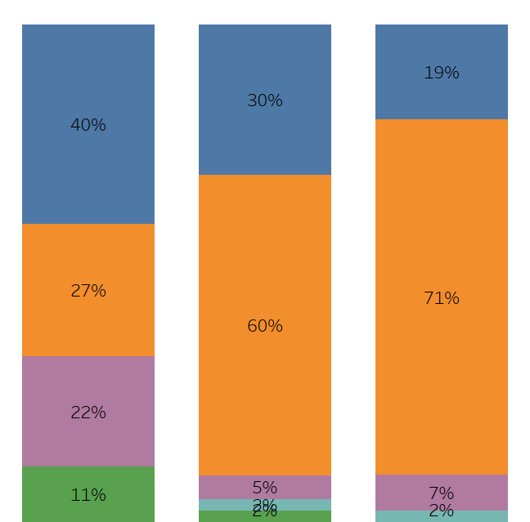
Percentage of Underrepresented Minority Fellows Per CV Program by Program Size
Program Size
Total
Small
Medium
Large
0%
1% - 25%
26% - 50%
51% - 75%
> 75%
(n=130)
(n=45)
(n=43)
(n=42)
Q: Thinking about the Fellows in your general cardiovascular program, please provide a count of the following: Total Number of underrepresented minority Fellows
(n=130)

Slide 12
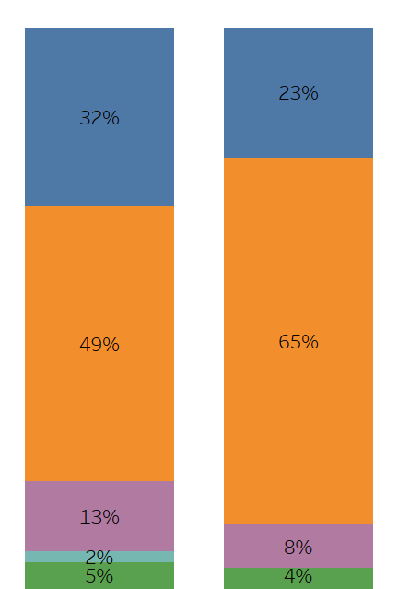
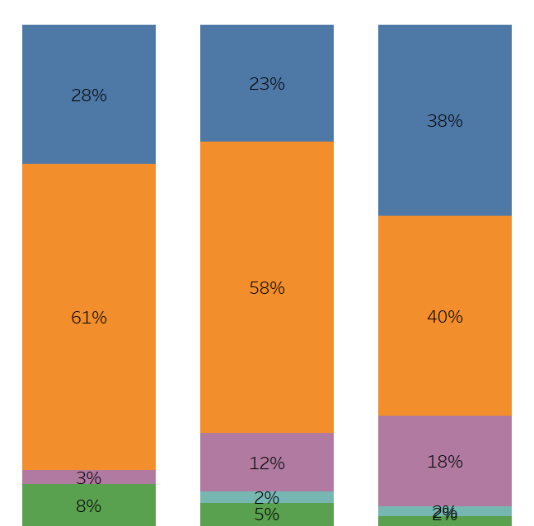
Percentage of Underrepresented Minority Fellows Per CV Program by PD Gender/Age
Program Director - Gender
Program Director - Age
Total
Male
Female
Early Career
(36 – 45 years)
Mid Career
(46 – 55 years)
Late Career
(> 55 years)
0%
1% - 25%
26% - 50%
51% - 75%
> 75%
(n=130)
(n=104)
(n=26)
(n=36)
(n=43)
(n=50)
Q: Thinking about the Fellows in your general cv program, please provide a count of the following: Total Number of underrepresented minority Fellows (n=130)

Slide 13
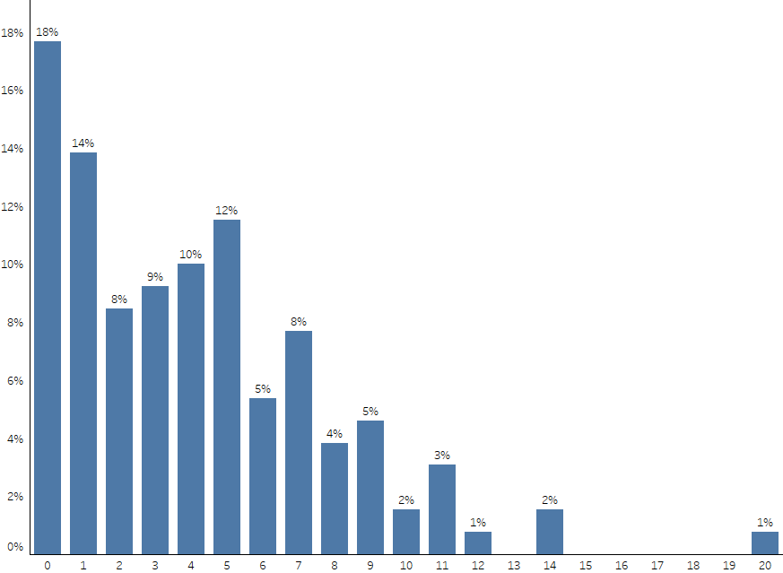
Total Number of International Medical Graduate Fellows Per CV Program
(n=130)
Q: Thinking about the Fellows in your general cv program, please provide a count of the following: Total Number of international medical graduate Fellows (n=130)

Slide 14
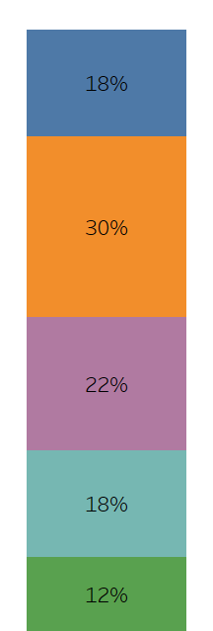
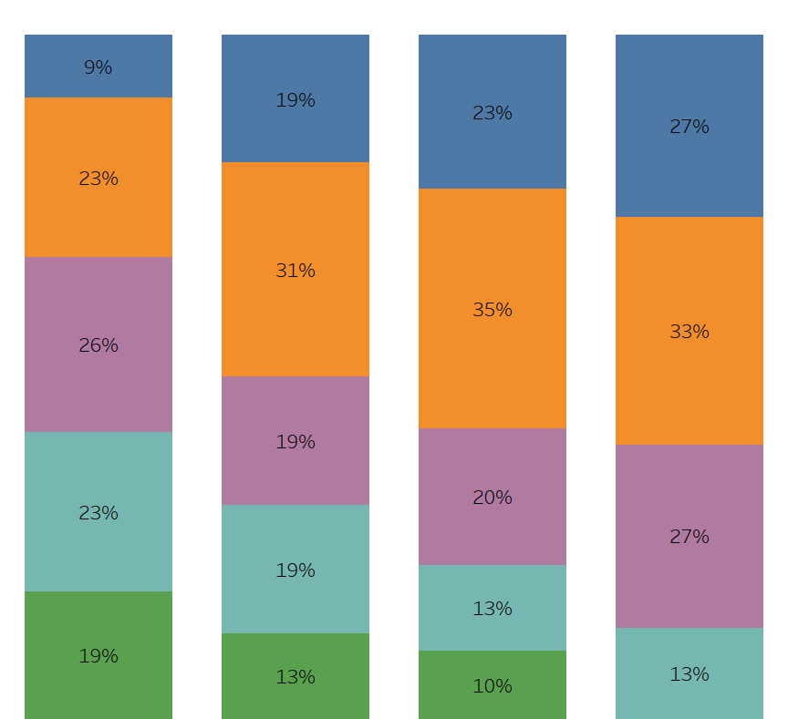
Percentage of International Medical Graduate Fellows Per CV Program by Region
Total
Northeast
Midwest
South
West
0%
1% - 25%
26% - 50%
51% - 75%
> 75%
(n=130)
(n=43)
(n=32)
(n=40)
(n=15)
Q: Thinking about the Fellows in your general cv program, please provide a count of the following: Total Number of international medical graduate Fellows (n=130)

Slide 15
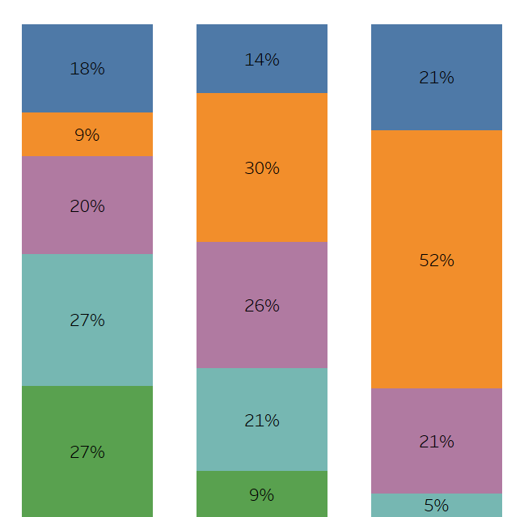
Percentage of International Medical Graduate Fellows Per CV Program by Program Size
Program Size
Total
Small
Medium
Large
0%
1% - 25%
26% - 50%
51% - 75%
> 75%
(n=130)
(n=45)
(n=43)
(n=42)
Q: Thinking about the Fellows in your general cv program, please provide a count of the following: Total Number of international medical graduate Fellows (n=130)

Slide 16
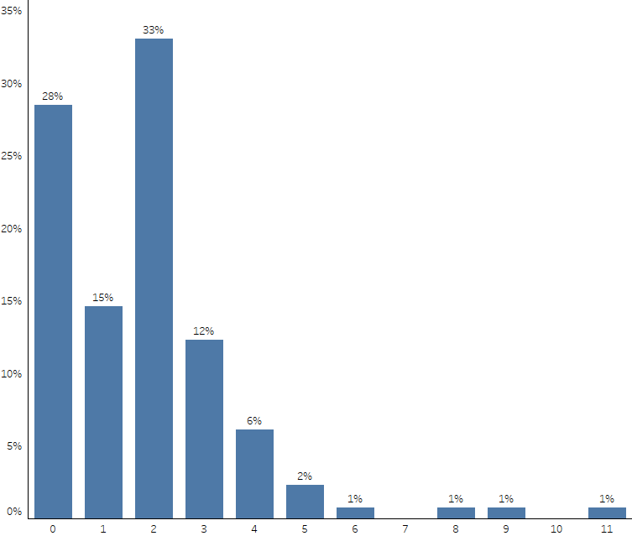
Total Number of Fellows in Advanced Fellowships Per CV Program – Interventional Cardiology
(n=130)
Q: How many fellows does your institution have in each of the following advanced fellowships? Interventional Cardiology (n=130)

Slide 17
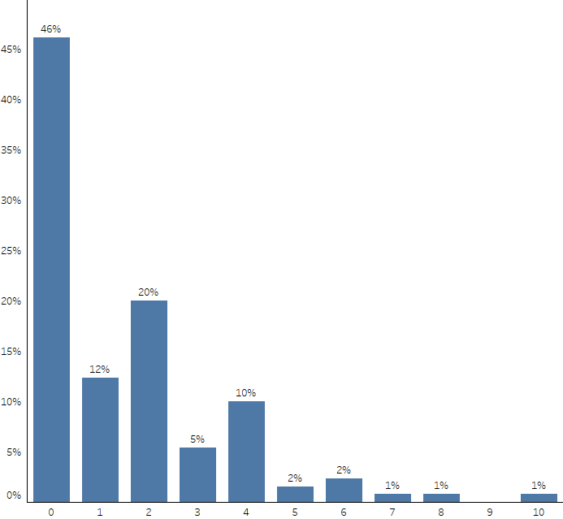
Total Number of Fellows in Advanced Fellowships Per CV Program – Electrophysiology
(n=130)
Q: How many fellows does your institution have in each of the following advanced fellowships? Electrophysiology (n=130)

Slide 18
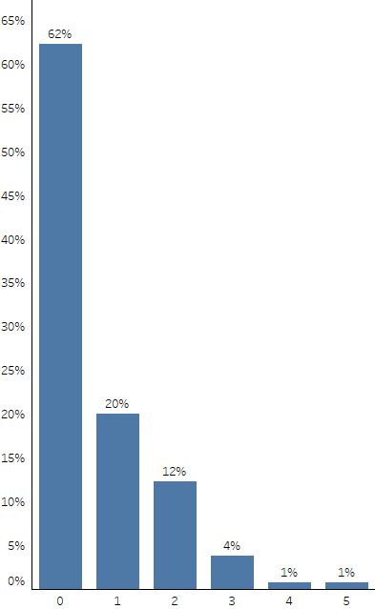
Total Number of Fellows in Advanced Fellowships Per CV Program – Heart Failure
(n=130)
Q: How many fellows does your institution have in each of the following advanced fellowships? Heart Failure (n=130)

Slide 19
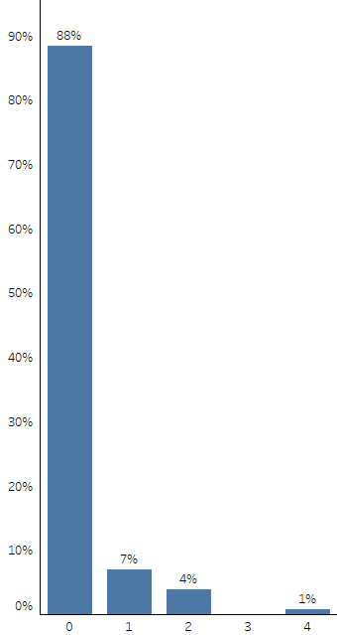
Total Number of Fellows in Advanced Fellowships Per CV Program – ACHD
(n=130)
Q: How many fellows does your institution have in each of the following advanced fellowships? ACHD (n=130)

Slide 20
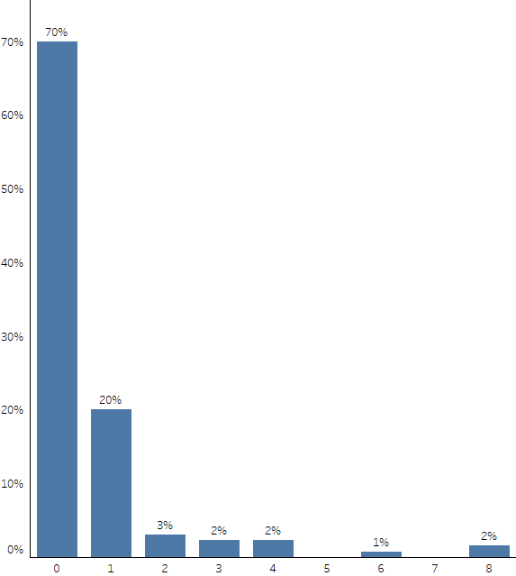
Total Number of Fellows in Advanced Fellowships Per CV Program – Imaging
(n=130)
Q: How many fellows does your institution have in each of the following advanced fellowships? Imaging (n=130)

Slide 21
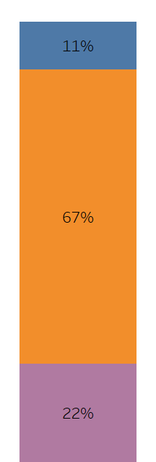
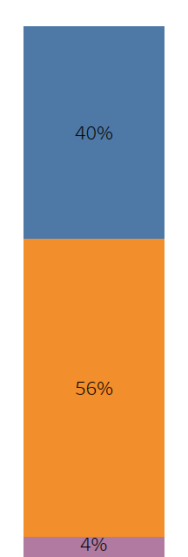
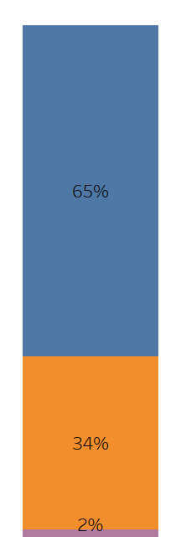
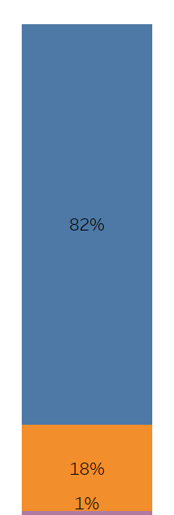
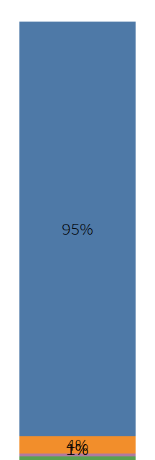

Estimated Number of Graduating Fellows in Various Work Settings –
Percentage Per CV Program
Going to
another
fellowship
Going to
community- based
clinical practice
Going to
academic-based
clinical practice
Going to
research focused
academic career
Other
(industry,
non-clinical, etc.)
Government job
(VA/ military)
0%
1% - 25%
26%
- 50%
(n=130)
(n=130)
(n=130)
(n=130)
(n=130)
(n=130)
> 75%
Q: In the current graduating class, to your best estimate how many fellows are … (n=130)

Slide 22
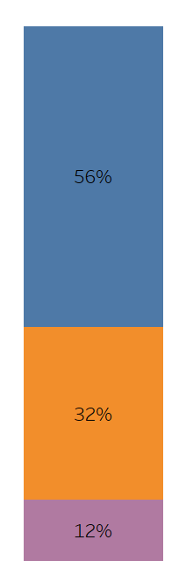
Usage of a 12 Month or 4 Week Block Schedule
The majority (56%) of CV training programs utilize a 4 week block schedule, while about 1 out of 3 (32%) utilize a 12 month schedule.
4 Week Block Schedule
“2 week blocks”
“2-3 week block schedule”
“2-4 week blocks”
“3 week block”
“13 week block schedule”
“13 month”
“Weekly”
“Transitioning from 12 month to 4 week in July 2018”
12 Month Schedule
Other
(n=130)
Q: Do you use a 12 month or 4 week block schedule? (n=130)

Slide 23
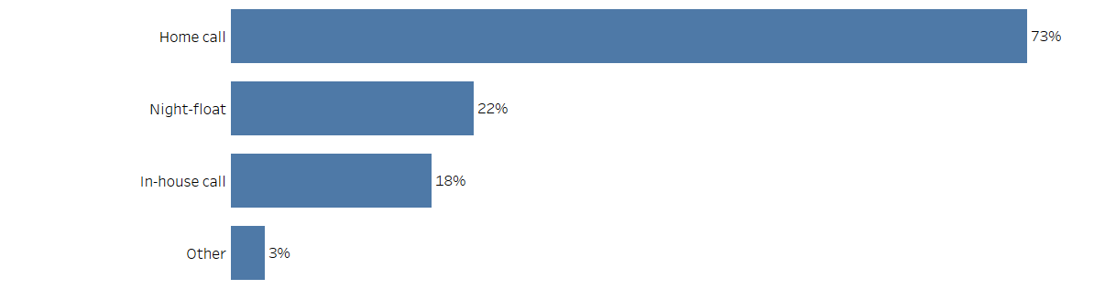
Fellowship Program Night Time Coverage Options at Primary Hospital
Nearly 3 out of 4 fellowship programs (73%) have Home Call as their top night time coverage option for their primary hospital.
(n=130)
Q: For night time coverage at your primary hospital does your fellowship program have the following? Please select all that apply. (n=130)

Slide 24
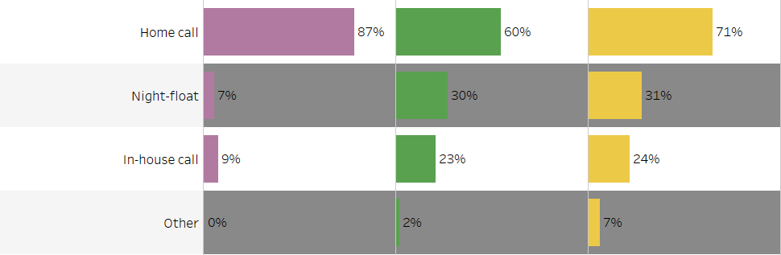
Fellowship Program Night Time Coverage Options at Primary Hospital by Program Size
Small CV Training Programs (87%) are more likely to offer home call for night time coverage at their primary hospital as compared to medium (60%) and large (71%) CV Training Programs. However, the medium and large programs are more likely to have night-float (30%/31%) and in-house call (23%/24%) as options while few small programs offer those options for night time coverage (7%/9%).
Program Size
Small
Medium
Large
(n=45)
(n=43)
(n=42)
Q: For night time coverage at your primary hospital does your fellowship program have the following? Please select all that apply. (n=130)

Slide 25
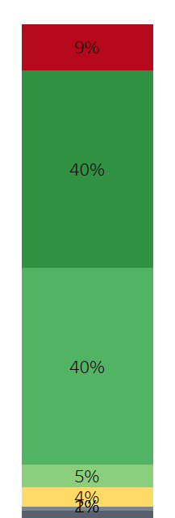
Ability for Fellows to “Moonlight”
More than 8 out 10 fellowship programs (85%) allow moonlighting for fellows. Most programs allow moonlighting in either year 1 (40%) or 2 (40%).
No, our program does not allow it
Allowed starting year 1
85%
Allowed starting year 2
Allowed starting year 3
Other
Not sure
(n=130)
No answer
Q: Do you allow fellows in the program to “moonlight”? If so, what year can “moonlighting” begin? (n=130)

Slide 26
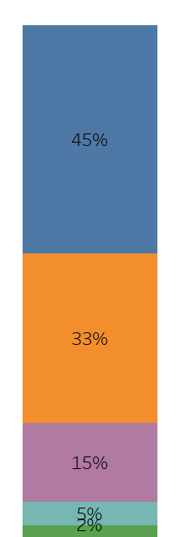
Number of Hospitals Fellows Cover During Clinical Rotations
Most fellows (78%) are covering either 1 or 2 hospitals during their clinical rotations.
1 hospital
78%
2 hospitals
3 hospitals
4 hospitals
Other
(n=130)
Q: How many hospitals do your fellows cover during their clinical rotations? (n=130)

Slide 27
CV Training Program Director Profile

Slide 28
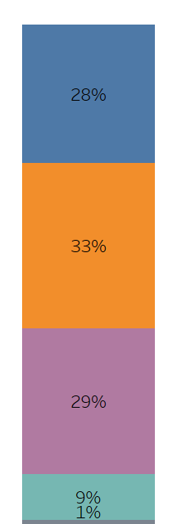

Age and Gender of CV Training Program Directors
Age
Gender
36 – 45 years old
Mean age = 52.9 years
Median age = 52.0 years
Std. Deviation = 9.206
Male
46 – 55 years old
56 – 65 years old
Female
66 – 75 years old
No answer
(n=130)
(n=130)
Q: What is your age? (n=130)
Q: What is your gender? (n=130)

Slide 29
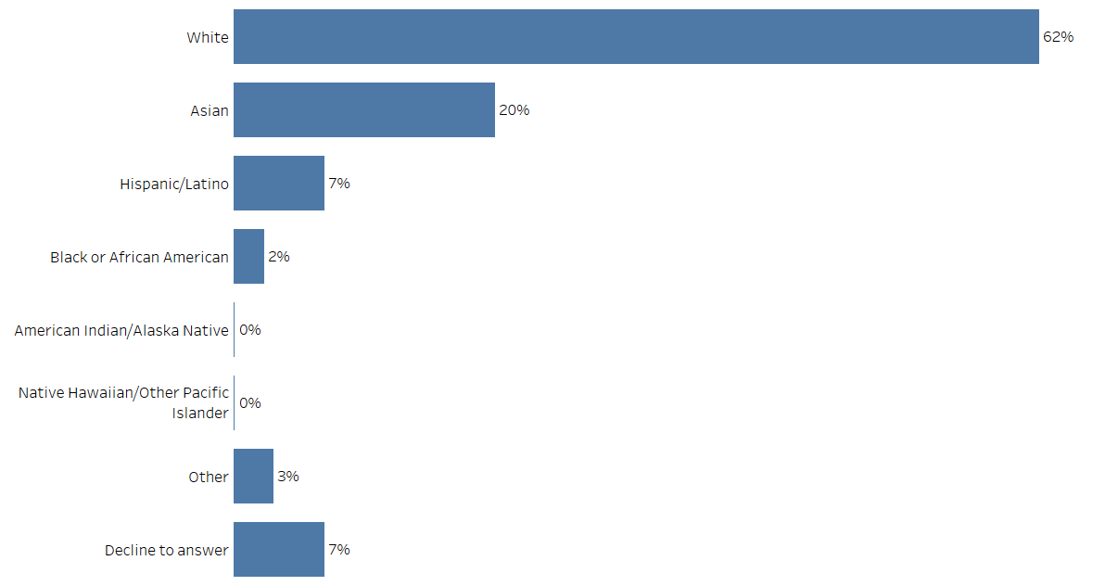
Ethnicity of CV Training Program Directors
(n=130)
Q: Which category describes your race/ethnicity? Please select all that apply. (n=130)

Slide 30
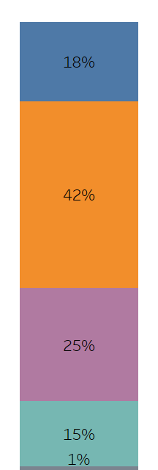
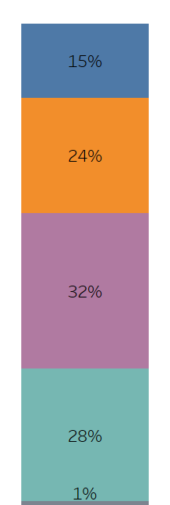
Number of Years: Since Training Completion / At Current Institution
Number of Years Since
Training Completion
Number of Years
at Current Institution
5 - 10 years
1 - 5 years
6 - 10 years
11 – 20 years
Mean years = 19.5 years
Median years = 18.0 years
Std. Deviation = 9.365
Mean years = 15.6 years
Median years = 14.0 years
Std. Deviation = 10.485
11 - 20 years
21 – 30 years
21 or more
years
31 or more
years
No answer
No answer
(n=130)
(n=130)
Q: Please indicate the number of years for each of the following: (n=130)

Slide 31
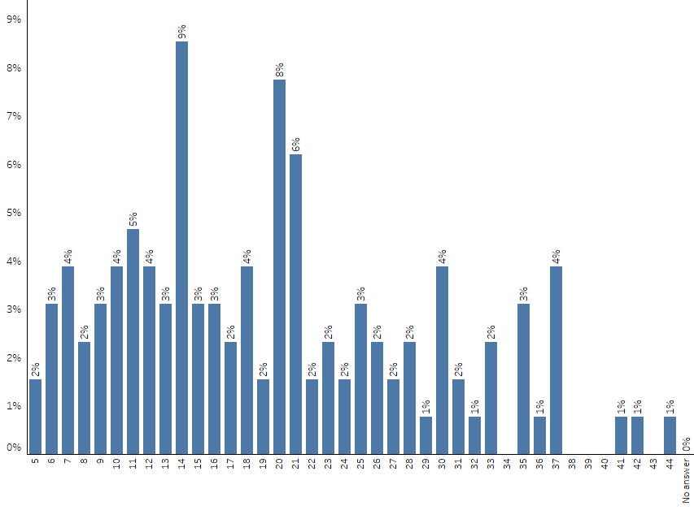
Number of Years: Since Training Completion Per CV Program
(n=130)
Q: Please indicate the number of years for each of the following: (n=130)

Slide 32
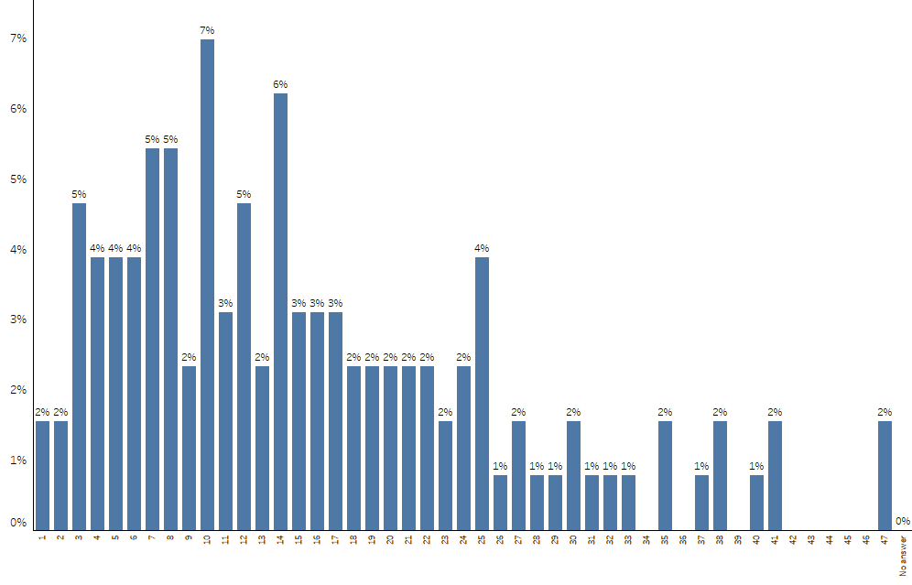
Number of Years: At Current Institution Per CV Program
(n=130)
Q: Please indicate the number of years for each of the following: (n=130)

Slide 33
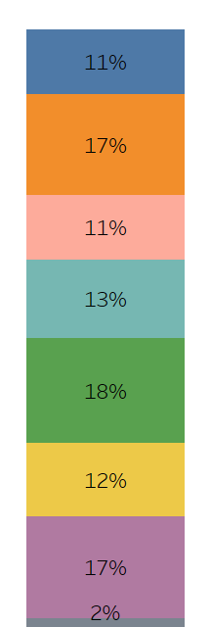
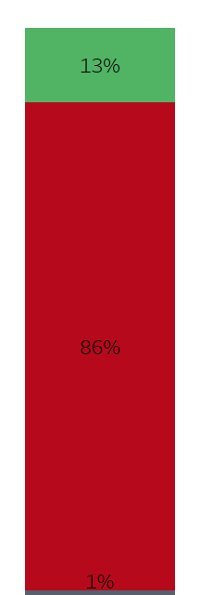
Number of Years: Program Director At Current Institution / Have Ever Been Program Director at Another Institution
Number of Years
Program Director at Current Institution
Have You Been Program Director
at Another Institution?
1 year
Yes
2 years
3 years
4 years
Mean years = 6.45 years
Median years = 4.00 years
Std. Deviation = 5.931
No
5 – 7 years
8 – 10 years
11 or more
years
No answer
(n=130)
(n=130)
Q: Please indicate the number of years for each of the following: (n=130)
Q: Prior to your current institution, have you been Program Director (PD) at another institution? (n=130)

Slide 34
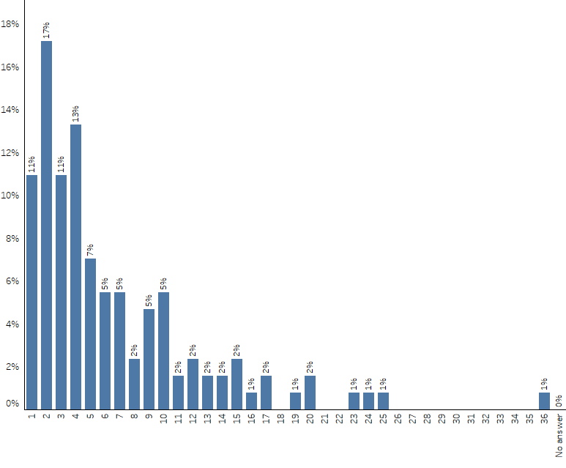
Number of Years: Program Director At Current Institution Per CV Program
(n=130)
Q: Please indicate the number of years for each of the following: (n=130)

Slide 35
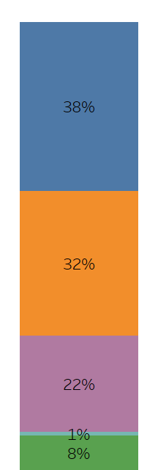
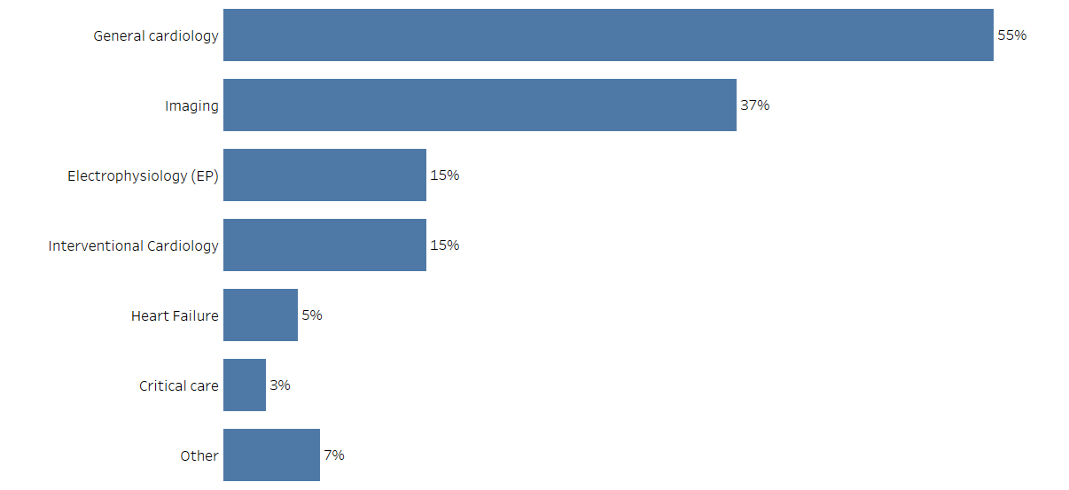
Current Academic Rank / Specialty
Current Academic Rank
Specialty
Associate Professor
Professor
“ACHD”
“Amyloidosis”
“Cardio-Oncology”
“Cardiovascular Prevention”
“Critical Care Cardiology”
“Interventional echo”
Assistant Professor
Instructor
(n=130)
Other
“Assistant Clinical Professor”
“Associate Clinical Professor”
“Clinical Professor”
“No academic ranks”
“Vice -Chair of Academic Affairs”
(n=130)
Q: What is your current academic rank? (n=130)
Q: What is your specialty? (n=130)

Slide 36
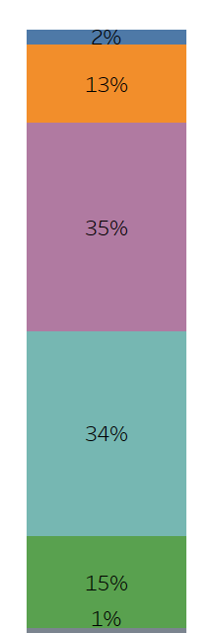
Estimated Percentage of Protected Time for Program Director Activity
For most Program Directors (69%) the current percentage of protected time for PD activity is either 11%-20% (35%) or 21%-30% (34%).
0%
1% - 10%
11% - 20%
Mean percentage of time = 23.8%
Median percentage of time = 20.0%
Std. Deviation = 12.683
21% - 30%
More than 30%
No answer
(n=130)
Q: To your best estimate what is your current percentage of protected time for Program Director (PD) activity? (n=130)

Slide 37
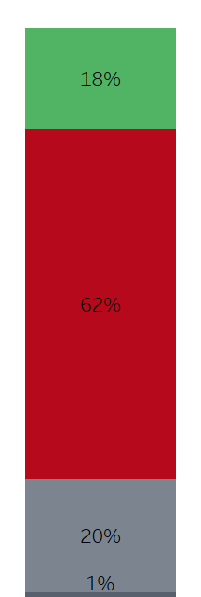
Planning to Step Down as PD in Next Two Years
Almost 1 out of 5 CV Training Program Directors surveyed (18%) plan to step down from their role within the next two years.
Planning to Step Down as PD
in Next Two Years
Yes
Why do you plan on stepping down as PD in the next two years?
“Administrative changes in the hospital system”
“Age”
“Changing jobs”
“Fatigue”
“I have been PD for a very long time.”
“I think it's time to let someone new take over -- fresh ideas.”
“Institutional tradition to hold leadership positions for 10 years. Will facilitate cutting back hours.”
“Keep junior faculty a chance to be program director. Direct my energies elsewhere”
“Large personal research footprint with multiple NIH R01 grants plus a potential promotion to oversight of all divisional academic pursuits.”
“Moving to a sister hospital”
“New job opportunity at another institution”
“Nothing novel after 11 years and I don't agree that ACGME requirements improve the quality of fellow education”
“Now chair”
“Pursuing additional roles in education, and permitting promotion of other colleagues earlier in career as clinician-educator.”
“Retiring”
“Too many other responsibilities to give it the time it needs. ACGME has added A LOT of administrative and teaching responsibilities to the PD role over the last decade - NAS, Wellness, QI, work hours, etc. It is a lot to keep track of”
“Transitioning to become associate chief of cardiology for academic affairs.”
No
Not sure
No answer
(n=130)
Q: Are you planning to step down as PD in the next two years? (n=130)
Q: Why do you plan on stepping down as PD in the next two years? (n=23)

Slide 38
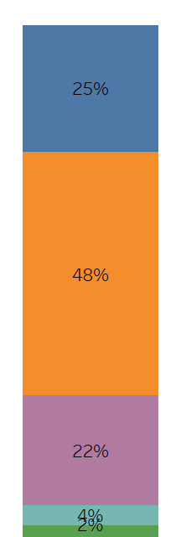
Number of Assistant Program Directors
Nearly half of programs (48%) have 1 Assistant Program Director, while 22% have 2 APDs.
0 APDs
1 APD
Mean percentage of APDs = 1.1 APDs
Median percentage of APDs = 1.0 APDs
Std. Deviation = 0.968
2 APDs
3 APDs
4 or more APDs
(n=130)
Q: How many Assistant Program Directors (APDs) does your program have? (n=130)

Slide 39
CV Training Program Director Perception of COCATS

Slide 40
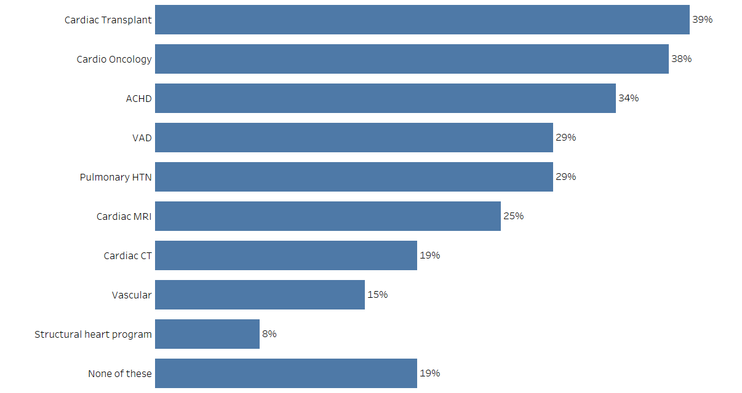
Is Direct Clinical Exposure to Any of the Following Lacking In Your Program?
More than 4 out of 5 CV training program directors (81%) indicated that direct clinical exposure was lacking in at least one area of their program. The top three areas were Cardiac Transplant (39%), Cardio Oncology (38%), and ACHD (34%).
(n=130)
Q: In your opinion, is direct clinical exposure to any of the following lacking in your program? Please select all that apply. (n=130)

Slide 41
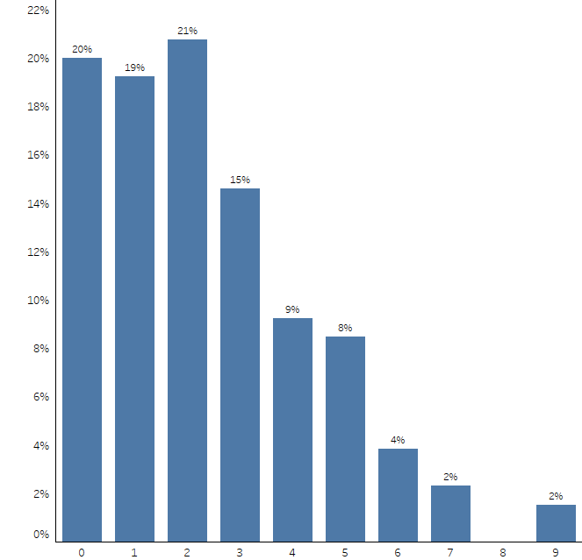
Is Direct Clinical Exposure to Any of the Following Lacking In Your Program? – Number of Lacking Items Per CV Program
About 8 out of 10 CV training programs feel that direct clinical exposure is lacking in their program. About 1 out of 5 (19%) felt that one area was lacking while an almost equal percentage thought they were lacking in two areas (21%), three areas (15%), or four or more areas (25%).
(n=130)
Number of Lacking Items Per CV Program
Q: In your opinion, is direct clinical exposure to any of the following lacking in your program? Please select all that apply. (n=130)

Slide 42
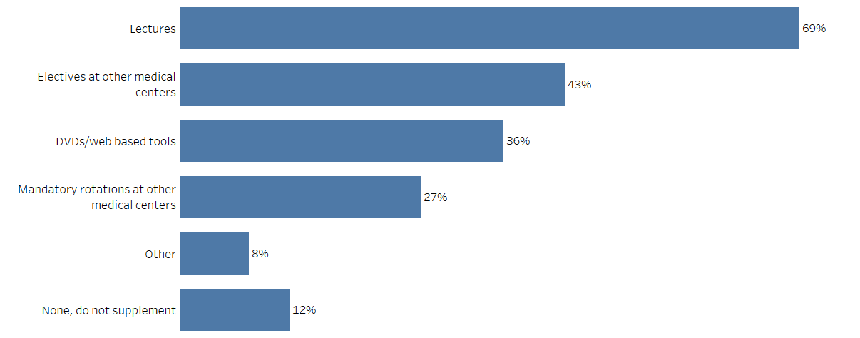
Supplemental Education for Services Not Offered by Program
More than 2 out of 3 programs (69%) supplement the education of their fellows with lectures, while more than 2 out of 5 (43%) offer electives at other medical centers.
(n=130)
Q: For the services which your program does not offer, how do you supplement the education of your fellows? Please select all that apply. (n=130)

Slide 43
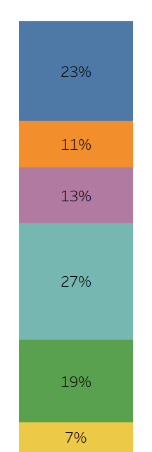
Number of Mandatory Months in Three Year Program: Research Months
In terms of mandatory research months the majority require between 1 – 3 months (51%).
Number of Mandatory Research Months
0 months
1 month
2 months
51%
3 months
4 – 6 months
Mean months = 3.1 months
Median months = 3.0 months
Std. Deviation = 3.664
7 or more months
(n=130)
Q: How many mandatory research months does each fellow have to spend in the three year program? (n=130)

Slide 44
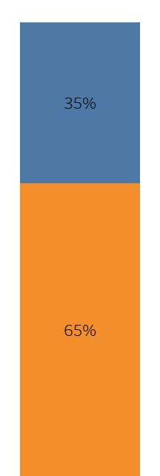





Mandatory Number of Months for Specific Areas: CT, MRI, Vascular, ACHD,
Cardiac Surgery, and Other
Cardiac Surgery
CT
MRI
Vascular
ACHD
Other
0
months
> 0
months
(n=130)
(n=130)
(n=130)
(n=130)
(n=130)
(n=130)
Q: During the three years the mandatory number of months for each of the following is: (n=130)

Slide 45

Offering of Multimodality Months
More than 4 out of 5 programs (84%) offer multimodality months where fellows spend significant time learning more than one imaging modality.
Yes
No
(n=130)
Q: Do you offer multimodality months (i.e., months where fellows spend significant time learning more than one imaging modality – e.g., a hybrid CT/nuclear
month)? (n=130)

Slide 46

Frequency of Institution’s Resources Limiting Ability to Adhere to COCATS
For about 2 out of 5 programs (43%) their institution’s resources never limit the ability of their trainees to adhere to COCATS guidelines. For almost an equal amount of programs (41%) their institution’s resources sometimes limit their ability to meet COCATS guidelines.
However, 15% of programs often (13%) or always (2%) feel that their institution’s resources limit their ability for their trainees to adhere to COCATS.
Never
Sometimes
Often
15%
Always
Not sure
(n=130)
Q: How often do your institution’s resources limit the ability of the trainee to adhere to COCATS guidelines? (n=130)

Slide 47







Number of Fellows Achieving At Least Level 2 Training in Specific Areas -
Percentage Per CV Program
Vascular Medicine/Imaging
Cardiac
Cath
Cardiac
CT
Cardiac MRI
Echo
Nuclear
EP
0%
1% - 25%
26% - 50%
51% - 75%
(n=130)
(n=130)
(n=130)
(n=130)
(n=130)
(n=130)
(n=130)
Q: In last year’s graduating class how many Fellows achieved at least level 2 training in the following areas? (n=130)

Slide 48


Number of Areas Fellows Can Achieve At Least Level 2 Training / Can Fellows Achieve Level 3 Training In Any Clinical Area During Three Years?
Nearly all programs (96%) offer 2 or more areas for Fellows to achieve at least level 2 training during their general cardiovascular disease fellowship.
The majority of programs (54%) also indicate that it is possible for Fellows to achieve level 3 training in any clinical area during their three years as well.
Number of Areas Fellows Can Achieve
At Least Level 2 Training
Can Fellows Achieve Level 3 Training
In Any Clinical Area During Three Years?
1 area
2 areas
Yes
96%
More than 2 areas
No
Not sure
Not sure
No answer
No answer
(n=130)
(n=130)
Q: In how many areas (e.g., echocardiography, nuclear, etc.) can a Fellow achieve at least level 2 training during their general cardiovascular disease
fellowship? (n=130)
Q: Can Fellows achieve level 3 training in any clinical area during their three years? (n=130)

Slide 49

Adjustments to Training Program Since COCATS 4
A little over half of training programs (55%) have made some type of program adjustment since COCATS 4 came out. For almost 1 out of 4 programs (22%) this involved an increase in the number of mandatory clinical months. For about 1 out of 10 the adjustment involved increasing the number of required echo months (11%) or increasing the number of required research months (10%).
“2 year general and then 2 year focused (general/imaging; cath., EP)”
“Added PV, increased CHF”
“Changed distribution of rotations”
“Decreased required cath months”
“Guided electives”
“Include vascular medicine rotation, added MMI month”
“Increase in dedicated ccu months and preventive”
“Modified rotations to allow overlap and cover core topics required”
“Required CTMR rotation”
“Spread research over 36 months”
“Vascular requirement”
(n=130)
Q: Since COCATS 4 came out, what changes have you made in your program? Please select all that apply. (n=130)

Slide 50

Adjustments to Training Program Since COCATS 4 by Program Size
More than half of all training programs have made some type of program adjustment since COCATS 4 came out regardless of the program size (56% of small/51% of medium/60% of large). The most common adjustment for training programs involved an increase in the number of mandatory clinical months (18% small/26% medium/24% large).
Program Size
Small
Medium
Large
(n=45)
(n=43)
(n=42)
Q: Since COCATS 4 came out, what changes have you made in your program? Please select all that apply. (n=130)

Slide 51


Overall Utility of COCATS 4 in Guiding Training Directors / Usefulness of COCATS Guidelines in Assessing Trainee Competency
More than half of CV training program directors (57%) believe that COCATS 4 is extremely/very useful in guiding them. Only 6% of training directors feel that it is not useful. Additionally, half of training directors (50%) believe that COCATS guidelines are extremely/very useful in assessing trainee competency while almost 1 out of 5 (19%) feel that it is not useful in that capacity.
Overall Utility of COCATS 4
In Guiding CV Training Program Directors
Usefulness of COCATS Guidelines
In Assessing Trainee Competency
Extremely
Useful
(5)
Extremely
Useful
(5)
50%
57%
(4)
(4)
(3)
(3)
(2)
(2)
19%
Not At All
Useful (1)
6%
Not At All
Useful (1)
(n=130)
No answer
(n=130)
No answer
Q: What is your overall perception of the utility of COCATS 4 in guiding you as a training program director? (n=130)
Q: How useful are COCATS guidelines in assessing competency of your trainees? (n=130)

Slide 52


Alignment of COCATS Guidelines With Competency Based Education / Alignment of COCATS Timelines with Trainee Achievability of Competence
More than half of CV training program directors (58%) believe that COCATS guidelines are extremely/very aligned with competency based education, while 1 out of 10 (10%) feel that they are not aligned. Similarly the majority (59%) believe that COCATS timelines for monthly rotations, procedural totals, and competencies are extremely/very aligned with their trainees’ ability to achieve competence, and only 9% do not feel that way.
Alignment of COCATS Guidelines
With Competency Based Education
Alignment of COCATS Timelines
With Trainee Achievability of Competence
Extremely
Aligned
(5)
Extremely
Aligned
(5)
58%
59%
(4)
(4)
(3)
(3)
(2)
(2)
Not At All
Aligned (1)
10%
Not At All
Aligned (1)
9%
(n=130)
No answer
(n=130)
No answer
Q: How aligned are COCATS guidelines with competency based education? (n=130)
Q: How well does the timeline for monthly rotations, procedural totals, and competencies proposed by COCATS align with your trainees’ ability to achieve
competence? (n=130)

Slide 53

Importance of COCATS 4 Milestones Compared to Clinical Evaluation of Trainee
CV Training Program Directors are fairly divided in their perceptions of the importance of the milestones defined in COCATS 4 as compared to their own clinical evaluations in determining the advancement and graduation of a trainee. Less than 1 out of 4 (23%) feel that the COCATS 4 milestones are more important than their clinical evaluations of the trainee, while 1 out of 3 (33%) feel that they are less important. More than 2 out of 5 (43%) feel that they are equally important.
Much More
Important
23%
Somewhat More
Important
Equal In Importance
Somewhat Less
Important
33%
Much Less
Important
Not sure
(n=130)
Q: How important are the milestones as defined in COCATS 4 compared to your clinical evaluations of the trainee in determining the advancement and
graduation of a trainee? (n=130)

Slide 54

Frequency of Using Competencies within COCATS for Trainee Assessment
Nearly 2 out of 3 CV training program directors (63%) always or often use the competencies within the COCATS documents for assessment of trainees. About 1 out of 3 (32%) sometimes use them while only 4% never use them.
Always
63%
Often
Sometimes
Never
Not sure
No answer
(n=130)
Q: How frequently do you use the competencies within the COCATS documents for assessment of trainees? (n=130)

Slide 55

Reliance on Numbers/Time Versus Competency to Assess Proficiency of Fellows
More than 6 out of 10 CV training program directors (62%) rely equally on numbers/time and competency in order to assess the proficiency of fellows and their ability to achieve levels of training.
Primarily relies on numbers/time
Equally relies on numbers/time and competency
Primarily relies on competency
Not sure
No answer
(n=130)
Q: In order to assess a fellow’s proficiency and achieving levels of training, my program… (n=130)

Slide 56

Perception of How Focused Trainees Are on Achieving Levels I-III
Slightly more than half of CV training program directors (51%) feel that their trainees have just the right balance on achieving levels I-III during their training. However, more than 2 out of 5 (44%) feel that trainees are too focused on achieving levels.
Too focused on achieving levels
Just the right balance
Not focused enough on achieving levels
Not sure
No answer
(n=130)
Q: How focused are trainees on achieving levels I-III during their training? (n=130)

Slide 57

Perception of Minimum Clinical Time Required for COCATS 4
A variety of perceptions exists among CV training program directors regarding the minimum clinical time required within the 3-year training period. Almost half (49%) believe that 24 months is the minimum clinical time required, while 34% believe that it is 25 months or more.
< 24 months
24 months
25 – 29 months
34%
30 months
> 30 months
Not sure
No answer
(n=130)
Q: Based on your understanding of COCATS 4, what is the minimum clinical time required within the 3-year training period? (n=130)

Slide 58
Please review the following two perspectives regarding COCATS 4:
Perspective I:
COCATS 4 has outlined guidelines that are better aligned with the needs
of CV trainees for the current job market of today’s general cardiologist.
Perspective II:
COCATS 4 has outlined guidelines that are poorly aligned with the needs of
CV trainees for the current job market of today’s general cardiologist.
Which opinion most closely resembles your own?

Slide 59

Perception of COCATS 4 Alignment with CV Trainees for Current Job Market
Nearly 7 out of 10 CV training program directors believe that COCATS 4 has outlined guidelines that are better aligned with the needs of CV trainees for the current job market of today’s general cardiologist. About 1 out of 5 training directors (19%) feel strongly about this perception.
A little more than 1 out of 10 (12%) believe that COCATS 4 is poorly aligned with the needs of CV trainees for the current job market.
Strongly agree with perspective I (COCATS 4 – better aligned)
69%
Somewhat agree with perspective I (COCATS 4 – better aligned)
Neutral / Neither
Somewhat agree with perspective II (COCATS 4 – poorly aligned)
12%
Strongly agree with perspective II (COCATS 4 – poorly aligned)
Not sure
No answer
(n=130)
Q: Which opinion most closely resembles your own? (n=130)

Slide 60

Perception of COCATS 4 Alignment with CV Trainees for Job Market by Program Size
The view of COCATS 4 differs by program size. More than 7 out of 10 CV training program directors in small (71%) and medium (79%) programs believe that COCATS 4 has outlined guidelines that are better aligned with the needs of CV trainees for the current job market of today’s general cardiologist. While fewer large programs (57%) agree with that perspective of COCATS 4, they are more neutral (26%) about it compared to the small (11%) and medium programs (9%).
Total
Small
Medium
Large
Strongly agree with perspective I (COCATS 4 – better aligned)
57%
69%
71%
79%
Somewhat agree with perspective I (COCATS 4 – better aligned)
Neutral / Neither
Somewhat agree with perspective II (COCATS 4 – poorly aligned)
12%
13%
12%
12%
Strongly agree with perspective II (COCATS 4 – poorly aligned)
Not sure
No answer
(n=130)
(n=45)
(n=43)
(n=42)
Q: Which opinion most closely resembles your own? (n=130)

Slide 61

Perception of COCATS 4 Alignment with CV Trainees for Job Market by Direct Clinical Exposure Lacking/Non-Lacking in Program
While programs that believe they are not lacking in direct clinical exposure are slightly less likely to agree (61%) that COCATS 4 is better aligned with CV trainee needs than those PDs whose programs are lacking in at least one area (71%), those which are not lacking tend to be more neutral about it (23%) than those lacking (13%).
Total
Non-Lacking*
Lacking**
Strongly agree with perspective I (COCATS 4 – better aligned)
61%
69%
71%
Somewhat agree with perspective I (COCATS 4 – better aligned)
* - Non-Lacking – is defined as program cited no areas in which direct clinical exposure was lacking in program
** - Lacking – is defined as program cited at least one area in which direct clinical exposure was lacking in program
Neutral / Neither
Somewhat agree with perspective II (COCATS 4 – poorly aligned)
12%
13%
12%
Strongly agree with perspective II (COCATS 4 – poorly aligned)
Not sure
No answer
(n=130)
(n=26)
(n=104)
Q: In your opinion, is direct clinical exposure to any of the following lacking in your program? Please select all that apply. (n=130)
Q: Which opinion most closely resembles your own? (n=130)

Slide 62

Ease/Difficulty of Incorporating Training Guidelines into Fellowship Program
About 2 out of 5 CV training program directors (39%) believe that it has been easy to incorporate the current training guidelines into their training programs for general fellowship. Slightly more training program directors (44%) are more neutral in their perception of the ease or difficulty of it; however, 16% of PDs believe that it has been difficult to do so.
Very Easy (5)
(4)
39%
(3)
(2)
16%
Very Difficult (1)
Not sure
(n=130)
Q: In general, how easy or difficult has it been for you to incorporate current training guidelines into your training program for general fellowship? (n=130)

Slide 63

Did You Have The Opportunity To Comment On COCATS 4?
The majority of CV training program directors (60%) did not have the opportunity to comment on COCATS 4. However, a little more than 1 out of 3 PDs (37%) did have the opportunity. Interestingly, less than half of those who could comment on COCATS 4 chose to do so. For those who chose not to comment they cited a lack of time, the perception that commenting would not matter in the final outcome, or a general agreement with the document as the primary reason for not participating.
Why did you not comment on COCATS 4?
Yes, I had the opportunity to comment on COCATS 4 and I did so
“Didn't think it would matter”
“Generally agreed”
“Generally satisfied with content”
“I didn't feel that my comments would be taken into consideration, nor did I have the time to thoroughly read them. I have been reading them as we go”
“I was a co-author”
“It was too long to read, and hard to understand”
“Lazy”
“No significant comments”
“They were OK”
“Time constraints”
“Wanted to monitor implementation at our institution”
“Well done”
Yes, I had the opportunity to comment on COCATS 4, but I did not do so
No, I did not have the opportunity to comment on COCATS 4
Not sure
(n=130)
Q: Did you have the opportunity to comment on COCATS 4? (n=130)
Q: Why did you not comment on COCATS 4? (n=29)

Slide 64
What have you liked most about COCATS 4?
“A more formalized framework for evaluation.”
“Acceptable for trainees going into private practice. More emphasis on imaging with less emphasis on cath lab rotations.”
“Adaptability to current needs”
“Addition of CBME concepts, milestones, language and EPAs. Also provides the "norms" for the cardiology Community of Practice
“An understanding of electives.”
"Broadens exposure to more CV disciplines although outside rotations are needed for some"
“Can offer a listing of topics to cover in a didactic curriculum.”
“Clear and simple to understand document”
“Clearer recommendations for procedural totals and time requirements. There are sections where this isn't clear, or a range is provided.”
“Clearly delineated milestones and time/number requirements for achieving level II and III”
“Competency based curriculum”
“Competency based objectives that are detailed”
“Competency requirements and tools”
“Contemporary training guidelines in novel areas such as ACHD, vascular medicine”
“Details”
“Emphasis on areas like imaging and prevention.”
“Emphasis on competency”
“Emphasis on new areas of cardiology”
“Fairly concrete and descriptive and goals/competencies are aligned with current market.”
“Fairly well lays out the minimum requirements for amount of clinical exposure to various areas of CV disease fellowship and the numbers for levels of training.”
“Flexibility”
“Gives some structure and is aspirational”
“Good standard”
“Helpful roadmap”
“Highlighted goal of Level II in echo being universally achieved; emphasized research should be throughout their training rather than in dedicated blocks of protected time; lowered the enthusiasm for a goal of more than 2 level II skills”
“I use them as guidance for time and #s for competency”
“Incorporation of change in training, e.g. RPVI into vascular 2, need for all to be echo 2”
“Integration of competencies”
“Invoking more of a competency based system rather than strictly months/numbers. You can do 1000 caths wrong or unsafe, or become very proficient with 150. It's more than numbers.”
“It is a starting point”
“It is direct and organized”
“It more clearly defines expectations for subdisciplines in cardiology”
Q: What have you liked most about COCATS 4? (n=63)

Slide 65
What have you liked most about COCATS 4? (continued)
“It's comprehensive and tries to provide some guidelines (numbers) regarding the degree of experience (time) that is likely to be necessary for fellows to achieve competence in various aspects of cardiovascular disease. These must be individually tailored based upon pre-fellowship education and experience (which vary among fellows) and the speed with which each fellow assimilates knowledge and attains comfort and competence in doing various procedures.”
"Less emphasis on months of time and more on procedural numbers and competency. More specific calling out of which competencies fit with level I, II, and III and by what point in fellowship a fellow should be at a given point. More clarity about multimodality imaging and how fellows should approach what imaging modalities they should choose."
“Less focus on numbers and more on individual assessment”
“Levels of competency are clearly outlined. These are matched to what is expected for fellows at specific stages of their training.”
“Logical recommendations about which year of training is typically best suited for the various components of experience”
“More detailed competency based approach to training in specific areas”
“More flexibility”
“Organization of document and tabular form of competencies.”
“Procedure volume guidelines for rotations”
“Relatively straightforward competency guidelines”
“Says in some instances that Level 3 can be achieved during a general 3 year fellowship. Important for those who want that to be their main focus in addition to HF/general Cardiology.”
“Serves as guideline for overall program format but seems to allow for customization of programs for individuals with specific interests.”
“Setting procedure numbers and giving us guidelines for the curriculum”
“Start to tackle multimodality”
“Structure and reference for program design”
“The Core Competency check lists. We use this in our Curricular requirements for our rotations.”
“The document is thorough and creates a framework to broaden the training of CV fellows to recognize the importance of the broad practice of contemporary CV medicine.”
“The emphasis on clinical competence beyond numbers alone makes a lot of sense, but true assessment of individually defined competencies can often be very subjective. Most staff have an ‘overall impression’ of working with someone rather than specific line item assessments. The number requirements help maintain an objective goal.”
“The focus on competency over time.”
“The milestones part of the document - the shift to competency”
“Very good guidelines for duration and content of training. Milestones are useful.”
“Very thorough, provides specific milestones to use in other documents for acgme/gme”
“Very well explained”
“Well balanced”
“Well delineated goals”
Q: What have you liked most about COCATS 4? (n=63)

Slide 66
What has been your greatest challenge in implementing COCATS4?
“ADCHD”
“Aligning evaluations with milestones achievements”
“Aligning milestones with competencies dedicated to card rotations in a manner than is both sensible and rewarding to the FIT”
“Although competency is introduced, still rely on numbers. So now just more cumbersome than COCATS 3.”
“Applying COCATS requirements to those in research or physician scientist training tracks.”
“Balancing time with fellow interests and available resources”
“Cardio-onc and vascular”
“Conflict scheduling fellows to meet guidelines early on to free them for electives”
“CT/MRI Imaging. There are very few high volume options to no options in-state.”
“Dense document that does not provide concrete recommendations for how to develop a curriculum”
“Developing training pathways for individuals wanting to achieve level III in echo”
“Did not finish addressing multimodality - this needs to be coordinated nationally and addressed with very clear guidelines on how many boards a general fellow takes prior to graduation. It is currently getting out of control and taking away from the value to general cardiology training. Please help. Please!”
“Difficulty with keeping track of procedures performed by the fellows. There are barriers to doing so electronically at my institution. This amounts to thousands of procedures across the various areas of cardiology, and includes interpretation of studies.”
“Don't really know how to measure competency. I know how to measure time/numbers. Don't have a good outlet for vascular training”
“Ensuring all minimum requirements are met despite fellows' different interests and diverse career paths.”
“Evaluation”
“Exposure to rotations not offered at my own institution”
“Faculty at different units and laboratories to incorporate competency based evaluation into their teaching and evaluation.”
“Favors larger programs with more diverse resources”
“Fellow's documentation of numerical portion of their competencies. Fellows wanting 'to do it all’”
“Fellows who are going the non-academic private practice route and wanting to be level 2 across the board.”
“Fitting in all requirements in 3 years”
“Fitting the ‘numbers’ into the strengths and weakness of the program design”
“For some areas, getting a good curriculum of didactic content has been slow to develop”
“Getting imaging incorporated given lack of CARDIOLOGISTS that are trained in these areas as opposed to radiologists”
“Hard to implement. Abstract at times.”
“Higher procedural numbers in some areas (cardiac CT).”
“How are they defining clinical months ? Is echo clinical - they are doing TEE and talking to patients and incorporating clinical history...”
“Integrating true competency based training into our evaluation of our fellows.”
“It assumes every hospital has multiple resources”
“It generally asks too much. Too little coordination between subsections. The overall training diagram is confusing. Institutional limitations make it impossible to abide by it unless you're in a quarternary institution.”
Q: What has been your greatest challenge in implementing COCATS4? Please explain. (n=69)

Slide 67
What has been your greatest challenge in implementing COCATS4?
(continued)
“It has made it feel like it is impossible to accomplish everything in 3 years. Also, what if somebody wanted to fast track?”
“Lack of focus on fellow's side about their final career goal.”
“Limited clinical volume in certain areas; small fellowship so coverage of clinical services may decrease fellows time in certain areas”
“Limited number of fellows and challenges supporting stand alone rotations in Cardiac MRI/CT, Vascular, CT surgery. Though there is mention of shifting to competency based training, COCATS 4 remains adherent to a "months recommended" which in essence reverts to the standard paradigm of time based training. It is hard to fit in all of the recommended rotations and still have fellows participate in the core rotations (ICU, consults) when you have a relatively small fellowship program.”
“Making sure the fellows get the opportunity to do be involved in research and scholarship activities.”
“Many competing demands/requirements”
“Many fellows are still in the mindset that they need to be level II in everything before graduating (echo, nuc, CT, MRI, Vascular, Cath). This is often true even of those going on to sub-specialty training. It would be helpful if as a group we took a strong position that fellows need to begin looking at depth of learning and not breadth and start planning on what areas the fellows want to focus on in their 3rd year for their long term careers. Perhaps we could create ‘tracks’ for individual career paths so that fellows are not sow worried that they might be ‘missing out’ if they are not certified in everything.”
“MRI, advanced heart failure”
“My faculty are choosing to interpret the time versus procedure number guidelines in the way that is best for them.”
“Needs more community program focused guidelines. Some recommendations difficult to justify as they have little relevance to clinical competency”
“Not enough months in fellowship to accomplish everything. Each task force seems to have operated in its own silo.”
“Not enough resources and less so time”
“Not realistic to limit fellows in level 2 training. I believe in the future, all cardiologists need to be level 2 trained in CT and echo.”
“Not so much a challenge of COCATs, but a challenge of incorporating all of COCATs as well rotations that are not required but are needed by our hospital while maintaining service/education balance.”
“Nothing specific. I just get that they didn't add much to what we were already doing.”
“Numbers of cases in the time allotted truncated by work hour regulations and less work performed in general by millennials”
“Often too much to learn in the 3 years”
“Really not applicable in highly academic fellowship, where research accomplishments correlate with future academic positions and success. For fellows planning to go into clinical practice the third (so-called) research year is used for additional clinical rotations. Obviously, everyone meets the ACGME requirements.”
“Reinforcing importance of competency with fellows”
“Requirements for a focused experience in heart failure, vascular medicine, and CT/MRI has reduced the time available for research or electives in the first 2 years. Therefore, research and elective time is being pushed to the third year.”
“Sheer volume of expected training.”
“So much of fellowship is mgmt of data tracking and COCATS4, while necessary, adds to the stack of documents. It has shoehorned more and more training/expectations into 3 years, which will eventually reach capacity. It does not rely on educational science or evidence within its structure.”
Q: What has been your greatest challenge in implementing COCATS4? Please explain. (n=69)

Slide 68
What has been your greatest challenge in implementing COCATS4?
(continued)
"Some of the challenges include, distributing fellows across the multiple institutions and hospitals and making sure they have sufficient time for advanced and unique rotations with educational value while also complying with needs of the institutions. Incorporating time for rotations and educational needs, i.e. ACHD, vascular imaging, CMR, where the work-efforts of the fellows are felt to not be as crucial from an institutional standpoint. Also given the current workplace environment, cost-containment, etc. with increase there has been more push for trainees to continue to get more involved in clinical rotations, i.e. night float or overnight coverage, Also some institutions, i.e. federal government hospitals, have made it stricter to do research rotations, and so the distribution of rotations across campus/hospitals becomes more difficulty to manage; Development and transition to a milestones and proficiencies approach continues to slowly evolve."
“The flexibility makes it difficult to organize the education of the trainees.”
“The imaging was very non descript and not helpful. Would have liked to see more push for multimodality.”
“The increased number of clinical months decreasing the ability to individualize training for a fellow.”
“The problem with COCATS in general is that it does not completely consider the requirements for some of the other board certification bodies. For example to be board certified in echocardiography numbers (procedures interpreted/performed, and months) are of great importance. COCATS should reflect these board requirements. Although competency assessment is the new buzz word in medical education, no one to my knowledge, has developed a reliable (across the board) tool beyond numbers and the board exam itself to assess this. Institutions are still struggling to determine the best way to assess competency. Oral boards were a failure. Although numbers (months/procedures) are not ideal they must be incorporated in COCATS 5 and beyond.”
“The reorganization of the curriculum which had previously been time/number-oriented”
“The structure and amount of imaging training is confusing”
“The volume of competencies addressed in each focus area are not easily integrated into attending/fellow feedback.”
“There is so much to cover, it's hard to tailor the curriculum to each fellow's needs, especially given the different career paths they each hope to pursue.”
“Timeliness of completing faculty feedback”
“Too many things”
“Too many words. It's really not useful to write so many words about something which is so intuitive.”
“Too vague in some procedural places, particularly with L3 Echo”
“Two months of vascular medicine is unnecessary - one month should be ok. This should be limited to preventive vascular medicine and screening for PaD. The competency list is too exhaustive to include interventional vascular disease. The competency requirements should be very limited. 2 months is putting a strain on other areas.”
“36 months of training makes it difficult to incorporate all of the time suggestions in COCATS.”
“Vague Boards in echo and nuclear should be achievable before general boards and serves as a Launchpad for general boards”
Q: What has been your greatest challenge in implementing COCATS4? Please explain. (n=69)

