Slide 1
ACC Member Wellness Initiative
An Early Career Perspective
Akshay Khandelwal, MD, FACC
Scott Lilly, MD, PhD, FACC
Poonam Velagapudi, MD, MS, FACC

Slide 2
Webinar Objectives
Review the prevalence of burnout in ACC early career members
Explore risk factors and causes of burnout for early career physicians
Discuss strategies for addressing burnout
Be aware of resources for burnout and well-being

Slide 3
Webinar Faculty
Moderator
Akshay Khandelwal, MD, FACC – Immediate Past Chair of ACC’s Board of Governors
Presenters
Scott Lilly, MD, PhD, FACC – Immediate Past Chair, ACC Early Career Section
Poonam Velagapudi, MD, FACC –Chair, ACC Early Career Section

Slide 4

Member Well-Being
Notes:
Addressing Member Well-Being is a critical component of ACC’s Strategic Goal to “Increase Relevance as the CV Professional Home.”

Slide 5
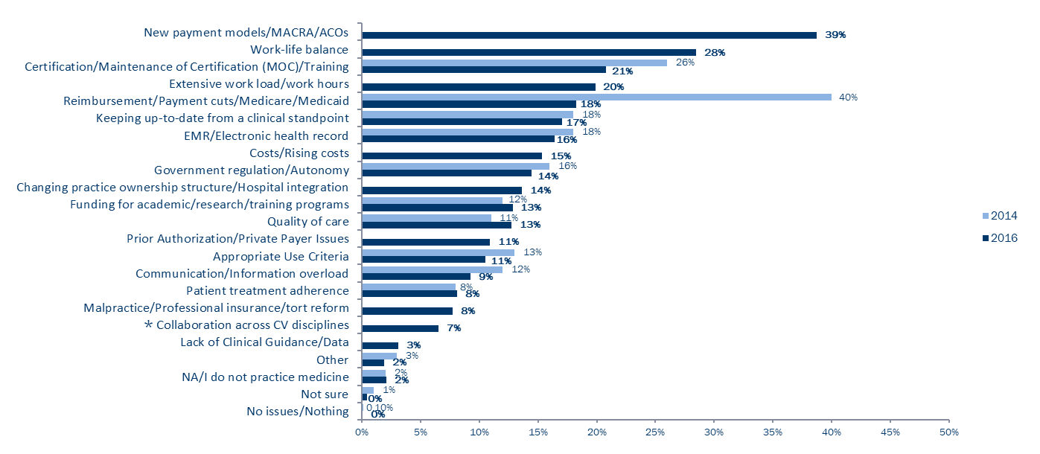
Biggest Challenges in CV Medicine
Payment issues/new models continues to be a challenge in CV medicine. Two fifths (39%) of members identify new payment models/MACRA/ACOs as the biggest issue facing CV medicine. Work-life balance (28%), certification/MOC (21%), and extensive work load/work hours (20%) are also challenges.
*
*
*
*
*
*
*
*
* New category added in 2016
Q: What are the three biggest issues you will face in cardiovascular medicine over the next three years?
Notes:
To steal from Mike Valentine’s Legislative Conference presentation, it’s no secret that CV professionals are feeling burnt out. It’s true that we cannot achieve the triple aim of improved outcomes, lower costs, better care, without definitively addressing the quadruple aim of clinician well-being

Slide 6
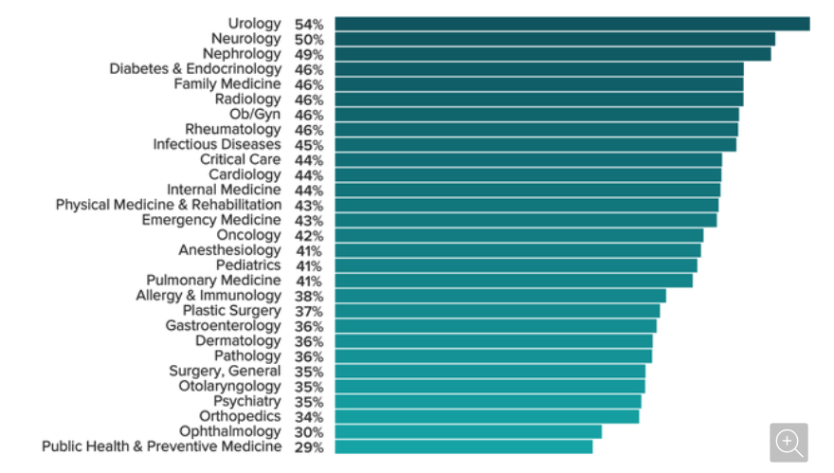
Which Physicians Are the Most Burned Out?
4 out of 10 Cardiologists
are “Burned-Out”
https://www.medscape.com/slideshow/2020-lifestyle-burnout-6012460#2

Slide 7
Mini-Z Burnout Questionnaire
1. Overall, I am satisfied with my current job.
Strongly Disagree | Disagree | Neither | Agree | Strongly Agree
6. Sufficiency of time for documentation is:
Poor | Marginal | Satisfactory | Good | Optimal
2. I feel a great deal of stress because of my job.
Strongly Disagree | Disagree | Neither | Agree | Strongly Agree
7. The degree to which my care team works efficiently together is:
Poor | Marginal | Satisfactory | Good | Optimal
Survey distributed late 2019, presented as a LBCT in 2020 Virtual ACC Meeting
N = 2035 Respondents, 35% of whom reported burnout
Causes, differences between membergroups forthcoming
3. My professional values are well aligned with those of my department leaders.
Strongly Disagree | Disagree | Neither | Agree | Strongly Agree
8. My proficiency with EHR use is:
Poor | Marginal | Satisfactory | Good | Optimal
4. Using your own definition of “burnout,” please select one of the answers below.
a. I enjoy my work. I have no symptoms of burnout.
b. I am stressed, but I don’t feel burned out.
c. I am definitely burning out and have symptoms of burnout, e.g., emotional exhaustion.
d. The symptoms of burnout that I am experiencing won’t go away.
e. I feel completely burned out. I am at the point where I may need to seek help.
9. Which number best describes the atmosphere in your primary work area?
1 - Calm | 2 | 3 - Busy, but reasonable | 4 | 5 - Hectic, chaotic
10. The amount of time I spend on the electronic health record (EHR) at home is:
Excessive | Moderately High | Satisfactory | Modest | Minimal/None
11. ACC helps me avoid burnout.
Strongly Disagree | Disagree | Neither | Agree | Strongly Agree
5. My control over my workload is:
Poor | Marginal | Satisfactory | Good | Optimal

Slide 8
Burnout & Wellness in
Early Career Physicians
Poonam Velagapudi, MD, MS, FACC, FSCAI
Twitter: @pooh_velagapudi

Slide 9

KIDS SCHOOL/ ACTIVITIES/ HOMEWORKS
EMAILS
COOK/ CLEAN
MEETINGS
EXERCISE
PREP PATIENTS
LECTURES/
PRESENTATIONS

Slide 10
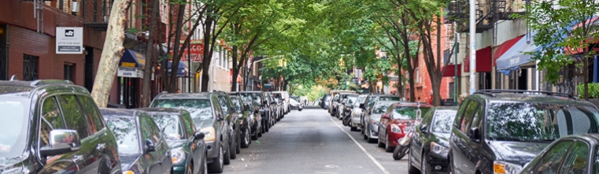
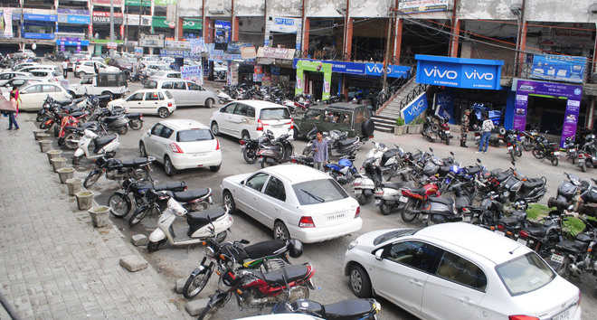
Expect the day to be like this!
Ends up being like this!

Slide 11
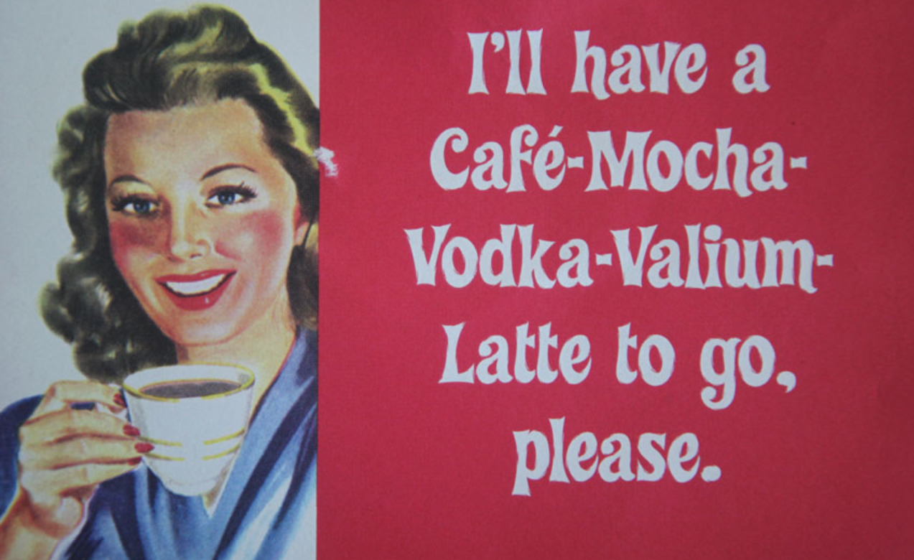
‘BURNOUT’?

Slide 12
Outline
Introduction & background on physician burnout
Risk factors and consequences of stress and burnout
Preventing burnout and promote wellness
Physician Burnout and Wellness Resources

Slide 13
Burnout Syndrome Causes and Definitions
Definition
characterized by loss of interest in work
depersonalization
Contributors
lack of sense of personal accomplishment
repeated exposure to work stresses
self-doubt
emotional exhaustion
Shanafelt TD, Boone S, Tan L et al. Burnout and satisfaction with work-life balance among US physicians relative to the general US population. Archives of internal medicine 2012;172:1377-85.

Slide 14
Stress
Burnout
Emotions are overreactive
Emotions are blunted
Produces urgency and
hyperactivity
Produces helplessness and
hopelessness
Loss of energy
Loss of motivation, ideals, and hope
Leads to anxiety disorders
Leads to detachment and depression
Primary damage is physical
Primary damage is emotional
May kill you prematurely
May make life seem not worth living
Understand the Difference Between Stress and Burnout

Slide 15
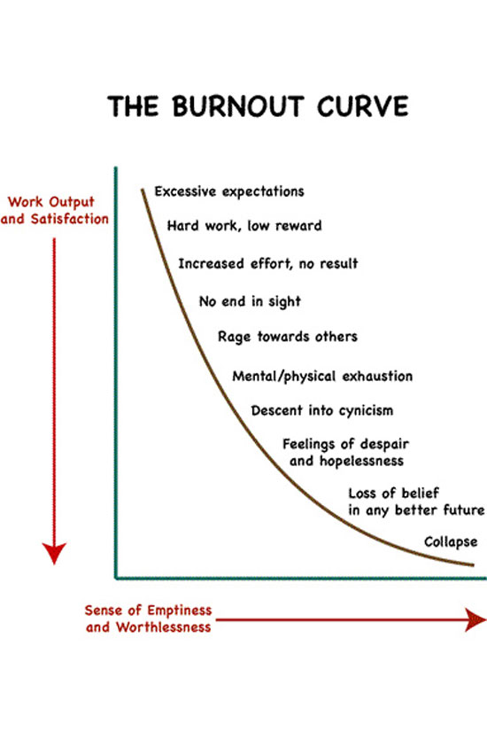
WHERE ARE YOU
ON
THE BURNOUT CURVE?

Slide 16
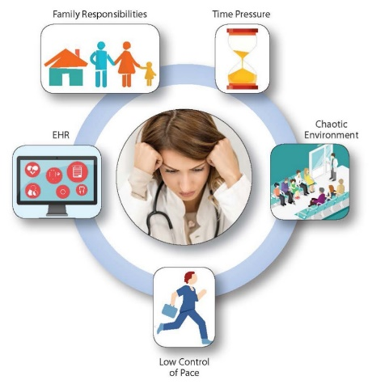
Risk Factors For Burnout
Long Duration of training: sub-specialty training
Financial Responsibilities
  Raising a family
  Student loan debt
  New mortgage
  Retirement planning
Supply-demand mismatch
  A shortage of more than 4000 cardiologists was predicted by a 2009 survey including general cardiologists, interventional cardiologists, electrophysiologists and pediatric cardiologists
  Increase # patients seen and Increase work hours
Academic Dissatisfaction
  Increased clinical duties, less time for research, educational, scholarly activities
Administrative Burden

Slide 17
Consequences of Burnout
2020 Medscape Physician Lifestyle Report
  44% cardiologists- burnout
  15%- millennials depressed
  Cardiology had one of the higher rates of burnout and lowest happiness rates
23% cardiologists considered professional help (least likely of all medical specialties)
Ways to cope
  Alcohol consumption
  Binge/unhealthy eating
  Self-isolation
Suicide Rates
  Double that of general population
  Women 130% higher than general female population
  Men 40% higher than general population
Physician
Patient care
Family/Friends
Personal Health
Hospital/Health Care Organization
https://www.medscape.com/slideshow/2020-lifestyle-burnout-6012460#1
Schernhammer ES, Colditz GA. Suicide rates among physicians: a quantitative and gender assessment (meta-analysis). The American journal of psychiatry 2004;161:2295-302.
Notes:
Patient care – suboptimal care, lower patient satisfaction, medical errors, malpractice suits
Health Care organizations/Hospital – decreased productivity, increased physician turnover
Personal – depression, suicidal ideation, substance abuse, early retirement
Family/Friends – relationship difficulties

Slide 18
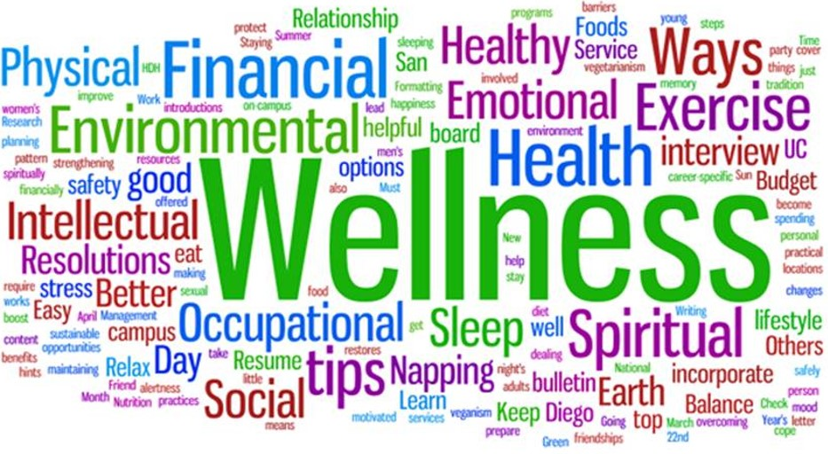
Define Physician Wellness
“finding joy and meaning in one’s life and work with an improved experience of providing care”
D I. The Quadruple Aim 2018

Slide 19
ACC Quadruple Aim
Physician burnout is counterproductive to the goals of the triple aim
This has added a fourth aim – “improve work life of health care providers”
Embedded in ACC’s strategic plan 2019-2023
Improve work life of health care providers
Reduce Costs
Enhance patient Experience
Improve Population Health

Slide 20
Tools to Assess Burnout and Wellness
Maslach Burnout Inventory (MBI)
  22 item questionnaire that addresses:
    Emotional Exhaustion
    Depersonalization
    Personal Accomplishment
American Psychiatric Association survey
  https://www.psychiatry.org/psychiatrists/practice/well-being-and-burnout/assess-yourself
Mini Z Survey – by AMA
ACC – rolling out a version of Mini Z
Identify potential questions targeted to ECPs to add to the survey

Slide 21
DEALING WITH BURNOUT: "THREE R" APPROACH
Recognize
Watch for the warning signs of burnout
Reverse
Undo the damage by managing stress and seeking support
Resilience
Build your resilience to stress by taking care of your physical and emotional health

Slide 22
TIPS TO PREVENT BURNOUT
Start the day with a relaxing ritual
Spend a few minutes after waking up meditating, writing in your journal, doing gentle stretches, or reading something that inspires you.
Adopt healthy eating, exercising, and sleeping habits
Eat right, participate in regular physical activity and get plenty of rest.
Set boundaries
Learn how to say no to requests on your time. Saying NO allows you to say YES to the things that you truly want to do.

Slide 23
Self-Care & Wellness
Sleep Hygiene
Mindfulness & Meditation
  Meditation Apps
  Mindfulness – practice of being completely aware and present in the current moment
  Promotes self-awareness & reduces stress
Yoga
Regular Exercise
Relaxation

Slide 24
TIPS TO PREVENT BURNOUT
Take a daily break from technology
Set a time each day to completely disconnect. Put away laptops, cell phones, and stop checking email.
Nourish your creative side
Try something new, start a fun project, or resume a favorite hobby. Choose activities that have nothing to do with work.
Learn how to manage stress
When you’re on the road to burnout, you may feel helpless. Learning how to manage stress can help you regain your balance.

Slide 25
COPING WITH JOB BURNOUT
Dealing with Job Stress | - Identify factors causing stress - Take steps to deal with the problem by changing work environment or the way you deal with the stressor.
Actively address problems | - Be proactive (feel less helpless if you assert yourself and express needs) - If you don’t have the authority or resources to solve the problem, talk to a superior.
Clarify your job description | - Ask your boss for an updated description of job duties/ responsibilities - Point out things you’re expected to do that are not part of your job description and gain a little leverage by showing that you’ve been putting in work over and above the parameters of your job.
Ask for new duties | Try something new.
Take time off | Away from work.

Slide 26
The COVID 19 Pandemic-
Impact on ECPs
Change in work productivity- elective cases canceled, decrease in other emergencies such as AMI
Disruption in routine work flow/ adapting new methods- telemedicine, new protocols (cath lab, echo lab, HF & transplant pts)
Treating COVID 19 patients- out of comfort zone of one’s specialty, managing vents and antibiotics, etc
Increased morbidity and mortality due to an unknown disease- patients, family, friends, colleagues
Change in personal life- due to lockdowns, school closures
Other important changes- travel affected, cancelled meetings/ adapting to
zoom meetings, impact on research, lectures cancelled/ adapting to zoom lectures

Slide 27
Ways to beat COVID burnout
Plan daily routine at work and home- include wellness related activities, do other things like writing/ reviewing
Learn new technology- telehealth, Zoom, Skype
Keep with current COVID-19 related data- to plan protocols, restoring regular work flows
Seek help and support where needed- leadership, colleagues, create online groups for exchange of information/ ideas
Spend time with family
Plan for future/ unforeseen

Slide 28
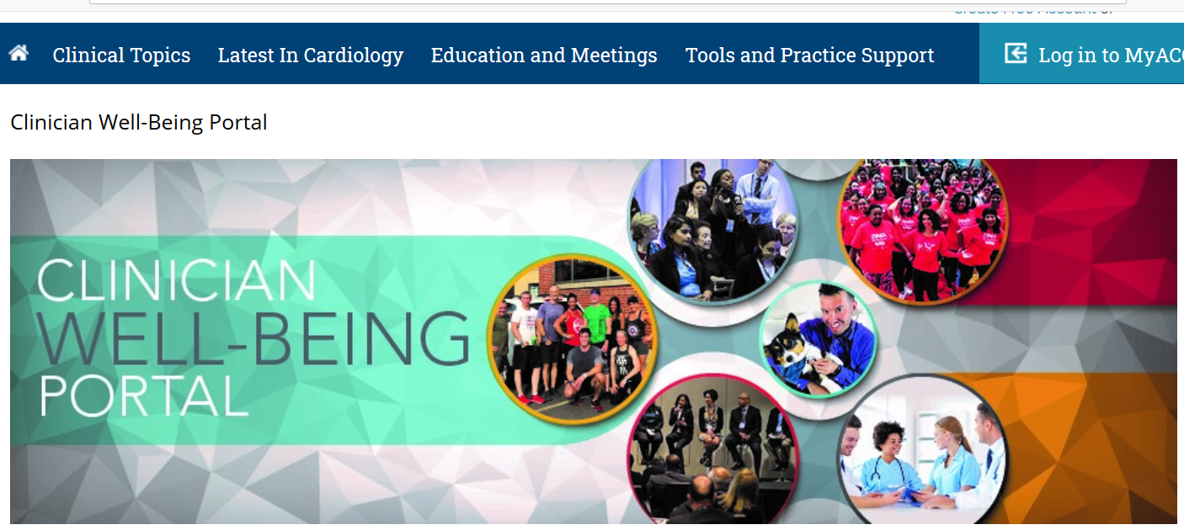
www.acc.org/clinicianwellbeing

Slide 29
Resources
https://www.newyorker.com/magazine/2018/02/05/customer-satisfaction-at-the-push-of-a-button
https://moqc.org/wp-content/uploads/2017/06/Physician-Burnout.pdf
https://www.nih.gov/sites/default/files/health-info/wellness-toolkits/emotional-wellness-checklist.pdf
https://www.bhwellness.org/toolkits/Work-and-Well-Being-Toolkit-for-Physicians.pdf
https://edhub.ama-assn.org/steps-forward/pages/professional-well-being
https://www.acponline.org/practice-resources/physician-well-being-and-professional-satisfaction/individual-physician-well-being-and-burnout-tools

Slide 30
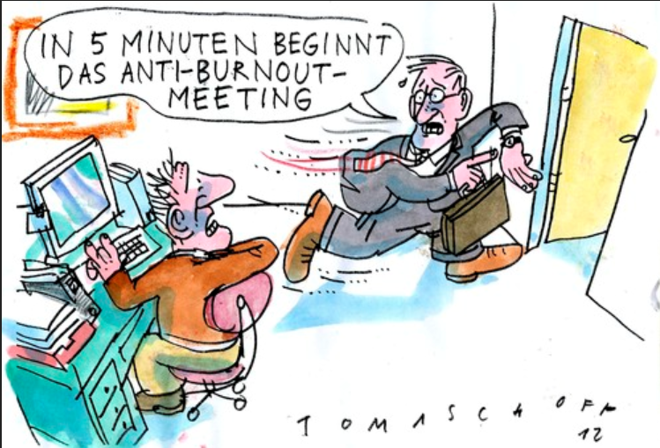
THANK YOU

Slide 31


