Slide 1
Cardiologist Compensation Plans: Principles and Implementation
Compensation and Opportunity Equity
Writing Committee
An ACC Workforce Policy Document

Slide 2
Citation
This slide set was adapted from the ACC 2019 Health Policy Statement on Cardiologist Compensation and Opportunity Equity (Journal of the American College of Cardiology).
The Statement was published ahead of print on September 16, 2019, and is available at: http://www.onlinejacc.org/content/early/2019/09/12/j.jacc.2019.07.040
The published document is also available at: ACC.org/Guidelines

Slide 3
Special Thanks To:
Slide Set Authors
Hena N. Patel, MD and Pamela S. Douglas, MD, MACC
2019 ACC Health Policy Statement on
Cardiologist Compensation and Opportunity Equity Writing Committee
Pamela S. Douglas, MD, MACC, Chair
Cathleen Biga, RN, MSN, FACC
Kristin M. Burns, MD, FACC
Richard A. Chazal, MD, MACC
Michael S. Cuffe, MD, MBA, FACC
James M. Daniel, Jr, JD, MBA
Catherine Garzio, MBA
Robert A. Harrington, MD, MACC
Hena N. Patel, MD
Mary Norine Walsh, MD, MACC
Michael J. Wolk, MD, MACC

Slide 4
Disclaimer
This slide set/presentation is provided for informational purposes only and does not provide legal advice; please consult with your own counsel for legal guidance on compliance with applicable laws and regulations. This slide set/presentation is not intended to be used for, and does not encourage any coordination, between competitors with respect to compensation practices. To comply with the antitrust laws, competitors should not discuss or agree on the salaries or other compensation.

Slide 5
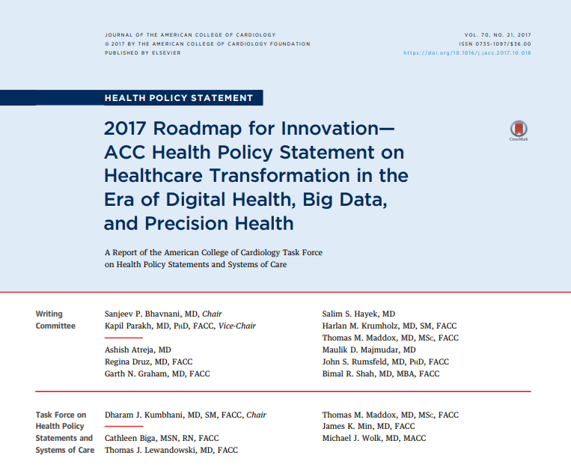
2019 Cardiologist Compensation and Opportunity Equity
PLACEHOLDER

Slide 6

Agenda
Definitions and General Principles
Creating a Compensation Plan
Lay the Foundation
Construct the Model
Implement the Plan
Review and Revise
Address Legal Concerns
Opportunity Equity
Leadership and Sustainability
Discussion

Slide 7
Definitions
Compensation
Dollar amount including base salary plus supplemental compensation
Encompasses a broad variety of activities, including: call, administrative, incentives (eg, clinical, quality, research, education, strategic initiatives, etc.)
Intentionally broad: all funding and resources provided to recruit, retain, reward and enhance cardiologists’ careers
Opportunity
All factors that directly or indirectly affect compensation (career advancement, work environment and culture, access to resources, etc.)
Essential prerequisite to ensuring compensation equity

Slide 8

Why is a Compensation Plan Important?
Advantages of a structured compensation plan
Strategic approach
Market and mission alignment
Development process can engage physicians
Maximizes workforce satisfaction and collegiality
Attracts and retains talent
Prospective approach for new hires, retentions, leave
Prepares for shift to value based reimbursement

Slide 9
No Compensation Plan = Missed Opportunity
Without a structured compensation plan
Goals and strategies may not be well-defined
Compensation may not address market imperatives
Physicians may be disengaged, with little incentive to achieve desired behaviors
No mechanism to reward team care, value/quality or non billable contributions
Fertile environment for suspecting non-level playing field, reducing trust and collegiality
No easy road map for new hires, retentions, leave, etc.

Slide 10
ACC Basic Principles
Cardiologist compensation should be equitable and fair for comparable work.
Equivalent work at each professional career stage based on skills, expertise and knowledge
Compensation not influenced by personal identity characteristics (including race, ethnicity, gender, gender identity, religion, nationality, disability or sexual orientation)
Cardiologist compensation should be objectively determined by a modeled systems approach that is prospectively developed and based on consensus principles.
Create a thoughtful and deliberate process that includes multiple stakeholders
Start with principles before proceeding to plan specifics
Include change management processes
Consider the financial impact on individuals and groups
Notes:
Principles #1 and #2

Slide 11
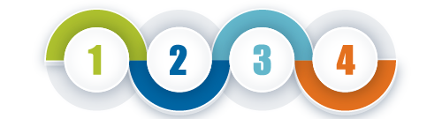
Creating a Compensation Model Key Steps
Construct the Model
Review/Revise
cvvv
cvvv
cvvv
cvvv
Engage and inform CV MDs
Lay the
Foundation
Implement

Slide 12

Step 1 Laying the Foundation for a Compensation Plan
The American College of Cardiology (ACC) believes that cardiologist compensation should be fully aligned with an organization’s/practice’s business strategies, mission and core values.
Identify activities and behaviors of greatest strategic value
Define culture and strategy
Specify measures and incentives
Keep the focus broad (not just wRVUs)
Action Checklist
Environmental/market scan
Strategic vision and direction
Ability to execute on strategic plan
Cultural readiness for compensation plan; trust
Compensation committee with cardiologist representation
Notes:
Principle #3

Slide 13
Clear and simple to understand
Flexible
Mutually agreed upon vision
Advances mission
Fair and equitable
Legal and compliant
Attracts and retains candidates
Transparent
Key Features
of a Good
Compensation Plan

Slide 14
Step 2 Construct the Model – 1
The ACC believes that cardiologist compensation should be individualized to reflect performance, productivity and other prospectively determined factors.
Value to the organization
Competition in the market
Bona fide business factors
Avoids subjective concerns
Action Checklist
Benchmark best practices
Salary vs. incentives
Nonnegotiable items
Unique to practice or market
External productivity and compensation standards
Notes:
Principle #4

Slide 15

Construct the Model – 2
The ACC believes that cardiologist compensation plans should define those activities and behaviors that will result in an increase or decrease in compensation.
Action Checklist
Select metrics
Individual metrics
Collective metrics
Include all missions/strategic areas
Ensure feasibility of data capture
Build algorithms for compensation
Notes:
Principle #9

Slide 16



Compensation Components and Metrics
Base Pay
Incentive Pay
Total Compensation
+
=
Fixed allocation
Guaranteed income based on:
Rank/partnership
Job description
Benchmarks
etc
Metrics driven
Variable income based on:
Productivity
Performance
Quality
Shared incentives
etc
This Photo by Unknown Author is licensed under CC BY-SA-NC

Slide 17



Components of a Compensation Model
Base Pay
Clinical Productivity
Administration Effort (Fair market value)
Education (‘Teaching value units’)
Research (Salary recovery, grants, papers)
Community Service and Outreach
Other compensation/Bonuses

Slide 18
Construct the Model – 3
Action Checklist
Reward clinical and academic productivity
Education
Research
Leadership/Administration
Teaching
Avoid penalties for decreased productivity if these value-added contributions divert time or effort away from clinical work
Leverage clinical and nonclinical expertise as strategic business tools
The ACC believes that cardiologist compensation should value and explicitly reward non-billable work including quality improvement, leadership/administration, teaching/ mentoring, research, community service and outreach activities.
Notes:
Principle #6

Slide 19
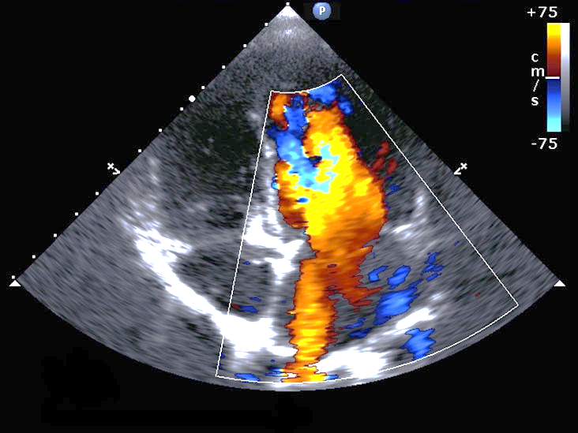
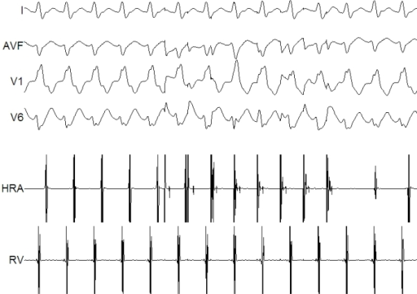
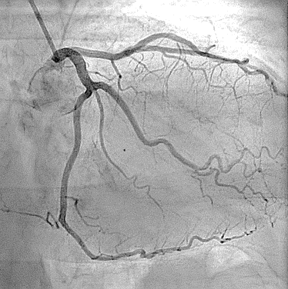
Construct the Model – 4
The ACC believes that cardiologist compensation plans should be designed to minimize unwarranted, systemic differences based solely on subspecialty.
Action Checklist
CV Team successes are shared by all
Clinical and non-invasive skills are adequately recognized
Calculate impact of model on various types of cardiologists
Watch for unintended consequences
Notes:
Principle #5

Slide 20
Construct the Model – 5
The ACC believes that cardiologist compensation should include strategies and formulas that offer flexibility to accommodate different job descriptions.
The ACC believes that cardiologist compensation should explicitly address and incorporate leave policies.
Action Checklist
Describe how to handle:
Full time, part time, full time with no call, etc.
Vacation, parental, family, medical leaves
Transitions in status
Maintain certainty, predictability and stability of employment
Minimize penalties or loss of status for leaves or part time work
Use flexibility as a strategic business tool
Notes:
Principles #7 and #8

Slide 21
Construct the Model – 6
The ACC believes that cardiologist compensation plans should not utilize salary history in setting cardiologist compensation.
The ACC believes that cardiologist starting compensation at a given institution or practice should be the same for all individuals at a given rank or position within a given subspecialty of cardiology at that institution and practice.
Action Checklist
Do not inquire about salary history or use it to set compensation
Create a base case starting salary
Use objective criteria to determine variations/components of a recruitment package
Consider recruitment committee training in implicit bias and evidence-based recruitment best practices
Notes:
Principles #10 and #11

Slide 22

Construct the Model – 7
Action Checklist
Foster a culture of transparency and accountability
Focus on measures that are easy to track and manage
Develop resources outlining compensation methodology
Consider involving cardiologists in selecting clinical quality measures
The ACC believes that cardiologist compensation should be transparent in approach, methodology, and calculations used in determining individual compensation.
Notes:
Principle #12

Slide 23

Step 3 Implement
The ACC believes that cardiologist compensation should include the tools and education required to achieve a fundamental understanding of compensation terms and processes in aggregate as well as how these apply in determining individual compensation.
Action Checklist
Define the factors used to determine compensation
Clearly communicate the components of the compensation model and algorithms used
Provide educational resources
Notes:
Principle #13

Slide 24
Map the Transition For a Seamless Rollout
Right time and motivation
Right people, procedures and direction
Accurate assessment of revenue sources
Clear and validated metrics and algorithms
Expertise to create models and track performance/pay
Simplicity with nuance. Ensure flexibility.
Impact on MDs and organization
Unintended consequences addressed
Compliance and legal considerations
Group and individual educational tools
Feedback and iteration
ROLL OUT!!

Slide 25


Step 4 Review/Revise
The ACC believes that both cardiology leadership and impartial external experts should regularly review cardiologist compensation models, metrics, and actual total compensation, including bonuses and access to resources and opportunities, and do so with reference to national benchmarks.
Action Checklist
Report on a regular basis
Create a physician dashboard
Include high level information
Compare to national benchmarks for both productivity and compensation
Periodic external review of plan structure and pay (results)
Correct errors rapidly if unjustified compensation discrepancies are found
Notes:
Principle #17

Slide 26

Legal Concerns
This is a highly regulated area.
Consider legal review of all compensation plans!!
Stark laws: Ban MD self-referral or referral to a health services provider with whom MD has a financial relationship
Antitrust laws: Ban coordination between competitors on compensation
Anti-discrimination laws or Equal Pay legislation: Prohibit discrimination, unequal pay based on gender, race, color, religion, national origin, age, or disability
Non-retaliation against those opposing discriminatory compensation practices
Notes:
Principle #10

Slide 27

Agenda
Definitions and general principles
Creating a compensation plan
Lay the foundation
Construct the model
Implementation
Review and revision
Legal concerns
Opportunity equity
Leadership and sustainability
Discussion

Slide 28
Opportunity Equity – 1
The ACC believes that cardiologist compensation should recognize that equity in cardiologist compensation ultimately depends on equal access to career opportunities.
Action Checklist
Create opportunities to provide the necessary work experiences for advancement
Create targeted development plans to ensure equal development opportunities
Ensure robust mentorship and sponsorship
Implement active leadership development and succession planning
Notes:
Principle #14

Slide 29

Opportunity Equity – 2
Action Checklist
Develop objective systems for recruitment, compensation and advancement
Ensure an inclusive workplace
Provide implicit bias training
Create a process for compliance
Build career paths
The ACC believes that, as part of ensuring opportunity equity, cardiology leadership should be responsible for mitigating the effects of unconscious or implicit bias and creating a culture of inclusion.
Notes:
Principle #15

Slide 30
Leadership and Sustainability
The ACC believes that cardiology practice/division leadership be responsible for equity in compensation and opportunity and should be accountable for creating and implementing fair policies and adhering to compensation best practices.
Action Checklist
Compare impact of compensation plan and other policies among ‘at-risk’ individuals/groups
Adopt evidence-based approaches to recruitment and retention
Implement objective performance evaluation using prospectively determined criteria
Raise awareness of and mitigate implicit bias
Notes:
Principle #16

Slide 31
Additional Resources
For more tools and resources, visit:
ACC.org/Guidelines
ACC.org/about-acc/diversity-and-inclusion/features/2019/09/compensation-equity
Notes:
Placeholder

Slide 32

Agenda
Definitions and general principles
Creating a compensation plan
Lay the foundation
Construct the model
Implementation
Review and revision
Legal concerns
Opportunity equity
Leadership and sustainability
Discussion

Slide 33


