Slide 1

Building a complex coronary interventional program
Tanveer Rab, MD, FACC Perwaiz M. Meraj, MD, FACC

Slide 2
Starting a Complex Coronary Intervention Program
Does your hospital have the volume?
Buy in from administration and your colleagues
Is there a will to invest?
Buy in from CT surgery
The Heart Team approach
Protocols and Standing Orders
Technical expertise

Slide 3
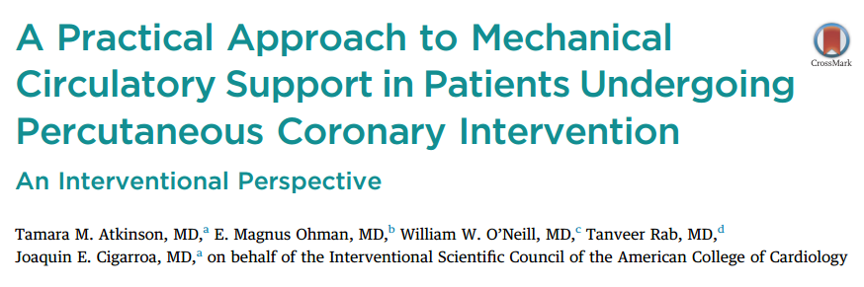

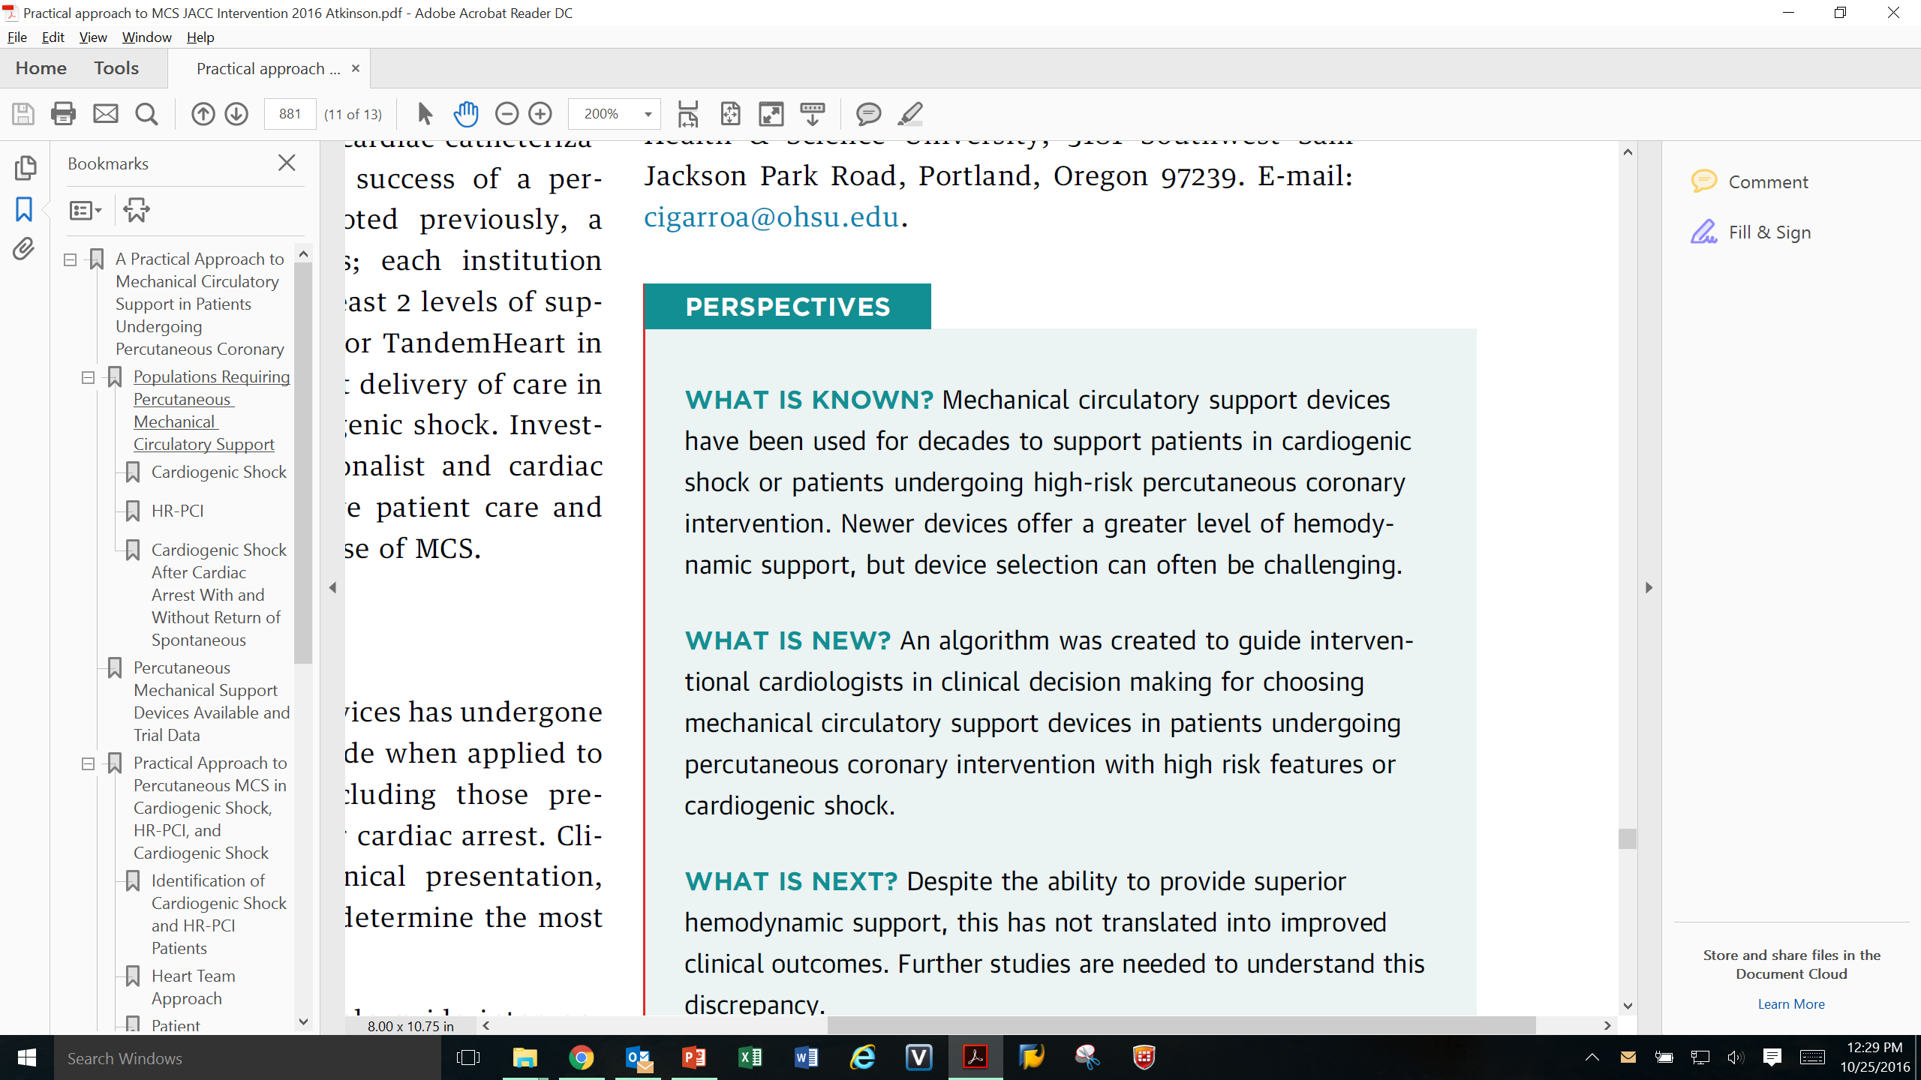
Multidisciplinary Heart Team Consultation-
Interventional Cardiology, CT Surgery, Advanced Heart Failure, Intensive Care
Atkinson, et al. JACC Interventions 2016
Notes:
The purpose of this slide is to remind your audience that the idea of having an algorithm comes from multiple different sources. This algorithm is from the 2016 Interventional Scientific Council from the American College of Cardiology. This article highlights how an algorithm is needed to assist clinical decision making for choosing mechanical support devices in the setting of high risk PCI OR cardiogenic shock. It is important to note that the algorithm starts with a definition of the high risk patient. Hospitals should start their algorithms by defining the high risk patient.

Slide 4
Population groups
High Risk PCI (HRPCI
The surgically ineligible patient
Undiagnosed CAD in the heart failure population

Slide 5
The volume is there:
Patient
Comorbidities
Complex
Coronary Artery
Disease
Heart failure, diabetes, advanced age, peripheral vascular disease, complex lesions, unstable angina/NSTEMI, prior surgery
Multi-vessel disease, Left Main disease
Protected
PCI
Patients
Protected PCI
Now FDA Indicated
Safe & Effective
Hemodynamic
Compromise
Depressed ejection fraction (LVEF<35%)

Slide 6
Undiagnosed CAD in the heart failure population
1.7M Patients
Class III/IV Heart Failure¹
Plus 261,000
Annual Incidence¹
68%
Have Coronary Artery Disease²
60%
With Reduced Ejection Fraction³
55%
Good vessel targets and not CABG candidates^{4,5}
28% (121,000)*
Diagnosed Ischemic Disease^{6,7}
72% (319,000)
Undiagnosed,
not tested for
ischemic disease⁷
*74% age 55-79 years⁸
Mozaffarian D, et al. Circulation. 2015;131(4):e29-e322.
Gheorghiade M, Bonow RO. Circulation. 1998;97(3):282-289.
Braunwald E. JACC Heart Fail. 2013;1(1):1-20.
Patel MR, et al. N Engl J Med. 2010;362(10):886-895.
Cornwell LD, et al JAMA Surg. 2015;150(4):308-315.
Farmer SA, et al. JACC Cardiovasc Imaging. 2014;7(7):690-700.
Doshi D, et al. J Am Coll Cardiol. 2016;68(5):450-458.
O'Neill WW, et al. Circulation. 2012;126(14):1717-1727.
Notes:
Many of you are already familiar with the funnel slide. You will use this slide to demonstrate the population of patients who are appropriate for Protected PCI. Let’s walk through it as a reminder of the information within.
First let’s review the VENN diagram on the right, which helps us define high risk patient characteristics.
These patients are hemodynamically stable and have complex coronary artery disease, such as left main disease or multi-vessel disease, which represents an increased risk to the patient.
They have depressed left ventricular ejection fraction, typically below an EF of 35%, and multiple comorbidities. These comorbidities may include heart failure, diabetes, advancing age and more.
If you recall, the shield in the center represents the convergence of high-risk factors identifying patients most appropriate for revascularization and those who have been shown to benefit from a Protected PCI.
On the left you see a funnel, which highlights the very large heart failure population in the United States today.
Based upon the 2015 Circulation update on heart disease and stroke statistics, there are currently 1.7M patients in Class III/IV heart failure. Additionally, the annual incidence rate is quite high (new cases of heart failure annually).
When you start to break it down, a large percentage, 68% of those patients have Coronary Artery Disease and of those 60% have reduced ejection fraction. Of the remaining population, 55% have good vessel targets. This is about 440,000 patients remaining.
Of the 440,000, only about 28% of 121,000 have been diagnosed with Ischemic disease. This is a small percentage of the overall category. The majority of which are relatively young, between the ages of 55 and 79. These are the patients right now who may benefit from Protected PCI. It is important to note that these are not surgical candidates so the hospital would not be hurting its surgical volume by treating this population.
This leaves about 319,000 patients who meet the criteria but are not diagnosed or tested for ischemic disease. This population is the potential additional population appropriate for treatment.

Slide 7

FY 2018 Payment by MS-DRG
New model:
Percutaneous Heart Assist Devices
Old model:
DRG 216: $57,249
DRG 217: $37,847
DRG 218: $34,270
DRG: 215: $77,678
DRG 216 is no longer in the mix. Impella will most often code to DRG 215 now at an increased national average of $77,000.
Bi-Pella and open procedures will code to DRG 1 or 2 depending upon MCC’s. National Average of $153,000.
There is a separate removal code for hospitals who accept transferred patients. DRG 268 national average of $39,000.

Slide 8
Building a Referral Network
Building a complex PCI program is similar to building a TAVR program
Community Interventionalists are not aware of what can be offered
Outreach and focused invitations for case review sessions is required to educate cardiologists about the options now available with Protected PCI
CT surgery may be the most important in house referral for surgically ineligible patients
Commitment from the hospital to provide resources and marketing
Always communicate with the referring physician

Slide 9
Heart Team Approach
Utilization of heart teams for complicated patients with prior CABG/PCI is a Class I indication
Involve CT surgeons, ICU specialists, anesthesiologists, heart failure specialists
Simple agreements and patient identification can make a big difference

Slide 10
Patient Algorithms Standardize Treatment
Diagnosis: High Risk Patient
Medical Management
Revascularization
Heart Team Decision
Choice of appropriate treatment (PCI vs CABG) by multi-disciplinary “heart team” - per Guidelines (Class I) ¹
PCI
CABG
With Hemodynamic Support
Depressed EF, Complex CAD with co-morbidities or unstable angina
FDA Approved Indication
per Guidelines ^{1,2}
Conventional
Protected
1. Levine GN, et al. J Am Coll Cardiol, 2011 Dec 6;58(24):e44-122
2. Amsterdam EA, et al. Circulation. 2014 Dec 23; 130(25):e344-426
Notes:
You can start this slide by reminding the hospital that they are using algorithms to identify patients and expedite treatment for other high risk patients already such as Sepsis, Pneumonia, STEMI, and TAVR. From these processes hospitals know that algorithms standardize treatment. The first step for a hospital to make to identify and treat these patients is to focus on developing an algorithm for identification of the high risk patient with CAD and a pathway for consistent treatment.

Slide 11
Skill sets
Large bore access
Access sites
Closure-Perclose and Preclose
Insertion of LV support devices
Rotational and Orbital atherectomy
Left Main and Bifurcation stenting
Basic CTO skill sets

Slide 12
Access
Know large bore access
Facile at Perclose and Preclose
Know alternate access such as Axillary and Transcaval (with structural interventional or surgical support)

Slide 13
Circulatory Support
Impella
ECMO
IABP

Slide 14
Multivessel Disease
Coronary Physiology
IFR and FFR
IVUS
OCT

Slide 15
Calcific coronary artery disease
Rotational atherectomy
Orbital atherectomy
Cutting and scoring balloons
Laser

Slide 16
Left Main and Coronary Bifurcations
Lesion preparation
01
Understanding the complex bifurcation lesion
02
Single vs two stent strategies
03
Optimize result with intracoronary imaging
04

Slide 17
Stent under expansion and restenosis
Intravascular imaging
Aggressive noncompliant and plaque-modification balloons
Atherectomy (laser, rotational)
Vascular brachytherapy

Slide 18
Chronic total occlusions
Dual access and injections
Antegrade and retrograde techniques, including dissection/re-entry devices
Specialty wires, microcatheters, devices for increasing guide/catheter support, externalization techniques

Slide 19
Managing complications
Echocardiography-guided pericardiocentesis
Covered stents, coils, beads
Snares/snaring techniques
Dual guide techniques
Dissection/re-entry to salvage distal flow
Endovascular rescue

Slide 20
The cath lab team
It is not only your skill set!
Seasoned well trained nurses, scrub techs and RT’s
Standardized drug protocols
Skillsets to rapidly deploy LV support devices
Access to appropriate tools and trouble shooting in an emergency

Slide 21
Dedicated Experienced Nurse coordinator
Protected PCI Coordinator
Initial Consult
Heart Cath Procedure
Heart Team Evaluation
High risk PCI performed
Follow Up
Care with
Referral MD
Outreach education
Protected PCI Coordinator
Dedicated to identifying appropriate patients
Facilitates timely throughput
Coordinates multidisciplinary discussion
Leads quality improvement efforts
Communicates with referral MDs
Coordinates follow up care to appropriate physician
Conducts outreach education
IM2-280-16

Slide 22
Economics
Establish reimbursement for the hospital with a specific payment for Protected PCI, analogous to TAVR or LVAD
Establish reimbursement for physicians, not bundled with PCI
Involvement and education of coding and billing personnel
Shared DRG for MCS devices

Slide 23
Quality metrics
Meticulous detail in assessing procedural and groin complications
Contrast use and X-Ray exposure
Post procedure renal function and drop in Hgb/HCT
Assessment of MI
Measurement of readmission rates, length of stay, and blood utilization and other quality indicators

Slide 24
Questions?
Tanveer Rab, MD, FACC – srab@emory.edu
Perwaiz Meraj, MD, FACC - PMeraj@northwell.edu

Slide 25


