Slide 1

The Audience Response System – Moderator Edition
Notes:
Speaker Ready Room – Moderator to come Practice

Slide 2



Session Moderators
This training guide is intended for sessions that have a faculty member in the room—usually one of the session co-chairs and not the presenter on stage-- to help moderate Conferences i/o
Session Moderator
Presenter
Attendees

Slide 3
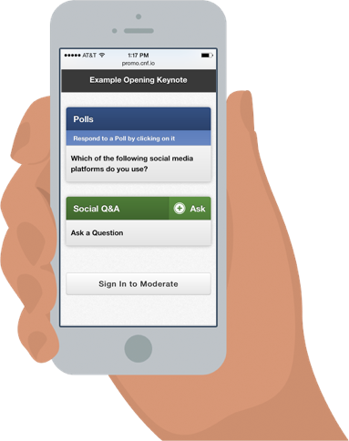
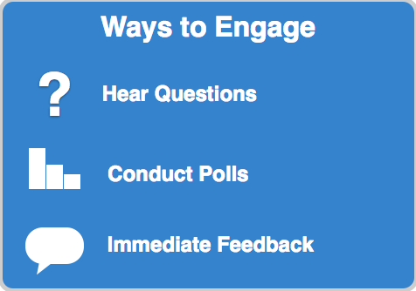
Conferences i/o is an award winning event tool that makes it easy to Interact & Engage with your attendees in real-time

Slide 4
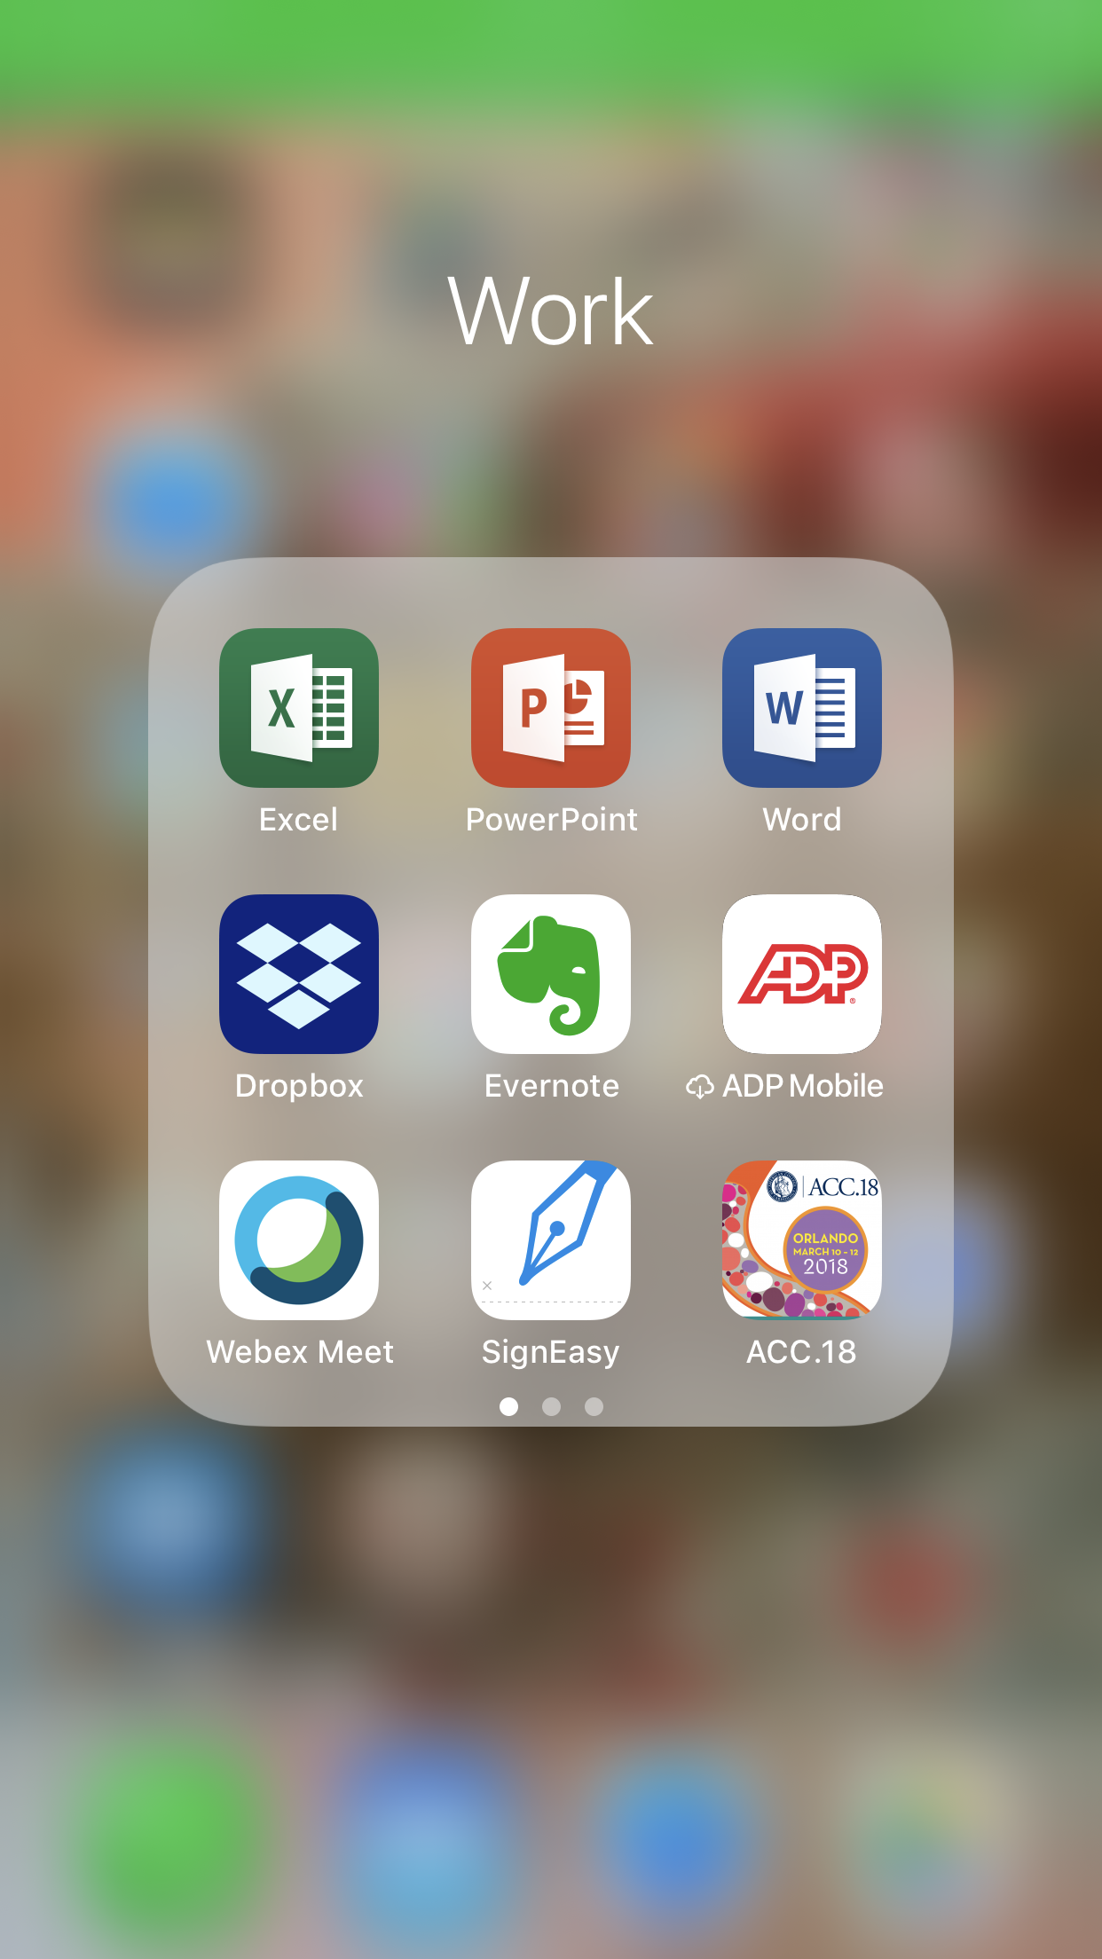
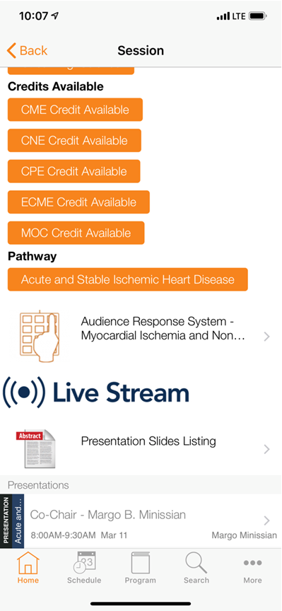
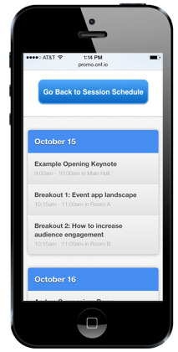
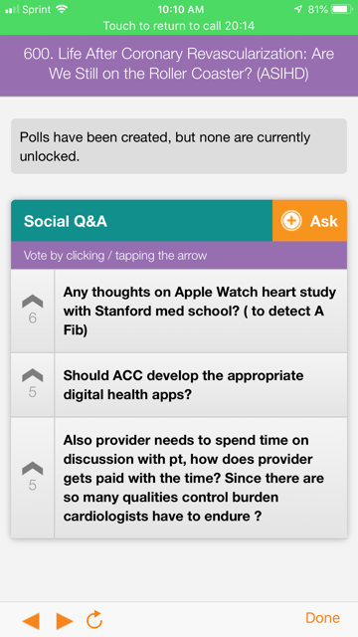
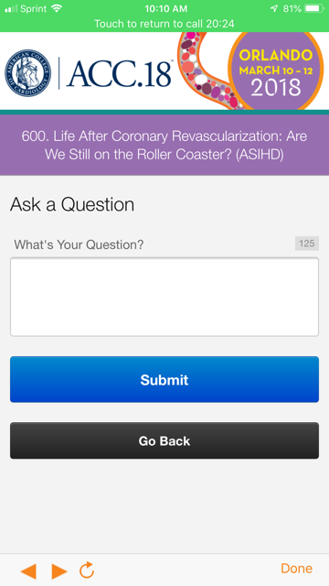
How Attendees Participate
Attendees simply navigate to the session within the ACC APP and can submit/ask questions.
1.
2.
3.
4.
5.
Open the ACC APP
Navigate to the desired session
Click / Tap ‘Ask a Question’ (This will open up the Social Q&A screen)
Click / Tap ‘Ask’
Enter in your question then click / tap Submit

Slide 5
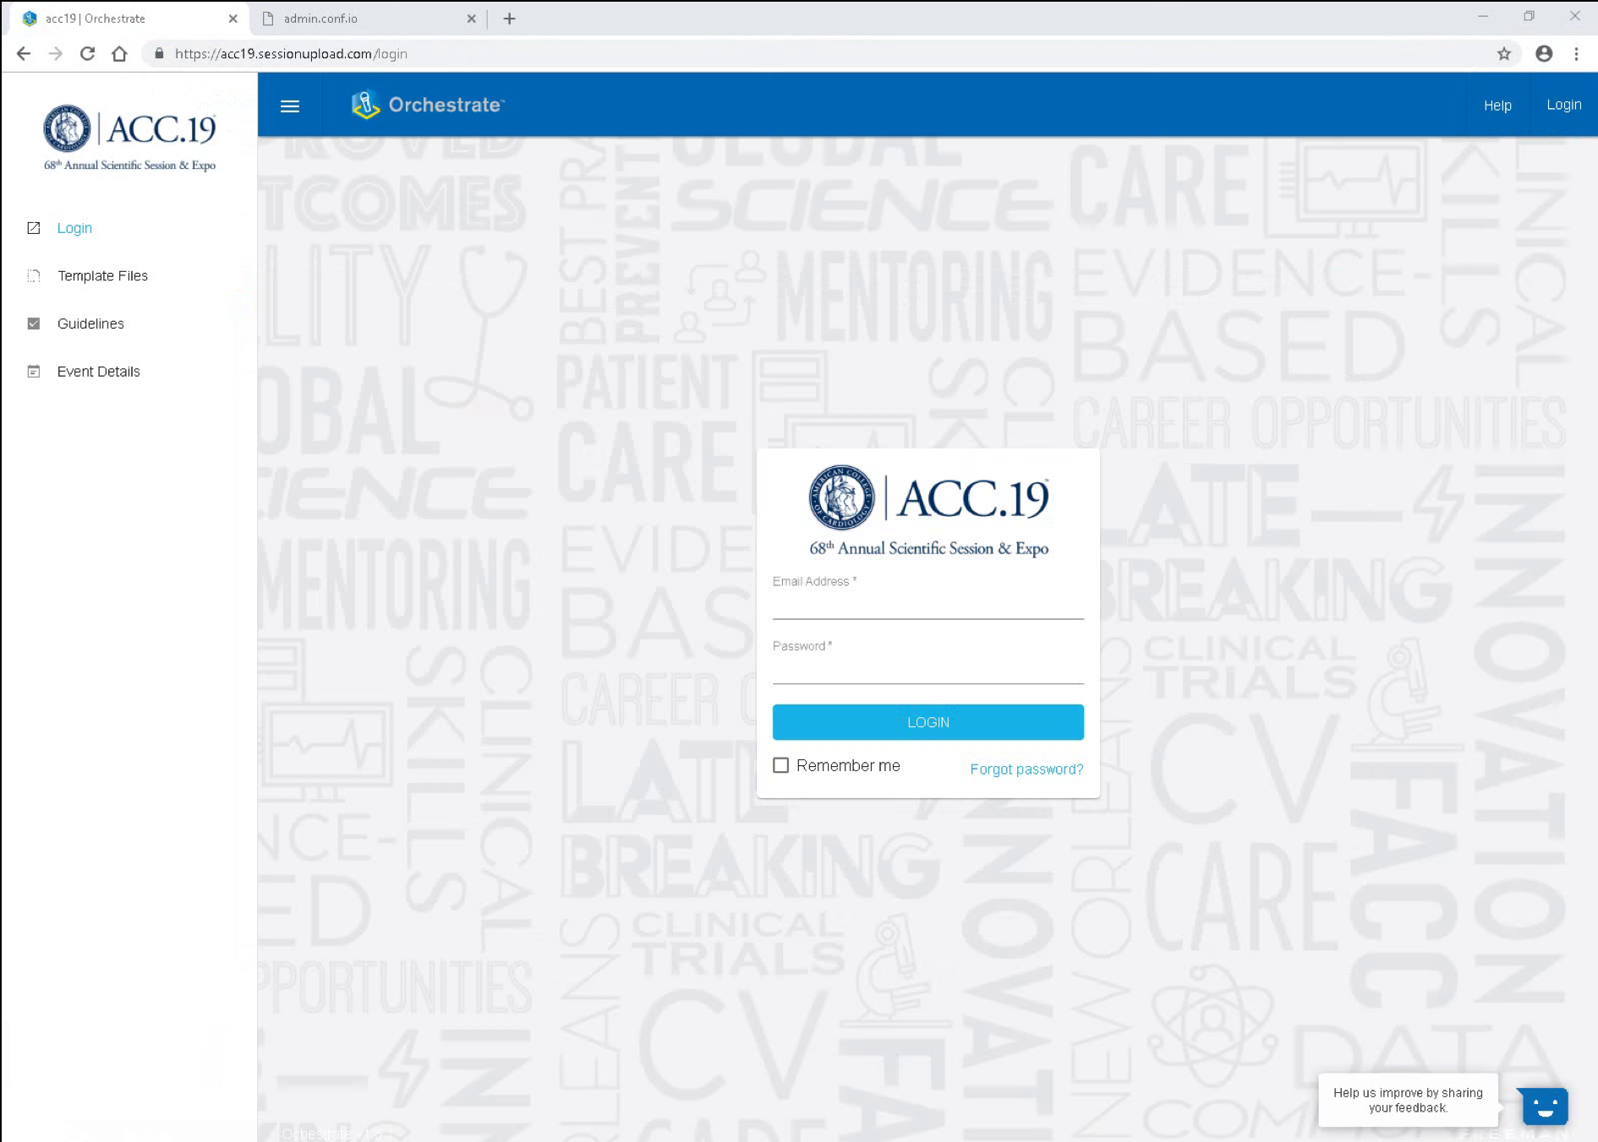
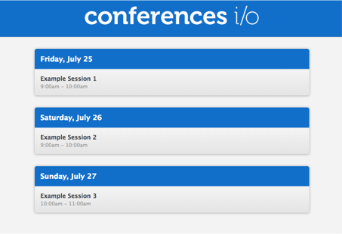
Moderator Tool
Moderators can easily access, view and review submitted questions in each session room. There is a laptop at the head table equipped with the CIO Moderator Tool opened in an internet browser tab for Moderator Control. There’s no need for them to login, we already log in the computers.
Click on the “CIO” tab within the opened browser on the head table laptop
Navigate to the appropriate session (In-Room Tech can assist if needed)

Slide 6
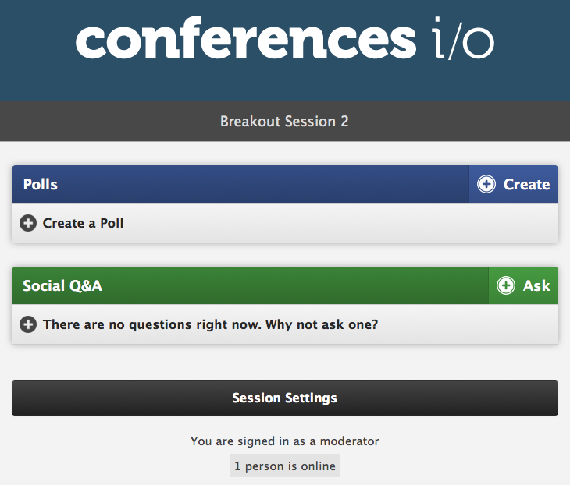
Moderator Basics
As the Moderator you will have access to some additional functionality...
Manage Q&A
Access Settings

Slide 7
BASICS OF THE SOCIAL Q&A FEATURE

Slide 8
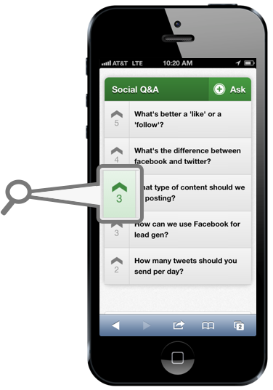
How Social Q&A Works
Attendees will submit questions during your session. Sessions will contain dedicated Q&A segments scheduled in the agenda
Both in-person classroom and remote online session attendees participating in the “ACC.XX Anywhere” virtual meeting product can submit questions
Attendees will see the questions that other people in the session and the online viewers have asked, and can up-vote questions that they want answer
The most popular questions automatically rise to the top of the list
So when it’s time for Q&A, you will know which questions are most important to the entire group, and can use Q&A time more efficiently!

Slide 9
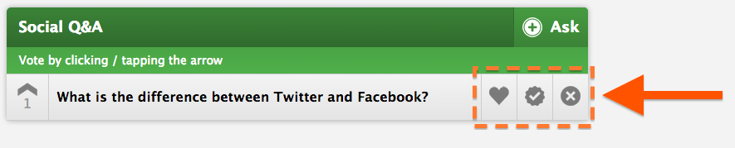
Moderator Buttons
The moderator has some additional buttons that the attendees don't see. These are provided to help the moderator keep the list of Social Q&A questions organized, but they're entirely optional. Some moderators use them, others choose not to.

Slide 10

Moderator Buttons
1. Delete: This is used to delete a question entirely. It will be removed from everyone's page. You do have the opportunity to undo a delete if you removed a question by accident.
2. Complete: This is used to mark a question as complete. Once a question is marked as complete it will no longer be visible on the attendees page so it keeps the list fresh.
3. Highlight: This is used to highlight a question. Nothing changes on the attendee side, but it makes it easy for the moderator to quickly find the questions that they earmarked for themselves, no matter where they end up in the list.

Slide 11
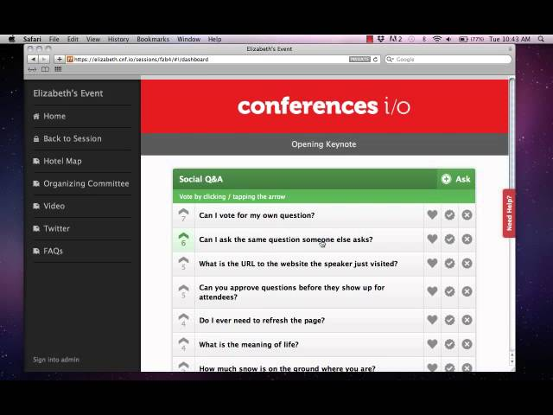
How to Moderate Q&A During Your Session
Play Video
Notes:
https://www.youtube.com/watch?v=uMH-oL_9evk

Slide 12
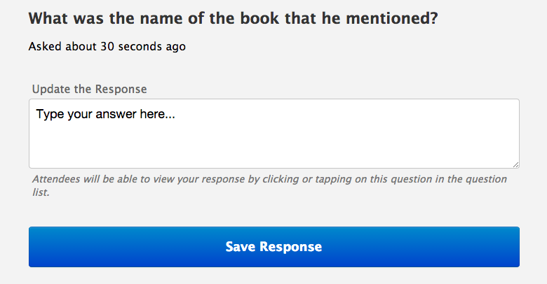
Appending Answers
Moderators can click on a question to append an answer or reply in real-time during a session.
The function of appending answers isn’t meant to replace the Q&A portion of your event, it’s meant to enhance it.
This functionality comes in handy for simple questions like “What was the name of the book that he mentioned?”
This is also a great feature for any questions that were not answered by your panel, or are more technical in nature.
Save precious Q&A time by appending answers to simple questions along the way

Slide 13
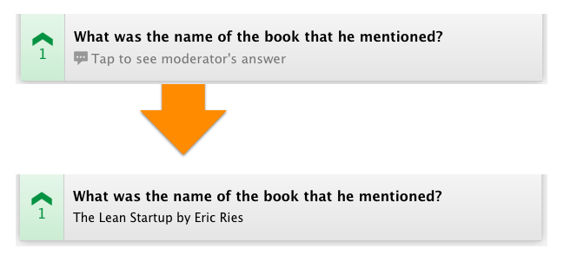
Appending Answers
Once a reply has been added the attendees can tap the question to see your response

Slide 14
FAQs
Q: How Will I See the List of Questions?
ACC provides a laptop for your use which is positioned on the head table in each classroom. Drop by the Speaker Service Center in the convention center to practice on a classroom stage set and to receive one-on-training from an AV tech on the use of the ARS system and moderator tool.

Slide 15
FAQs
Q: How Do We Get The Questions To The Presenter?
The most common format is for you (the moderator) to just verbally facilitate the questions to the presenter. It’s a very efficient process and will allow you to get through as many questions as possible.

Slide 16
FAQs
Q: Should I wait until the end to answer questions? What if the 10 minutes I dedicated for Q&A turns into 3 minutes because my presentation took longer than expected?
Audience Q&A is scheduled in the session agenda by the Annual Meeting Program Committee planners, usually at the end of a session; but they can also be scheduled after a presentation. It is important to stay on schedule so that the Q&A time allocated is preserved. It is the role of the session co-chairs to coordinate the session in advance with the faculty, stress the importance of keeping on time and not to use the Q&A time as a buffer for overrunning talks. The audience rates sessions lower when the dedicated Q&A time is eliminated. Eliminating the Q&A will specifically dilute the engagement satisfaction of the online remote participants.

Slide 17
FAQs
Q: Can I Pre-Populate Some Questions I Think My Attendees Might Ask?
Absolutely. -Populating a few questions yourself is a great way to get the ball rolling for the attendees. You can engage the audience by coordinating your faculty to include polling-type questions in their presentations as well. The use of the audience response polling function with multiple choice questions should be submitted with the presentation in advance to allow for the AV techs to program the slide(s).

