Slide 1


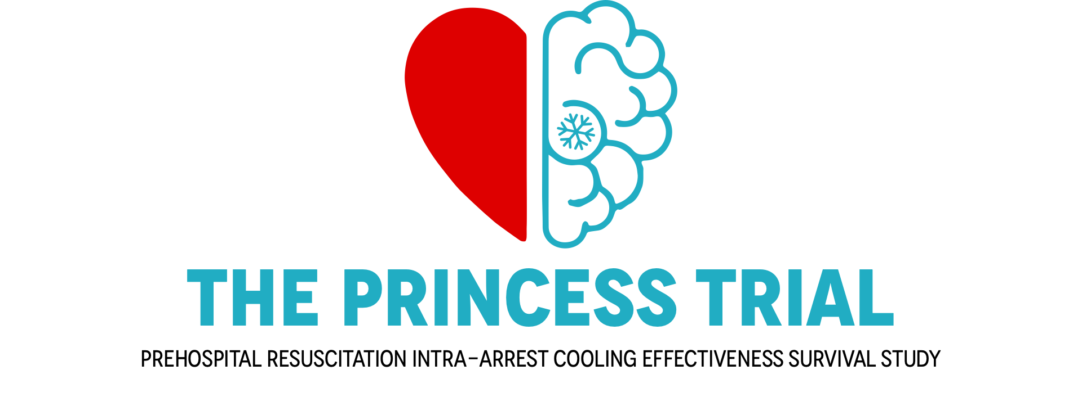

Per Nordberg, MD, PhD,
Principal Investigator
Center for Resuscitation Science,
Karolinska Institutet, Stockholm, Sweden
Disclosures:
Grants from Swedish Heart and Lung Foundation and Laerdal Foundation
Cooling device provided without cost, BrainCool AB

Slide 2





Hypothermia in cardiac arrest protects the brain
Animal data shows that ”the earlier, the better”
Most studies are based on hospital cooling
Prehospital cooling with cold fluids is
not hemodynamically safe
CARDIAC ARREST

Slide 3

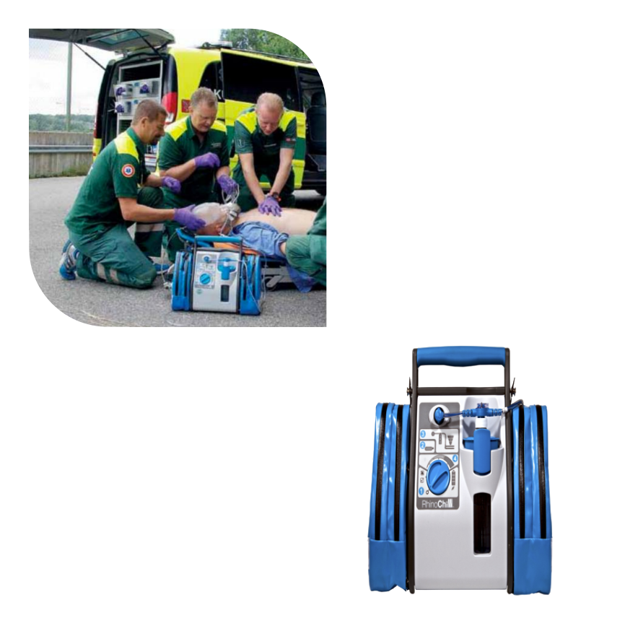
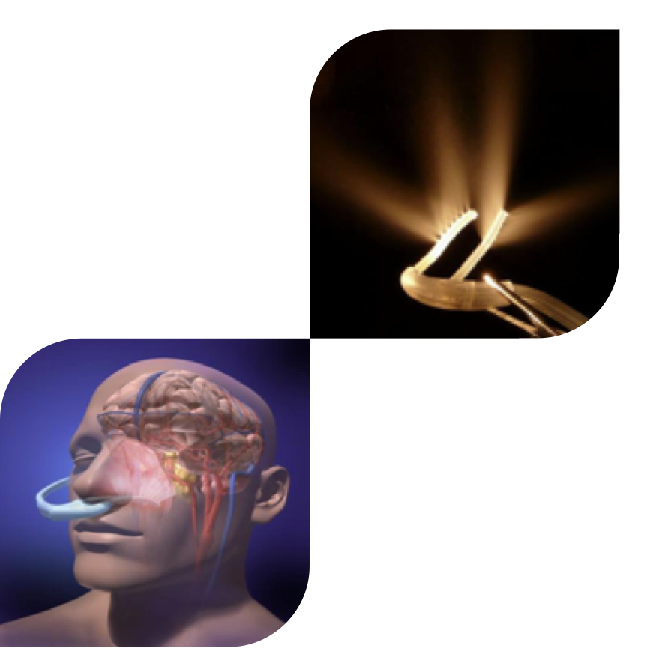
TRANSNASAL EVAPORATIVE COOLING
Primarily brain cooling
Easy to use, early initiation
Non-invasive
Continuous cooling
No volume load

Slide 4

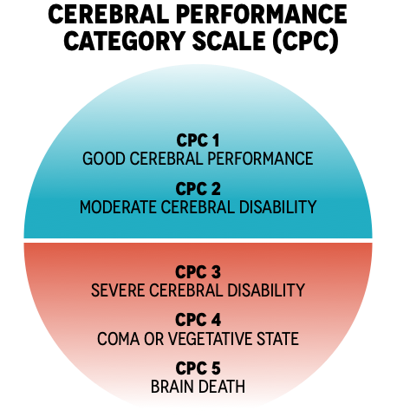

To study the effect of intra-arrest, trans-nasal evaporative cooling on neurologic intact survival in out-of-hospital cardiac arrest patients.
Primary outcome was survival with CPC 1-2 at 90 days

Slide 5

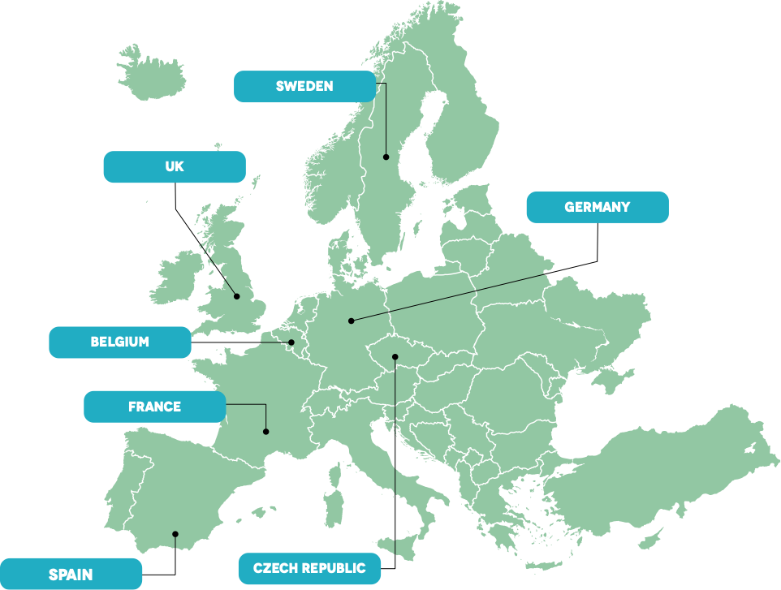
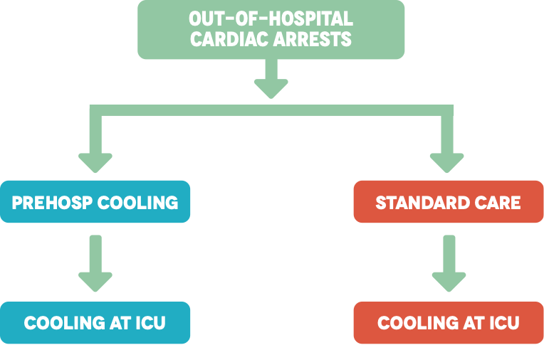
Study period 2010-2018

Slide 6

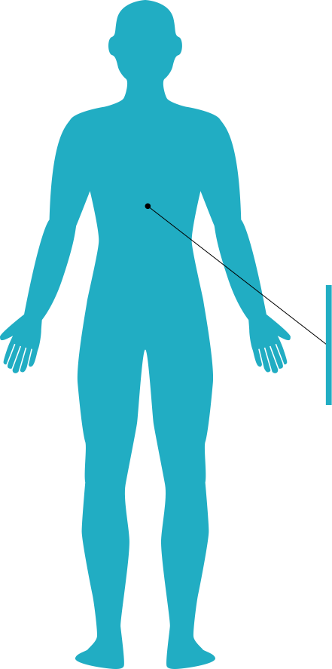
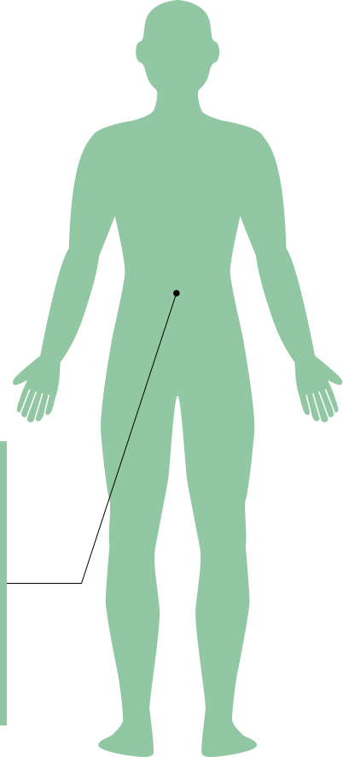

Inclusion criteria
Bystander witnessed cardiac arrest
Age ≥18 years
Exclusion criteria
Age ≥80 years
Obvious non-cardiac cause
A barrier to place intra nasal catheters
DNAR orders
Achieve ROSC prior to randomization
Response time of EMS > 15 minutes
Predefined subgroup:
Ventricular fibrillation

Slide 7

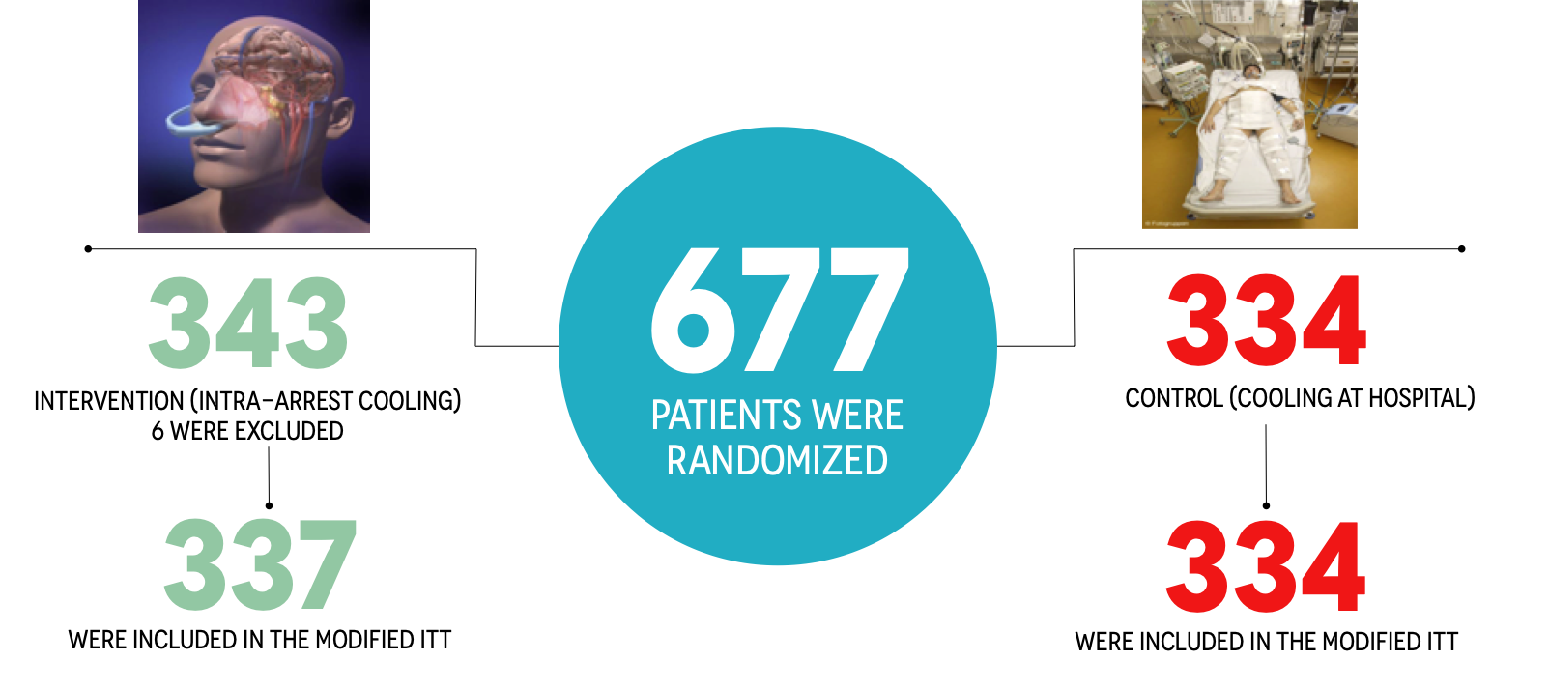

Slide 8




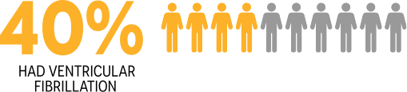

Slide 9

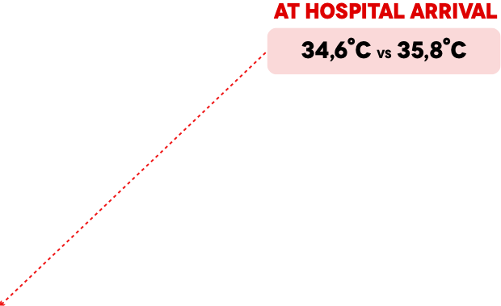
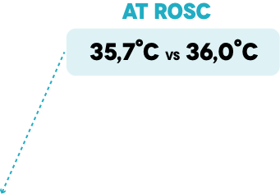
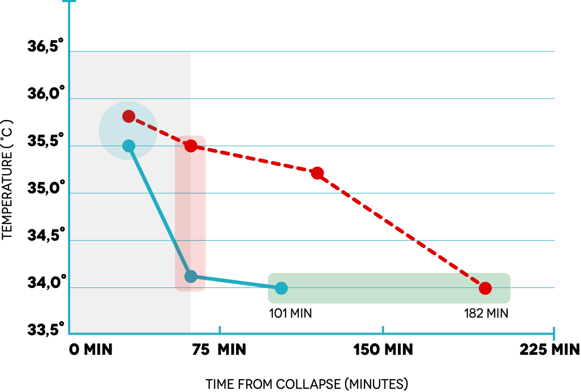
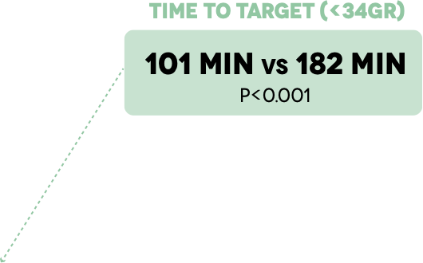

Slide 10

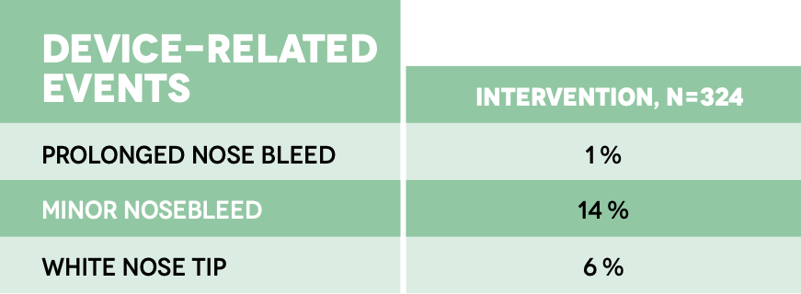
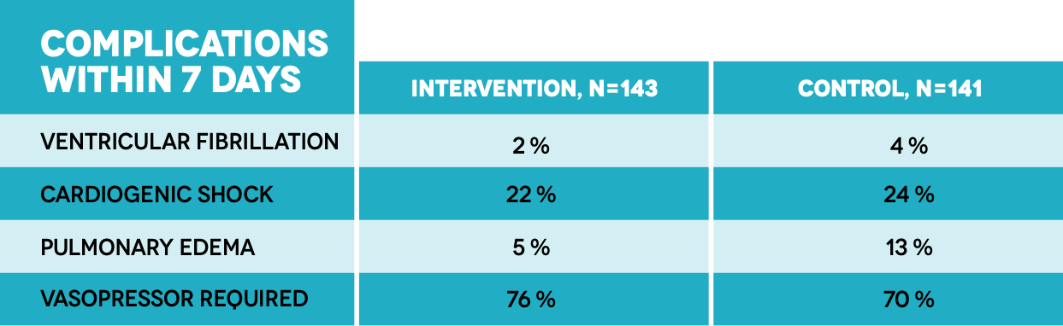

Slide 11

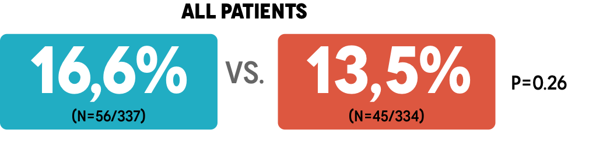
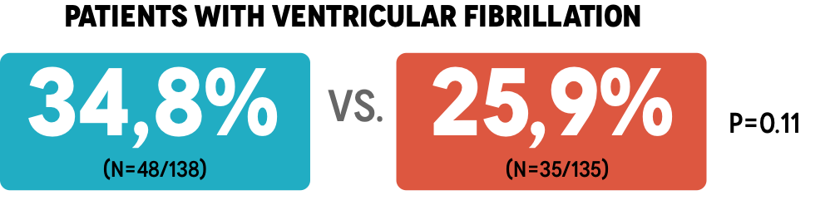
INTERVENTION
CONTROL
Absolute difference 3.1%, relative difference 23%
Absolute difference 8.9%, relative difference 25%

Slide 12


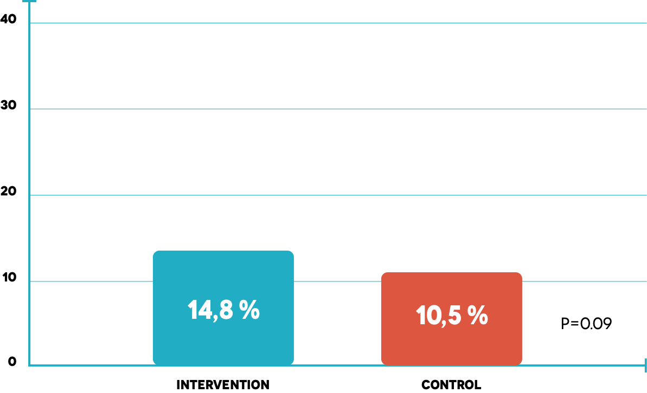
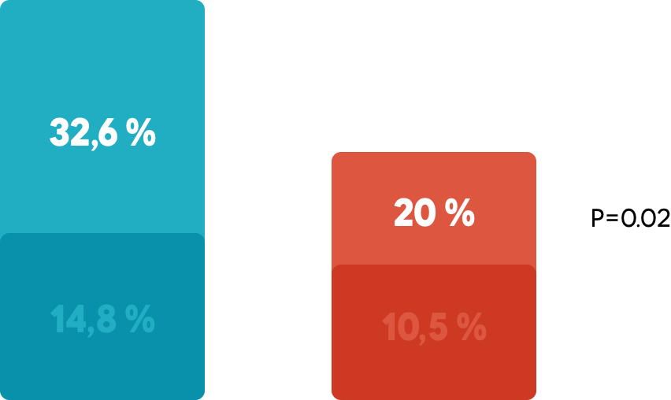
45/138
27/135
50/337
35/334

Slide 13
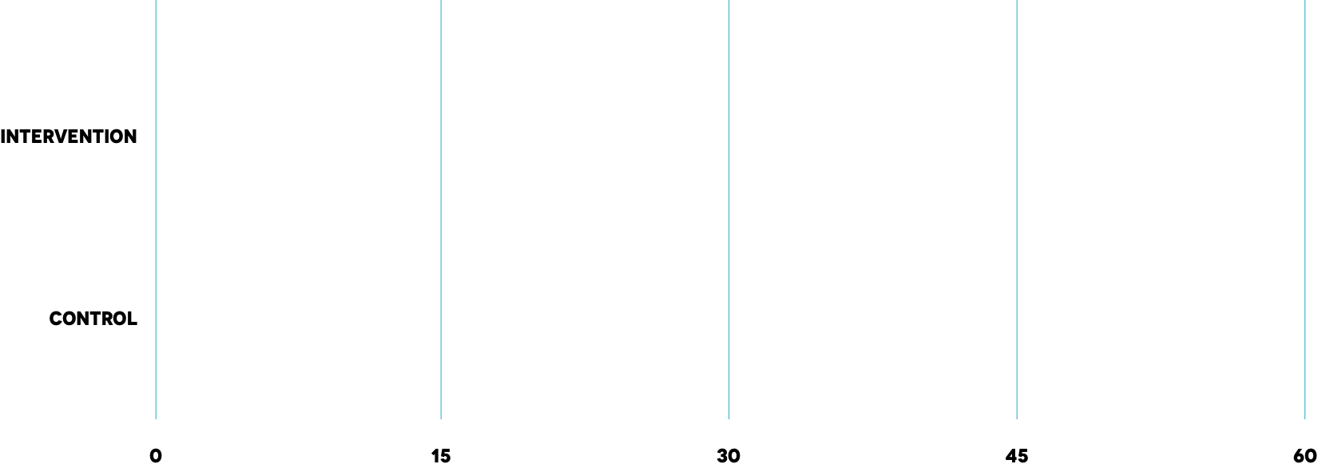




NEUROLOGIC OUTCOMES, CPC 1-4
NUMBER OF PATIENTS ALIVE AT 90 DAYS
CPC 1
n=50
n=60
CPC 1
n=35
n=52

Slide 14
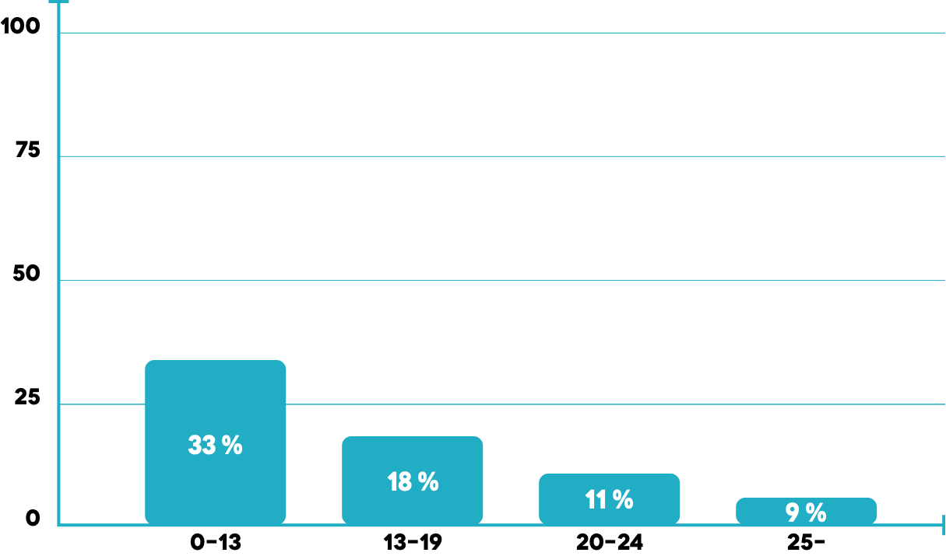
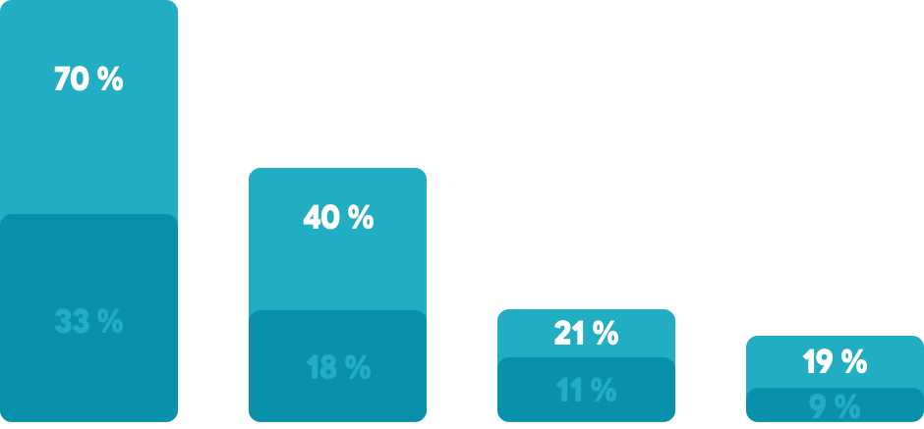
TIME TO COOLING AND NEUROLOGIC OUTCOME
ALL PATIENTS
/ PATIENTS WITH VF
MEDIAN TIME TO COOLING 19 MINUTES
Survival with CPC 1-2 at 90 days, VF patients
Time from collapse to intra-arrest cooling

Slide 15
CONCLUSIONS
TRANSNASAL EVAPORATIVE COOLING IN OUT-OF-HOSPITAL CARDIAC ARREST
HEMODYNAMICALLY SAFE
SIGNIFICANTLY SHORTENED TIME TO TARGET TEMPERATURE
THE DIFFERENCE IN PRIMARY OUTCOME (CPC 1-2) WAS NOT STATISTICALLY SIGNIFICANT
TREND TOWARDS IMPROVED NEUROLOGIC OUTCOME IN PATIENTS WITH VENTRICULAR FIBRILLATION
SIGNIFICANTLY IMPROVED COMPLETE RECOVERY (CPC 1) IN PATIENTS WITH VENTRICULAR FIBRILLATION

Slide 16

A special Thanks to:
Leif Svensson
Fabio Silvio Taccone
Anatolij Truhlar
Jacob Hollenberg
Sune Forsberg
Thomas Hermansson
Anders Bäckman
Martin Jonsson
Email: per.nordberg@sll.se

