Slide 1
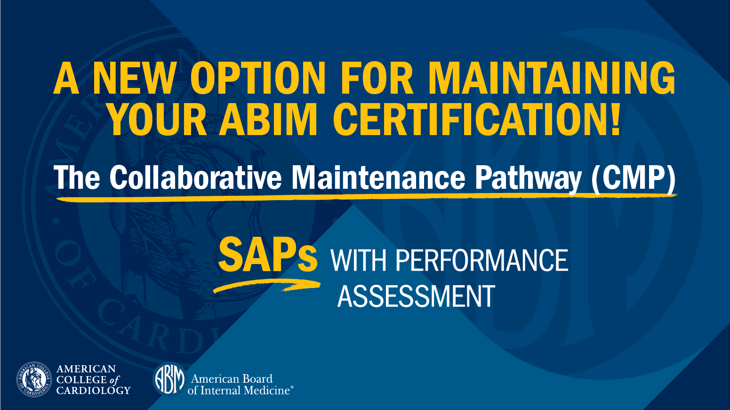

Slide 2
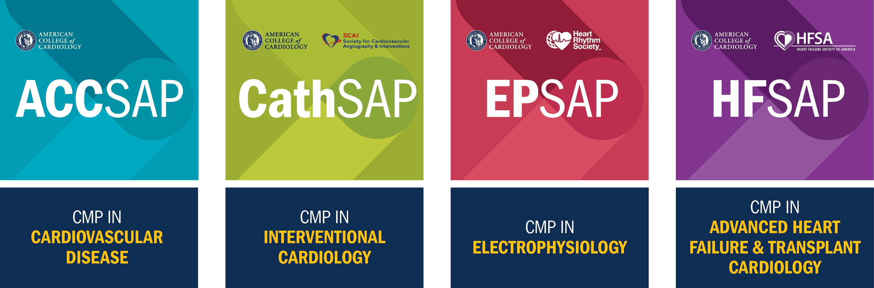
THE CMP INTEGRATES LIFELONG LEARNING WITH ASSESSMENT
Coming June 2020!

Slide 3
6 STEPS TO PARTICIPATING IN THE CMP in 2020
Be currently CERTIFIED
by the ABIM &
NOT IN AN EXAM GRACE PERIOD
PURCHASE the Relevant SAP
Includes 5 years of access
1
2
ENROLL in the CMP¹
ACC.org/CMPenroll
Spend 7 or more HOURS
“ENGAGING”
in the topic of focus for the year.
Complete in either order
3
4
Take/Pass a
PERFORMANCE ASSESSMENT²
REPEAT STEPS 4 & 5
each year.
(But on a different 20% of the field each year)
5
6
¹Enrollment is currently open for everything but Heart Failure, which is anticipated to open in late March 2020.
²The CMP for CVD is a “regular” year in 2020, which means you need to PASS a Performance Assessment.
The CMP for IV, EP, and HF is “no consequences” in 2020, so no passing score is required.

Slide 4
Be currently CERTIFIED by the ABIM and
NOT in an EXAM GRACE PERIOD
STEP 1:
To participate in the CMP in 2020, you must BE CERTIFIED by the ABIM and NOT IN AN EXAM GRACE PERIOD.
A grace period occurs when you fail an assessment in the year you were due but have met all of your other MOC program requirements. If you are in a grace period and have questions, please contact the ABIM directly.
You can check your certification status by signing in to your
ABIM Physician Portal at www.abim.org.
ABIM Contact Information:
  Phone: 800-441-2246
  Email: request@abim.org

Slide 5
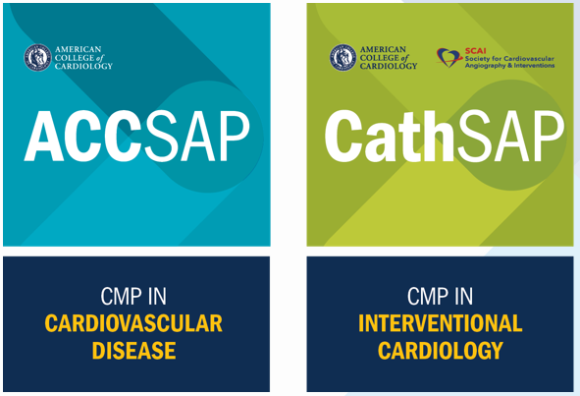
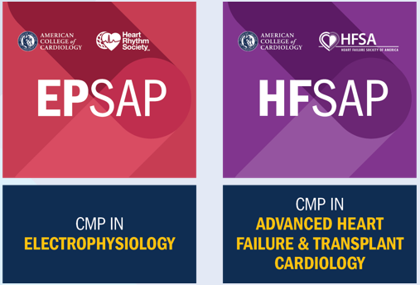
STEP 2: Purchase the Relevant SAP
(your purchase provides you with 5 years of access)
My institution subscribes to CardioSource Plus.
Will the CMP be available through it?
CardioSource Plus includes the traditional elements of a SAP (text, presentations, practice questions). It does not include the CMP. TO PARTICIPATE IN THE CMP, YOU MUST PURCHASE YOUR OWN PERSONAL SUBSCRIPTION TO THE SAP**.
As long as you use the SAME ACC.ORG ACCOUNT to access the SAP through CardioSource Plus and to access your personal subscription to the SAP, your progress and usage data will be stored in one central location. This includes any time already spent toward your 7 hours of Learning Engagement.
**CardioSource Plus Users can Order SAPs by:
ENROLLING in the CMP, which will prompt you to buy ACCSAP (technical difficulties prevent CardioSource Plus users from purchasing outside of enrollment).
CALLING ACC’s Member Care team at 800-253-4636, x5603 from 9:00 a.m. to 5:00 p.m. ET.
Coming June 2020!
Notes:
Secondly, to participate in the CMP you must purchase the relevant SAP. Your purchase provides you with 5 years of access.

Slide 6

STEP 3: ENROLL in the CMP
Enrolling is easy! To enroll, you must:
  Have a PERSONAL SUBSCRIPTION to the SAP*.
  Have your ABIM DIPLOMATE number, DATE OF BIRTH, and the NAME that appears on your ABIM certificate.
  Have a CELL PHONE NUMBER or EMAIL ADDRESS that you can use for 2-Factor Authentication.
  After enrolling:
  You will have ACCESS TO THE CMP HUB within the SAP, where you can track your 7 hours and access Performance Assessments.
  You can CONTINUE WORKING TOWARD YOUR 7 HOURS / 70%
  To enroll**, visit
  ACC.org/CMPEnroll
*SAPs through CardioSource Plus do not include the CMP. Refer to slide 5 for details.
**Enrollment is currently open for Cardiovascular Disease, Interventional Cardiology and Electrophysiology. Check back in late March 2020 for Heart Failure.

Slide 7
Spend 7 HOURS “ENGAGING” and SCORE 70%
STEP 4:
Spend 7 OR MORE HOURS “ENGAGING” in the topic covered by the CMP Performance Assessment. Spend at least 7 hours:
    Reading the text and/or watching/listening to presentations
    Completing ALL the practice questions and answering at least 70% of them correctly (you may answer as many times as necessary to achieve that score).
The 7 hours must be accrued in the same calendar year as the Performance Assessment.
If you STUDY ONLINE, the SAP will track your time. If you download files to listen/read offline, it will not count.
Visit the CMP HUB WITHIN the SAP to see your progress toward 7 hours and a score of 70%. The CMP Hub will become available after you enroll in the CMP for that SAP’s specialty.
Spend 7 hours
reading, watching,
& scoring 70%
Study Online and the SAP Tracks
Your Time!

Slide 8
STEP 5: Take a PERFORMANCE ASSESSMENT
2020
Performance Assessment Dates
ACCSAP
Sept. 16 – 22, 2020
Dec. 2 – 8, 2020
CathSAP
Aug. 19 – 25, 2020
Nov. 4 – 10, 2020
EP SAP
Aug. 19 – 25, 2020
Nov. 4 – 10, 2020
Heart Failure SAP
TBD
  Performance Assessments are TESTS that are:
  SHORTER in length (60 questions that are structured just like the Practice questions in the SAP)
  FOCUSED on only 20% of the ABIM blueprint each year
  OPEN BOOK
  TIMED – you will have 2 hours to complete the test and you must complete it in one sitting.
  ONLINE – you may take a performance assessment in your home or office
  Available during two specific weeks each year. You will have one chance during each of the two weeks to pass the Performance Assessment.
Notes:
[read slide]

Slide 9
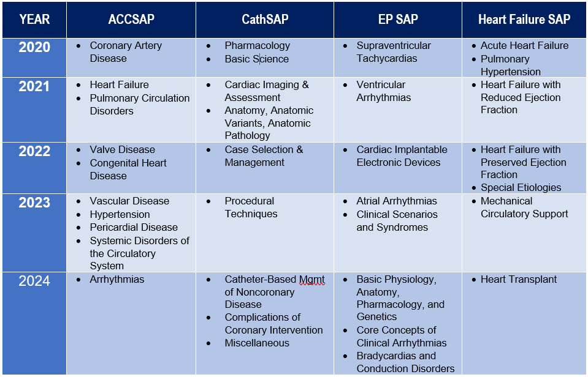
STEP 6: REPEAT STEPS 4 and 5 Each Year
CMP Topics by Year
The CMP promotes continuous learning through a focus on 20% OF THE FIELD EACH YEAR.
You start with whatever topic is the focus the year that you enroll.
You have to do something EVERY YEAR to maintain your certification via the CMP:
  Spend 7 hours engaging in the topic(s), including achieving a score of 70% or better on the practice questions for the topic(s)
  PASS the Performance Assessment.
Notes:
And your final step in participating is to [read slide]

Slide 10
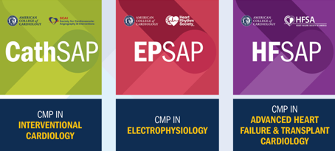
WHAT DOES “NO CONSEQUENCES” MEAN FOR THE CMP?
2020 IS A
NO CONSEQUENCES YEAR
No Need to Pass a Performance Assessment for 2020
2020 is a “no consequences” year for IV, EP & HF. AS LONG AS YOU PARTICIPATE IN THE CMP, you will be considered as meeting your assessment requirement. Participation includes:
  Spending 7 hours learning/engaging/answering all Practice questions and scoring 70% or better
  Taking the CMP Performance Assessment.
IF YOU ARE SUCCESSFUL on the CMP Performance Assessment in 2020, IT WILL COUNT AS A PASS.
CMP IN INTERVENTIONAL CARDIOLOGY
CMP IN ELECTROPHYSIOLOGY
CMP IN
ADVANCED HEART FAILURE & TRANSPLANT CARDIOLOGY
Notes:
We’ve mentioned “no consequences” several times in this presentation, so let’s talk about it a little more in depth…..[read slide]

Slide 11
WHAT DOES “NO CONSEQUENCES” MEAN FOR THE CMP?
2020 IS A
NO CONSEQUENCES YEAR
No Need to Pass a Performance Assessment for 2020
If you are NOT SUCCESSFUL and your EXAM WAS DUE IN 2020, YOU WILL BE CONSIDERED AS MEETING YOUR ASSESSMENT REQUIREMENT and you can continue to participate in the CMP.
In 2021 AND BEYOND, YOU MUST PASS either the first or second offering of the performance assessment to be considered as meeting your assessment requirement.
A ‘NO CONSEQUENCES” YEAR DOESN'T MEAN YOU CAN SKIP THE ASSESSMENT. If you skip it, and your certification expires in 2020, your status will change to Not Certified.
CMP IN INTERVENTIONAL CARDIOLOGY
CMP IN ELECTROPHYSIOLOGY
CMP IN
ADVANCED HEART FAILURE & TRANSPLANT CARDIOLOGY
Notes:
[read slide]

Slide 12

WHICH CMPs ARE NO CONSEQUENCES* IN 2020?
2020 IS A
REGULAR YEAR
You must PASS a Performance Assessment in 2020
2020 IS A
NO CONSEQUENCES YEAR
NO NEED to Pass a Performance Assessment for 2020.
You must PASS in 2021 & beyond.
CMP IN CARDIOVASCULAR DISEASE
CMP IN INTERVENTIONAL CARDIOLOGY
CMP IN ELECTROPHYSIOLOGY
CMP IN
ADVANCED HEART FAILURE & TRANSPLANT CARDIOLOGY
*A “No Consequences” year doesn’t mean you can skip the assessment. If you skip it, and your certification expires in 2020, your status will change to Not Certified.

Slide 13
WHAT HAPPENS IF I DON’T PASS THE CMP PERFORMANCE ASSESSMENT?
2020 IS A
REGULAR YEAR
You must PASS a Performance Assessment
For Cardiovascular Disease (ACCSAP), you MUST PASS THE CMP PERFORMANCE ASSESSMENT EVERY YEAR to be considered as meeting your assessment requirement.
You get 2 CHANCES TO PASS EACH YEAR.
IF YOU DO NOT PASS A CMP PERFORMANCE ASSESSMENT you have the option to meet your assessment requirement by passing an ABIM assessment. After passing one of ABIM’s alternatives, you can then return to the CMP.
CMP IN CARDIOVASCULAR DISEASE
Notes:
With all this talk of passing, you may be wondering what happens if you DON’T pass.
For Cardiovascular Disease, starting in 2020, you must pass the CMP performance assessment every year to be considered as meeting your assessment requirement. You get 2 chances to pass each year.
If you do not pass a CMP performance assessment you must meet your assessment requirement by passing either ABIM’S new 2-year Knowledge Check In or the 10-year exam. After passing one of ABIM’S alternatives, you can then return to the CMP.

Slide 14
WHAT HAPPENS IF I DON’T PASS THE CMP PERFORMANCE ASSESSMENT?
For IV, EP, and HF Only:
In 2020: If you don’t pass in 2020, you will still be counted as meeting your assessment requirement BECAUSE 2020 IS A “NO CONSEQUENCES” YEAR for these specialties.
In 2021 & Beyond:
You MUST PASS THE CMP PERFORMANCE ASSESSMENT EVERY YEAR to be considered as meeting your assessment requirement.
You get 2 CHANCES TO PASS EACH YEAR.
IF YOU DO NOT PASS a CMP performance assessment you must MEET YOUR ASSESSMENT REQUIREMENT BY PASSING AN ABIM ASSESSMENT. After passing one of ABIM’s alternatives, you can then return to the CMP.
2020 IS A
NO CONSEQUENCES YEAR
No Need to Pass a Performance Assessment for 2020
CMP IN INTERVENTIONAL CARDIOLOGY
CMP IN ELECTROPHYSIOLOGY
CMP IN
ADVANCED HEART FAILURE & TRANSPLANT CARDIOLOGY
Notes:
For No Consequences CMPs (IV, EP, and HF), if you don’t pass in 2020 you will still be counted as meeting your assessment requirement because 2020 is a No Consequences year.

