Slide 1
2018 AHA/ACC Guideline for the Management of Adults With Congenital Heart Disease (ACHD)
© American College of Cardiology Foundation and American Heart Association, Inc.

Slide 2
Publication Information
This slide set is adapted from the 2018 AHA/ACC Guideline for the Management of Adults With Congenital Heart Disease
Published on August 16th, 2018, available at: Circulation and Journal of the American College of Cardiology.
The full-text guidelines are also available on the following websites: AHA (professional.heart.org) and ACC (www.acc.org)

Slide 3
2018 Adults With Congenital Heart Disease Guideline Writing Committee
Karen K. Stout, MD, FACC, Chair†
Curt J. Daniels, MD, Vice Chair*†‡
Jamil A. Aboulhosn, MD, FACC, FSCAI*§ Stephanie Fuller, MD, MS, FACC#
Biykem Bozkurt, MD, PhD, FACC, FAHA║ Michelle Gurvitz, MD, FACC**
Craig S. Broberg, MD, FACC*† Paul Khairy, MD, PhD*†
Jack M. Colman, MD, FACC† Michael J. Landzberg, MD, FACC*†
Stephen R. Crumb, DNP, AACC† Arwa Saidi, MB, BCH, FACC*†
Joseph A. Dearani, MD, FACC¶ Anne Marie Valente, MD, FACC, FAHA, FASE††
George F. Van Hare, MD‡‡
†ACC/AHA Representative. ‡International Society for Adult Congenital Heart Disease Representative. §Society for Cardiovascular Angiography and Interventions. ║ACC/AHA Task Force on Clinical Practice Guidelines Liaison. ¶Society of Thoracic Surgeons Representative. #American Association for Thoracic Surgery Representative. **ACC/AHA Task Force on Performance Measures Liaison. ††American Society of Echocardiography Representative. ‡‡Heart Rhythm Society Representative.

Slide 4
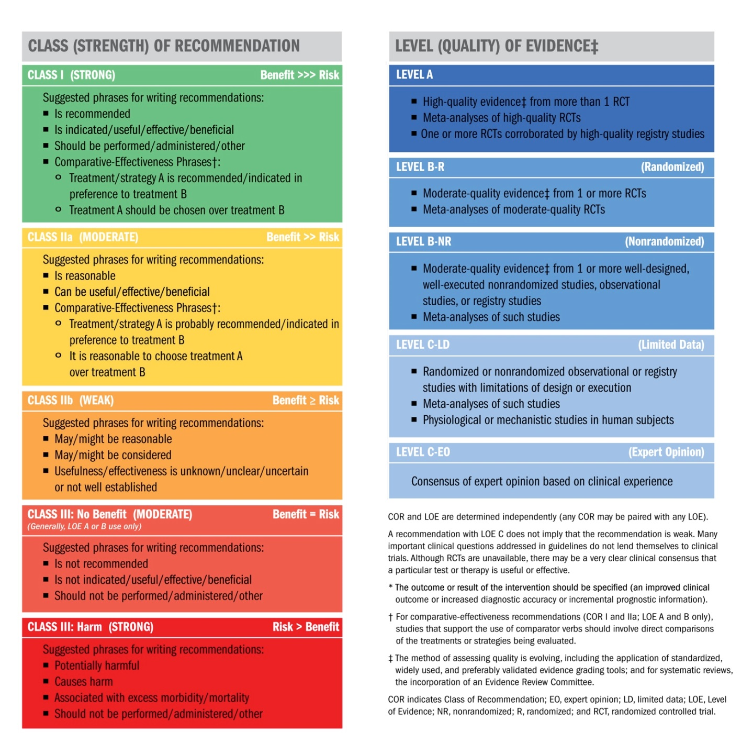
Applying Class of Recommendation and Level of Evidence to Clinical Strategies, Interventions, Treatments, or Diagnostic Testing
in Patient Care*
(Updated August 2015)
Notes:
MC note: Second formatting option

Slide 5
Systematic Reviews on ACHD
“Medical Therapy for Systemic Right Ventricles: A Systematic Review (Part 1)
“Interventional Therapy Versus Medical Therapy for Secundum Atrial Septal Defect: A Systematic Review (Part 2)

Slide 6
ACHD AP CLASSIFICATION (CHD Anatomy + Physiological Stage = ACHD AP Classification)
CHD Anatomy
(This list is not meant to be comprehensive; other conditions may be important in individual patients. ASD, atrial septal defect; AVSD, atrioventricular septal defect; CCTGA, congenitally corrected transposition of the great arteries; CHD, congenital heart disease; d-TGA, dextro-transposition of the great arteries; FC, functional class; HCM, hypertrophic cardiomyopathy; l-TGA, levo-transposition of the great arteries; NYHA, New York Heart Association; TGA, transposition of the great arteries; and VSD, ventricular septal defect. )
I: Simple
Native disease Isolated small ASD Isolated small VSD Mild isolated pulmonic stenosis Repaired conditions Previously ligated or occluded ductus arteriosus Repaired secundum ASD or sinus venosus defect without significant residual shunt or chamber enlargement Repaired VSD without significant residual shunt or chamber enlargement
(Con’t.)

Slide 7
ACHD AP CLASSIFICATION
CHD Anatomy
II: Moderate Complexity
Repaired or unrepaired conditions Aorto-left ventricular fistula Anomalous pulmonary venous connection, partial or total Anomalous coronary artery arising from the pulmonary artery Anomalous aortic origin of a coronary artery from the opposite sinus AVSD (partial or complete, including primum ASD) Congenital aortic valve disease Congenital mitral valve disease Coarctation of the aorta Ebstein anomaly (disease spectrum includes mild, moderate, and severe variations) Infundibular right ventricular outflow obstruction Ostium primum ASD Moderate and large unrepaired secundum ASD Moderate and large persistently patent ductus arteriosus Pulmonary valve regurgitation (moderate or greater) Pulmonary valve stenosis (moderate or greater) Peripheral pulmonary stenosis Sinus of Valsalva fistula/aneurysm Sinus venosus defect Subvalvar aortic stenosis (excluding HCM; HCM not addressed in these guidelines) Supravalvar aortic stenosis Straddling atrioventricular valve Repaired tetralogy of Fallot VSD with associated abnormality and/or moderate or greater shunt
(Con’t.)

Slide 8
ACHD AP CLASSIFICATION
CHD Anatomy
III: Great Complexity (or Complex)
Cyanotic congenital heart defect (unrepaired or palliated, all forms) Double-outlet ventricle Fontan procedure Interrupted aortic arch Mitral atresia Single ventricle (including double inlet left ventricle, tricuspid atresia, hypoplastic left heart, any other anatomic abnormality with a functionally single ventricle) Pulmonary atresia (all forms) TGA (classic or d-TGA; CCTGA or l-TGA) Truncus arteriosus Other abnormalities of atrioventricular and ventriculoarterial connection (i.e., crisscross heart, isomerism, heterotaxy syndromes, ventricular inversion)
(Con’t.)

Slide 9
ACHD AP CLASSIFICATION
Physiological State
A
NYHA FC I symptoms No hemodynamic or anatomic sequelae No arrhythmias Normal exercise capacity Normal renal/hepatic/pulmonary function
B
NYHA FC II symptoms Mild hemodynamic sequelae (mild aortic enlargement, mild ventricular enlargement, mild ventricular dysfunction) Mild valvular disease Trivial or small shunt (not hemodynamically significant) Arrhythmia not requiring treatment Abnormal objective cardiac limitation to exercise
(Con’t.)

Slide 10
ACHD AP CLASSIFICATION
Physiological Stage
C
NYHA FC III symptoms Significant (moderate or greater) valvular disease; moderate or greater ventricular dysfunction (systemic, pulmonic, or both) Moderate aortic enlargement Venous or arterial stenosis Mild or moderate hypoxemia/cyanosis Hemodynamically significant shunt Arrhythmias controlled with treatment Pulmonary hypertension (less than severe) End-organ dysfunction responsive to therapy
D
NYHA FC IV symptoms Severe aortic enlargement Arrhythmias refractory to treatment Severe hypoxemia (almost always associated with cyanosis) Severe pulmonary hypertension Eisenmenger syndrome Refractory end-organ dysfunction

Slide 11
2018 ACHD Clinical Practice Guidelines
Access to Care

Slide 12
Access to Care
Recommendation for Access to Care
COR | LOE | Recommendation
I | B-NR | Physicians caring for patients with ACHD should support access to care by 1) assuring smooth transitions for adolescents and young adults from pediatric to adult providers (Level of Evidence: B-NR); and 2) promoting awareness of the need for lifelong specialized care through outreach and educational programs (Level of Evidence: C-EO).
 | C-EO

Slide 13
2018 ACHD Guideline
Delivery of Care

Slide 14
Delivery of Care
Recommendations for Delivery of Care
COR | LOE | Recommendations
I | B-NR | Patients with ACHD AP classification IB-D, IIA-D, and IIIA-D* should be managed in collaboration with an ACHD cardiologist .
I | C-LD | Cardiac surgery, catheter-based interventional cardiac procedures, and electrophysiological procedures involving congenital heart lesions in patients with ACHD should be performed by operators with expertise in CHD procedures and in collaboration with an ACHD cardiologist.
*See details on the ACHD Anatomic and Physiological classification system.

Slide 15
2018 ACHD Guideline
Evaluation of Suspected and Known CHD

Slide 16
Electrocardiogram
Recommendations for Electrocardiogram
COR | LOE | Recommendations
I | C-EO | A standard 12-lead electrocardiogram (ECG) is recommended in adults with CHD with serial assessment depending on the specific ACHD AP classification or when symptoms develop or worsen.
I | C-EO | Ambulatory electrocardiographic monitoring should be performed in patients with CHD who are at risk of tachyarrhythmia, bradyarrhythmia or heart block, or when symptoms possibly of arrhythmic origin develop.
(Con’t.)

Slide 17
Ionizing Radiation principles
Recommendation for Ionizing Radiation Principles
COR | LOE | Recommendation
I | B-NR | Strategies to limit and monitor radiation exposure are recommended during imaging of patients with ACHD, with studies not involving ionizing radiation chosen whenever appropriate.
(Con’t.)

Slide 18
Echocardiography
Recommendations for Echocardiography
COR | LOE | Recommendations
I | B-NR | Intraoperative TEE is recommended to guide surgical repair of CHD in adults.
I | C-EO | Patients with ACHD should undergo transthoracic echocardiography (TTE) for initial assessment, with timing of serial assessment based on anatomic and physiological severity and clinical status.
(Con’t.)

Slide 19
CMR Imaging
Recommendations for CMR Imaging
COR | LOE | Recommendations
I | B-NR | In patients with ACHD who have or who are at risk of developing RV enlargement and dysfunction, serial CMR is recommended for quantitative assessment of RV size and function.
IIa | C-LD | CMR can be useful in the initial evaluation and serial assessment of selected patients with CHD based on anatomic complexity and clinical status.

Slide 20
Cardiac Computed Tomography
Recommendation for Cardiac Computed Tomography
COR | LOE | Recommendation
IIa | C-LD | CCT imaging can be useful in patients with ACHD when information that cannot be obtained by other diagnostic modalities is important enough to justify the exposure to ionizing radiation.

Slide 21
Cardiac Catheterization
Recommendations for Cardiac Catheterization
COR | LOE | Recommendations
I | C-LD | Cardiac catheterization (hemodynamic and/or angiographic) in patients with ACHD AP classification II and III, or interventional cardiac catheterization in patients with ACHD AP classification I to III should be performed by, or in collaboration with, cardiologists with expertise in ACHD.
IIa | B-NR | In patients with a low or intermediate pretest probability of coronary artery disease (CAD), use of CT coronary angiography is reasonable to exclude significant obstructive CAD when cardiac catheterization has significant risk or because of patient preference.

Slide 22
Exercise Testing
Recommendations for Exercise Testing
COR | LOE | Recommendations
IIa | B-NR | In patients with ACHD, cardiopulmonary exercise testing (CPET) can be useful for baseline functional assessment and serial testing.
IIa | C-LD | In symptomatic patients with ACHD, a 6-minute walk test can be useful to objectively assess symptom severity, functional capacity, and response to therapy.

Slide 23
2018 ACHD Guideline
Transition Education

Slide 24
Transition Education
Recommendation for Transition Education
COR | LOE | Recommendation
I | B-NR | Clinicians caring for patients with CHD should deliver developmentally appropriate transition education to adolescent and young patients with CHD, and to their families/support network.

Slide 25
2018 ACHD Guideline
Exercise and Sports

Slide 26
Exercise and Sports
Recommendations for Exercise and Sports
COR | LOE | Recommendations
I | C-LD | Clinicians should assess activity levels at regular intervals and counsel patients with ACHD about the types and intensity of exercise appropriate to their clinical status.
IIa | C-LD | CPET can be useful to guide activity recommendations for patients with ACHD.
IIa | B-NR | Cardiac rehabilitation can be useful to increase exercise capacity in patients with ACHD.

Slide 27
2018 ACHD Guideline
Mental Health and Neurodevelopmental Issues

Slide 28
Mental Health and Neurodevelopmental Issues
Recommendations for Mental Health and Neurodevelopmental Issues
COR | LOE | Recommendations
I | B-NR | Patients with ACHD should be evaluated for depression and anxiety.
IIa | B-NR | Referral for mental health evaluation and treatment is reasonable in patients with ACHD.
IIb | B-NR | Neurodevelopmental or neuropsychological testing may be considered in some patients with ACHD to guide therapies that enhance academic, behavioral, psychosocial, and adaptive functioning.

Slide 29
2018 ACHD Guideline
Concomitant Syndromes

Slide 30
Concomitant Syndromes
Recommendation for Concomitant Syndromes
COR | LOE | Recommendation
IIa | B-NR | Genetic testing for 22q11 deletions is reasonable for patients with conotruncal cardiac defects.

Slide 31
2018 ACHD Guideline
Noncardiac Medical Issues

Slide 32
Noncardiac Medical Issues
Recommendation for Noncardiac Medical Issues
COR | LOE | Recommendation
I | C-LD | Patients with ACHD at risk for hepatitis C should be screened and vaccinated for viral hepatitis and treated as appropriate.

Slide 33
2018 ACHD Guideline
Noncardiac Surgery

Slide 34
Noncardiac Surgery
Recommendations for Noncardiac Surgery
COR | LOE | Recommendations
I | C-LD | Optimization before and close surveillance after invasive procedures, regardless of the complexity of the anatomic defect or type of procedure is beneficial for patients with ACHD.
I | B-NR | In patients with ACHD AP classification IB-D, IIA-D, and IIIA-D* noncardiac surgical and interventional procedures should be performed in a hospital with or in consultation with experts in ACHD when possible.
*See Table on the ACHD AP classification system

Slide 35
2018 ACHD Guideline
Pregnancy, Reproduction, and Sexual Health

Slide 36
Pregnancy
Recommendations for Pregnancy
COR | LOE | Recommendations
I | C-LD | Women with CHD should receive prepregnancy counseling with input from an ACHD cardiologist to determine maternal cardiac, obstetrical and fetal risks, and potential long-term risks to the mother.
I | C-LD | An individualized plan of care that addresses expectations and contingencies should be developed for and with women with CHD who are pregnant or who may become pregnant and shared with the patient and all caregivers.
I | B-NR | Women with CHD receiving chronic anticoagulation should be counseled, ideally before conception, on the risks and benefits of specific anticoagulants during pregnancy.
I | B-NR | Women with ACHD AP classification IB-D, IIA-D, and IIIA-D* should be managed collaboratively during pregnancy by ACHD cardiologists, obstetricians, and anesthesiologists experienced in ACHD.
*See Table on the ACHD AP classification system
(Con’t.)

Slide 37
Pregnancy
I | C-EO | In collaboration with an ACHD cardiologist to ensure accurate assessment of pregnancy risk, patients at high risk of maternal morbidity or mortality, including women with pulmonary arterial hypertension (PAH), Eisenmenger syndrome, severe systemic ventricular dysfunction, severe left-sided obstructive lesions, and/or ACHD AP classification ID, IID, and IIID* should be counseled against becoming pregnant or be given the option of terminating pregnancy.
I | B-NR | Men and women of childbearing age with CHD should be counseled on the risk of CHD recurrence in offspring.
IIa | B-NR | Exercise testing can be useful for risk assessment in women with ACHD AP classification IC-D, IIA-D, and IIIA-D* who are considering pregnancy.
IIa | B-NR | When either parent has CHD, it is reasonable to perform fetal echocardiography.
*See Table on the ACHD AP classification system
(Con’t.)

Slide 38
Contraception
Recommendations for Contraception
COR | LOE | Recommendations
I | C-LD | Women of childbearing potential with CHD should be counseled about the risks associated with pregnancy and appropriate contraceptive options .
III: Harm | B-NR | Estrogen-containing contraceptives are potentially harmful for women with CHD at high risk of thromboembolic events (e.g., cyanosis, Fontan physiology, mechanical valves, prior thrombotic events, PAH) .
(Con’t.)

Slide 39
2018 ACHD Guideline
Heart Failure and Transplant

Slide 40
Heart Failure
Recommendation for Heart Failure
COR | LOE | Recommendation
I | C-LD | Consultation with ACHD and HF specialists is recommended for patients with ACHD and HF or severe ventricular dysfunction.

Slide 41
2018 ACHD Guideline
Palliative Care

Slide 42
Palliative Care
Recommendation for Palliative Care
COR | LOE | Recommendation
IIa | B-NR | Discussion of end-of-life issues and advance directives can be beneficial for patients with ACHD or their surrogates.

Slide 43
2018 ACHD Guideline
Shunt Lesions

Slide 44
Atrial Septal Defect
Recommendations for Atrial Septal Defect
COR | LOE | Recommendations
Diagnostic
I | C-EO | Pulse oximetry at rest and during exercise is recommended for evaluation of adults with unrepaired or repaired ASD with residual shunt to determine the direction and magnitude of the shunt.
I | B-NR | CMR, CCT, and/or TEE are useful to evaluate pulmonary venous connections in adults with ASD .
I | B-NR | Echocardiographic imaging is recommended to guide percutaneous ASD closure .
(Con’t.)

Slide 45
Atrial Septal Defect
Therapeutic
I | B-NR^{SR} | In adults with isolated secundum ASD causing impaired functional capacity, right atrial and/or RV enlargement, and net left-to-right shunt sufficiently large to cause physiological sequelae (e.g., pulmonary–systemic blood flow ratio [Qp:Qs] ≥1.5:1) without cyanosis at rest or during exercise, transcatheter or surgical closure to reduce RV volume and improve exercise tolerance is recommended, provided that systolic PA pressure is less than 50% of systolic systemic pressure and pulmonary vascular resistance is less than one third of the systemic vascular resistance.
I | B-NR | Adults with primum ASD, sinus venosus defect or coronary sinus defect causing impaired functional capacity, right atrial and/or RV enlargement and net left-to-right shunt sufficiently large to cause physiological sequelae (e.g., Qp:Qs ≥1.5:1) without cyanosis at rest or during exercise, should be surgically repaired unless precluded by comorbidities, provided that systolic PA pressure is less than 50% of systemic pressure and pulmonary vascular resistance is less than one third of the systemic vascular resistance.
IIa | C-LD^{SR} | In asymptomatic adults with isolated secundum ASD, right atrial and RV enlargement, and net left-to-right shunt sufficiently large to cause physiological sequelae (e.g., Qp:Qs 1.5:1 or greater), without cyanosis at rest or during exercise, transcatheter or surgical closure is reasonable to reduce RV volume and/or improve functional capacity, provided that systolic PA pressure is less than 50% of systemic pressure and pulmonary vascular resistance is less than one third systemic resistance.
(Con’t.)

Slide 46
Atrial Septal Defect
IIa | C-LD | Surgical closure of a secundum ASD in adults is reasonable when a concomitant surgical procedure is being performed and there is a net left-to-right shunt sufficiently large to cause physiological sequelae (e.g., Qp:Qs 1.5:1 or greater) and right atrial and RV enlargement without cyanosis at rest or during exercise.
IIb | B-NR | Percutaneous or surgical closure may be considered for adults with ASD when net left-to-right shunt (Qp:Qs) is 1.5:1 or greater, PA systolic pressure is 50% or more of systemic arterial systolic pressure, and/or pulmonary vascular resistance is greater than one third of the systemic resistance.
III: Harm | C-LD | ASD closure should not be performed in adults with PA systolic pressure greater than two thirds systemic, pulmonary vascular resistance greater than two thirds systemic, and/or a net right-to-left shunt.
(Con’t.)

Slide 47
Secundum ASD

Slide 48
Anomalous Pulmonary Venous Connections
Recommendations for Anomalous Pulmonary Venous Connections
COR | LOE | Recommendations
Diagnostic
I | B-NR | CMR or CTA is recommended for evaluation of partial anomalous pulmonary venous connection.
IIa | B-NR | Cardiac catheterization can be useful in adults with partial anomalous pulmonary venous connection to further define hemodynamics.
(Con’t.)

Slide 49
Anomalous Pulmonary Venous Connections
Therapeutic
I | B-NR | Surgical repair is recommended for patients with partial anomalous pulmonary venous connection when functional capacity is impaired and RV enlargement is present, there is a net left-to-right shunt sufficiently large to cause physiological sequelae (e.g., Qp:Qs ≥1.5:1), PA systolic pressure is less than 50% systemic pressure and pulmonary vascular resistance is less than one third of systemic resistance.
I | B-NR | Repair of partial anomalous pulmonary venous connection is recommended at the time of closure of a sinus venosus defect or ASD.
I | B-NR | Repair of a scimitar vein is recommended in adults when functional capacity is impaired, evidence of RV volume overload is present, there is a net left-to-right shunt sufficiently large to cause physiological sequelae (e.g., Qp:Qs ≥1.5:1), PA systolic pressure is less than 50% systemic pressure and pulmonary vascular resistance is less than one third systemic.
IIa | B-NR | Surgery can be useful for right- or left-sided partial anomalous pulmonary venous connection in asymptomatic adults with RV volume overload, net left-to-right shunt sufficiently large to cause physiological sequelae (e.g., Qp:Qs ≥1.5:1), pulmonary pressures less than 50% systemic and pulmonary vascular resistance less than one third systemic.
IIa | B-NR | Surgery can be useful for repair of a scimitar vein in adults with evidence of RV volume overload, with Qp:Qs 1.5:1 or greater.

Slide 50
Ventricular Septal Defect
Recommendations for Ventricular Septal Defect
COR | LOE | Recommendations
Therapeutic
I | B-NR | Adults with a VSD and evidence of left ventricular volume overload and hemodynamically significant shunts (Qp:Qs ≥1.5:1) should undergo VSD closure, if PA systolic pressure is less than 50% systemic and pulmonary vascular resistance is less than one third systemic.
IIa | C-LD | Surgical closure of perimembranous or supracristal VSD is reasonable in adults when there is worsening aortic regurgitation (AR) caused by VSD.
IIb | C-LD | Surgical closure of a VSD may be reasonable in adults with a history of IE caused by VSD if not otherwise contraindicated.
IIb | C-LD | Closure of a VSD may be considered in the presence of a net left-to-right shunt (Qp:Qs ≥1.5:1) when PA systolic pressure is 50% or more than systemic and/or pulmonary vascular resistance is greater than one third systemic.
III: Harm | C-LD | VSD closure should not be performed in adults with severe PAH with PA systolic pressure greater than two thirds systemic, pulmonary vascular resistance greater than two thirds systemic and/or a net right-to-left shunt.
(Con’t.)

Slide 51
Hemodynamically Significant Ventricular Level Shunt

Slide 52
Atrioventricular Septal Defect
Recommendations for Atrioventricular Septal Defect
COR | LOE | Recommendations
Diagnostic
IIa | C-EO | Cardiac catheterization can be useful in adults with atrioventricular septal defect when pulmonary hypertension is suspected.
Therapeutic
I | C-LD | Surgery for severe left atrioventricular valve regurgitation is recommended per GDMT indications for mitral regurgitation.
I | C-EO | Surgery for primary repair of atrioventricular septal defect or closure of residual shunts in adults with repaired atrioventricular septal defect is recommended when there is a net left-to-right shunt (Qp:Qs ≥1.5:1), PA systolic pressure less than 50% systemic and pulmonary vascular resistance less than one third systemic.
IIa | C-EO | Operation for discrete LVOT obstruction in adults with atrioventricular septal defect is reasonable with a maximum gradient of 50 mm Hg or greater, a lesser gradient if HF symptoms are present, or if concomitant moderate-to-severe mitral or AR are present.
IIb | C-EO | Surgery for primary repair of atrioventricular septal defect or closure of residual shunts in adults with repaired atrioventricular septal defect may be considered in the presence of a net left-to-right shunt (Qp:Qs ≥1.5:1), if PA systolic pressure is 50% or more systemic, and/or pulmonary vascular resistance is greater than one third systemic.
III: Harm | C-LD | Surgery for primary repair of atrioventricular septal defect or closure of residual shunts in adults with repaired atrioventricular septal defect should not be performed with PA systolic pressure greater than two thirds systemic, pulmonary vascular resistance greater than two thirds systemic, or a net right-to-left shunt.

Slide 53
Patent Ductus Arteriosus
Recommendations for Patent Ductus Arteriosus
COR | LOE | Recommendations
Diagnostic
I | C-EO | Measurement of oxygen saturation should be performed in feet and both hands in adults with a PDA to assess for the presence of right-to-left shunting.
IIa | C-EO | In addition to the standard diagnostic tools, cardiac catheterization can be useful in patients with PDA and suspected pulmonary hypertension.
Therapeutic
I | C-LD | PDA closure in adults is recommended if left atrial or LV enlargement is present and attributable to PDA with net left-to-right shunt, PA systolic pressure less than 50% systemic and pulmonary vascular resistance less than one third systemic.
IIb | B-NR | PDA closure in adults may be considered in the presence of a net left-to-right shunt if PA systolic pressure is 50% or greater systemic, and/or pulmonary vascular resistance is greater than one third systemic.
III: Harm | C-LD | PDA closure should not be performed in adults with a net right-to-left shunt and PA systolic pressure greater than two thirds systemic or pulmonary vascular resistance greater than two thirds systemic.
(Con’t.)

Slide 54
2018 ACHD Guideline
Left-Sided Obstructive Lesions

Slide 55
Cor Triatriatum
Recommendations for Cor Triatriatum
COR | LOE | Recommendations
Diagnostic
I | B-NR | Adults presenting with cor triatriatum sinister should be evaluated for other congenital abnormalities, particularly ASD, VSD, and anomalous pulmonary venous connection.
IIa | B-NR | In adults with prior repair of cor triatriatum sinister and recurrent symptoms, it is reasonable to evaluate for pulmonary vein stenosis.
Therapeutic
I | B-NR | Surgical repair is indicated for adults with cor triatriatum sinister for symptoms attributable to the obstruction or a substantial gradient across the membrane.

Slide 56
Congenital Mitral Stenosis
Recommendation for Congenital Mitral Stenosis
COR | LOE | Recommendation
I | B-NR | Adults with congenital mitral stenosis or a parachute mitral valve should be evaluated for other left-sided obstructive lesions.

Slide 57
Subaortic Stenosis
Recommendations for Subaortic Stenosis
COR | LOE | Recommendations
Diagnostic
IIb | C-LD | Stress testing for adults with LVOT obstruction to determine exercise capacity, symptoms, electrocardiographic changes, or arrhythmias may be reasonable in the presence of otherwise equivocal indications for intervention.
Therapeutic
I | C-EO | Surgical intervention is recommended for adults with subAS, a maximum gradient 50 mm Hg or more and symptoms attributable to the subAS.
I | C-LD | Surgical intervention is recommended for adults with subAS and less than 50 mm Hg maximum gradient and HF or ischemic symptoms, and/or LV systolic dysfunction attributable to subAS.
IIb | C-LD | To prevent the progression of AR, surgical intervention may be considered for asymptomatic adults with subAS and at least mild AR and a maximum gradient of 50 mm Hg or more.

Slide 58
Congenital Valvular Aortic Stenosis
Recommendations for Congenital Valvular Aortic Stenosis
COR | LOE | Recommendations
Diagnostic
I | B-NR | Adults with bicuspid aortic valve should be evaluated for coarctation of the aorta by clinical examination and imaging studies.
IIa | B-NR | It is reasonable to screen first-degree relatives of patients with bicuspid aortic valve or unicuspid aortic valve with echocardiography for valve disease and aortopathy.
Therapeutic
IIb | B-NR | In adults with bicuspid aortic valve stenosis and a noncalcified valve with no more than mild AR meeting indications for intervention per GDMT, it may be reasonable to treat with balloon valvuloplasty.
(Con’t.)

Slide 59
Turner Syndrome
Recommendations for Turner Syndrome
COR | LOE | Recommendations
Diagnostic
I | B-NR | Women with Turner syndrome should be evaluated for bicuspid aortic valve, coarctation of the aorta, and enlargement of the ascending aorta.
Therapeutic
IIa | B-NR | Prophylactic replacement of the aortic root or ascending aorta in adults with Turner syndrome is reasonable when the aortic diameter is 2.5 cm/m² or greater.

Slide 60
Coarctation of the Aorta
Recommendations for Coarctation of the Aorta
COR | LOE | Recommendations
Diagnostic
I | B-NR | Initial and follow-up aortic imaging using CMR or CTA is recommended in adults with coarctation of the aorta, including those who have had surgical or catheter intervention.
I | C-EO | Resting blood pressure should be measured in upper and lower extremities in all adults with coarctation of the aorta.
IIa | C-LD | Ambulatory blood pressure monitoring in adults with coarctation of the aorta can be useful for diagnosis and management of hypertension.
IIb | B-NR | Screening for intracranial aneurysms by magnetic resonance angiography or CTA may be reasonable in adults with coarctation of the aorta.
IIb | C-LD | Exercise testing to evaluate for exercise-induced hypertension may be reasonable in adults with coarctation of the aorta who exercise.
Therapeutic
I | B-NR | Surgical repair or catheter-based stenting is recommended for adults with hypertension and significant native or recurrent coarctation of the aorta.
I | C-EO | GDMT is recommended for treatment of hypertension in patients with coarctation of the aorta.
IIb | B-NR | Balloon angioplasty for adults with native and recurrent coarctation of the aorta may be considered if stent placement is not feasible and surgical intervention is not an option.

Slide 61
2018 ACHD Guideline
Right-Sided Lesions

Slide 62
Valvular Pulmonary Stenosis
Recommendations for Valvular Pulmonary Stenosis
COR | LOE | Recommendations
I | B-NR | In adults with moderate or severe valvular pulmonary stenosis and otherwise unexplained symptoms of HF, cyanosis from interatrial right-to-left communication, and/or exercise intolerance, balloon valvuloplasty is recommended.
I | B-NR | In adults with moderate or severe valvular pulmonary stenosis and otherwise unexplained symptoms of HF, cyanosis, and/or exercise intolerance who are ineligible for or who failed balloon valvuloplasty, surgical repair is recommended.
IIa | C-EO | In asymptomatic adults with severe valvular pulmonary stenosis, intervention is reasonable.
(Con’t.)

Slide 63
Isolated PR After Repair of PS
Recommendations for Isolated PR After Repair of Pulmonary Stenosis
COR | LOE | Recommendations
I | C-EO | In symptomatic patients with moderate or greater PR resulting from treated isolated pulmonary stenosis, with RV dilation or RV dysfunction, pulmonary valve replacement is recommended.
I | C-EO | For asymptomatic patients with residual PR resulting from treatment of isolated pulmonary stenosis with a dilated right ventricle, serial follow-up is recommended.
IIb | C-EO | In asymptomatic patients with moderate or greater PR resulting from treatment of isolated pulmonary stenosis with progressive RV dilation and/or RV dysfunction, pulmonary valve replacement may be reasonable.
(Con’t.)

Slide 64
Isolated PR After Repair of PS

Slide 65
Branch and Peripheral Pulmonary Stenosis
Recommendations for Branch and Peripheral PS
COR | LOE | Recommendations
Diagnostic
I | B-NR | For adults with peripheral or branch PS, ongoing surveillance is recommended.
Therapeutic
IIa | B-NR | In adults with peripheral or branch PA stenosis, PA dilation and stenting can be useful .

Slide 66
Double-Chambered Right Ventricle
Recommendations for Double-Chambered Right Ventricle
COR | LOE | Recommendations
I | C-LD | Surgical repair for adults with double-chambered right ventricle and moderate or greater outflow obstruction is recommended in patients with otherwise unexplained symptoms of HF, cyanosis, or exercise limitation.
IIb | C-LD | Surgical repair for adults with double-chambered right ventricle with a severe gradient may be considered in asymptomatic patients.

Slide 67
Ebstein Anomaly
Recommendations for Ebstein Anomaly
COR | LOE | Recommendations
Diagnostic
IIa | B-NR | In adults with Ebstein anomaly, CMR can be useful to determine anatomy, RV dimensions, and systolic function .
IIa | B-NR | In adults with Ebstein anomaly, TEE can be useful for surgical planning if TTE images are inadequate to evaluate tricuspid valve morphology and function.
IIa | B-NR | Electrophysiological study with or without catheter ablation can be useful in the diagnostic evaluation of adults with Ebstein anomaly and ventricular preexcitation but without supraventricular tachycardia.
IIa | B-NR | In adults with Ebstein anomaly, electrophysiological study (and catheter ablation, if needed) is reasonable before surgical intervention on the tricuspid valve even in the absence of preexcitation or supraventricular tachycardia.
(Con’t.)

Slide 68
Ebstein Anomaly
Therapeutic
I | B-NR | Surgical repair or reoperation for adults with Ebstein anomaly and significant TR is recommended when one or more of the following are present: HF symptoms, objective evidence of worsening exercise capacity, progressive RV systolic dysfunction by echocardiography or CMR.
I | C-LD | Catheter ablation is recommended for adults with Ebstein anomaly and high-risk pathway conduction or multiple accessory pathways.
IIa | B-NR | Surgical repair or reoperation for adults with Ebstein anomaly and significant TR can be beneficial in the presence of progressive RV enlargement, systemic desaturation from right-to-left atrial shunt, paradoxical embolism, and/or atrial tachyarrhythmias.
IIb | B-NR | Bidirectional superior cavopulmonary (Glenn) anastomosis at time of Ebstein anomaly repair may be considered for adults when severe RV dilation or severe RV systolic dysfunction is present, LV function is preserved, and left atrial pressure and LV end diastolic pressure are not elevated.
(Con’t.)

Slide 69
Tetralogy of Fallot
Recommendations for TOF
COR | LOE | Recommendations
Diagnostic
I | B-NR | CMR is useful to quantify ventricular size and function, pulmonary valve function, pulmonary artery anatomy and left heart abnormalities in patients with repaired TOF.
I | B-NR | Coronary artery compression testing is indicated before right ventricle–to-PA conduit stenting or transcatheter valve placement in repaired TOF.
IIa | B-NR | Programmed ventricular stimulation can be useful to risk stratify adults with TOF and additional risk factors for SCD.
IIa | C-EO | In patients with repaired TOF, cardiac catheterization with angiography, if indicated, is reasonable to assess hemodynamics when adequate data cannot be obtained noninvasively in the setting of an arrhythmia, HF, unexplained ventricular dysfunction, suspected pulmonary hypertension or cyanosis.
(Con’t.)

Slide 70
Tetralogy of Fallot
Therapeutic
I | B-NR | Pulmonary valve replacement (surgical or percutaneous) for relief of symptoms is recommended for patients with repaired TOF and moderate or greater PR with cardiovascular symptoms not otherwise explained.
IIa | B-NR | Pulmonary valve replacement (surgical or percutaneous) is reasonable for preservation of ventricular size and function in asymptomatic patients with repaired TOF and ventricular enlargement or dysfunction and moderate or greater PR .
IIa | B-NR | Primary prevention ICD therapy is reasonable in adults with TOF and multiple risk factors for SCD.
IIb | C-EO | Surgical pulmonary valve replacement may be reasonable for adults with repaired TOF and moderate or greater PR with other lesions requiring surgical interventions.
IIb | C-EO | Pulmonary valve replacement, in addition to arrhythmia management, may be considered for adults with repaired TOF and moderate or greater PR and ventricular tachyarrhythmia.
(Con’t.)

Slide 71
Pulmonary Valve Replacement in Patients With TOF Repair and PR
(Con’t.)

Slide 72
Pulmonary Valve Replacement in Patients With TOF Repair and PR

Slide 73
Right Ventricle–to-Pulmonary Artery Conduit
Recommendations for Right Ventricle–to-PA Conduit
COR | LOE | Recommendations
Diagnostic
I | B-NR | Coronary artery compression testing with simultaneous coronary angiography and high-pressure balloon dilation in the conduit is indicated before right ventricle–to-PA conduit stenting or transcatheter valve placement.
I | B-NR | In patients with stented right ventricle–to-PA conduits and worsening PS or PR, evaluation for conduit complications should be performed, including fluoroscopy to evaluate for stent fracture and blood cultures to assess for IE.
IIa | C-LD | In adults with right ventricle–to-PA conduit and arrhythmia, congestive HF, unexplained ventricular dysfunction or cyanosis cardiac catheterization is reasonable to assess the hemodynamics.
Therapeutic
IIa | B-NR | Right ventricle–to-PA conduit intervention is reasonable for adults with right ventricle–to-PA conduit and moderate or greater PR or moderate or greater stenosis with reduced functional capacity or arrhythmia.
IIb | B-NR | Right ventricle–to-PA conduit intervention may be reasonable for asymptomatic adults with right ventricle–to-PA conduit and severe stenosis or severe regurgitation with reduced RV ejection fraction or RV dilation.

Slide 74
Right Ventricle–to-Pulmonary Artery Conduit
Recommendations for Right Ventricle–to-PA Conduit
COR | LOE | Recommendations
Diagnostic
I | B-NR | Coronary artery compression testing with simultaneous coronary angiography and high-pressure balloon dilation in the conduit is indicated before right ventricle–to-PA conduit stenting or transcatheter valve placement.
I | B-NR | In patients with stented right ventricle–to-PA conduits and worsening PS or PR, evaluation for conduit complications should be performed, including fluoroscopy to evaluate for stent fracture and blood cultures to assess for IE.
IIa | C-LD | In adults with right ventricle–to-PA conduit and arrhythmia, congestive HF, unexplained ventricular dysfunction or cyanosis cardiac catheterization is reasonable to assess the hemodynamics.
Therapeutic
IIa | B-NR | Right ventricle–to-PA conduit intervention is reasonable for adults with right ventricle–to-PA conduit and moderate or greater PR or moderate or greater stenosis with reduced functional capacity or arrhythmia.
IIb | B-NR | Right ventricle–to-PA conduit intervention may be reasonable for asymptomatic adults with right ventricle–to-PA conduit and severe stenosis or severe regurgitation with reduced RV ejection fraction or RV dilation.

Slide 75
2018 ACHD Guideline
Complex Lesions (Transposition of the Great Arteries)

Slide 76
Transposition of the Great Arteries With Atrial Switch
Recommendations for d-TGA With Atrial Switch
COR | LOE | Recommendations
Diagnostic
I | C-EO | Ambulatory monitoring for bradycardia or sinus node dysfunction is recommended for adults with d-TGA with atrial switch, especially if treated with beta blockers or other rate-slowing agents.
I | C-EO | Adults with d-TGA with atrial switch repair should undergo annual imaging with either echocardiography or CMR to evaluate for common long-term complications of the atrial switch.
IIa | C-LD | Assessment for a communication through the interatrial baffle or venous stenosis is reasonable for adults with d-TGA with atrial switch, particularly if transvenous pacemaker/ICD implantation is considered or leads are already present.
Therapeutic
I | B-NR | GDMT with appropriate attention to the need for anticoagulation is recommended to promptly restore sinus rhythm for adults with d-TGA with atrial switch repair presenting with atrial arrhythmia.
(Con’t.)

Slide 77
Transposition of the Great Arteries With Arterial Switch
Recommendations for d-TGA With Arterial Switch
COR | LOE | Recommendations
Diagnostic
I | C-LD | Baseline and serial imaging with either echocardiography or CMR should be performed in adults with d-TGA with arterial switch who have neoaortic dilation, valve dysfunction or PA or branch PA stenosis or ventricular dysfunction.
I | C-EO | Coronary revascularization for adults with d-TGA with arterial switch should be planned by surgeons or interventional cardiologists with expertise in revascularization in collaboration with ACHD providers to ensure coronary and pulmonary artery anatomy are understood
IIa | B-NR | It is reasonable to perform anatomic evaluation of coronary artery patency (catheter angiography, or CT or MR angiography) in asymptomatic adults with d-TGA with arterial switch.
IIa | C-EO | Physiological tests of myocardial perfusion for adults with d-TGA after arterial switch can be beneficial for assessing symptoms suggestive of myocardial ischemia.
IIa | C-EO | GDMT is reasonable to determine the need for coronary revascularization for adults with d-TGA after arterial switch.
(Con’t.)

Slide 78
Transposition of the Great Arteries With Arterial Switch
Therapeutic
IIa | C-EO | GDMT is reasonable to determine indications for aortic valve replacement in adults with d-TGA after arterial switch with severe neoaortic valve regurgitation.
IIa | C-EO | Catheter or surgical intervention for PS is reasonable in adults with d-TGA after arterial switch with symptoms of HF or decreased exercise capacity attributable to PS.
(Con’t.)

Slide 79
Congenitally Corrected Transposition of the Great Arteries
Recommendations for Congenitally Corrected Transposition of the Great Arteries
COR | LOE | Recommendations
Diagnostic
IIa | C-LD | CMR is reasonable in adults with CCTGA to determine systemic RV dimensions and systolic function.
Therapeutic
I | B-NR | Tricuspid valve replacement is recommended for symptomatic adults with CCTGA and severe TR, and preserved or mildly depressed systemic ventricular function.
IIa | C-LD | Tricuspid valve replacement is reasonable for asymptomatic adults with CCTGA and severe TR with dilation or mild dysfunction of the systemic ventricle.
IIb | B-NR | Conduit intervention/replacement may be considered for adults with CCTGA and symptomatic subpulmonary left ventricle–to-PA conduit dysfunction, recognizing that unloading the subpulmonary ventricle may have a detrimental impact on systemic atrioventricular valve function.

Slide 80
2018 ACHD Guideline
Complex Lesions {Fontan Palliation of Single Ventricle Physiology (Including Tricuspid Atresia and Double Inlet Left Ventricle)}

Slide 81
Fontan Palliation of Single Ventricle Physiology (Including Tricuspid Atresia and Double Inlet Left Ventricle)
Recommendations for Fontan Palliation of Single Ventricle Physiology
COR | LOE | Recommendations
Diagnostic
I | C-LD | New presentation of an atrial tachyarrhythmia in adults with Fontan palliation should be managed promptly and include prevention of thromboembolic events and consultation with an electrophysiologist with CHD expertise.
I | C-EO | Adults after Fontan palliation should be evaluated annually with either echocardiography or CMR.
I | C-EO | Cardiac catheterization should be performed in adults before initial Fontan surgery or revision of a prior Fontan connection to assess suitability of preintervention hemodynamics for Fontan physiology or revision of a prior Fontan connection.
I | C-EO | New onset or worsening atrial tachyarrhythmias in adults with single ventricle after Fontan palliation should prompt a search for potential hemodynamic abnormalities, which may necessitate imaging and/or cardiac catheterization.
IIa | B-R | In adults with Fontan palliation, it is reasonable to encourage a regular exercise program appropriate to their abilities.
(Con’t.)

Slide 82
Fontan Palliation of Single Ventricle Physiology (Including Tricuspid Atresia and Double Inlet Left Ventricle)
IIa | B-R | In adults with Fontan palliation, it is reasonable to encourage a regular exercise program appropriate to their abilities.
IIa | C-LD | Imaging of the liver (ultrasonography, CMR, CT) and laboratory evaluation of liver function for fibrosis, cirrhosis, and/or hepatocellular carcinoma are reasonable in adults after Fontan palliation.
IIa | C-EO | In adults after Fontan palliation, it is reasonable to perform biochemical and hematological testing on an annual basis especially for liver and renal function.
IIa | C-LD | Cardiac catheterization can be useful to evaluate a symptomatic adult after Fontan palliation when noninvasive testing is insufficient to guide therapy.
IIa | C-LD | Evaluation for cardiac transplantation is reasonable in adults with Fontan palliation and signs and symptoms of protein-losing enteropathy.
IIb | C-EO | It may be reasonable to perform catheterization in asymptomatic adults after Fontan palliation to evaluate hemodynamics, oxygenation and cardiac function to guide optimal medical, interventional and/or surgical therapy.
(Con’t.)

Slide 83
Fontan Palliation of Single Ventricle Physiology (Including Tricuspid Atresia and Double Inlet Left Ventricle)
Therapeutic
I | C-EO | Anticoagulation with a vitamin K antagonist is recommended for adults with Fontan palliation with known or suspected thrombus, thromboembolic events, or prior atrial arrhythmia, and no contraindications to anticoagulation.
IIa | C-LD | Catheter ablation can be useful in adults after Fontan palliation with intra-atrial reentrant tachycardia or focal atrial tachycardia.
IIa | C-LD | Fontan revision surgery, including arrhythmia surgery as indicated, is reasonable for adults with atriopulmonary Fontan connections with recurrent atrial tachyarrhythmias refractory to pharmacological therapy and catheter ablation who have preserved systolic ventricular function and severe atrial dilation.
IIa | B-R | Pulmonary vasoactive medications can be beneficial to improve exercise capacity in adults with Fontan repair.
IIb | B-NR | Antiplatelet therapy or anticoagulation with a vitamin K antagonist may be considered in adults after Fontan palliation without known or suspected thrombus, thromboembolic events, or prior arrhythmia.
IIb | C-LD | Reoperation or intervention for structural/anatomic abnormalities in a Fontan palliated patient with symptoms or with failure of the Fontan circulation may be considered.

Slide 84
2018 ACHD Guideline
Severe PAH and Eisenmenger Syndrome

Slide 85
Severe PAH
Recommendations for Severe PAH
COR | LOE | Recommendations
Diagnostic
I | B-NR | Patients with ACHD with pulmonary vascular resistance 2.5 Wood units or greater (≥4 Wood units/m²) should be assessed collaboratively by an ACHD cardiologist and an expert in pulmonary hypertension to develop a management plan.
I | B-NR | Adults with septal or great artery shunts should undergo periodic screening for pulmonary hypertension with TTE.
I | B-NR | Cardiac catheterization to assess pulmonary vascular hemodynamics is recommended for adults with septal or great artery shunts and clinical symptoms, signs, or echocardiographic findings suggestive of pulmonary hypertension.
I | B-NR | In adults with septal or great artery shunts, cardiac catheterization with hemodynamics (performed before or at time of closure) is beneficial to assess suitability for closure.
I | C-EO | BNP, chest x-ray, 6-minute walk test, and cardiac catheterization are useful for initial and follow-up evaluation of patients with ACHD with PAH.
(Con’t.)

Slide 86
Eisenmenger Syndrome
Recommendations for Eisenmenger Syndrome
COR | LOE | Recommendations
Diagnostic
I | C-EO | When evaluating adults with presumed Eisenmenger syndrome, clinicians should confirm diagnostic imaging and cardiac catheterization data accuracy and exclude other potential contributors to right-to-left shunting or pulmonary hypertension.
Therapeutic
I | A | Bosentan is beneficial in symptomatic adults with Eisenmenger syndrome with ASD or VSD.
IIa | B-R | In symptomatic adults with Eisenmenger syndrome, bosentan and PDE-5 inhibitors are reasonable in combination if symptomatic improvement does not occur with either medication alone.
IIa | C-EO | Bosentan is a reasonable therapy to treat symptomatic adults with Eisenmenger syndrome with 1 of the following: shunts other than ASD/VSD (e.g., PDA, aortopulmonary window) (Level of Evidence C-EO), or complex congenital heart lesions or Down syndrome (Level of Evidence B-NR).
 | B-NR
IIa | B-NR | It is reasonable to use PDE-5 inhibitors (e.g., sildenafil, tadalafil) to treat symptomatic adults with Eisenmenger syndrome with ASD, VSD, or great artery shunt.

Slide 87
2018 ACHD Guideline
Coronary Anomalies

Slide 88
Anomalous Coronary Artery Evaluation
Recommendations for Anomalous Coronary Artery Evaluation
COR | LOE | Recommendations
Diagnostic
I | C-LD | Coronary angiography, using catheterization, CT, or CMR, is recommended for evaluation of anomalous coronary artery.
I | C-LD | Anatomic and physiological evaluation should be performed in patients with anomalous aortic origin of the left coronary from the right sinus and/or right coronary from the left sinus.
(Con’t.)

Slide 89
Anomalous Aortic Origin of Coronary Artery
Recommendations for Anomalous Aortic Origin of Coronary Artery
COR | LOE | Recommendations
Therapeutic
I | B-NR | Surgery is recommended for AAOCA from the left sinus or AAOCA from the right sinus for symptoms or diagnostic evidence consistent with coronary ischemia attributable to the anomalous coronary artery.
IIa | C-LD | Surgery is reasonable for anomalous aortic origin of the left coronary artery from the right sinus in the absence of symptoms or ischemia.
IIa | C-EO | Surgery for AAOCA is reasonable in the setting of ventricular arrhythmias.
IIb | B-NR | Surgery or continued observation may be reasonable for asymptomatic patients with an anomalous left coronary artery arising from the right sinus or right coronary artery arising from the left sinus without ischemia or anatomic or physiological evaluation suggesting potential for compromise of coronary perfusion (e.g., intramural course, fish-mouth-shaped orifice, acute angle).
(Con’t.)

Slide 90
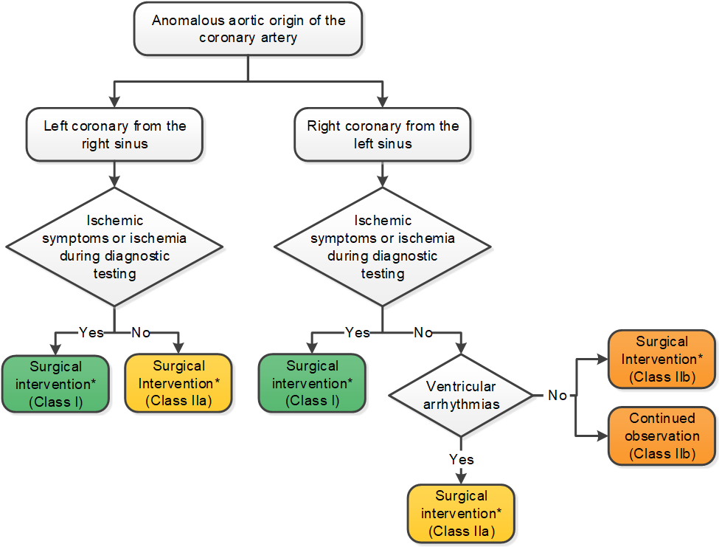
Anomalous Aortic origin of the Coronary Artery
*Surgical intervention to involve unroofing or coronary revascularization for patients with concomitant fixed obstruction.
(Con’t.)

Slide 91
Anomalous Coronary Artery Arising From the PA
Recommendations for Anomalous Coronary Artery Arising From the PA
COR | LOE | Recommendations
Therapeutic
I | B-NR | Surgery is recommended for anomalous left coronary artery from the PA.
I | C-EO | In a symptomatic adult with anomalous right coronary artery from the PA with symptoms attributed to the anomalous coronary, surgery is recommended.
IIa | C-EO | Surgery for anomalous right coronary artery from the PA is reasonable in an asymptomatic adult with ventricular dysfunction or with myocardial ischemia attributed to anomalous right coronary artery from the PA.

